Slide 1
A data-driven approach to referable diabetic retinopathy detection
Authors: Ramon Pires Sandra Avila Jacques Wainer | Eduardo Valle Micheal D. Abramoff Anderson Rocha
Presenter: Morgan Jones

Slide 2
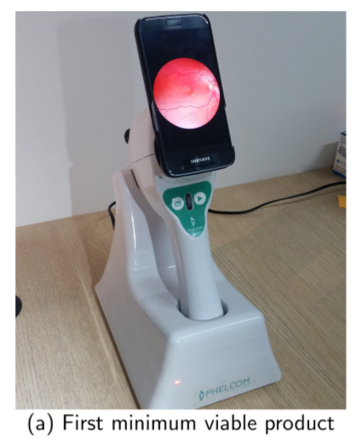
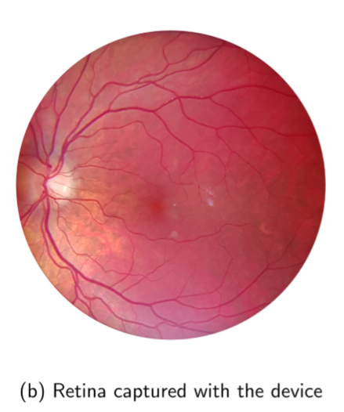
Diabetic Retinopathy
Sight loss due to diabetes
1 in 11 people suffer from Diabetes Mellitus
High chance of sight loss due to Diabetic Retinopathy (DR)
7.7 million people aged 40+ in U.S. have DR
Larger prevalence in developing countries
Early detection critical for limiting progression
Note: Authors partnered with Phelcom Technologies
In poor countries with a lack of health care professionals (Ophthalmologists) and where patients cannot afford regular consultations automated screening can help catch DR at an early stage by deciding who needs to be referred to a professional.
Notes:
Introduce background of Diabetic Retinopathy. Mentions statistics of DR. Mention the strain on resource and the need for better easier referral. Mention authors partnership with Phelcom Technologies.

Slide 3
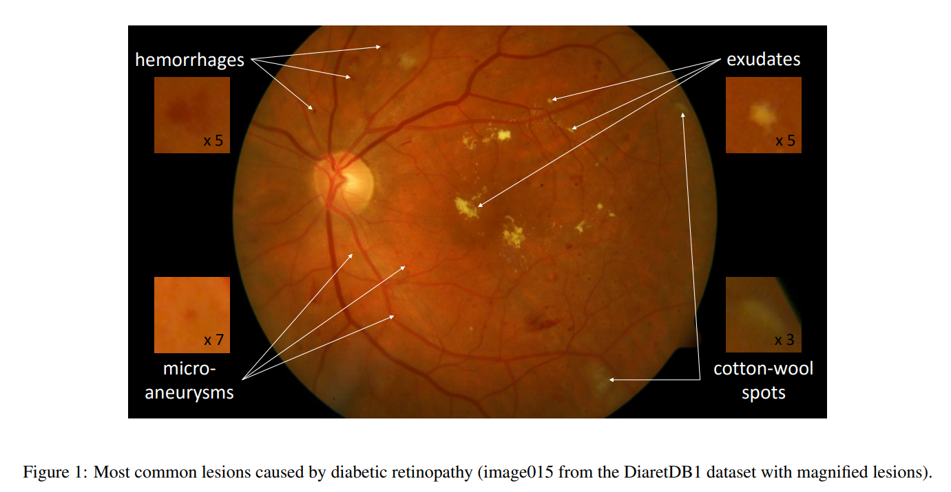
Current methods for DR referral
Previous methods focus on detecting lesions using handcrafted feature engineering to exploit visual structures in the retina image.
These “Lesion-first”, “Referral-later” approaches are questionable.
Hand crafted lesion detectors (using expert knowledge)
Mid-level representation
Data-driven lesion detectors
Notes:
Discuss current methods

Slide 4
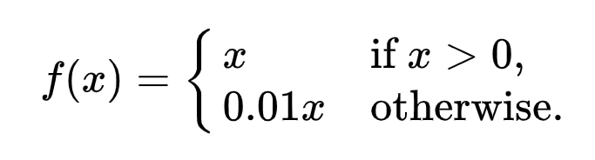
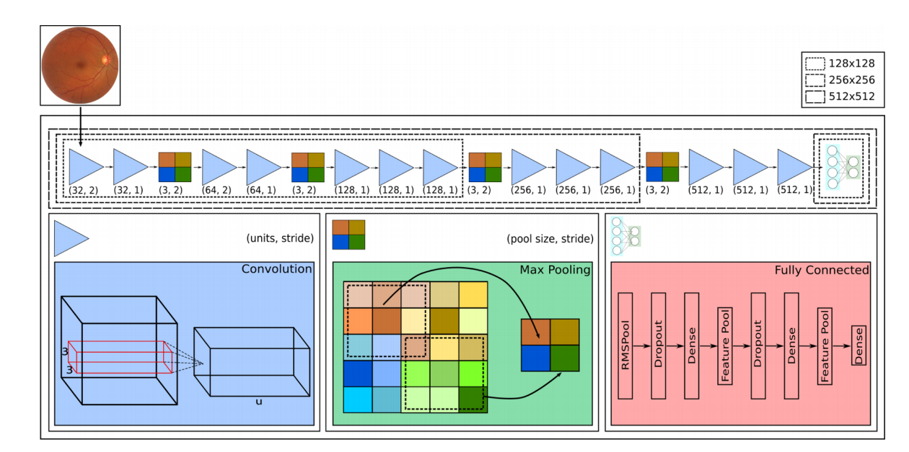
Solution Architecture
.
Convolutional Neural Network Architecture (CNN)
Leaky ReLU activation function
Inspired by:
o_O, 2015 Kaggle Diabetic Retinopathy Detection Challenge competitor
VGG-16, 2014 ImageNet competitor for natural image classification
Notes:
High level over the solution architecture and a brief description of convolutional neural networks
https://medium.com/@RaghavPrabhu/understanding-of-convolutional-neural-network-cnn-deep-learning-99760835f148
Architecture resembles VGG-16 in terms of arrangement of pooling and conv layers. Whereas the fully-connected stage is more inspired by the o_O solution.
Modelled the problem as a classification rather than a regression. Referral rather than severity
Convolutional layer neurons/filters convolve over input. Then after element wise multiplication with the receptive field the result is summed and outputted to a feature/activation map. Also the output is passed through the activation function (Leaky ReLU)
Strides can be applied to reduce the dimensionality of the input.
Pooling layers merge neighbouring features into one. (Downsampling)
Very small receptive field (3 X 3)
Pooling layers separate 2 or 3 convolutional layers
Convolutional layers start at 32 filters and double after each pooling layer
Stride in 1st & 3rd convolutional layers
Leaky RELU (accelerates the convergence of the gradient in comparison with conventional activation functions)
The 1024 units of the hidden dense layers employ dropout with a probability of 0.5. (Dropout tries to prevent a model overfitting)

Slide 5
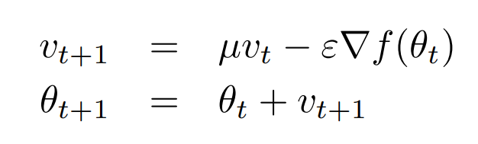
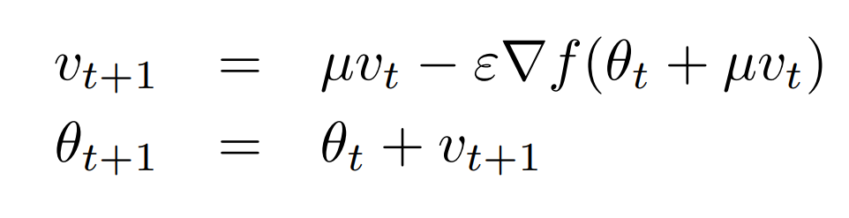
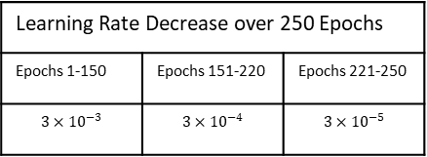

CNN Optimisation
Stochastic Gradient Descent
Classic Momentum
$$θ_{t+1}=θ_{t}−ε∇f(θ_{t})$$
Updating weights from the gradient of the loss function
Velocity at time t
Nesterov Momentum
Momentum Coefficient [0, 1]
Position at time t
Learning Rate (> 0)
Learning Rate Decrease over 250 Epochs
Epochs 1-150 | Epochs 151-220 | Epochs 221-250
$$3×{10}^{−3}$$ | $$3×{10}^{−4}$$ | $$3×{10}^{−5}$$
L2 regularisation (weight decay) with factor 0.0005
Cross-entropy instead of MSE as Loss Function
Notes:
Gradient of loss function got via backpropagation. How we use that to adjust the weights is the choice. Accelerates GD by accumulating a velocity in the direction of the downward gradient. Accelerates convergence in areas of low curvature. Nesterov momentum computes a partial update to the position allowing for a more responsible stable change in velocity.
L2 regularisation (ridge regression): Is to help prevent overfitting. Adds the squared magnitude of the weight to the loss function. Penalising the weights of the nodes more. + 0.0005 * sum(weights^2)
For the loss function cross entropy is used because the problem is a (binary) classification not a regression (for which mean squared error would be used). “seek a set of model weights that minimize the difference between the model’s predicted probability distribution given the dataset and the distribution of probabilities in the training dataset. This is called the cross-entropy.”
Binary CE = - ylog(p) + (1-y)log(1-p)

Slide 6
Data Augmentation
Generating more images for our learner
Relatively small annotated datasets
Most images from control group (healthy patients)
Augmentation through perturbations/transformations
Inflate training set to better represent under-sampled classes
Notes:
Operations/perurbations performed before submission to the network. Operations are done by choosing a random variable from a range for each operation. Example: between 0-360 for rotations, translations between 40 and -40. # of perturbed versions of each class depend on the balance weights of that class that is inversely proportional to the number of images(inputs) for each class.
Pertubations
Geometric (Zoom, rotations, cropping.. etc)
Photometric (Contrast enhancements, histogram equalisations)
Keep classes balanced while inflating training set. Proportions the same because augmentations applied to all images.

Slide 7
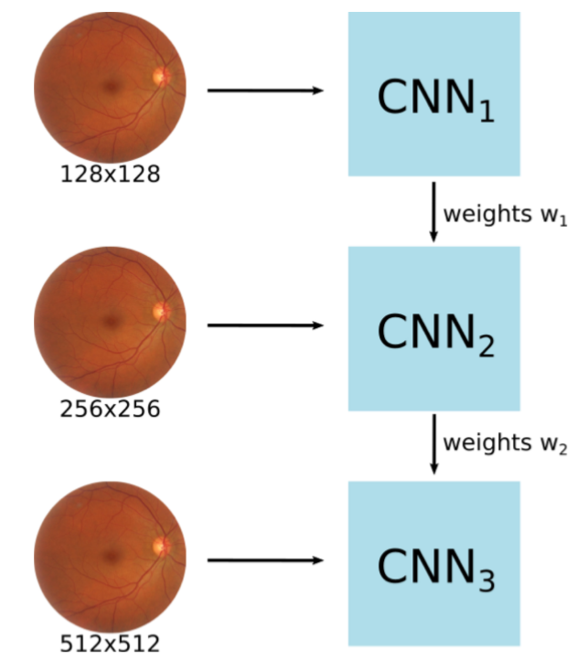
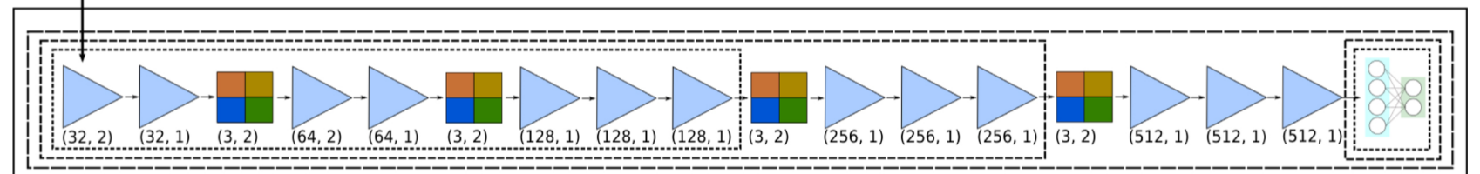
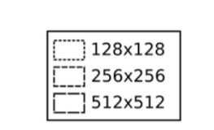
Multi-Resolution Training
Poor initial network weights leads to poor local minima and training large CNNs from scratch requires very large datasets.
Train reduced versions of the entire network (fewer convolution layers) using smaller images, and pre-initialize larger networks with the learned parameters.
The multi-resolution training accelerates the optimization of deeper networks by using parameters pretrained with smaller networks.
Notes:
Training simplified versions of the CNN that require less training samples and then using learned parameters as a starting point for the next stages

Slide 8
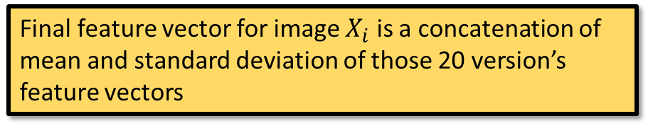

Robust feature Extraction
$$X_{i}=[μ_{i},α_{i}]$$
n=20 versions of each input image created by pseudo-random data augmentation
Data-driven process because all feature are extracted directly from the data by the CNN without human intervention
Final feature vector for image $X_{i}$ is a concatenation of mean and standard deviation of those 20 version’s feature vectors
Ultimate goal is to check if patient needs a referral not to detect lesions
Include a binary indicator variable referring to retina presenting highest risk
Whenever we have photos of both a patient’s retinas we leverage the additional info to help in decision
Per patient analysis
$$X_{retina}=[μ_{retina},{μ_{retina′},{ α}_{retina},α}_{retina′},δ_{right}]$$
Notes:
Pseudo-random because same perturbations are always applied to all images.
Feature vectors are extracted by CNN for each image (version) final feature vector for an image is the mean and standard deviation of the 20 feature vectors of each of its versions.
Extract features in last pooling layer of CNN

Slide 9
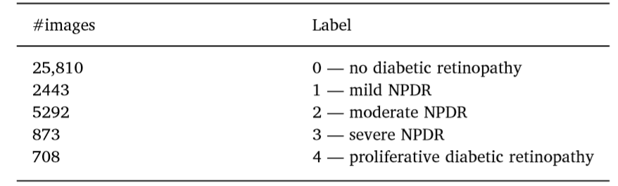
Datasets & Validation
DR2. 520 images from Department of Ophthalmology, Federal university of São Paulo
Messidor-2. Collection of 874 DR examinations (1748 images)
Original Kaggle challenge provided 88,702 images annotated by EyePACS
Original labels of Kaggle training data
Non-referable
Referable
Training and testing from same dataset
5 x 2-fold Cross Validation
Cross-dataset validation protocol
Notes:
Datasets collected at different times, in different hospitals and with different cameras.
Reiterate data augmentation was needed because number of parameters much higher than the number of available training images.
CV is balanced by class (stratified CV).
Messidor-2:
Graded by specialists according to ICDR severity scale.
DR2:
Referral labels provided for 435 by experts
EyePACS:
35,126 for images training & 53,576 for testing
Size ranges from 320 x 211 to 5184 x 3456 pixels
Includes both left and right eyes graded by severity
Converted labels from Severity to Referral Necessity

Slide 10
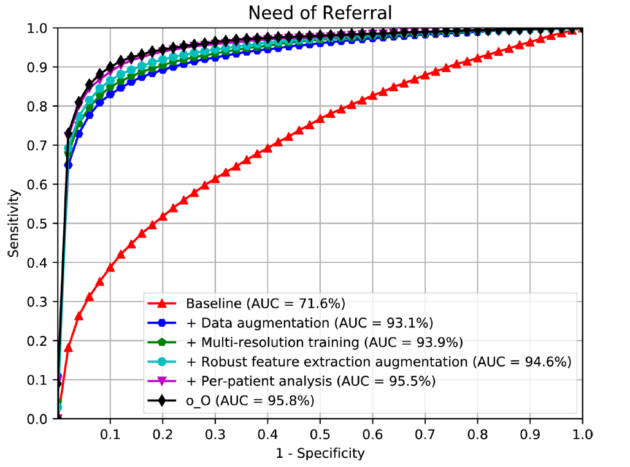
Results
Progressive Improvements
Q1: Is data augmentation essential to train the CNN?
Q2: Is the multi-resolution training important to train with larger images?
Q3: Is the robust feature-extraction augmentation satisfactory?
Q4: Is the per-patient analysis important to provide more robustness?
ROC for referral assessment on Kaggle dataset. Showing progressive improvements and original o_O solution.
Notes:
Comparison of progressive improvements. On receiver operating characteristic curve
Please note o_O is better but it an ensemble of six classifiers. Ours is one better expert classifier.
And this is on the Kaggle dataset. Next slide we see that our one does better for cross-dataset validation, which is more realistic of the real world because the different dataset have very different acquisition conditions and it shows our algorithm generalises well to new data.

Slide 11
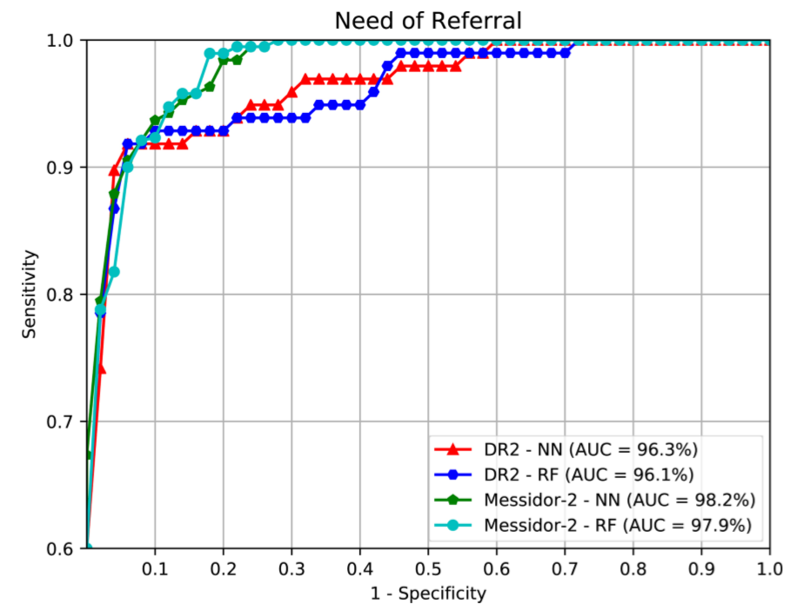
Results
Cross dataset validation
Q5: Can we diagnose retinal images collected under different acquisition conditions?
ROC results for referral assessment. Cross-dataset protocol when training with Kaggle; and testing with either DR2 or Messidor-2.
Notes:
datasets have very different acquisition conditions. Here we show the results of training on Kaggle dataset but then testing on DR2 and Messidor-2.
Extracting features provides us with flexibility to choose different machine learning algorithms. We choose to use A Neural Network and Random Forest.
Using the best solution from the previous section trained on Kaggle data (exploiting per-patient analysis only when we have access to images of both eyes)
NN:
2 layers 32 units, 3rd layer 2 units. ReLU activation.
Layers intercalated by feature pool layers. Trained the network for 100 epochs using Adam Optimizer (adaptive learning rate optimization algorithm)
RF:
Extensive grid search for hyper parameters maximising AUC. Trying 50-300 estimators/trees and gini/entropy criterion.
All experiments used 200 or 300 and entropy
Here we train CNN on Kaggle and use it as a feature extractor for DR and messidor-2. Then run the classifiers on the extracted features???
These results corroborate the hypothesis that it is possible to train a robust data-driven solution to precisely pinpoint diabetic retinopathy referral needs, independently of operators and camera settings of the training set of images.
Note: one of the previous leading solutions run against the Messifor-2 dataset was by Abramoff et el. It had 98% AUC after adopting CNNs however ours had equally remarkable results at 98.2% --
Therefore reinforcing that detecting DR lesions is not essential for a reliable and effective DR screening. NOTE ALSO we don’t use messidor-2 data to train or omptimse our CNN that is done by Kaggle data this shows robustness of the method.

Slide 12
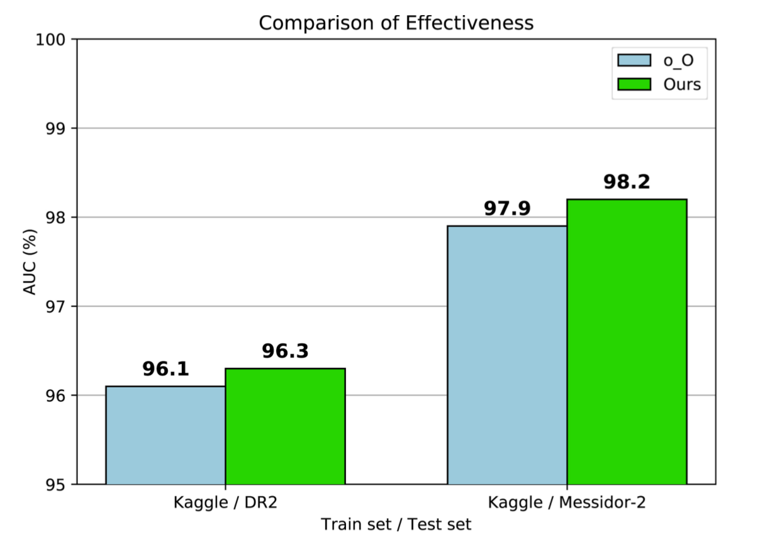
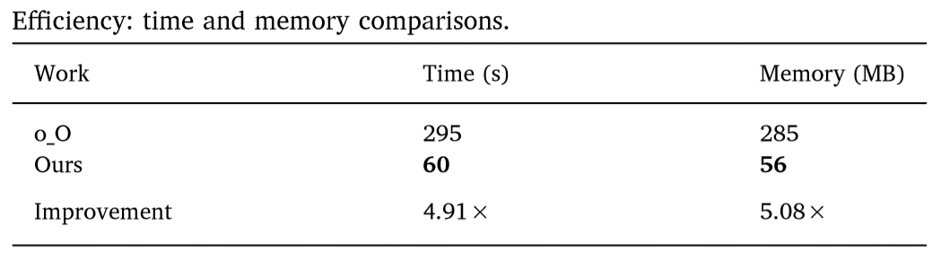
Results
Cross-Dataset comparison with o_O’s method
DR2 : One image at a time
Messior-2 : Per-patient analysis (images of both eyes)
Comparison of current work and o_O using cross-dataset validation over DR2 and Messidor-2.
Notes:
Adapted the o_O solution for a binary classification problem and evaluated its efficiency and effectiveness.
Recall o_O is an ensemble of six methods trained with features extracted from 2 CNNs.
Performed the tests using one “GeForce GTX TITAN X”.
Simulated real time diagnostic environment screening 50 patients (100 images)
Time is time to:
Loading all libraries
Loading parameters of CNN
Pseudo-augmenting input images
Inference of higher probability among eyes
Memory is:
Disk space for CNN params
2 hidden layer neural networks in memory
Our method has huge improvements in space and time efficiency. And also slight improvements in classification effectiveness.

Slide 13
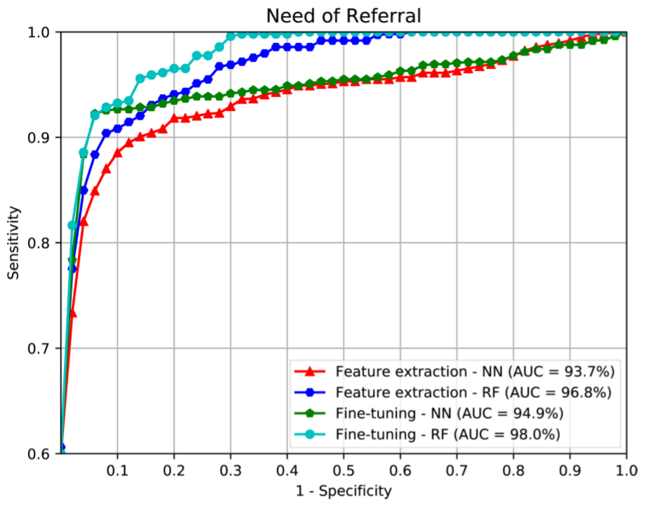
Transfer Learning on DR2
5x 2-fold Cross Validation on DR2 comparing both transfer learning set-ups looking at both classifiers individually.
ROC results for referral assessment evaluating transfer learning schemes and two classifiers (Neural Network & Random forest) over DR2 dataset.
Notes:
Idea of transfer learning comes from the idea that many deep neural networks trained on natural images learn similar features: textures, corners, edges, colour blobs… etc.
2 types=>
Feature Extraction: Freeze the CNN and use it to extract features
Fine Tuning: Freeze the former high level layers and fine tune the later layers
Source problem: Severity assessment, Target Problem: Referral Assessment
Here we train a CNN of the same architecture to work with to assess severity of DR (five outputs in the decision layer instead of 2) we also use our previously mentioned improvements (data aug, multi-res ..etc)
Fine tuning is better. With RF

Slide 14
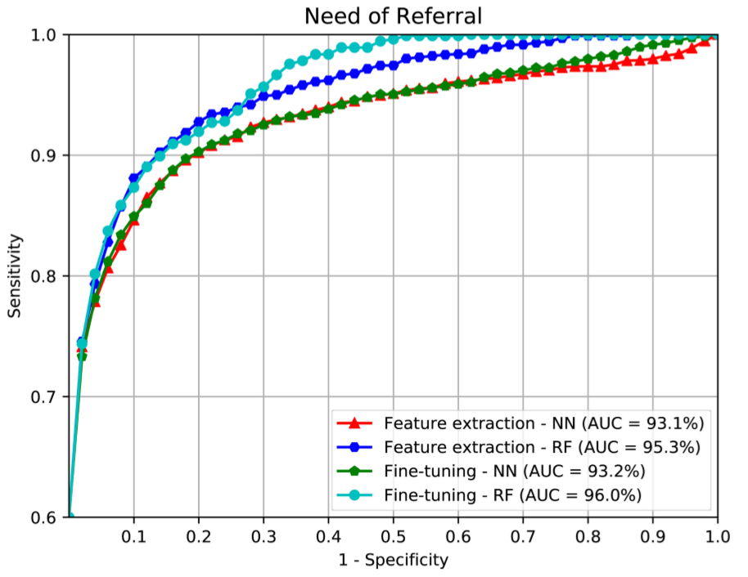
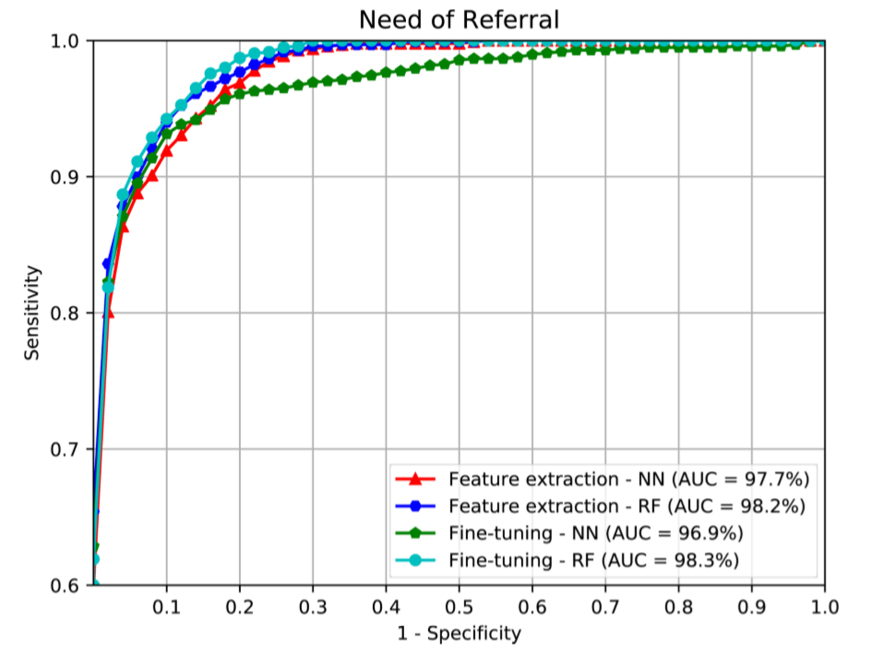
Transfer Learning on Messidor-2
ROC results for referral assessment evaluating transfer learning schemes and two classifiers (Neural Network & Random forest) over Messidor-2 dataset on per image analysis.
ROC results for referral assessment evaluating transfer learning schemes and two classifiers (Neural Network & Random forest) over Messidor-2 dataset on per patient analysis.
Notes:
On the left provide decision for each eye
On the right provide decision based on both eyes. And out performs as you would imagine.
Same here: Fine tuning is better. With RF
Although these results confirm that patient based is better than per image.

Slide 15
Summary
DR referral without lesion detection
Better computation, implementation & generalisation
98.2% AUC with a single network
Transfer Learning as novel aspect of work
Future Work
Visualisation for interpretability & accountable screening procedure
Investigate effectiveness/efficiency trade-off of other models
Notes:
Computationally and implementational better. Ability to generalise well across datasets.
Approach based on procedural rigorous scientific investigation
Current best result for referral is 99% as achieved with 10 CNN ensemble, we get 98.2% with a single network.
If thinking about deploying the solution in mobile or low power device to reach more areas ours is more efficient.
Transfer Learning is novel aspect of the work
Data-driven DR screening is state-of-the-art
All results say it is possible to perform DR referral without relying of lesion detection
Future Work:
Activation visualisation to better understand networks decision & provide accountable screening procedure.
Intensify investigations of models that trade of effectiveness and time/memory allowing us to embedd solution into portable retinal cameras

