Slide 1
Playing Atari with Deep Reinforcement Learning
Volodymyr Mnih, Koray Kavukcuoglu, David Silver, Alex Graves, Ioannis Antonoglou, Daan Wierstra, Martin Riedmiller
Presenter: Morgan Jones

Slide 2
Overview
RL Background
Atari 2600 Testbed
Action-Value Function
Deep Reinforcement Learning (DQN)
Experiments & Results
Summary & Resulting work

Slide 3
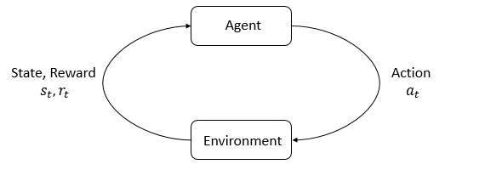
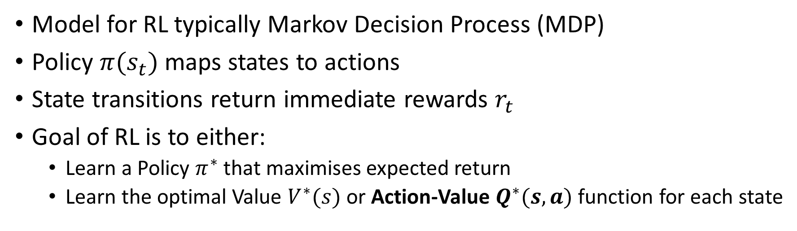
The Reinforcement Learning Problem
Model for RL typically Markov Decision Process (MDP)
Policy $π(s_{t})$ maps states to actions
State transitions return immediate rewards $r_{t}$
Goal of RL is to either:
Learn a Policy $π^{∗}$ that maximises expected return
Learn the optimal Value $V^{∗}(s)$ or Action-Value $Q^{∗}(s,a)$ function for each state
Notes:
MDP
Q Learning. State the authors are using a deep network to approximate the Q(s,a) function.
Mention success of TD-Backgammon

Slide 4
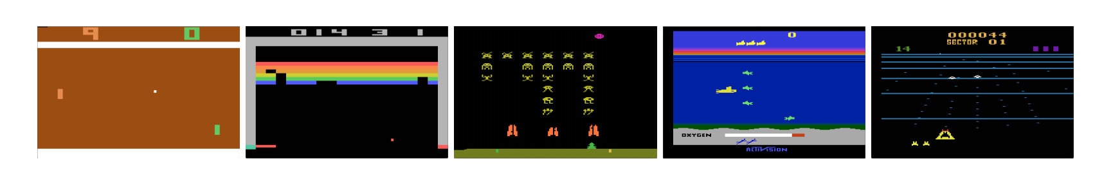
Atari 2600 in Arcade Learning Environment
Challenging testbed for RL & interesting set of tasks
High Dimensional Visual Input (210x160 RGB @ 60Hz)
Note: Each state is sequence of actions & observations
Five Atari Games: Pong, Breakout, Space Invaders, Seaquest, Beam Rider
Notes:
Because it is impossible to fully understand current situation from only the current screen.
(Not sure of direction or speed …etc.)

Slide 5
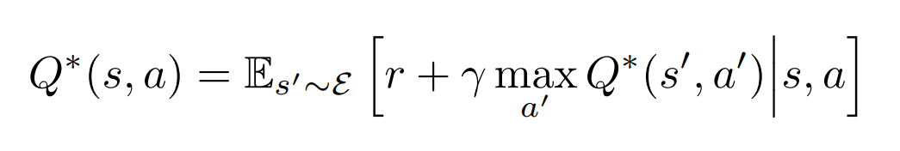
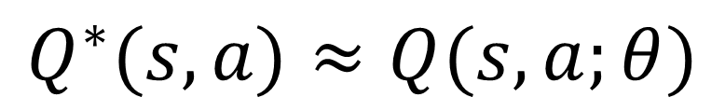
Q-Network
Traditionally value iteration algorithms converge to optimal action-value function
$$Q^{∗}(s,a)≈Q(s,a;θ)$$
Use neural network function approximator instead
Notes:
Q(s,a)
Richard Bellman - Bellman Equation – foundation of dynamic programming
Q-Learning
Replace value iteration with non-linear function approximator (NN). Theta are parameters (weights) of network
Mention this is model-free RL because we are not using the rest of the model just approximating q-values

Slide 6
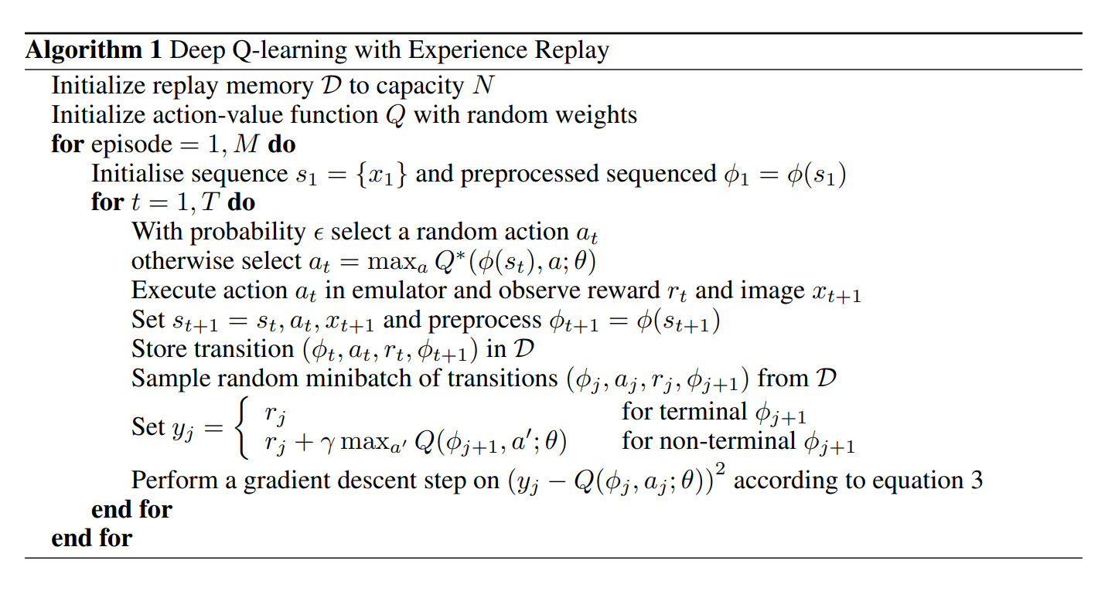
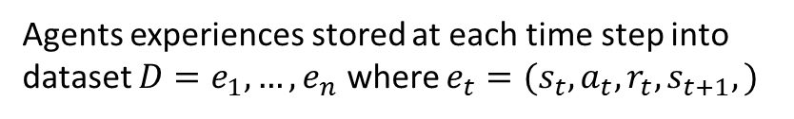
DQN with Experience Replay
Agents experiences stored at each time step into dataset $D=e_{1},…,e_{n}$ where $e_{t}=(s_{t},a_{t},r_{t},s_{t+1},)$
Notes:
Deep nn can extract features to learn better representations that can be achieved through handcrafting features.
TD-Gammon architecture is some inspiration because it used NN to estimate Value function.
Authors use Experience Replay
Perform Q-learning updates to mini-batches in the inner loop of the algorithm.

Slide 7
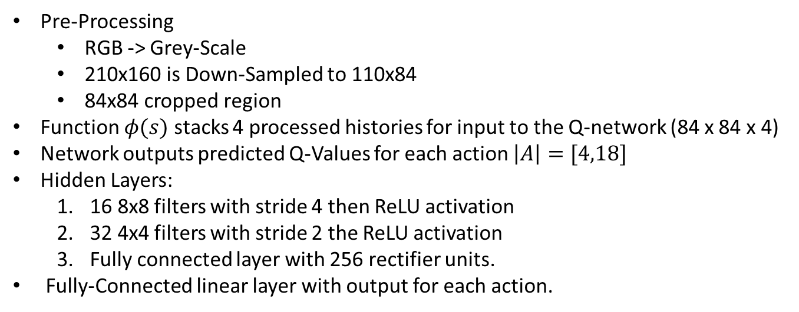
Pre-processing & Model Architecture
Pre-Processing
RGB -> Grey-Scale
210x160 is Down-Sampled to 110x84
84x84 cropped region
Function $φ(s)$ stacks 4 processed histories for input to the Q-network (84 x 84 x 4)
Network outputs predicted Q-Values for each action $\left|A\right|=[4,18]$
Hidden Layers:
16 8x8 filters with stride 4 then ReLU activation
32 4x4 filters with stride 2 the ReLU activation
Fully connected layer with 256 rectifier units.
Fully-Connected linear layer with output for each action.
Notes:
Final cropping step only needed because authors use GPU implementation that requires square inputs.
Advantage is ability to compute Q-values for all possible actions for a state with only one forward pass through the network.

Slide 8
Training
Same agent (architecture, algorithm, hyperparameters) on 7 Atari games but normalised rewards across all games [1,0,-1]
Trained for a total 10 million frames with a replay memory of 1 million most recent frames.
Training with minibatches of size 32. Using a greedy/exploitation policy during training. Learning rate annealed linearly from 1 to 0.1 over the first million frames.
Frame skipping technique, agent sees and acts every kth frame (k=4)
Notes:
7 Games: Beam Rider, Breakout, Enduro, Pong, Q*bert, Seaquest, Space Invaders
Positive rewards goto 1, negative rewards goto -1 & zero rewards remain at zero.
This limits the scale of the error derivatives making it easier to same learning rate hyperparameter across games.
Note: this could limit agent performance since there is no differentiation between rewards of different magnitude.
Frame skipping technique, agent sees every kth frame with last action being repeated on frames it doesn’t see.
Easier skip emulator forward than select action for each frame, this allows k times more games to be played.
K=4 for games except for Space Invaders where k=3 (to make the lasers visible to the agent)

Slide 9
Experiments & Results

