Slide 1
A data-driven approach to referable diabetic retinopathy detection
Authors: Ramon Pires Sandra Avila Jacques Wainer | Eduardo Valle Micheal D. Abramoff Anderson Rocha
Presenter: Morgan Jones

Slide 2
Diabetic Retinopathy
Sight loss due to diabetes
1 in 11 people suffer from Diabetes Mellitus
High chance of sight loss due to Diabetic Retinopathy (DR)
7.7 million people aged 40+ in U.S. have DR
Larger prevalence in developing countries
Early detection critical for limiting progression
In poor countries with a lack of health care professionals (Ophthalmologists) and where patients cannot afford regular consultations automated screening can help catch DR at an early stage by deciding who needs to be referred to a professional.
Notes:
Introduce background of Diabetic Retinopathy. Mentions statistics of DR. Mention the strain on resource and the need for better easier referral. Mention authors partnership with Phelcom Technologies.

Slide 3
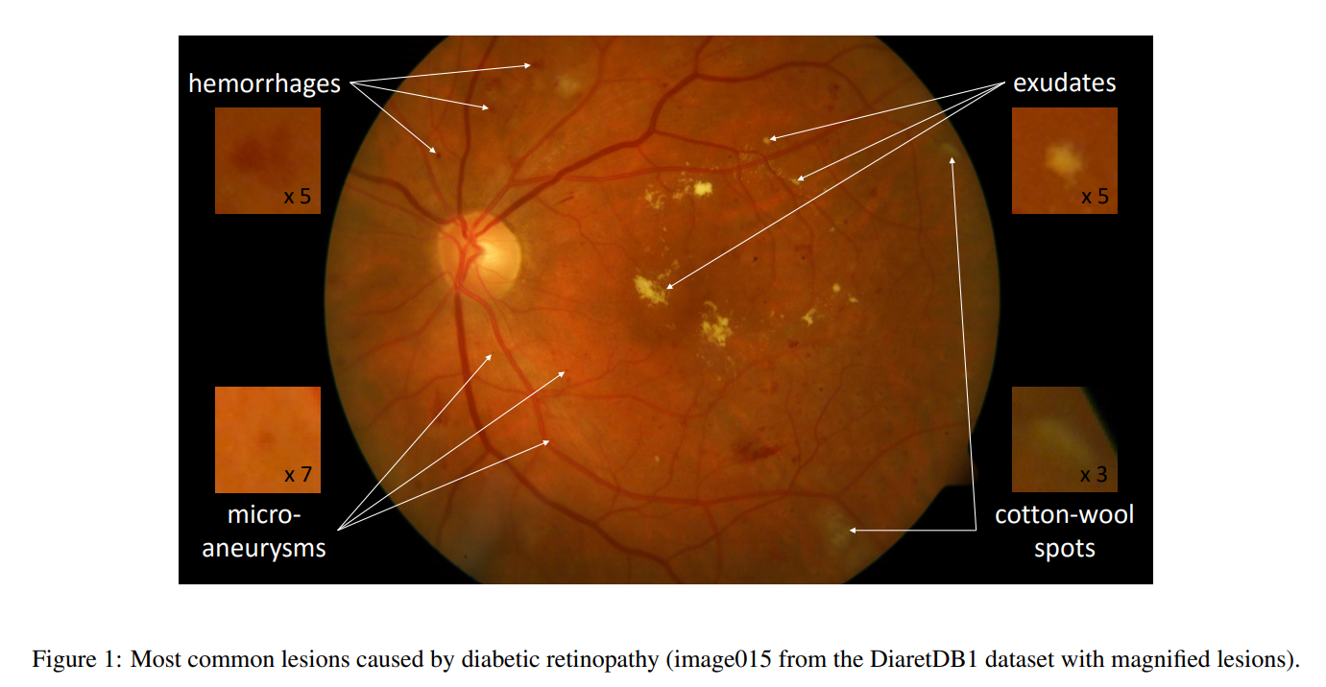
Current methods for DR referral
Previous methods focus on detecting lesions using handcrafted feature engineering to exploit visual structures in the retina image.
These “Lesion-first”, “Referral-later” approaches are questionable.
Hand crafted lesion detectors (using expert knowledge)
Mid-level representation
Data-driven lesion detectors
Notes:
Discuss current methods

Slide 4
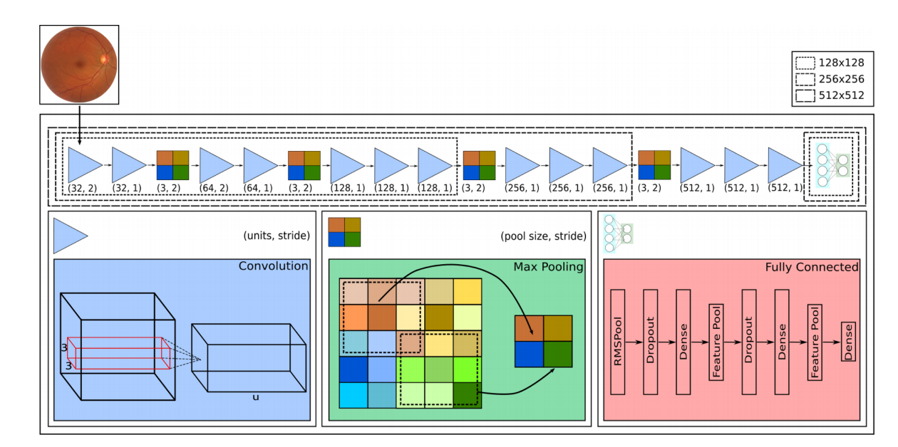
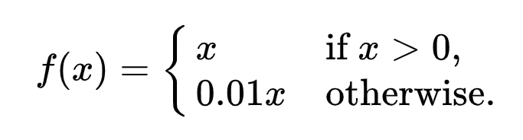
Solution Architecture (CNN)
Convolutional Neural Network Architecture
Modelled the problem as a classification rather than a regression. Referral rather than severity.
Very small receptive field (3 X 3)
Pooling layers separate 2 or 3 convolutional layers
Convolutional layers start at 32 filters and double after each pooling layer
Stride in 1st & 3rd convolutional layers
Leaky RELU (accelerates the convergence of the gradient in comparison with conventional activation functions)
Inspired by:
o_O, 2015 Kaggle Diabetic Retinopathy Detection Challenge competitor
VGG-16, 2014 ImageNet competitor for natural image classification
Notes:
High level over the solution architecture and a brief description of convolutional neural networks
https://medium.com/@RaghavPrabhu/understanding-of-convolutional-neural-network-cnn-deep-learning-99760835f148
Architecture resembles VGG-16 in terms of arrangement of pooling and conv layers. Whereas the fully-connected stage is more inspired by the o_O solution.

Slide 5
Solution Architecture (CNN)
Notes:
Detail RMSPool, info about layers/strides/filters, leaky RELU

Slide 6
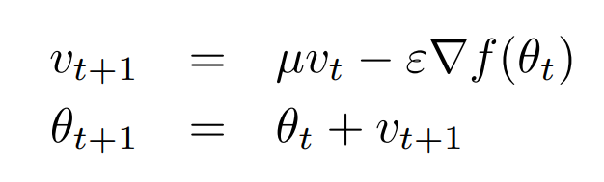
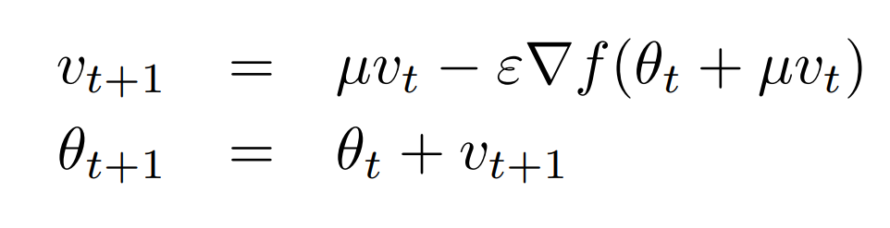
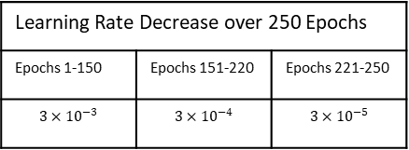

CNN Optimisation
Stochastic Gradient Descent
Classic Momentum
$$θ_{t+1}=θ_{t}−ε∇f(θ_{t})$$
Updating weights from the gradient of the loss function
Velocity at time t
Nesterov Momentum
Momentum Coefficient [0, 1]
Position at time t
Learning Rate (> 0)
Learning Rate Decrease over 250 Epochs
Epochs 1-150 | Epochs 151-220 | Epochs 221-250
$$3×{10}^{−3}$$ | $$3×{10}^{−4}$$ | $$3×{10}^{−5}$$
MENtion L2 regularisation here & cross-entropy
Notes:
Gradient of loss function got via backpropagation. How we use that to adjust the weights is the choice. Accelerates GD by accumulating a velocity in the direction of the downward gradient. Accelerates convergence in areas of low curvature. Nesterov momentum computes a partial update to the position allowing for a more responsible stable change in velocity.

Slide 7
Data Augmentation
Generating more images for our learner
Relatively small annotated datasets
Most images from control group (healthy patients)
Augmentation through perturbations/transformations:
Geometric (Zoom, rotations, cropping.. etc)
Photometric (Contrast enhancements, histogram equalisations)
Inflate training set
Better represent under-sampled classes
Keep classes balanced while doing so
Notes:
Operations/perurbations performed before submittion to the network. Operations are done by choosing a random variable from a range for each operation. Example: between 0-360 for rotations, translations between 40 and -40. # of perturbed versions of each class depend on the balance weights of that class that is inversely proportional to the number of images(inputs) for each class.

Slide 8
Robust feature extractionTODO?

Slide 9
Transfer learningTODO?

Slide 10
Datasets & ValidationTODO?

Slide 11
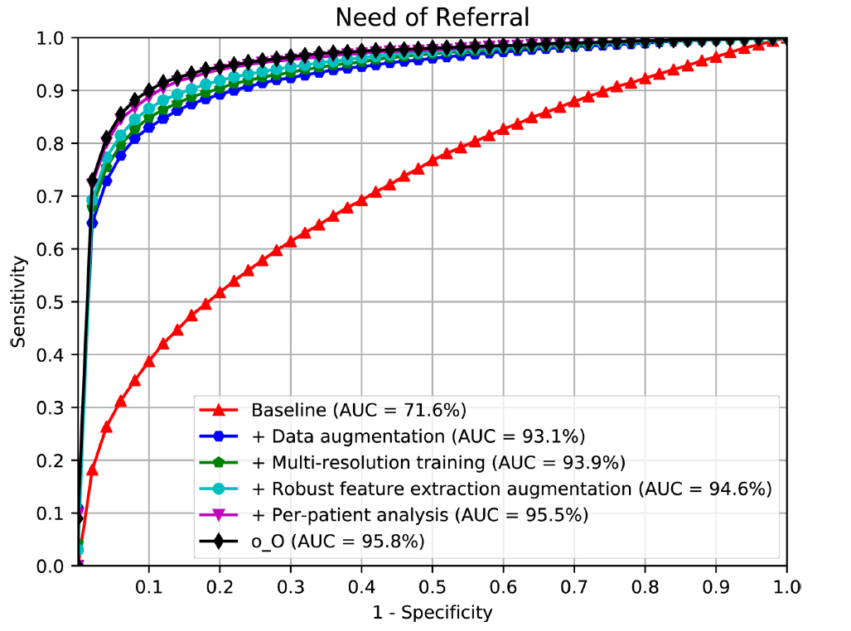
Results
Q1: Is data augmentation essential to train the CNN?
Q2: Is the multi-resolution training important to train with larger images?
Q3: Is the robust feature-extraction augmentation satisfactory?
Q4: Is the per-patient analysis important to provide more robustness?
ROC for referral assessment on Kaggle dataset. Showing progressive improvements and original o_O solution.
Notes:
Comparison with O_o solution on the graph.

