Slide 1
A data-driven approach to referable diabetic retinopathy detection
Authors: Ramon Pires Sandra Avila Jacques Wainer | Eduardo Valle Micheal D. Abramoff Anderson Rocha
Presenter: Morgan Jones

Slide 2
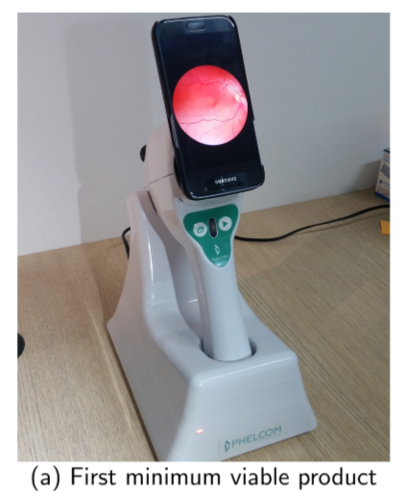
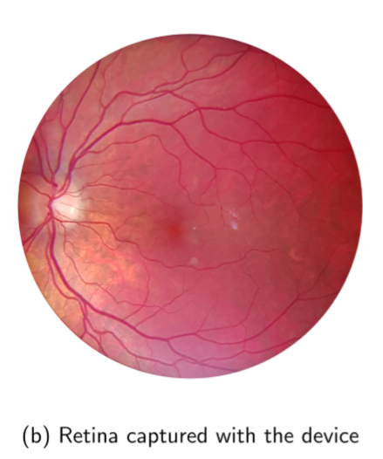
Diabetic Retinopathy
Sight loss due to diabetes
1 in 11 people suffer from Diabetes Mellitus
High chance of sight loss due to Diabetic Retinopathy (DR)
7.7 million people aged 40+ in U.S. have DR
Larger prevalence in developing countries
Early detection critical for limiting progression
Note: Authors partnered with Phelcom Technologies
In poor countries with a lack of health care professionals (Ophthalmologists) and where patients cannot afford regular consultations automated screening can help catch DR at an early stage by deciding who needs to be referred to a professional.
Notes:
Introduce background of Diabetic Retinopathy. Mentions statistics of DR. Mention the strain on resource and the need for better easier referral. Mention authors partnership with Phelcom Technologies.

Slide 3
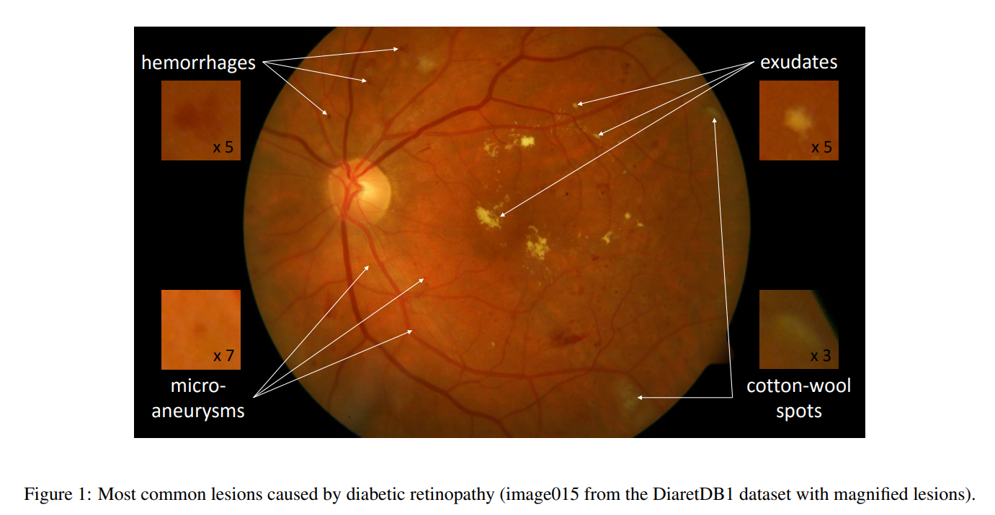
Current methods for DR referral
Previous methods focus on detecting lesions using handcrafted feature engineering to exploit visual structures in the retina image.
These “Lesion-first”, “Referral-later” approaches are questionable.
Hand crafted lesion detectors (using expert knowledge)
Mid-level representation
Data-driven lesion detectors
Notes:
Discuss current methods

Slide 4
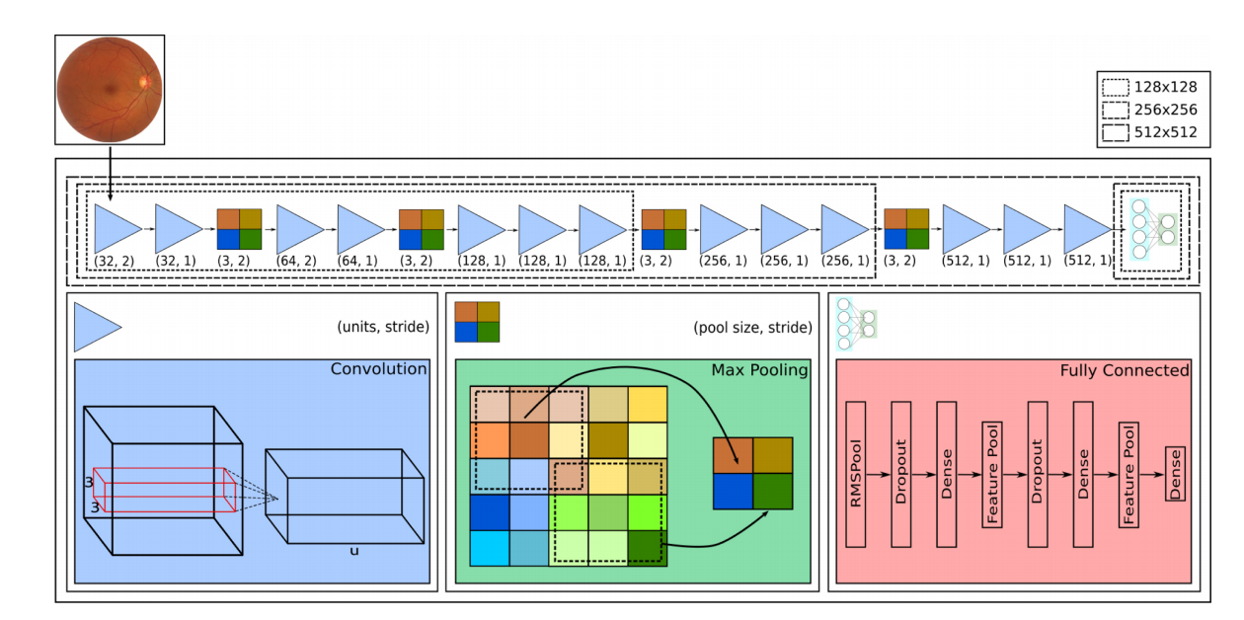
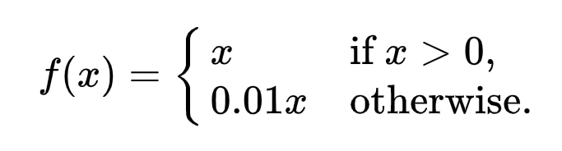
Solution Architecture
Convolutional Neural Network Architecture (CNN)
Modelled the problem as a classification rather than a regression. Referral rather than severity.
Very small receptive field (3 X 3)
Pooling layers separate 2 or 3 convolutional layers
Convolutional layers start at 32 filters and double after each pooling layer
Stride in 1st & 3rd convolutional layers
Leaky RELU (accelerates the convergence of the gradient in comparison with conventional activation functions)
Inspired by:
o_O, 2015 Kaggle Diabetic Retinopathy Detection Challenge competitor
VGG-16, 2014 ImageNet competitor for natural image classification
Notes:
High level over the solution architecture and a brief description of convolutional neural networks
https://medium.com/@RaghavPrabhu/understanding-of-convolutional-neural-network-cnn-deep-learning-99760835f148
Architecture resembles VGG-16 in terms of arrangement of pooling and conv layers. Whereas the fully-connected stage is more inspired by the o_O solution.

Slide 5
Solution Architecture (CNN)
Notes:
Detail RMSPool, info about layers/strides/filters, leaky RELU

Slide 6
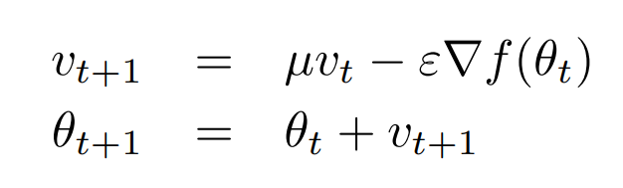
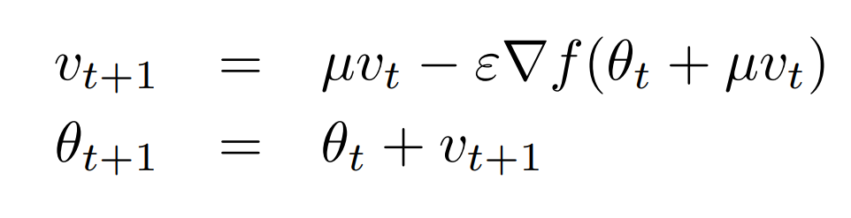
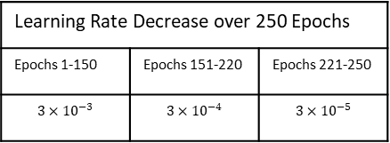

CNN Optimisation
Stochastic Gradient Descent
Classic Momentum
$$θ_{t+1}=θ_{t}−ε∇f(θ_{t})$$
Updating weights from the gradient of the loss function
Velocity at time t
Nesterov Momentum
Momentum Coefficient [0, 1]
Position at time t
Learning Rate (> 0)
Learning Rate Decrease over 250 Epochs
Epochs 1-150 | Epochs 151-220 | Epochs 221-250
$$3×{10}^{−3}$$ | $$3×{10}^{−4}$$ | $$3×{10}^{−5}$$
L2 regularisation (weight decay) with factor 0.0005
Cross-entropy instead of MSE as Loss Function
Notes:
Gradient of loss function got via backpropagation. How we use that to adjust the weights is the choice. Accelerates GD by accumulating a velocity in the direction of the downward gradient. Accelerates convergence in areas of low curvature. Nesterov momentum computes a partial update to the position allowing for a more responsible stable change in velocity.
For the loss function cross entropy is used because the problem is a (binary) classification not a regression (for which mean squared error would be used). “seek a set of model weights that minimize the difference between the model’s predicted probability distribution given the dataset and the distribution of probabilities in the training dataset. This is called the cross-entropy.”
Binary CE = - ylog(p) + (1-y)log(1-p)

Slide 7
Data Augmentation
Generating more images for our learner
Relatively small annotated datasets
Most images from control group (healthy patients)
Augmentation through perturbations/transformations:
Geometric (Zoom, rotations, cropping.. etc)
Photometric (Contrast enhancements, histogram equalisations)
Inflate training set
Better represent under-sampled classes
Keep classes balanced while doing so
Notes:
Operations/perurbations performed before submission to the network. Operations are done by choosing a random variable from a range for each operation. Example: between 0-360 for rotations, translations between 40 and -40. # of perturbed versions of each class depend on the balance weights of that class that is inversely proportional to the number of images(inputs) for each class.

Slide 8
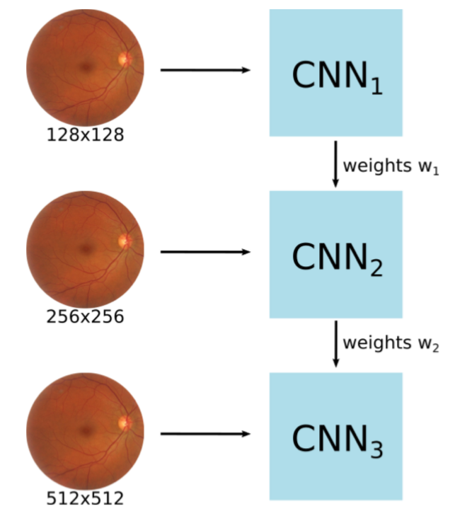
Multi-Resolution Training
Poor initial network weights leads to poor local minima and training large CNNs from scratch requires very large datasets.
Training simplified versions of the CNN that require less training samples and then using learned parameters as a starting point for the next stages.
Train reduced versions of the entire network (fewer convolution layers) using smaller images, and pre-initialize larger networks with the learned parameters.
The multi-resolution training accelerates the optimization of deeper networks by using parameters pretrained with smaller networks.

Slide 9
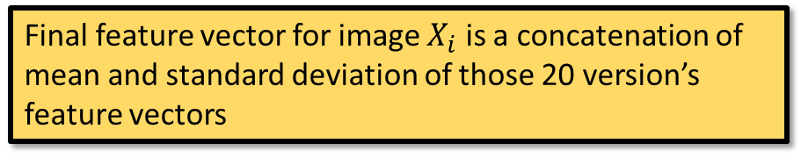

Robust feature Extraction
$$X_{i}=[μ_{i},α_{i}]$$
n=20 versions of each input image created by pseudo-random data augmentation
Data-driven process because all feature are extracted directly from the data by the CNN without human intervention
Final feature vector for image $X_{i}$ is a concatenation of mean and standard deviation of those 20 version’s feature vectors
Ultimate goal is to check if patient needs a referral not to detect lesions
Include a binary indicator variable referring to retina presenting highest risk
Whenever we have photos of both a patient’s retinas we leverage the additional info to help in decision
Per patient analysis
$$X_{retina}=[μ_{retina},{μ_{retina′},{ α}_{retina},α}_{retina′},δ_{right}]$$
Notes:
Pseudo-random because same perturbations are always applied to all images.
Feature vectors are extracted by CNN for each image (version) final feature vector for an image is the mean and standard deviation of the 20 feature vectors of each of its versions.

Slide 10
Transfer learningTODO?

Slide 11
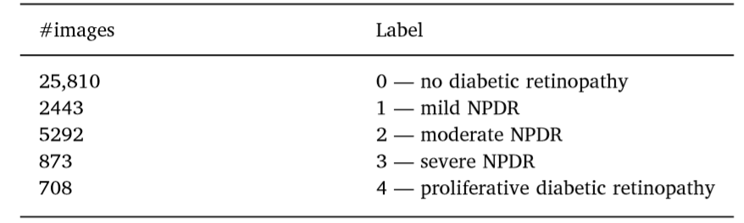
Datasets & Validation
DR2. 520 images from Department of Ophthalmology, Federal university of São Paulo
Referral labels provided for 435 by experts
Messidor-2. Collection of 874 DR examinations (1748 images)
Graded by specialists according to ICDR severity scale.
Original Kaggle challenge provided 88,702 images annotated by EyePACS
35,126 for images training & 53,576 for testing
Size ranges from 320 x 211 to 5184 x 3456 pixels
Includes both left and right eyes graded by severity
Converted labels from Severity to Referral Necessity
Training and testing from same dataset (without intersection)
5 x 2-fold Cross Validation
Cross-dataset validation protocol
Non-referable
Referable
Notes:
Datasets collected at different times, in different hospitals and with different cameras.
Reiterate data augmentation was needed because number of parameters much higher than the number of available training images.
CV is balanced by class (stratified CV).

Slide 12
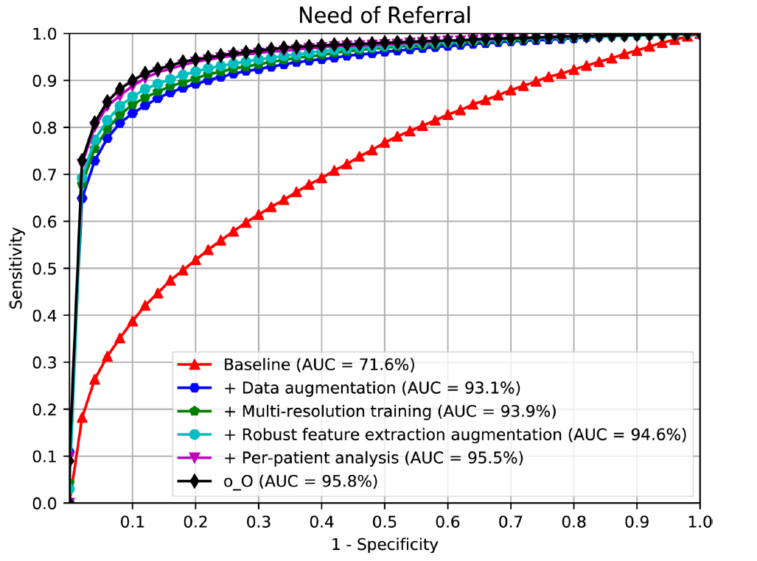
Results
Q1: Is data augmentation essential to train the CNN?
Q2: Is the multi-resolution training important to train with larger images?
Q3: Is the robust feature-extraction augmentation satisfactory?
Q4: Is the per-patient analysis important to provide more robustness?
ROC for referral assessment on Kaggle dataset. Showing progressive improvements and original o_O solution.
Notes:
Comparison with O_o solution on the graph.

