Slide 1
A data-driven approach to referable diabetic retinopathy detection
Ramon Pires, Sandra Avila, Jacques Wainer, Eduardo Valle, Micheal D. Abramoff, Anderson Rocha

Slide 2
Diabetic Retinopathy
Sight loss due to diabetes
Notes:
Introduce background of Diabetic Retinopathy. Mentions statistics of DR. Mention the strain on resource and the need for better easier referral. Mention authors partnership with Phelcom Technologies.

Slide 3
Current methods for DR referral
Notes:
Discuss current methods

Slide 4
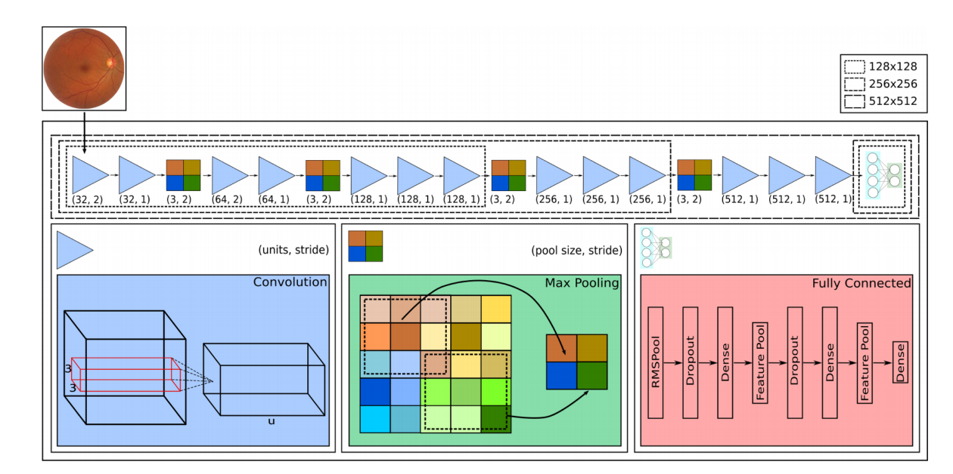
Solution Architecture (CNN)
Problem was a regression output of Severity. Now remodelled as binary classification Referral/No Referral
Convolutional Neural Network Architecture
Inspired by:
o_O, 2015 Kaggle Diabetic Retinopathy Detection Challenge competitor
VGG-16, 2014 ImageNet competitor for natural image classification
Notes:
High level over the solution architecture and a brief description of convolutional neural networks
https://medium.com/@RaghavPrabhu/understanding-of-convolutional-neural-network-cnn-deep-learning-99760835f148

Slide 5
Solution Architecture (CNN)
Notes:
Detail RMSPool, info about layers/strides/filters, leaky RELU

Slide 6
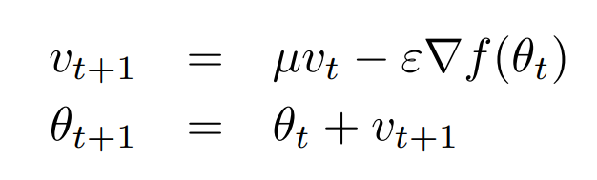
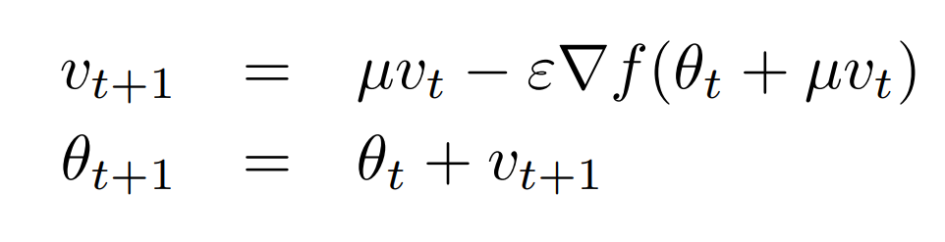
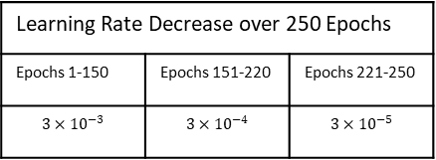

CNN Optimisation
Stochastic Gradient Descent
Classic Momentum
$$θ_{t+1}=θ_{t}−ε∇f(θ_{t})$$
Updating weights from the gradient of the loss function.
Velocity at time t
Nesterov Momentum
Momentum Coefficient [0, 1]
Position at time t
Learning Rate (> 0)
Learning Rate Decrease over 250 Epochs
Epochs 1-150 | Epochs 151-220 | Epochs 221-250
$$3×{10}^{−3}$$ | $$3×{10}^{−4}$$ | $$3×{10}^{−5}$$
MENtion L2 regularisation here & cross-entropy
Notes:
Gradient of loss function got via backpropagation. How we use that to adjust the weights is the choice. Accelerates GD by accumulating a velocity in the direction of the downward gradient. Accelerates convergence in areas of low curvature. Nesterov momentum computes a partial update to the position allowing for a more responsible stable change in velocity.

Slide 7
Data Augmentation through Image Generation

