Slide 1
Playing Atari with Deep Reinforcement Learning
Volodymyr Mnih, Koray Kavukcuoglu, David Silver, Alex Graves, Ioannis Antonoglou, Daan Wierstra, Martin Riedmiller
Presenter: Morgan Jones

Slide 2
Overview
RL Background
Atari 2600 Testbed
Action-Value Function
Deep Reinforcement Learning (DQN)
Experiments & Results
Summary & Resulting work

Slide 3
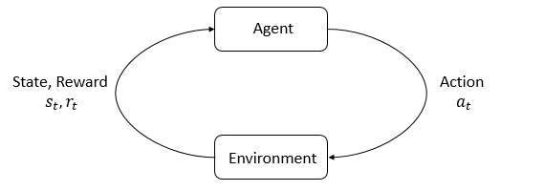
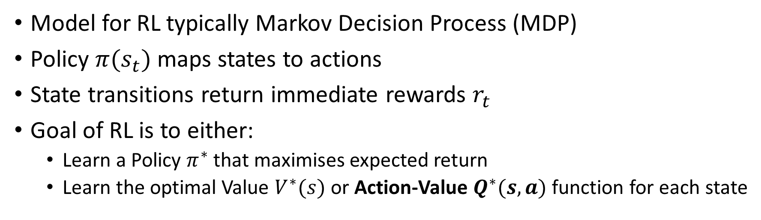
The Reinforcement Learning Problem
Model for RL typically Markov Decision Process (MDP)
Policy $π(s_{t})$ maps states to actions
State transitions return immediate rewards $r_{t}$
Goal of RL is to either:
Learn a Policy $π^{∗}$ that maximises expected return
Learn the optimal Value $V^{∗}(s)$ or Action-Value $Q^{∗}(s,a)$ function for each state
Notes:
MDP
Q Learning. State the authors are using a deep network to approximate the Q(s,a) function.
Mention success of TD-Backgammon
RL can see actions yield result after many timesteps. Trial & error, punishment & reward type system.

Slide 4
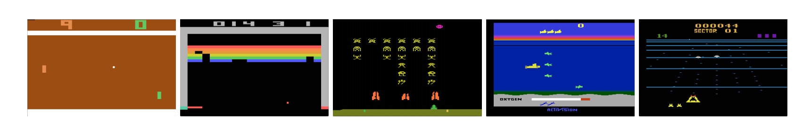
Atari 2600 in Arcade Learning Environment
Challenging testbed for RL & interesting set of tasks
High Dimensional Visual Input (210x160 RGB @ 60Hz)
Note: Each state is sequence of actions & observations
Five Atari Games: Pong, Breakout, Space Invaders, Seaquest, Beam Rider
Notes:
Because it is impossible to fully understand current situation from only the current screen.
(Not sure of direction or speed …etc.)

Slide 5
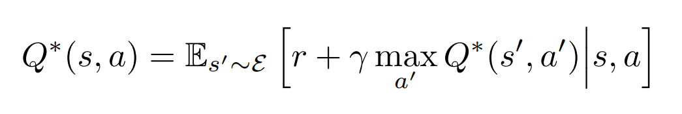

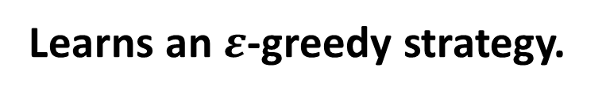
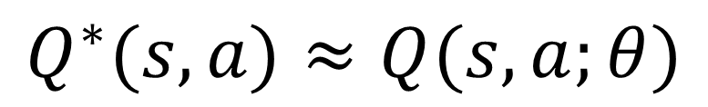
Q-Network
Traditionally value iteration algorithms converge to optimal action-value function
$$Q^{∗}(s,a)≈Q(s,a;θ)$$
Use neural network function approximator instead
Model-free & Off Policy
$$L_{i}\left(θ_{i}\right)=𝔼_{s,a\sim p(.)}\left[{(y_{i}−Q(s,a;θ_{i}))}^{2}\right]$$
Learns an $ε$-greedy strategy.
Loss Function @ iteration $i$
Notes:
Q(s,a)
Richard Bellman - Bellman Equation – foundation of dynamic programming
Q-Learning
Q-Network is a NN function approximator to the Q-Value function. DQN is the whole algorithm on the next slide.
Replace value iteration with non-linear function approximator (NN). Theta are parameters (weights) of network
Mention this is model-free RL because we are not using the rest of the model just approximating q-values
Solves RL problem from the emulator without explicitly constructing an estimate of the emulator.
Off-policy – updates the Q-values using next state and greedy action. (on-Policy – updates Q-Values using next state Q-value and current policy’s action. )
Learns about the greedy strategy (to select the action to maximise q-value)
That is it selects the maximising action a = max Q(s,a,theta) with probability 1-e & selects a random action with probability e
Learning can be achieved
The targets for learning at the current iteration depend on the network weights at the previous iteration this is different to supervised learning where targets for learning are fixed. Target for learning is the reward plus max of the q-value as suggested by the previous state of the network

Slide 6
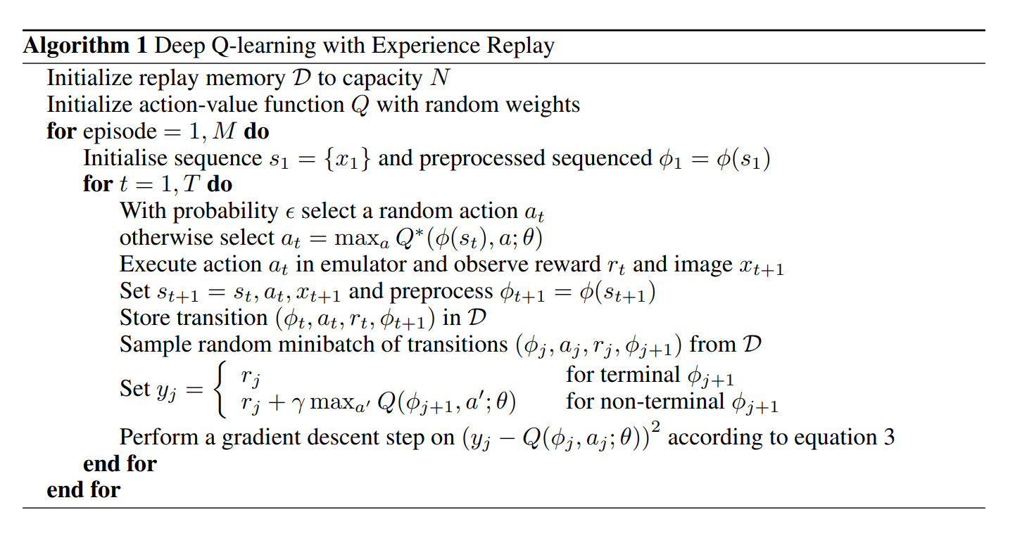
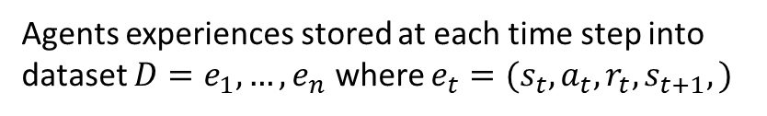
DQN with Experience Replay
Agents experiences stored at each time step into dataset $D=e_{1},…,e_{n}$ where $e_{t}=(s_{t},a_{t},r_{t},s_{t+1},)$
Notes:
Deep nn can extract features to learn better representations that can be achieved through handcrafting features.
TD-Gammon architecture is some inspiration because it used NN to estimate Value function.
Authors use Experience Replay
Perform Q-learning updates to mini-batches in the inner loop of the algorithm.

Slide 7
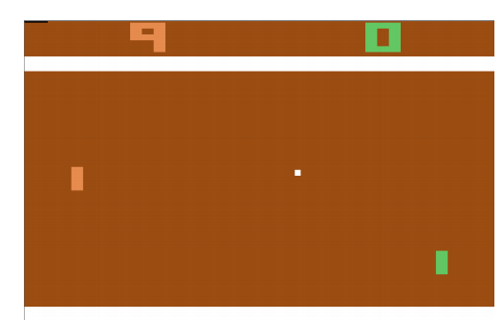
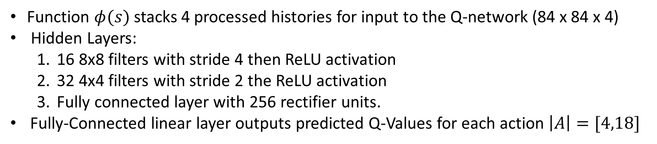
Pre-processing & Model Architecture
Pre-Processing
RGB -> Grey-Scale
210x160 is Down-Sampled to 110x84
84x84 cropped region
Function $φ(s)$ stacks 4 processed histories for input to the Q-network (84 x 84 x 4)
Hidden Layers:
16 8x8 filters with stride 4 then ReLU activation
32 4x4 filters with stride 2 the ReLU activation
Fully connected layer with 256 rectifier units.
Fully-Connected linear layer outputs predicted Q-Values for each action $\left|A\right|=[4,18]$
Notes:
Final cropping step only needed because authors use GPU implementation that requires square inputs. (Disclaimer! my diagram does not visualise cropping!)
Advantage is ability to compute Q-values for all possible actions for a state with only one forward pass through the network.

Slide 8
Training
Normalised rewards across all games [1,0,-1]
Trained for 10 million frames with replay memory of 1 million most recent frames.
Minibatches of size 32.
Using a greedy policy during training. Greediness annealed linearly from 1 to 0.1 over the first million frames.
Frame skipping technique, agent sees and acts every kth frame
K = 3 for Space Invaders
K = 4 for all other games
Notes:
7 Games: Beam Rider, Breakout, Enduro, Pong, Q*bert, Seaquest, Space Invaders
Positive rewards goto 1, negative rewards goto -1 & zero rewards remain at zero.
This limits the scale of the error derivatives making it easier to same learning rate hyperparameter across games.
Note: this could limit agent performance since there is no differentiation between rewards of different magnitude.
Frame skipping technique, agent sees every kth frame with last action being repeated on frames it doesn’t see.
Easier skip emulator forward than select action for each frame, this allows k times more games to be played.
K=4 for games except for Space Invaders where k=3 (to make the lasers visible to the agent)

Slide 9
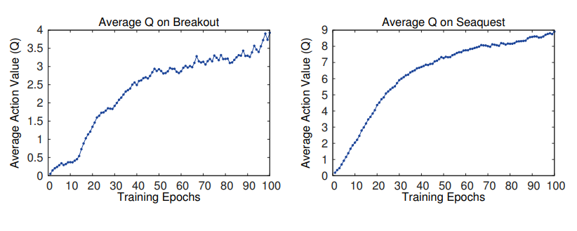
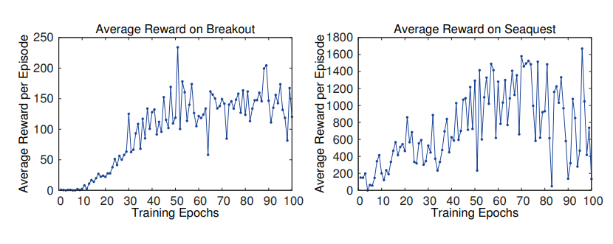
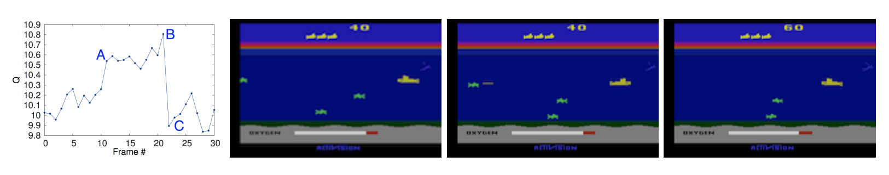
Experiments & Results
Q-Value improvement over training.
Reward improvement over training (Noisy).
Visualisation of Q-Value change throughout game of Seaquest.
Notes:
Since the evaluation metric (loss function) is the total reward collected the authors compute it over training.
However it doesn’t give the impression of learning progress because the signal is noisy. (because small, weight changes result in large changes to the game states visited)
Q-Value is more stable metric (right), this is reward obtained from current state.
The values for all 4 plots are averaged over a fixed set of states collected at the beginning training. The Q-Value is taken from each state by maximising over its actions.
The smooth improvement to predicted Q-value shows the method is able to train large neural networks using an RL signal.

Slide 10
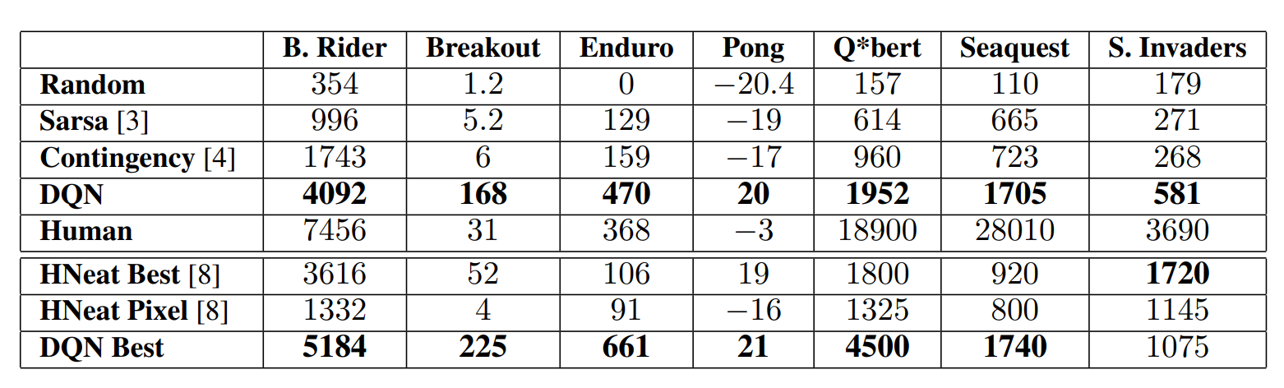
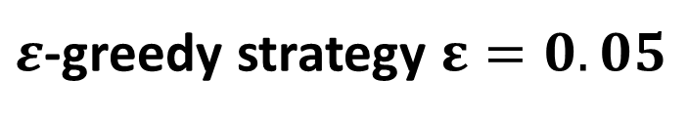
Experiments & Results
$ε$-greedy strategy $ε=0.05$
Notes:
For the learned methods we report average score obtained following an e-greed policy with e=0.05
Two past s-o-a use hand engineered feature sets.
DQN is better despite no prior knowledge about the inputs/representations (Notable convolutional nets as feature extractors is novel for atari)
NHEAT HERE
Two comparisons of Nheat (evolutionary policy search algorithm)
Better than human expert on Breakout, Enduro, Pong and close on Beam Rider
Far from human performance on Q*bert, Seaquest and Space Invaders.

Slide 11
Summary
State-of-the-art at playing 6 Atari Games
Substantially launched the field of Deep Reinforcement Learning
Resulting Work
Variety of Improvements (DDQN, Prioritised Replay …etc, RAINBOW)
All major model-free & model-based RL algorithms that use deep neural networks
Authors’ (Deepmind) major works
AlphaGo -> AlphaZero

