Slide 1
Playing Atari with Deep Reinforcement Learning
Volodymyr Mnih, Koray Kavukcuoglu, David Silver, Alex Graves, Ioannis Antonoglou, Daan Wierstra, Martin Riedmiller
Presenter: Morgan Jones

Slide 2
Overview
RL Background
Atari 2600 Testbed
Action-Value Function
Deep Reinforcement Learning (DQN)
Experiments & Results
Summary & Resulting work

Slide 3
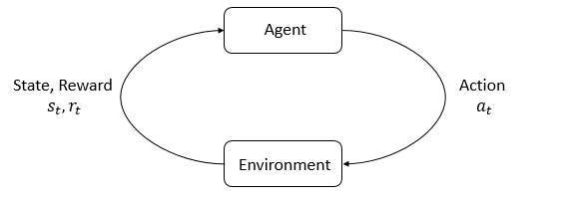
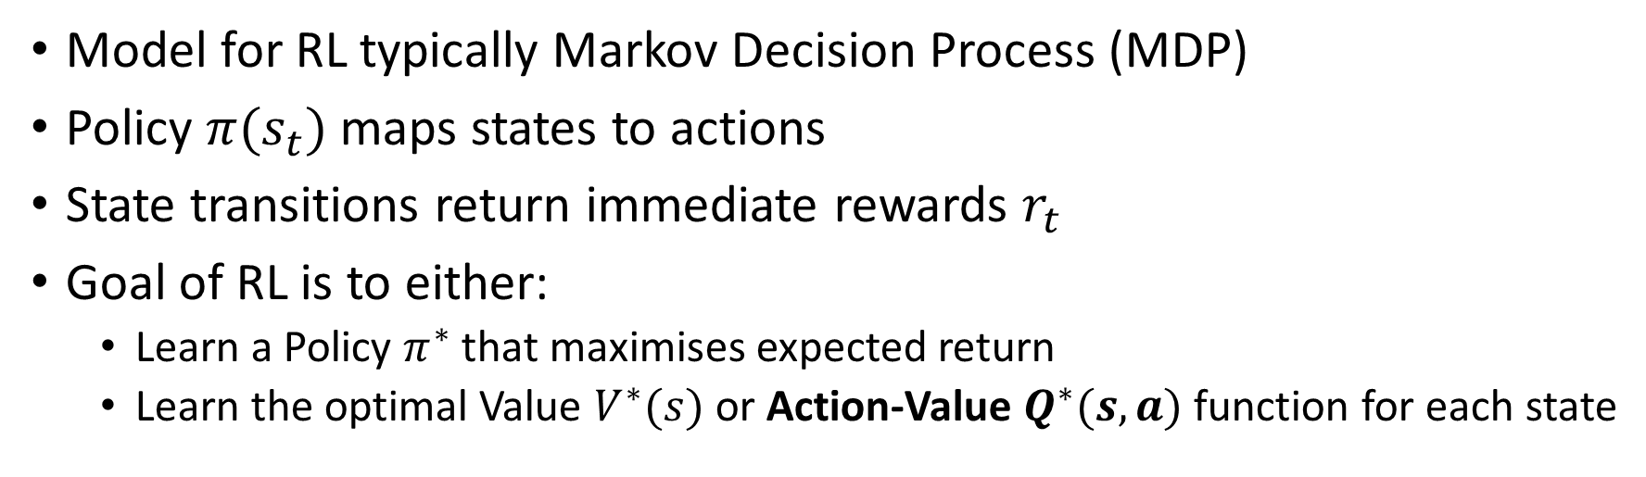
The Reinforcement Learning Problem
Model for RL typically Markov Decision Process (MDP)
Policy $π(s_{t})$ maps states to actions
State transitions return immediate rewards $r_{t}$
Goal of RL is to either:
Learn a Policy $π^{∗}$ that maximises expected return
Learn the optimal Value $V^{∗}(s)$ or Action-Value $Q^{∗}(s,a)$ function for each state
Notes:
MDP
Q Learning. State the authors are using a deep network to approximate the Q(s,a) function.
Mention success of TD-Backgammon

Slide 4
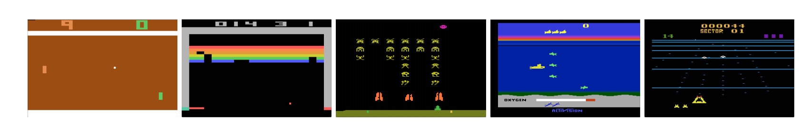
Atari 2600 in Arcade Learning Environment
Challenging testbed for RL & interesting set of tasks
High Dimensional Visual Input (210x160 RGB @ 60Hz)
Note: Each state is sequence of actions & observations
Five Atari Games: Pong, Breakout, Space Invaders, Seaquest, Beam Rider
Notes:
Because it is impossible to fully understand current situation from only the current screen.
(Not sure of direction or speed …etc.)

Slide 5
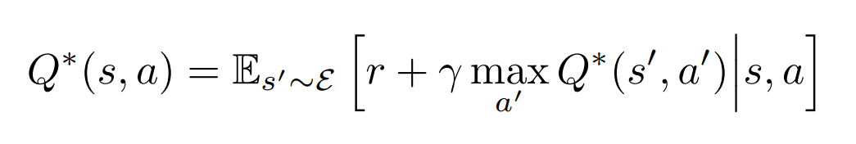
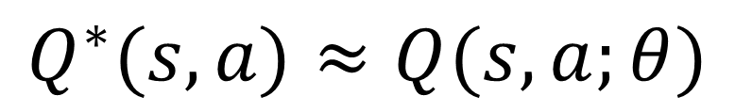
Q-Network
Traditionally value iteration algorithms converge to optimal action-value function
$$Q^{∗}(s,a)≈Q(s,a;θ)$$
Use neural network function approximator instead
Notes:
Q(s,a)
Bellman Equation
Q-Learning
Replace value iteration with non-linear function approximator (NN). Theta are parameters (weights) of network

Slide 6
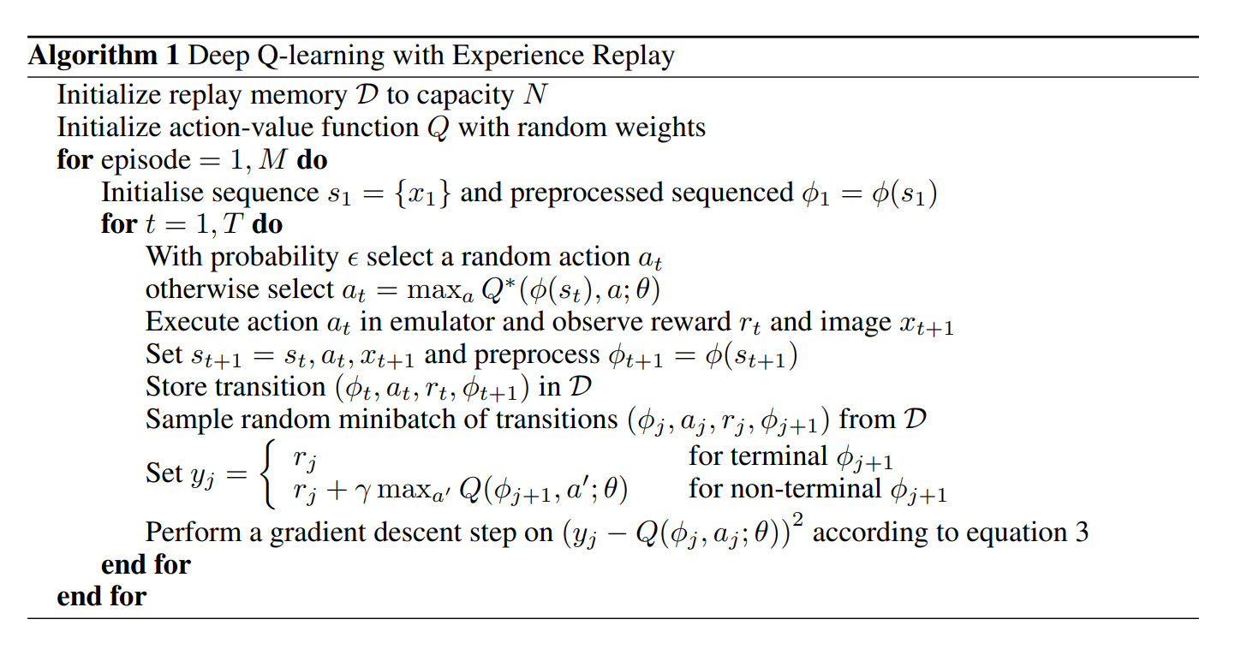
DQN with Experience Replay
Notes:
Deep nn can extract features to learn better representations that can be achieved through handcrafting features.
TD-Gammon architecture is some inspiration because it used NN to estimate Value function.
Authors use Experience Replay

Slide 7
Pre-processing & Model Architecture

