Slide 1
Detecting Spam
Daniel Jouran, Ryan Smith, Morgan Wood, & Shiyunyang Zhao
^{Presentation for STOR 565}
^{December 1, 2023}

Slide 2
Overview
Goal: Compare the performance of various classification methods for detecting spam emails
Data set:
Classification of 4601 emails as either spam or non-spam
6 numerical variables describing the frequency of certain words or characters in each email
Data source: From the TidyTuesday project¹.
This dataset is a subset of the Spam E-mail Database² distributed by R and collected by Hewlett-Packard Labs.
¹https://github.com/rfordatascience/tidytuesday/tree/979c7204bb80fd3a00ca1b622de7ebd0f49766bf/data/2023/2023-08-15
²https://search.r-project.org/CRAN/refmans/kernlab/html/spam.html

Slide 3
Variables
Variable | Description
crl.tot | Total length of words in ALL CAPITALS
dollar | Occurrences of " $ ", as percent of total number of characters
bang | Occurrences of " ! ", as percent of total number of characters
money | Occurrences of "money", as percent of total number of words
n000 | Occurrences of the string "000", as percent of total number of words
make | Occurrences of "make", as a percent of total number of words
yesno | Outcome variable, a factor with levels 'n' not spam, 'y' spam

Slide 4
Methodology
Naïve Bayes
Logistic Regression
Linear Determinate Analysis (LDA)
Quadratic Determinate Analysis (QDA)
K-Nearest Neighbors (KNN)
Support Vector Machines (SVM)
Linear & Non-Linear
Classification Trees
Bagging Trees
Boosting Trees
Random Forest

Slide 5
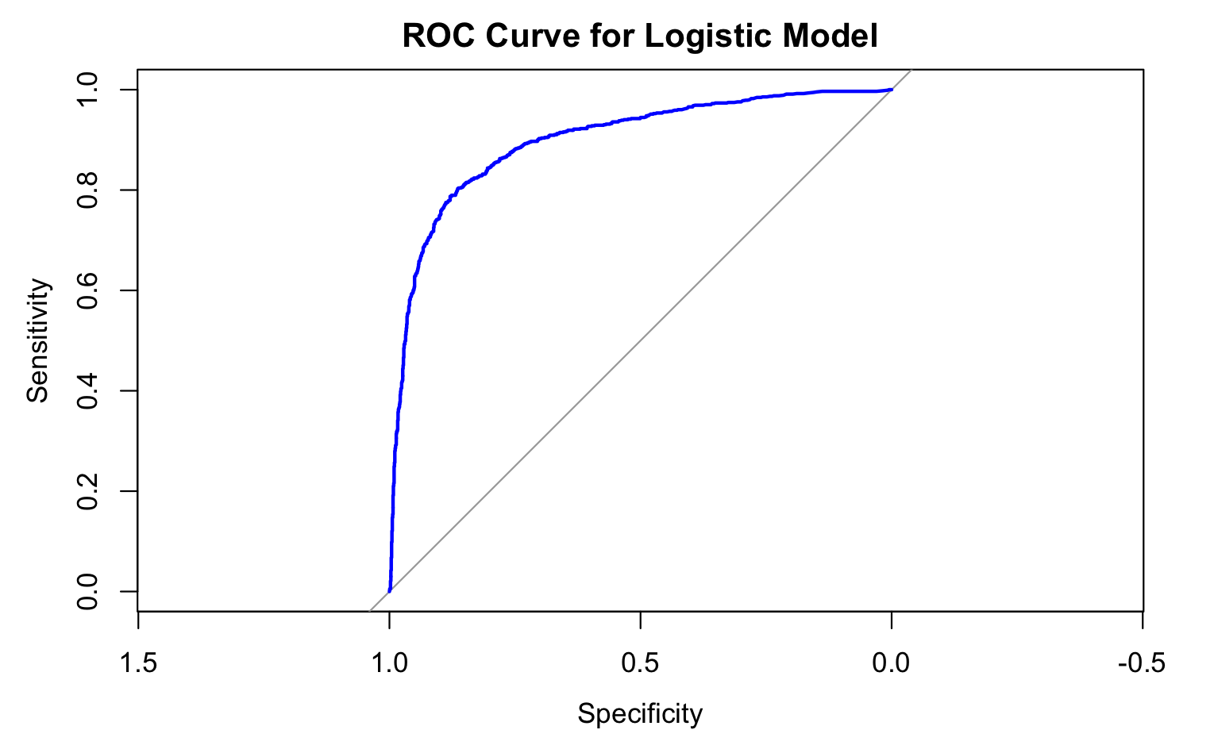
Logistic Regression
Initial Model Fitting
Stepwise Selection
Accuracy: 82.96%
ROC
Final predictors: excluding "make"
Correctly Predicted Spam: 65.78%
Predictor "make" not statistically significant
Correctly Predicted Non-Spam: 94.06%

Slide 6
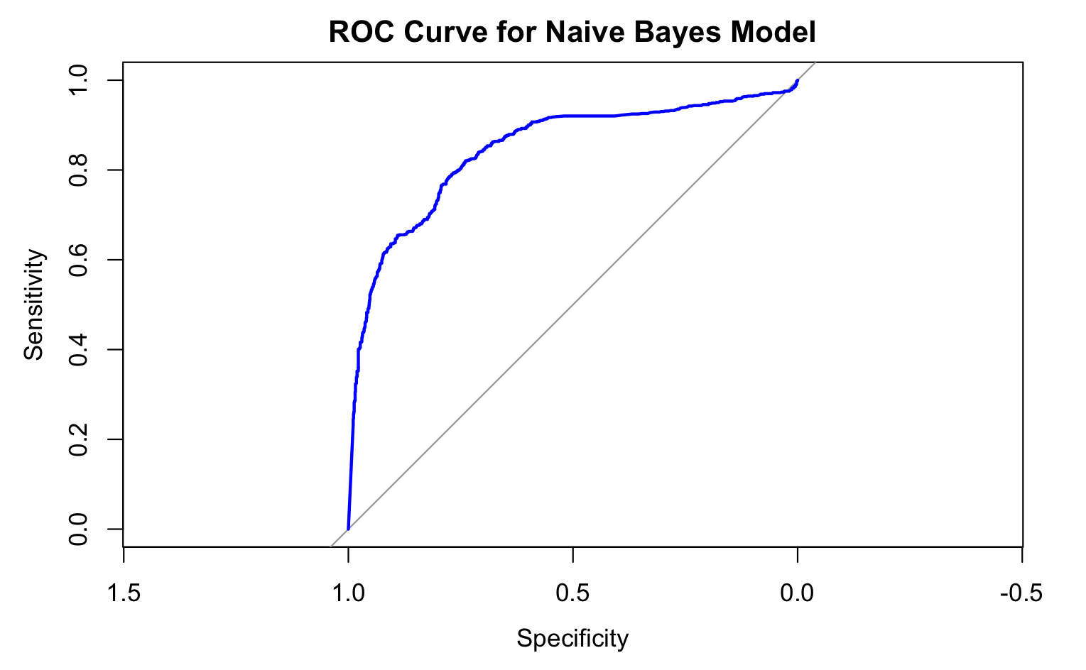
Naïve Bayes Regression
Accuracy: 77.31%
ROC
Correctly Predicted Spam: 42.98%
Correctly Predicted Non-Spam: 95.42%

Slide 7
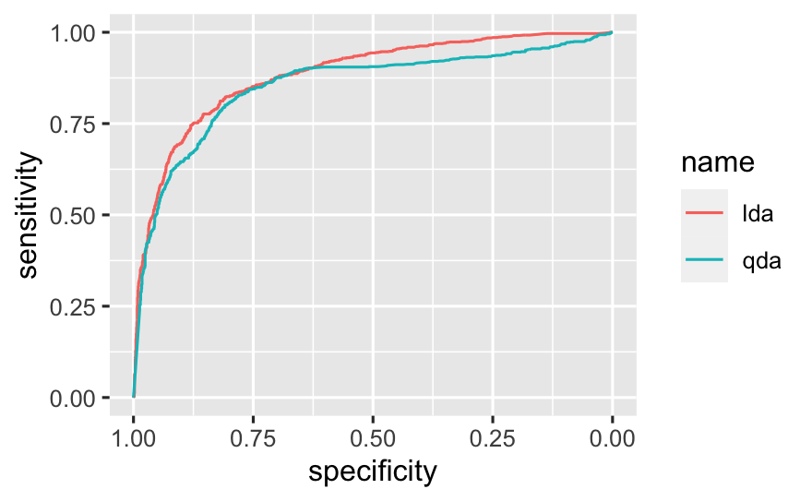
LDA | Actual Not Spam | Actual Spam
Predicted Not Spam | 1357 | 518
Predicted Spam | 41 | 385
LDA Accuracy:
75.71%
QDA | Actual Not Spam | Actual Spam
Predicted Not Spam | 1330 | 449
Predicted Spam | 68 | 454
QDA Accuracy:
77.53%

Slide 8
Support Vectors
Linear SVM | Actual Not Spam | Actual Spam
Predicted Not Spam | 1321 | 314
Predicted Spam | 77 | 589
Non-Linear SVM | Actual Not Spam | Actual Spam
Predicted Not Spam | 1300 | 231
Predicted Spam | 98 | 672
Linear Accuracy: 83%
Non-Linear Accuracy: 85.7%

Slide 9
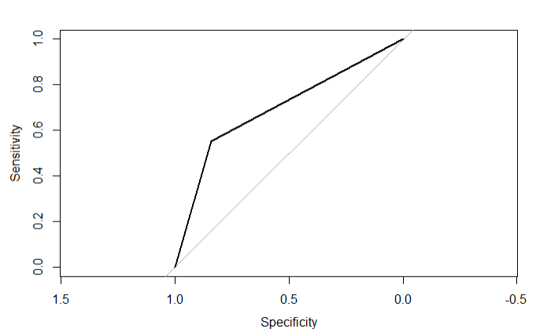
K-Nearest Neighbors
When K=10
ROC Curve
KNN | Actual Not Spam | Actual Spam
Predicted Not Spam | 1176 | 405
Predicted Spam | 222 | 498
KNN Accuracy: 72.75%

Slide 10
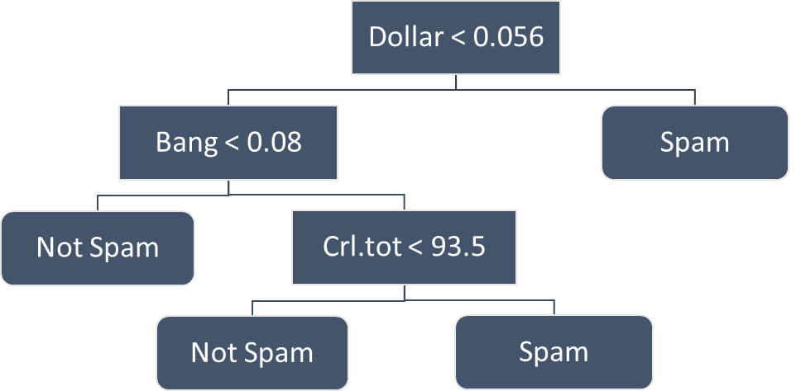
Tree-Based Methods
Methods:
Classification Tree
Boosting
Random Forest
Bagging
Performance:
84% - 88% accurate

Slide 11
Results
Method | %(Correctly ID as Spam) | %(Correctly ID as Not Spam) | %(Correctly Classified)
Random Forest | 78.52% | 94.06% | 87.96%
Bagging | 81.17% | 89.84% | 86.44%
Boosting | 78.63% | 91.42% | 86.40%
SVM (Non-Linear) | 74.42% | 92.99% | 85.7%
Classification Tree | 74.64% | 90.41% | 84.22%
SVM (Linear) | 65.23% | 94.49% | 83%
Logistic Regression | 65.78% | 94.06% | 82.96%
QDA | 50.28% | 95.14% | 77.53%
Naïve Bayes Regression | 49.28% | 95.42% | 77.31%
LDA | 42.64% | 97.07% | 75.71%
K-Nearest Neighbors | 55.15% | 84.12% | 72.75%

Slide 12
Thank You

Slide 13
Additional Notes on Analysis
Data has 1813 spam observations and 2788 non-spam observations
For all methods, Training to Test split is 1:1
Random Forest is shown with 2 predictors (model with three predictors has 87.4% accuracy)
Classification trees were grown using deviance and pruned using cv and misclassification rate
Boosting is displayed using stumps (i.e., single interaction level) and using shrinkage of 0.06 (chosen using cv)

Slide 14
Naive Bayes Regression
Accuracy: 77.31%
True Positive: 49.28
True Negative: 95.42%
 | Actual Not Spam | Actual Spam
Predicted Not Spam | 1334 | 458
Predicted Spam | 64 | 445

