Slide 1
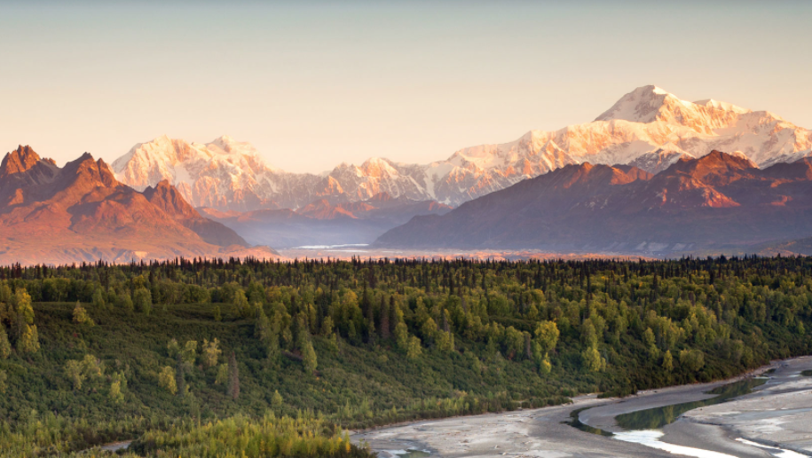
Global Deforestation With a focus on South American countries
Nouhad Louedziane
Marty Semenas
Morgan Maciupa
Notes:
Morgan

Slide 2
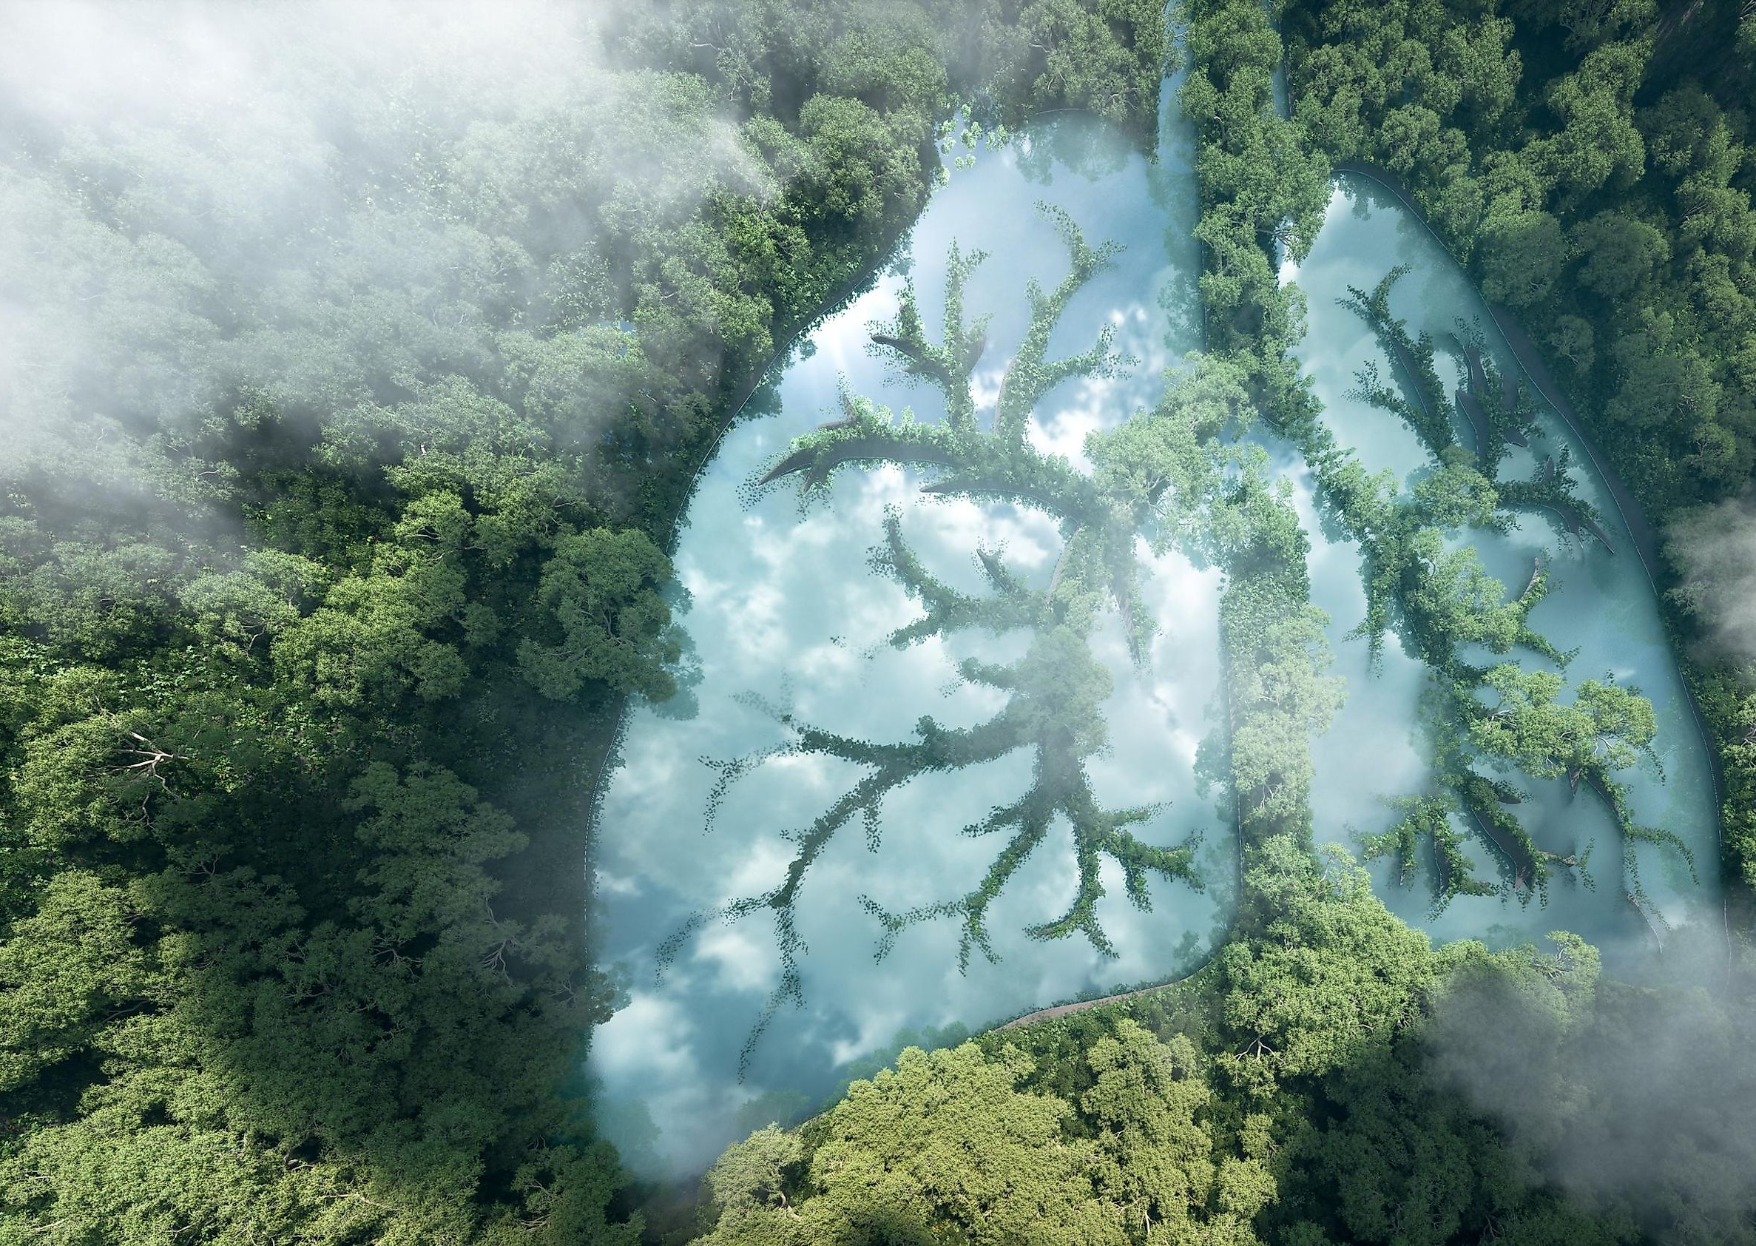
Motivation and Summary
Core idea: Looking at trends of deforestation and subsequent reforestation in South America, and the following increase of biodiversity following reforestation.
Motivation: Genuine interest in deforestation data/global sustainability
Questions: - Which continents are leading with deforestation
- Deforestation/Reforestation rates in South America
- Main drivers of deforestation
Notes:
Describe whether you were able to answer these questions to your satisfaction, and briefly summarize your findings.
Morgan

Slide 3
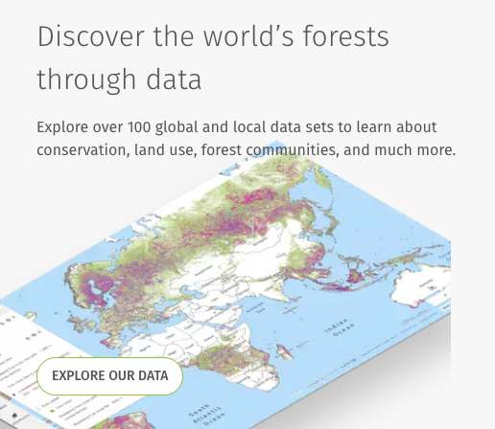
Data
Sources: - Global Forest Watch
- Our World in Data
- UN Food and Agriculture Organisation
Type: Forest cover over time in csv format
Notes:
Nou

Slide 4
Data Clean up & Exploration
Gathered global data and filtered down to South American countries
Lack of data on the link between reforestation and biodiversity
Limited and small datasets on deforestation
Increase in size in forest area in North American, Australia/Oceania
Marked difference in deforestation rates in Brazil compared to other South American countries
Notes:
World of Data has graphs and contains datasets
Limited and small datasets on deforestation: trees grow slowly, small datasets over decades
Nou

Slide 5
Data Analysis
Global deforestation/Reforestation
Filtered down to rates of deforestation/reforestation in South American countries
Focus on Brazil’s rates of deforestation/reforestation
Explore drivers of deforestation
Notes:
Marty

Slide 6
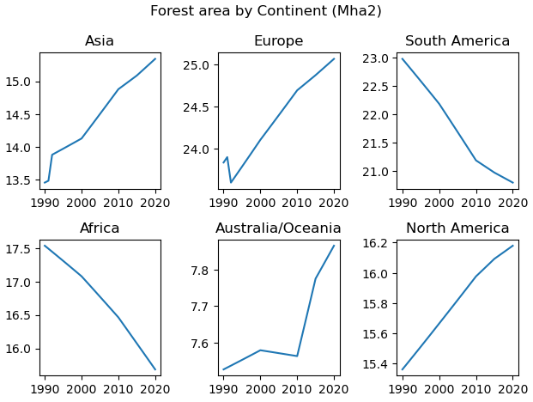
Notes:
Nou

Slide 7
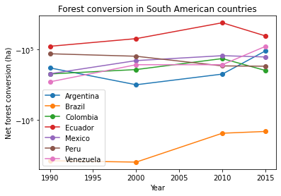
Notes:
Nou

Slide 8
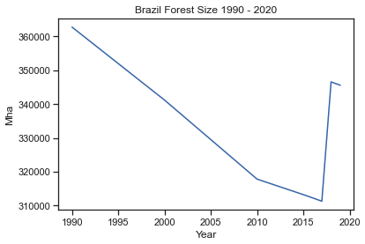
Notes:
Nou

Slide 9
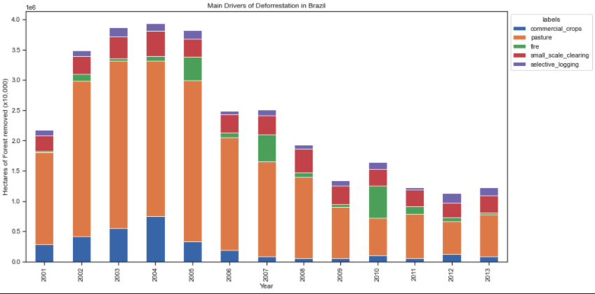
Notes:
Morgan

Slide 10
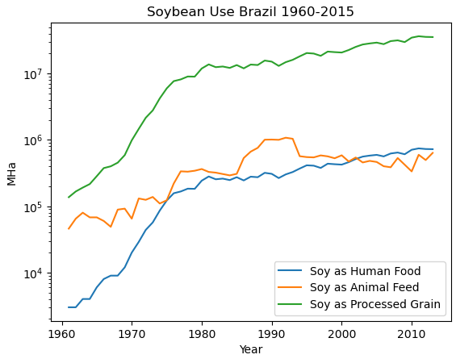
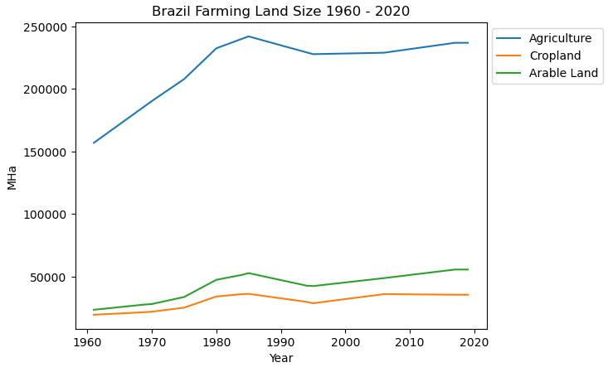
Notes:
Morgan

Slide 11
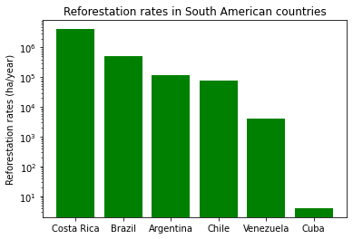
Notes:
Nou

Slide 12
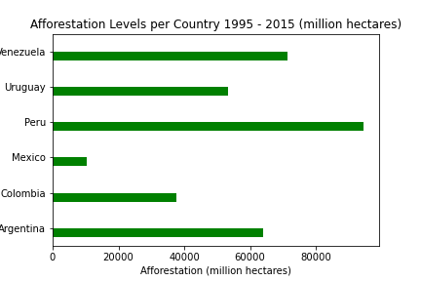
Notes:
Nou

Slide 13
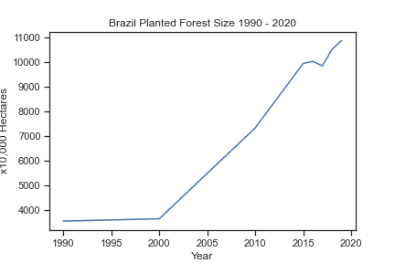
Notes:
Nou

Slide 14
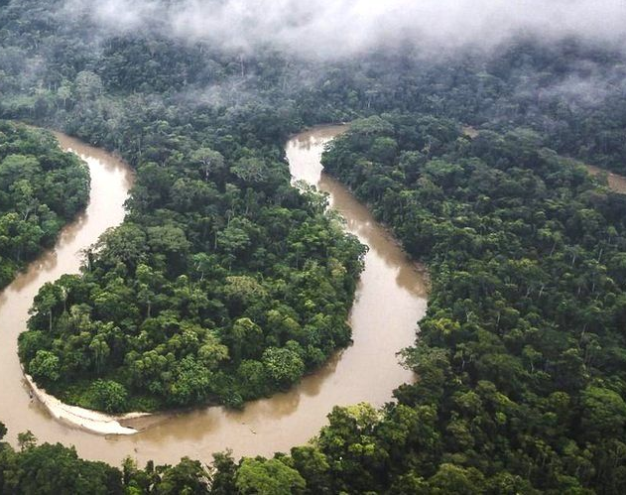
Post Mortem
Spending more time on researching biodiversity data
Looking for more data on other specific countries such as Australia
Found data on countries that are driving deforestation in developing countries through imports/exports
Notes:
Marty

Slide 15
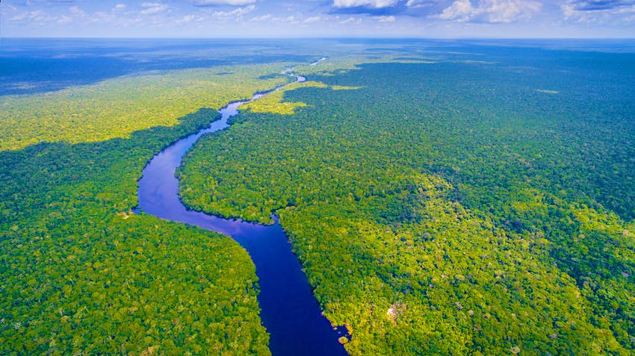
Questions for the computer screens

