Slide 1

Australian Energy Production
An insight, provided by Morgan, Fares & Carly.

Slide 2
Presenting Part I & II Of The Data Journey
Back end ETL, data sourcing & data cleaning.
Visualisations, dashboard and story telling.

Slide 3

Extract, Transform, Load

Slide 4
ETL: Data Sourcing & Cleaning
Government Data (www.energy.gov.au/data & the ABS)
Energy.gov data extracted through CSVs & ABS data extracted through web scraping.
PostgreSQL Database.
Loading through python in Pandas notebook.
See next page for more cleaning.

Slide 5
Cleaning Steps & Observations
Poorly uniformed data.
Poor use of excel to create usable CSV’s.
Adding columns for year of data & column for renewable/non-renewable indicator.
Use google API to find latitudes & longitudes for all energy plants.
Source only from years that have fuel source data.
Remove irrelevant columns from all data frames.

Slide 6
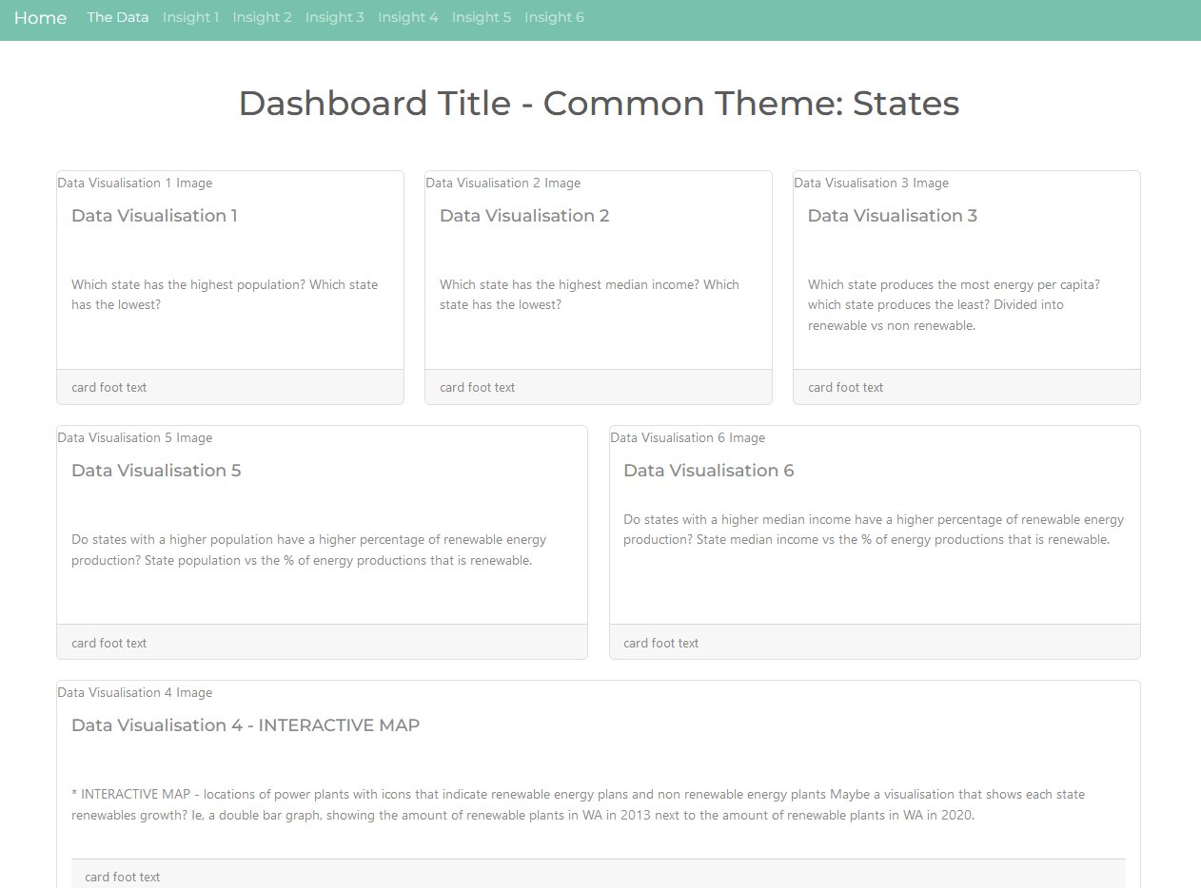
Dashboard & Data Story

Slide 7
Dashboard Development
Flask API
JS library Leaflet Awesome Markers
Jinja HTML
CSS Bootswatch Theme
JS Plotly Visualisations

Slide 8

Our Visualizations & Data Story
Let’s check out the dashboard, shall we?
*Link Here*

Slide 9
Thank you for coming to our Ted Talk.

Slide 10
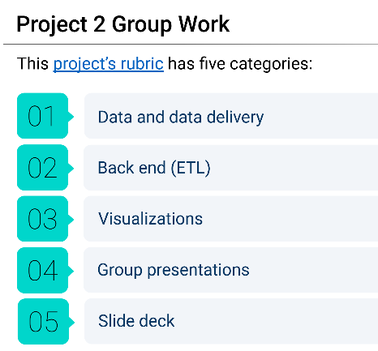
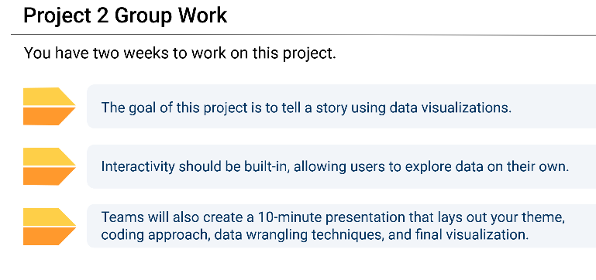

Slide 11
