Slide 1
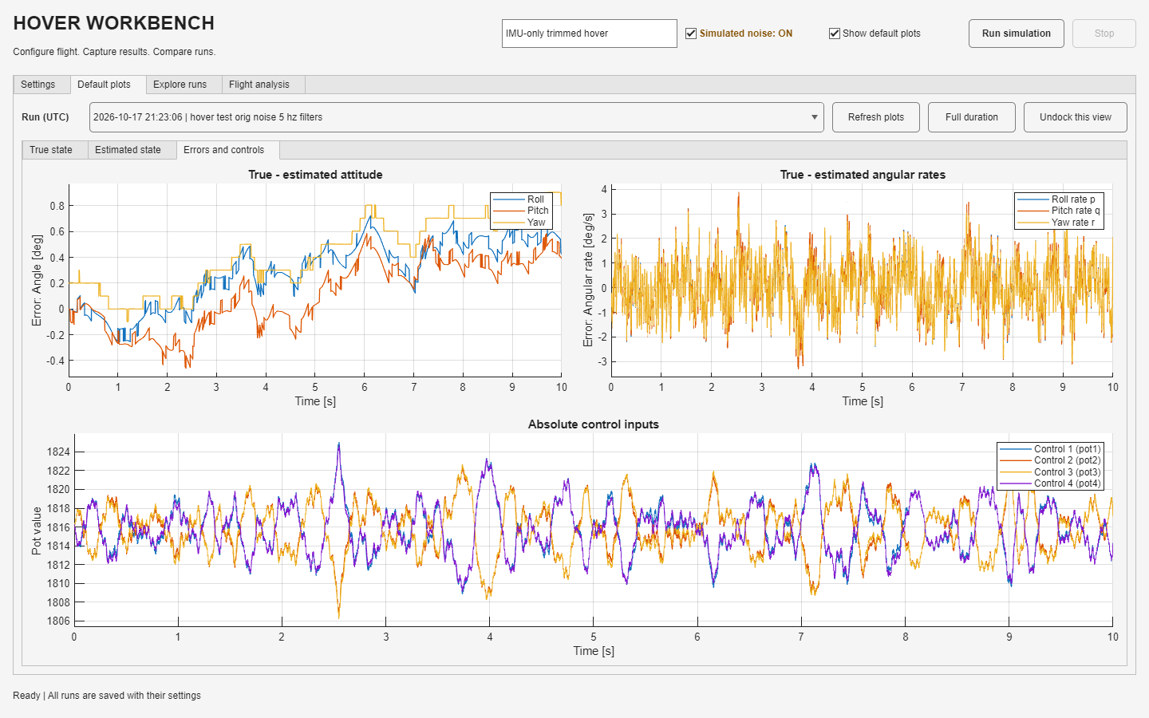
Hover
Workbench
USER GUIDE
Betaflight SITL in
MATLAB and Simulink
Configuration, flight tests and saved-run analysis
Notes:
This guide describes the current four-flapper hover simulation. SITL means software in the loop: the locally compiled Betaflight firmware closes the loop around the simulated plant. The UI and model captures come from the repository at commit 1a25d4a. The figures show saved simulation results, not physical flight measurements. Speaker notes provide additional operating detail and source references.
Source: UCI_FWMAV_Flight_Control_Simulation_and_Development, commit 1a25d4a.
- Betaflight/README.md
- 1_Hover Simulation Work/HoverWorkbench/README.md
- Screenshot: 24-default-errors.png

Slide 2
A first successful run
The workbench opens with a complete noisy hover example
Launch from the repository root
1 Open the app
Keep the supplied hover example for the first run.
addpath('Betaflight', ...
'1_Hover Simulation Work');
app = hoverWorkbench;
2 Review Run setup
Confirm duration, fidelity, noise and drag.
3 Name the run
MATLAB R2025b, Simulink and the
local Betaflight host build are required.
Add notes, then press Run simulation.
4 Inspect the result
Open Default plots, Explore runs or Flight analysis.
02
Notes:
The repository launcher adds the workbench package path. On a fresh checkout, the generated local native host is not in Git. Build it using ./Betaflight/build-host.ps1 -InstallToolchain from PowerShell, following Betaflight/README.md. Existing configured machines normally already have the executable. Use Normal simulation mode. A new app starts with the complete IMU-only hover example, rather than the separate script-default PID configuration. Load hover example restores the supplied baseline. Reset to script defaults is a different action. Wait for archival to finish before starting another run.
Source: UCI_FWMAV_Flight_Control_Simulation_and_Development, commit 1a25d4a.
- Betaflight/README.md, Open and run / Build on Windows
- 1_Hover Simulation Work/hoverWorkbench.m
- 1_Hover Simulation Work/HoverWorkbench/HoverWorkbenchController.m

Slide 3
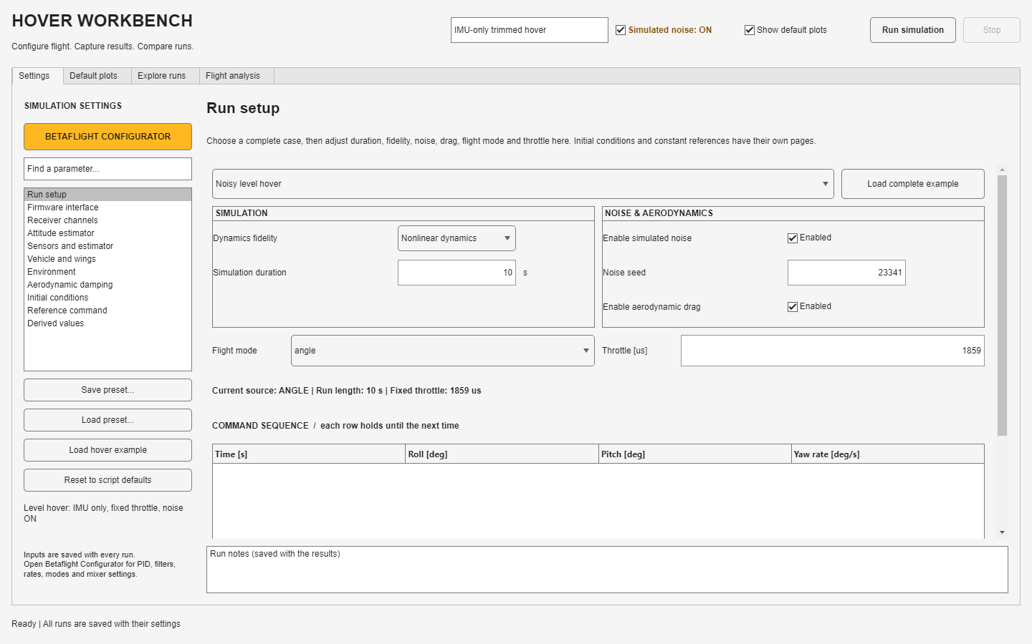
Run setup
The main controls for the next simulation share one page
Complete example
Choose a case, then press Load complete example.
Test conditions
Set duration, dynamics fidelity, noise, seed and drag.
Flight command
Check mode and throttle. The toolbar noise toggle stays visible.
03
Notes:
Loading a complete example replaces the current settings, including gains and filters. The default is 10 s of nonlinear motion, ANGLE mode, noise and drag enabled, seed 23341, and receiver throttle 1859 microseconds. The case dropdown and Load complete example button work together. Noise changes sensor bias, white noise, vibration and actuator disturbance. Disabling drag sets the effective CDx/CDy/CDz/CDw to zero while preserving entered values. Show default plots only changes rendering, not automatic run archival. Run notes and the label belong to the next run.
Source: UCI_FWMAV_Flight_Control_Simulation_and_Development, commit 1a25d4a.
- HoverWorkbenchController.m: renderFlightTest, loadFlightExample, startRun
- +hover/hoverExample.m
- +hover/buildVariables.m

Slide 4
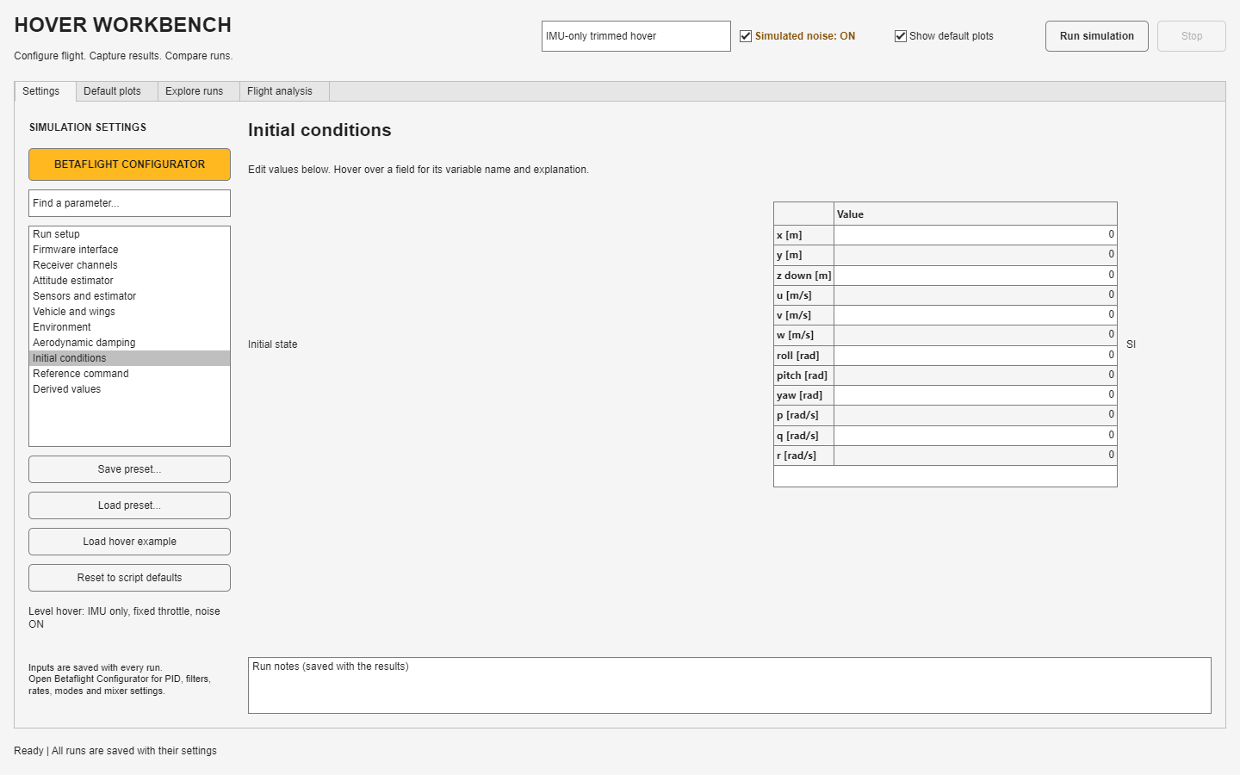
Initial conditions and references
Starting motion and requested motion are separate inputs
Initial conditions
Set the vehicle state at release: position, velocity, attitude and rates.
Reference command
Set a constant target when the command sequence is empty.
Check the units
State tables use rad and rad/s. Command sequences use deg and deg/s.
04
Notes:
The state vector is [x y z u v w phi theta psi p q r]. Position uses NED coordinates, with z positive down. Body velocity and rates use forward-right-down axes. Initial-state and constant-reference tables use SI units, including radians and radians per second. For example, enter 5*pi/180 as a numeric value of approximately 0.0872665 rad for a five-degree initial roll. The command-sequence table uses degrees and degrees per second. ANGLE uses roll/pitch angle targets and yaw rate. RATE uses all three body-rate targets. Constant Xref is separate from X0. A reference sequence overrides its selected command components after each row time. Initial conditions are not a direct estimator truth reset. Startup uses a supported stationary IMU fixture before the airborne dynamics begin.
Source: UCI_FWMAV_Flight_Control_Simulation_and_Development, commit 1a25d4a.
- +hover/settingsSchema.m
- HoverWorkbenchController.m: editMatrix, renderFields
- Betaflight/+bf/commandReference.m
- Betaflight/+bf/startup.m

Slide 5
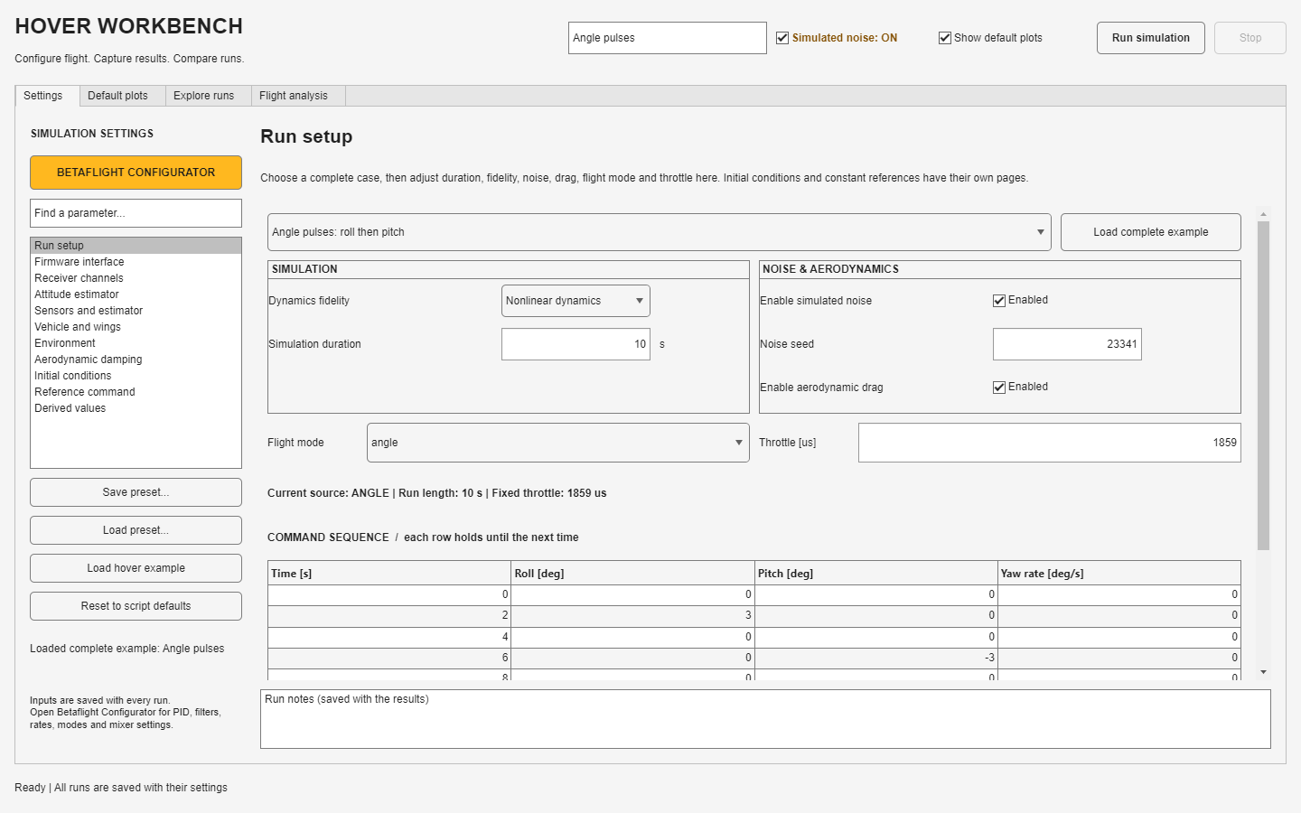
Command sequences and flight modes
Each sequence row holds its command until the next row
ANGLE mode
Roll and pitch columns request angles in degrees. Yaw requests deg/s.
RATE mode
All three command columns request angular rates in deg/s.
Release time
Use increasing times. An empty sequence uses the constant reference.
05
Notes:
The supplied cases include noisy level hover, noisy roll/pitch recovery, angle pulses, and rate doublets. The angle example requests +3 degrees roll from 2 to 4 s, then -3 degrees pitch from 6 to 8 s. Receiver updates occur at their configured 100 Hz default. Requested commands pass through native receiver processing and controller modes; they are not injected directly as motor torque. Raw receiver mode uses channel pulses and requires an empty physical-reference sequence. Commands beyond the simulation stop time do not occur. The physical plant has no yaw authority in its default configuration.
Source: UCI_FWMAV_Flight_Control_Simulation_and_Development, commit 1a25d4a.
- +hover/flightExample.m
- Betaflight/+bf/commandReference.m
- Betaflight/host/bf_host.c: feedAuxiliary
- HoverWorkbenchController.m: editSequence

Slide 6
How settings reach the simulation
The run captures the inputs when you press Run simulation
Where you edit | What changes | What to expect
Vehicle, wings and drag | Mass, inertia, thrust response and aerodynamic forces | Different physical motion and hover trim
Sensors and estimator | Sensor disturbances plus native gyro/accel filters | Different measurements and feedback lag
Betaflight Configurator | Native firmware CLI configuration | Different control, estimation and mixer behavior
Run setup and references | Release state, commands and test duration | A different experiment with the same model
Plot controls | Displayed signals, zoom and figure layout | The archived simulation samples stay intact
Firmware editor changes require Apply to bfConfig before the next run.
06
Notes:
Workbench native filter controls write the same settings stored in the Betaflight CLI document. Plant variables are built from the workbench settings; the app does not execute the whole lin_hover.m script. The model runs through Simulink.SimulationInput. A newly launched local firmware process receives the effective configuration. Controls are locked during a run and settings are captured at its start. The current editor, currently selected saved run, and independently open configurator have distinct roles. Applying a configurator opened from the workbench returns the configuration to that workbench. Previously saved records do not change when you edit the current settings.
Source: UCI_FWMAV_Flight_Control_Simulation_and_Development, commit 1a25d4a.
- +hover/makeSimulationInput.m
- +hover/buildVariables.m
- HoverWorkbenchController.m: startRun, openFirmware, applyFirmware
- Betaflight/+bf/Client.m

Slide 7
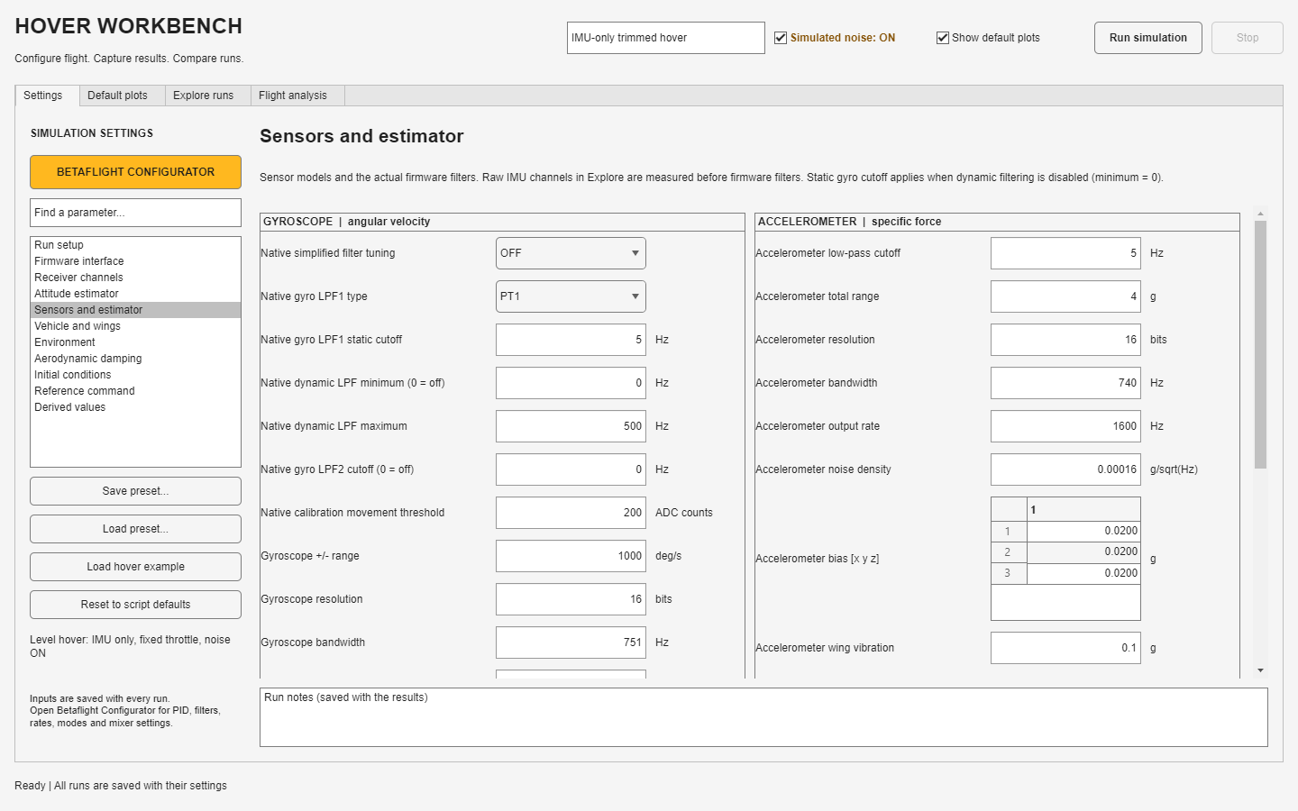
Sensors and the 5 Hz defaults
Physical sensor parameters and firmware filters appear in separate sections
Gyroscope
LPF1 uses PT1 at 5 Hz. Dynamic minimum is 0 and LPF2 is disabled.
Accelerometer
The native low-pass filter uses PT2 at 5 Hz.
Filtering tradeoff
Lower cutoffs reduce fast disturbances and add feedback lag.
07
Notes:
Simplified gyro filter tuning is OFF so it does not rewrite the manual cutoffs. A dynamic minimum of zero disables the dynamic LPF; its displayed maximum of 500 Hz is inactive in this setup. Gyro LPF2 at zero disables that second filter. PT1 and PT2 have different frequency/phase responses even when their cutoff numbers match. This build uses native firmware filters, not the retained legacy accel.LPF_set/gyro.LPF_set coefficients. Bias, white-noise density, sample rate and vibration affect raw measurements. The current white-noise block power is density squared times bandwidth without sample-rate division; changing bandwidth or sample rate can change actual noise RMS. The physical Accel Bandwidth block is currently bypassed. Resolution fields derive legacy LSB variables; the host performs its own fixed virtual-ADC conversion.
Source: UCI_FWMAV_Flight_Control_Simulation_and_Development, commit 1a25d4a.
- +hover/nativeGyroSchema.m
- +hover/nativeAttitudeSchema.m
- Betaflight/+bf/hoverConfig.m
- lin_hover_sim/Gyro Model
- lin_hover_sim/Accelerometer Model
- Betaflight/host/bf_host.c: feedIMU

Slide 8
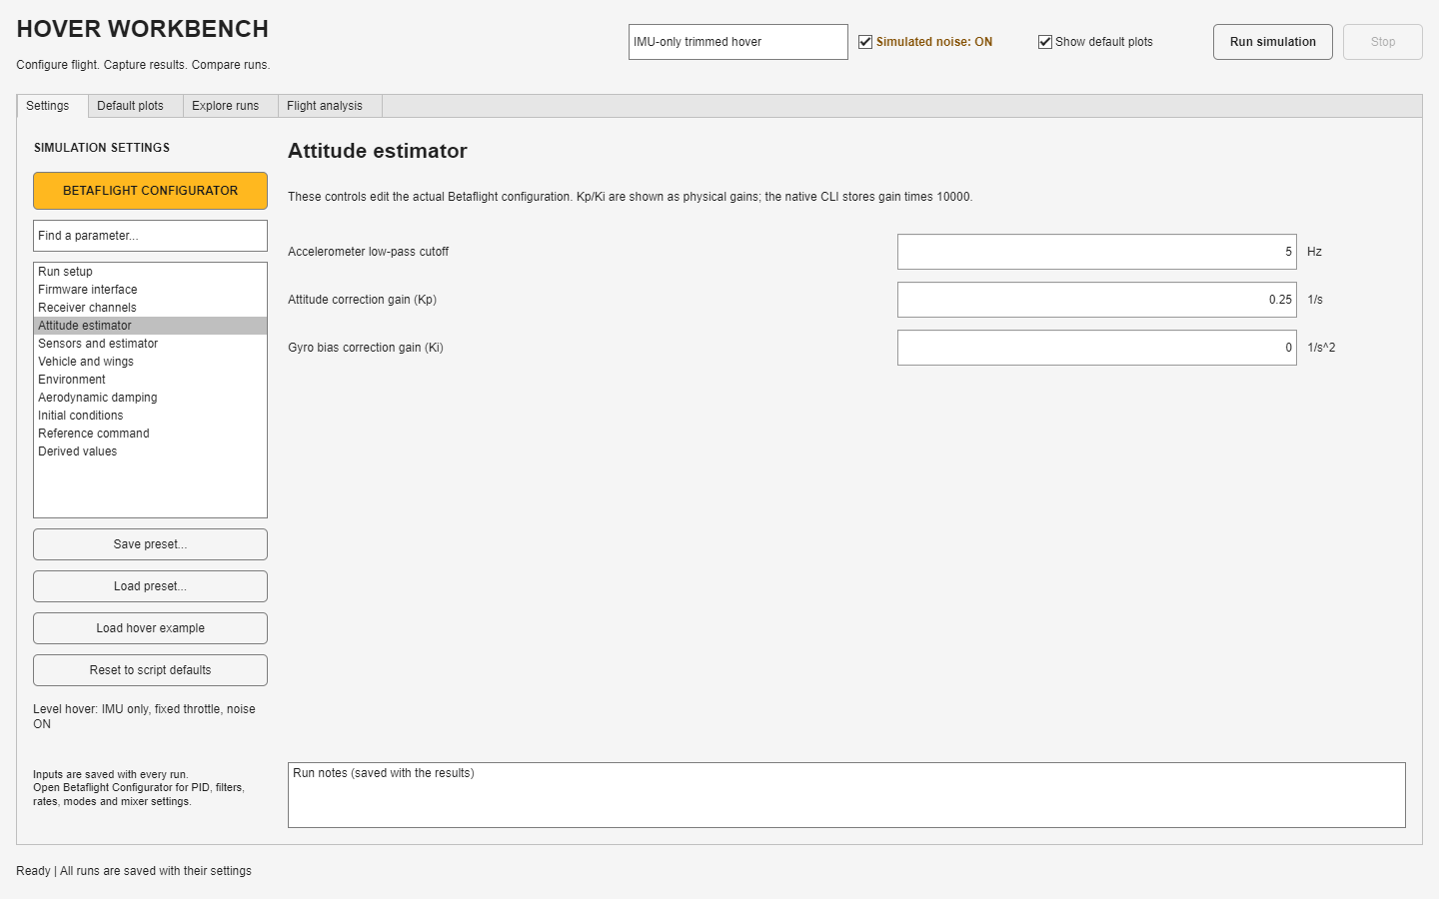
Attitude estimation and calibration
Gyro integration and accelerometer correction work together
Estimator gains
Kp = 0.25 corrects attitude. Ki = 0 disables integral bias correction.
Before release
Stationary gyro calibration estimates the gyro offset.
Accel calibration
The example enables ideal bench offsets from the known sensor bias.
08
Notes:
Estimator Kp/Ki are distinct from the rate-controller PID gains. The UI shows physical gains; native imu_dcm_kp/ki store the value multiplied by 10000. Default Kp 0.25 therefore corresponds to 2500. The 5 s supported warmup includes the example 4 s native gyro calibration, with gyro bias and noise supplied at sensor sample rate. Native motion checking can restart calibration. Ideal bench accel calibration computes integer acc_calibration offsets from the known simulated bias; it is an ideal bench assumption, not an in-flight truth correction. Accelerometers measure specific force and cannot distinguish gravity from every translational acceleration. Calibration can reduce bias-driven drift but does not remove random noise or guarantee perfect attitude.
Source: UCI_FWMAV_Flight_Control_Simulation_and_Development, commit 1a25d4a.
- +hover/nativeAttitudeValue.m
- Betaflight/+bf/startup.m
- Betaflight/+bf/calibrationGyroSamples.m
- Betaflight/+bf/calibratedConfig.m
- Betaflight/upstream/src/main/sensors/gyro.c

Slide 9
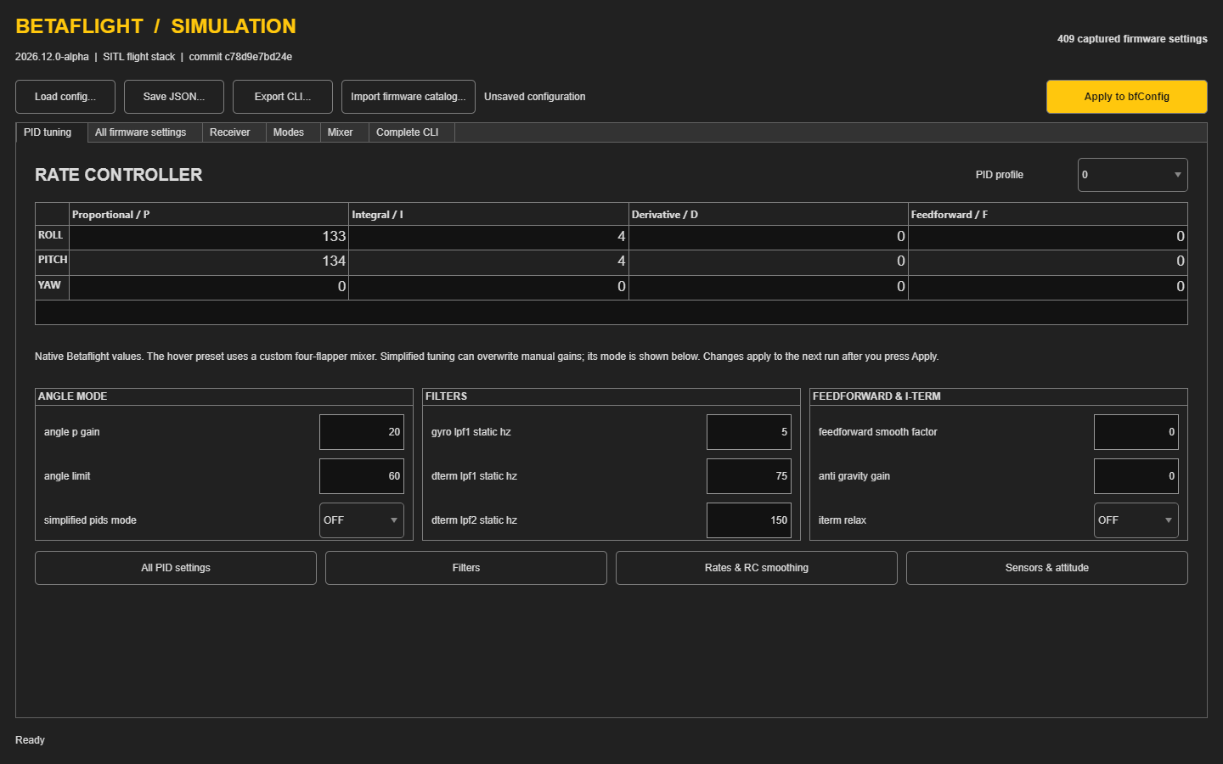
Betaflight Configurator
A local editor for the compiled firmware configuration
Open from Settings
Use BETAFLIGHT CONFIGURATOR to connect edits to the workbench.
Edit native values
Change P, I, D, F or the quick controls for the selected PID profile.
Apply edits
Press Apply to bfConfig, then return to the workbench.
09
Notes:
This window is the repository simulation configurator, built in MATLAB. It uses the actual firmware CLI catalog and is separate from Betaflight website or hardware Configurator connections. It does not run the flight algorithms itself. All firmware simulation executes locally in the compiled process. Changes in this separate window stay there until Apply to bfConfig. Apply updates the base-workspace bfConfig and, when opened from the workbench, calls back into the workbench settings. Save JSON/Export CLI preserve firmware-only configurations; workbench Save preset includes the physical simulation configuration as well. Native P/I/D/F numbers are not torque gains.
Source: UCI_FWMAV_Flight_Control_Simulation_and_Development, commit 1a25d4a.
- Betaflight/+bf/Configurator.m: apply, buildTuning
- HoverWorkbenchController.m: openFirmware, applyFirmware
- Betaflight/+bf/Client.m

Slide 10
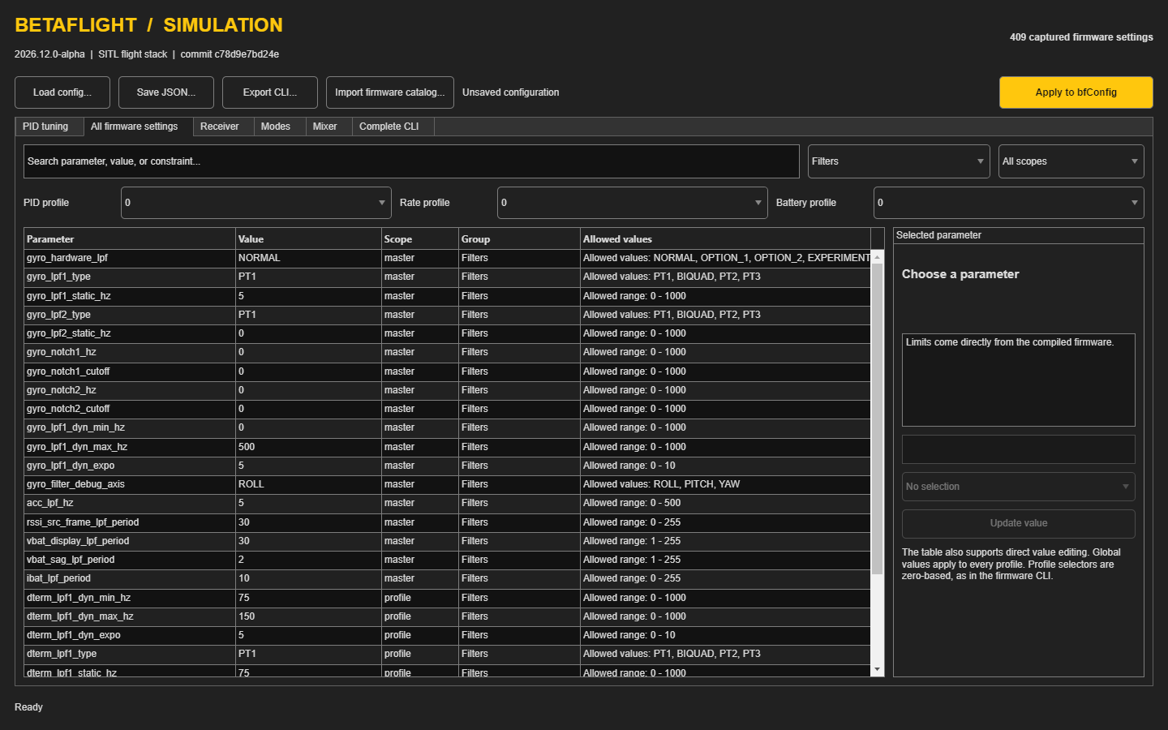
Advanced firmware settings
Search by parameter, group or profile scope
Find the parameter
Filter the list by group, then edit the value or selected-parameter control.
Choose the scope
Master settings are global. PID and rate profiles use zero-based indexes.
Apply edits
Press Apply to bfConfig. Hardware options need modeled inputs.
10
Notes:
The captured catalog contains 409 settings in this pinned build. The allowed values and ranges come from the compiled firmware. All firmware settings shows master/profile/rateprofile/battery_profile scope. The selected profile is part of the configuration. Receiver, Modes, Mixer and Complete CLI tabs edit the corresponding native commands. A catalog entry does not mean that all associated hardware exists in the simulation. For example, the default model supplies no altitude sensor, magnetometer, GPS or motor-RPM telemetry. Hardware-only features cannot be validated by simply enabling their settings. The default simulation uses an IMU-only ANGLE setup.
Source: UCI_FWMAV_Flight_Control_Simulation_and_Development, commit 1a25d4a.
- Betaflight/+bf/Configurator.m: buildSettings, profileChanged, commitCommands
- Betaflight/README.md: Fidelity boundaries
- Betaflight/configuration/settings-get.txt

Slide 11
PID gains for this plant
The menu values preserve the original small-signal torque gains
Axis | Original Kp | Original Ki | Menu P / I / D / F
Roll | 0.022 | 0.005 | 133 / 4 / 0 / 0
Pitch | 0.0221134 | 0.00502577 | 134 / 4 / 0 / 0
Yaw | No default plant authority | No default plant authority | 0 / 0 / 0 / 0
Pmenu ≈ 6042.59 Kp Imenu ≈ 791.952 Ki
These factors depend on the mixer, arm length, thrust slope and output range.
11
Notes:
Original gains operate on body-rate error in rad/s and output torque in N m. With arm S=0.11 m, thrust slope C11=0.000458 N/pot and native motor range 1055 to 1950, one PID-sum unit produces c_tau=2*S*C11*(1950-1055)/1000=9.01802e-5 N m. Pmenu=Kp*(pi/180)/(c_tau*0.032029); Imenu=Ki*(pi/180)/(c_tau*0.244381). Roll P/I before rounding: 132.9369/3.9598; pitch: 133.6221/3.9802. If needed, Dmenu=Kd*(pi/180)/(c_tau*0.000529), but native D differentiates measured rate, so derivative placement and filtering also need matching. The complete ANGLE response depends on outer-loop gains, filters and limits. Optional PID modifiers are disabled in the supplied examples. Integral and output limits remain. Recalculate after actuator scaling changes.
Source: UCI_FWMAV_Flight_Control_Simulation_and_Development, commit 1a25d4a.
- 1_Hover Simulation Work/lin_hover.m: original rate gains
- Betaflight/README.md: gain conversion
- Betaflight/upstream/src/main/flight/pid.h
- Betaflight/upstream/src/main/flight/pid_init.c
- +hover/hoverExample.m

Slide 12
What the PID controls change
These gains act on angular rate inside the firmware
Term | Role | When you change it
P: proportional | Reacts to the current rate error | Higher P strengthens correction, but can increase oscillation.
I: integral | Accumulates persistent rate error | Higher I corrects steady imbalance faster, but can add overshoot.
D: derivative | Responds to changes in measured rate | Can damp fast motion, with greater sensitivity to gyro noise.
F: feedforward | Responds to changes in the requested rate | Anticipates command changes. It does not correct a stationary bias.
ANGLE mode adds an outer attitude loop. Its angle gain is separate from rate P.
12
Notes:
The complete examples use the converted P/I values and set D/F to zero. These explanations describe the native terms, not a recommendation to enable them all. P operates on requested rate minus gyro rate. I integrates rate error with firmware limits and any enabled modifiers. Native D differentiates the measured gyro rate, with D-term filtering. Feedforward responds to setpoint movement through native receiver and feedforward processing. In ANGLE mode, the outer angle controller produces a rate target for this loop. Changing estimator Kp is a separate operation that changes the attitude estimate, not the rate-controller gain. Keep filters, limits and command mode fixed when comparing gain changes.
Source: UCI_FWMAV_Flight_Control_Simulation_and_Development, commit 1a25d4a.
- Betaflight/upstream/src/main/flight/pid.c
- Betaflight/upstream/src/main/flight/pid_init.c
- Betaflight/upstream/src/main/fc/rc.c
- Betaflight/+bf/hoverConfig.m

Slide 13
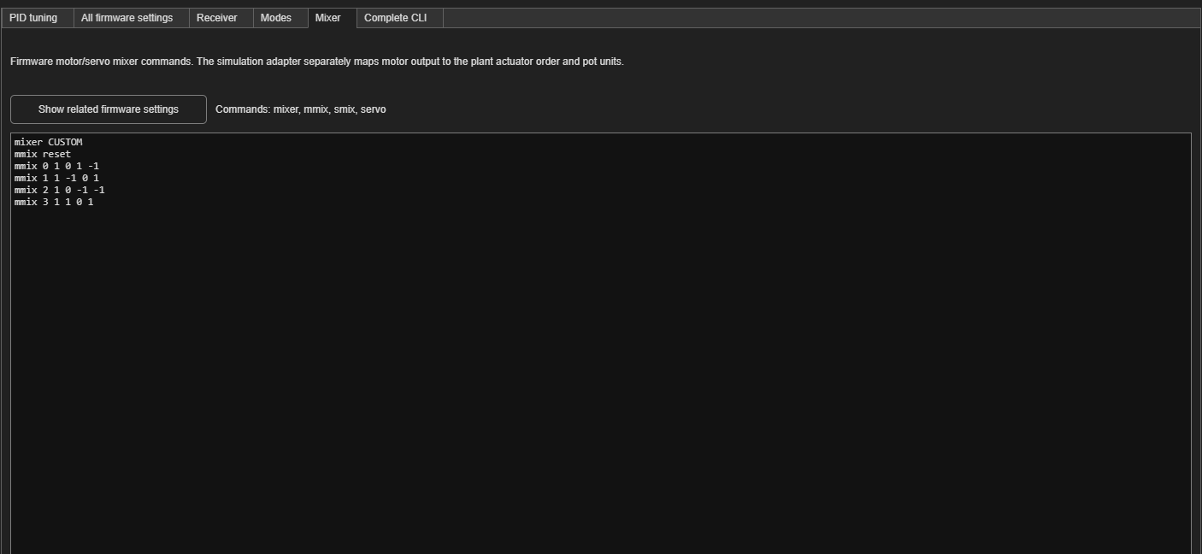
Receiver throttle and actuator output
The throttle field and plant hover trim use different scales
1859 µs
Receiver throttle in the supplied example
≈ 1816.1 pot
Plant hover trim from weight and thrust slope
The custom mixer commands front, right, rear and left actuators.
13
Notes:
The 1859 us receiver pulse passes through native throttle interpretation, idle/endpoints and mixing. It is not directly the plant pot command. The measured example gives about 1815.75 pot mean output versus the plant trim near 1816.1, leaving a small quantized trim mismatch. The adapter subtracts u0 from each absolute motor output before the actuator model. The nonlinear plant adds u0 back when forming physical flapper commands; the linear plant uses delta inputs about hover. Roll mixer coefficients are [0 -1 0 1] and pitch [1 0 -1 0]. Re-trim after mass, thrust slope, output endpoints or throttle-curve changes. Fixed throttle has no altitude feedback.
Source: UCI_FWMAV_Flight_Control_Simulation_and_Development, commit 1a25d4a.
- Betaflight/+bf/hoverConfig.m
- Betaflight/+bf/simulationOptions.m
- Betaflight/+bf/FlightController.m
- lin_hover_sim/Lin vs NonLin Dynamics
- Betaflight/README.md

Slide 14
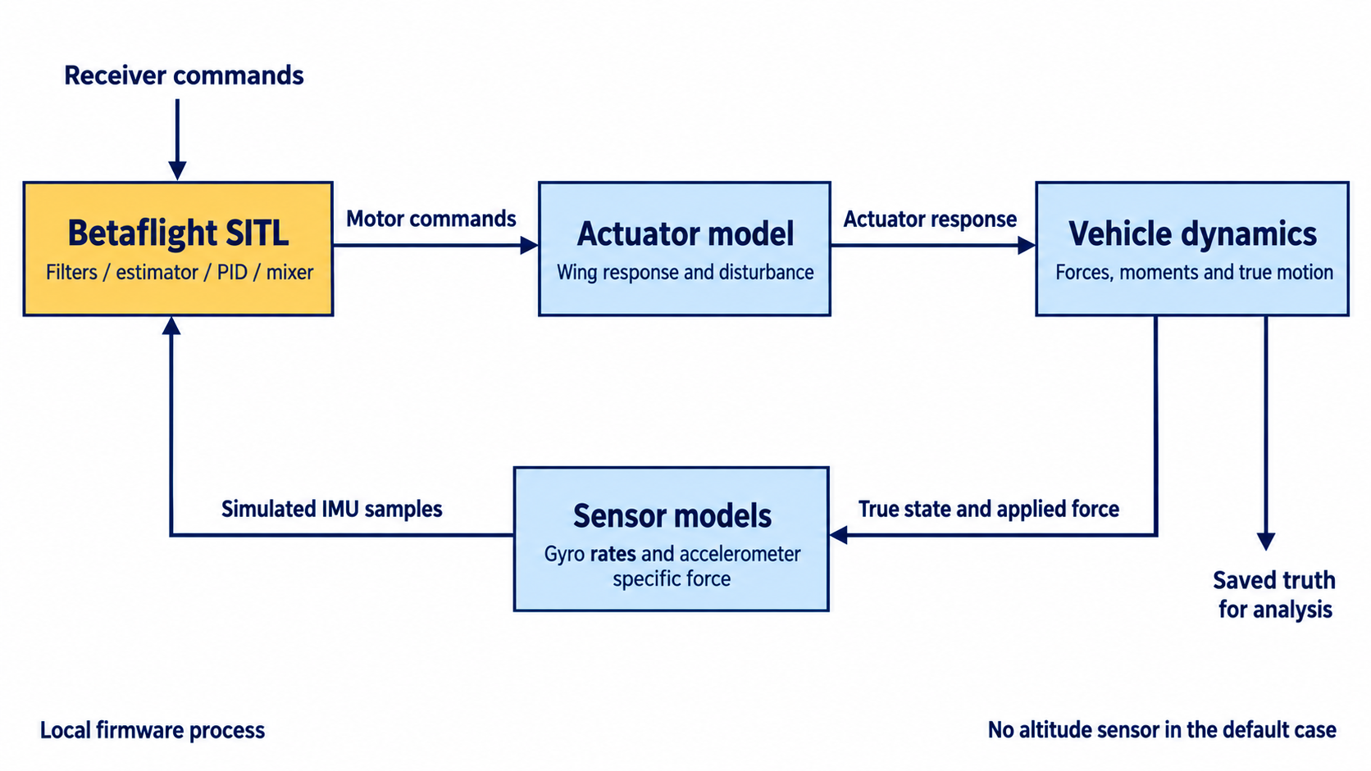
The closed simulation loop
14
Notes:
Conceptual diagram of the actual signal path. Native Betaflight receives simulated IMU and receiver input. Its output drives actuator dynamics, which drive the vehicle model. The true vehicle state and applied actuator force create ideal physical sensor signals, then sensor disturbances create measured input for the next firmware step. True state also goes to logging. No truth attitude quaternion bypasses the estimator in the default IMU-only case. The True state port supports optional navigation feed paths, but NavigationSensors is zero in the default case. Diagram generated for this guide from the implementation sources; UI/model captures elsewhere are direct exports.
Source: UCI_FWMAV_Flight_Control_Simulation_and_Development, commit 1a25d4a.
- lin_hover_sim.slx
- bf_flight_controller.slx
- Betaflight/+bf/FlightController.m
- Betaflight/host/bf_host.c
- Illustration: architecture.png

Slide 15
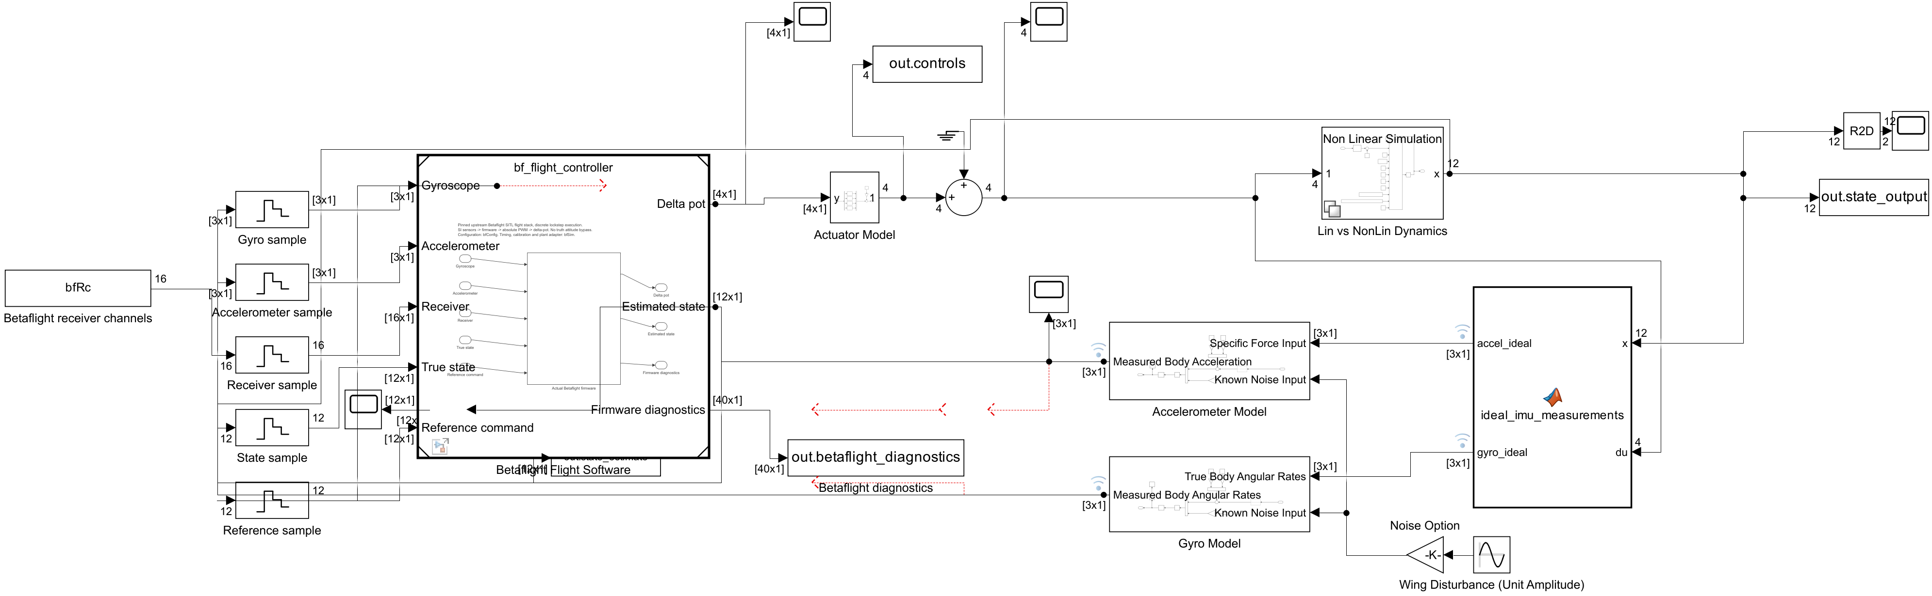
The top-level Simulink model
lin_hover_sim.slx remains the simulation entry point
Flight software
Physical simulation
Measurements and logs
The referenced model wraps local SITL.
Actuator output drives the selected dynamics.
Sensors feed firmware. True states feed analysis.
15
Notes:
Actual Simulink diagram export without changing block layout or saving model edits. Signal direction includes a feedback loop, so read the blocks by their role rather than assuming every line flows left to right. The top-level model contains the flight-software reference, actuator model, linear/nonlinear dynamics variant, ideal IMU calculation, gyro and accelerometer models, and logged workspace outputs. Sample blocks feed the bridge at the fixed simulation sensor interface. The Ground/Sum path remains part of the existing disturbance structure.
Source: UCI_FWMAV_Flight_Control_Simulation_and_Development, commit 1a25d4a.
- 1_Hover Simulation Work/lin_hover_sim.slx
- Screenshot: 09-model-top.png

Slide 16
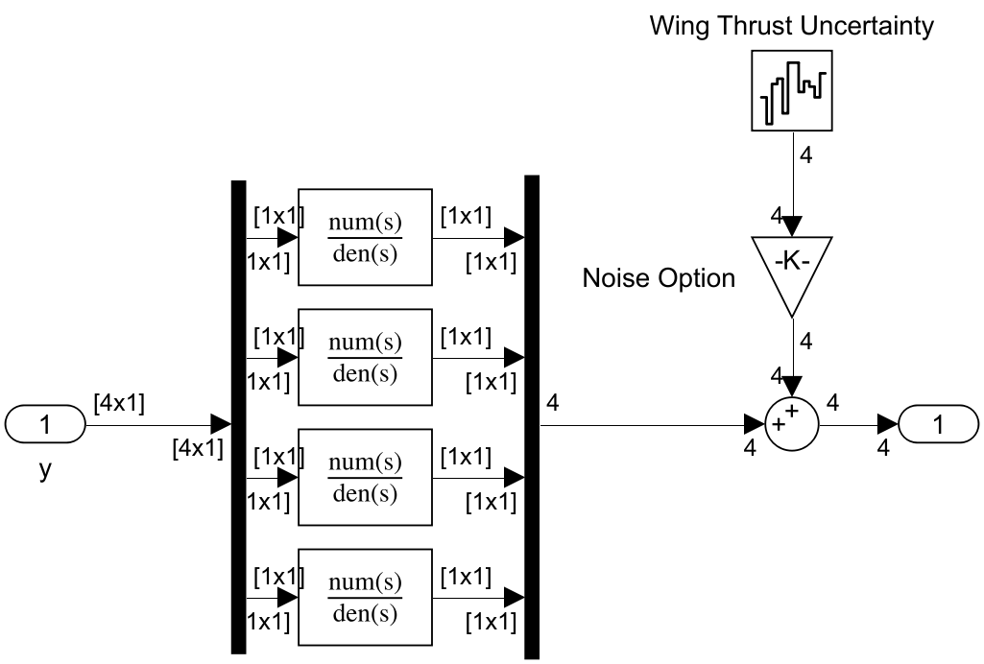
Actuator response
Motor commands pass through the modeled wing dynamics
Four actuator channels
Each channel includes the existing transfer-function response.
45.5 ms
Default wing time constant. Larger values slow the actuator response.
Noise also controls the wing disturbance input.
16
Notes:
The bridge outputs delta-pot after subtracting hover trim from absolute motor commands. Each actuator channel applies the existing transfer function parameterized by tau_wing. Default tau_wing is 0.0455 s. Wing thrust uncertainty enters the actuator output through the noise switch. The plant maps effective actuator output to thrust and moments. Actuator lag can limit useful controller bandwidth and affect phase margin; a larger PID gain cannot remove the physical delay. The image is the actual Actuator Model subsystem.
Source: UCI_FWMAV_Flight_Control_Simulation_and_Development, commit 1a25d4a.
- lin_hover_sim/Actuator Model
- 1_Hover Simulation Work/lin_hover.m: tau_wing
- Betaflight/+bf/FlightController.m

Slide 17
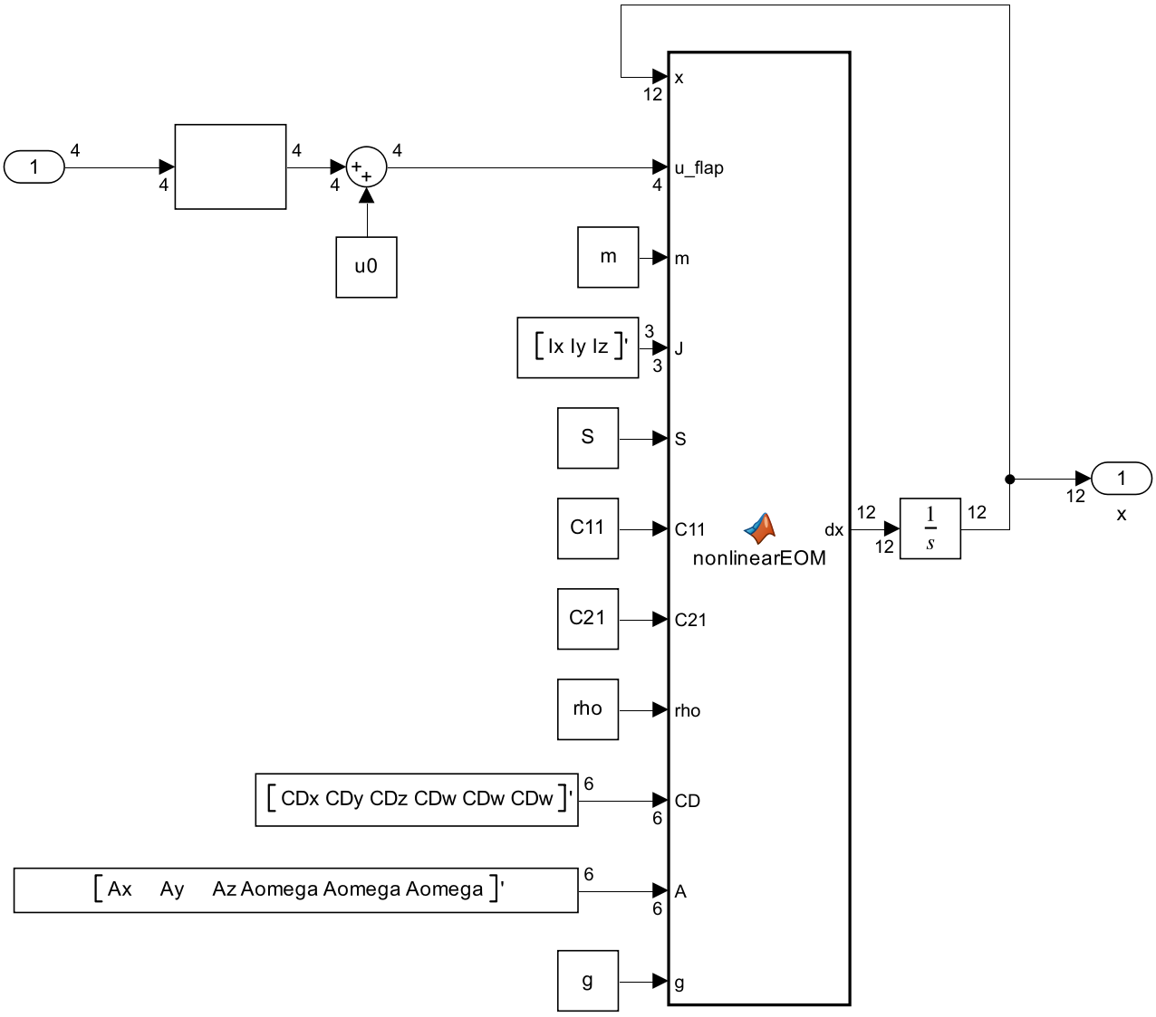
Vehicle motion
The dynamics integrate forces and moments into a twelve-state trajectory
Linear or nonlinear
The linear model describes perturbations near hover. The nonlinear model includes full attitude coupling.
Physical settings matter
Mass, inertia, arm length, thrust coefficients and drag change the response and the required trim.
Drag OFF sets all effective CD values to zero.
17
Notes:
The nonlinear subsystem calls nonlinearEOM and integrates its 12-state derivative. Parameters include mass, inertia, arm, C11/C21, rho, CD, projected areas and gravity. The linearized alternative uses the state-space model about hover. The same ideal IMU helper selects matching linear or quadratic drag forces. There is no altitude or position controller in the default configuration, so position can drift even with small attitude angles. The current nonlinear plant hard-codes zero yaw torque. Changing the reference-speed drag inputs influences the derived damping of the linear model; the nonlinear force law uses its physical quadratic coefficients.
Source: UCI_FWMAV_Flight_Control_Simulation_and_Development, commit 1a25d4a.
- lin_hover_sim/Lin vs NonLin Dynamics/Non Linear Simulation
- lin_hover_sim/Lin vs NonLin Dynamics/Linear Simulation
- +hover/buildVariables.m
- Betaflight/+bf/idealImu.m

Slide 18
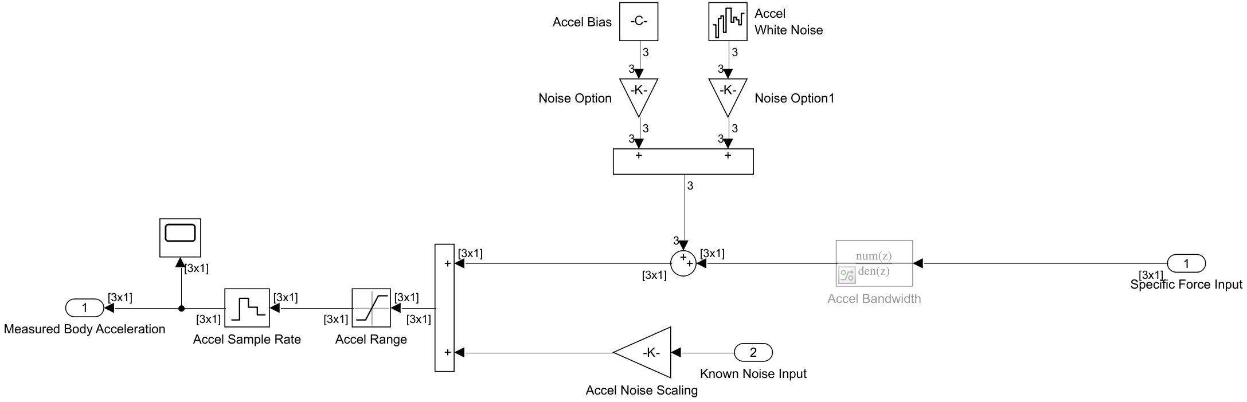
Simulated IMU measurements
Raw measurements come from the physical plant and sensor models
Gyroscope
Accelerometer
Measures body angular rate, then adds sensor effects.
Measures specific force: thrust and drag per unit mass.
18
Notes:
The accelerometer diagram reads from right to left. Ideal accelerometer input is non-gravitational force per mass. For level steady hover its body Z signal is approximately -g in FRD; in ideal free fall it is zero. Gyro input is the plant p/q/r. Bias, white noise and wing vibration enter through the noise-controlled paths, followed by range clipping and sample-and-hold. The Accel Bandwidth block shown gray is commented through in this build. Raw gyro/accel logs capture these physical-model measurements before native firmware filtering/calibration. The host then converts SI values to virtual sensor counts, using the gyro driver scale and a 256-count/g accel scale with the required sign transformation. Resolution fields in the app do not replace those host scales.
Source: UCI_FWMAV_Flight_Control_Simulation_and_Development, commit 1a25d4a.
- Betaflight/+bf/idealImu.m
- lin_hover_sim/Accelerometer Model
- lin_hover_sim/Gyro Model
- Betaflight/host/bf_host.c: feedIMU
- +hover/addImuSignals.m

Slide 19
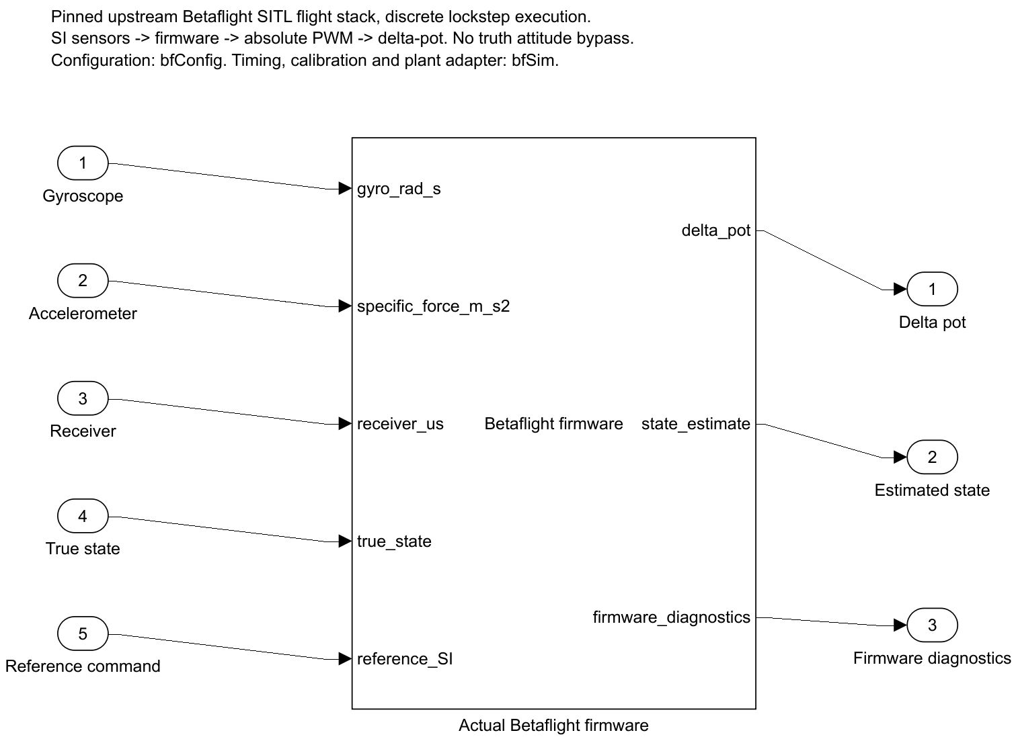
Local SITL, timing and startup
A new firmware process closes the loop for each run
4 kHz interface
Simulink exchanges IMU samples with the local firmware every 250 µs.
Native PID and mixer
Their rate is 4000 / divider Hz. Receiver frames default to 100 Hz.
Before t = 0
Warmup, calibration, arming and throttle settling precede plant release.
19
Notes:
The MATLAB System block uses bf.Client and a local TCP connection to the compiled executable. It does not call the Betaflight website. Native receiver processing, filters, Mahony estimator, PID and mixer run in upstream firmware code, with host virtual time and simulated sensor input. The interface stays at 4 kHz while physical gyro/accel sample holds default to 3200/1600 Hz. PID/mixer divider defaults to 1. Startup defaults are 5 s supported warmup, 0.3 s arming settle, 1 s throttle spoolup. Plotted time starts at release. True-state input does not bypass attitude estimation in the default NavigationSensors=0 case. This host models no CPU execution cost or physical ESC wire timing. Normal Simulink mode is required; Accelerator/Rapid Accelerator and embedded code generation do not support this process boundary.
Source: UCI_FWMAV_Flight_Control_Simulation_and_Development, commit 1a25d4a.
- bf_flight_controller.slx
- Betaflight/+bf/FlightController.m
- Betaflight/+bf/Client.m
- Betaflight/+bf/startup.m
- Betaflight/host/bf_host.c
- Betaflight/+bf/simulationOptions.m

Slide 20
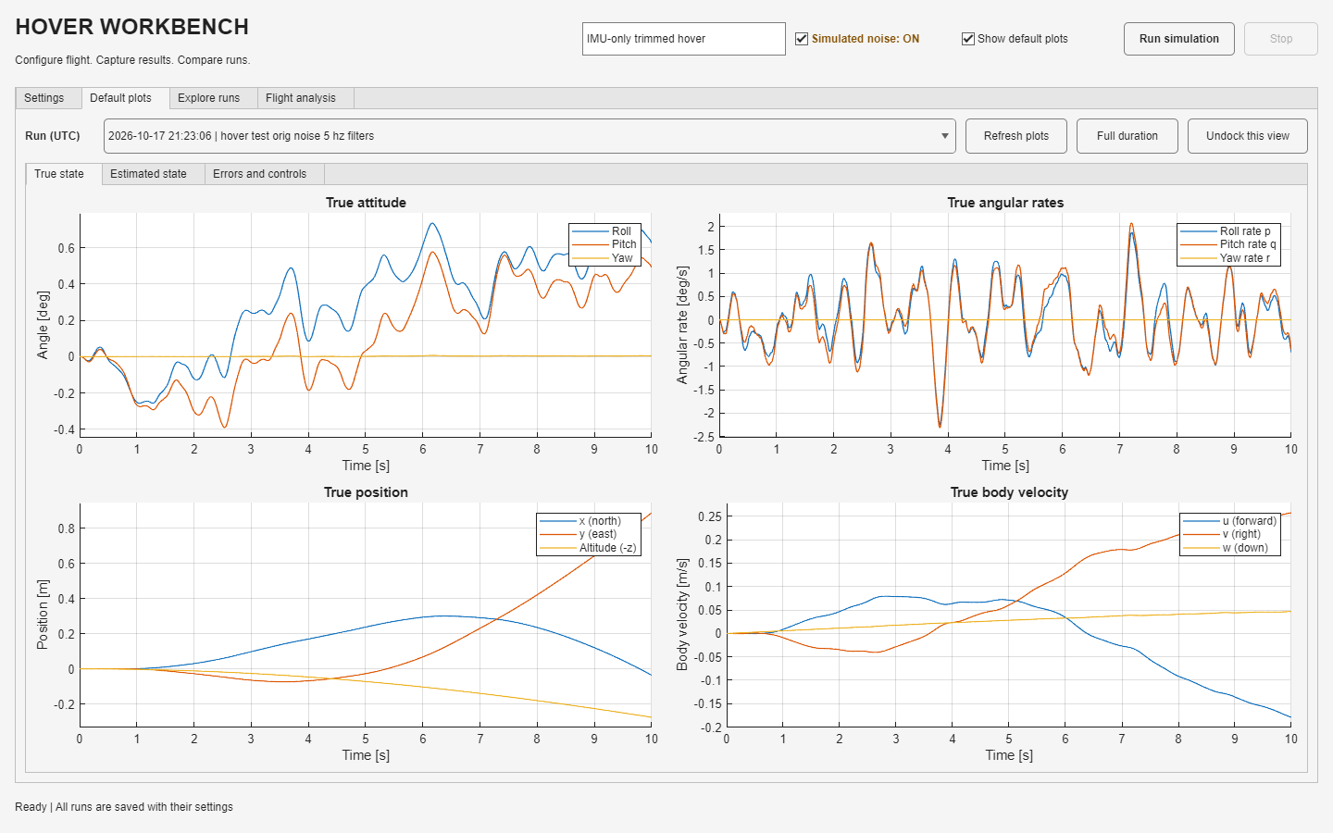
Default plots
A quick overview of the saved run
Choose the run
The dropdown selects saved data, independent of the next-run settings.
True state
Attitude, body rates, position and body velocity have separate plots.
Navigate the view
Home or Full duration restores the complete time span.
20
Notes:
Show default plots can disable automatic rendering without disabling run archival. True state, Estimated state and Errors and controls are separate groups. Angles display in degrees and rates in degrees/s. Position displays altitude=-z; body velocity retains u/v/w with w positive down. Each axis zooms independently. Broad views use a peak-preserving display subset for performance. Zoom restores full visible sample detail; CSV/workspace exports keep every sample. Undock this view creates an independent figure snapshot for the selected group.
Source: UCI_FWMAV_Flight_Control_Simulation_and_Development, commit 1a25d4a.
- +hover/defaultPlotSpec.m
- +hover/defaultPlots.m
- +hover/displaySamples.m
- +hover/fitPlot.m
- HoverWorkbenchController.m: buildDefaultPlots

Slide 21
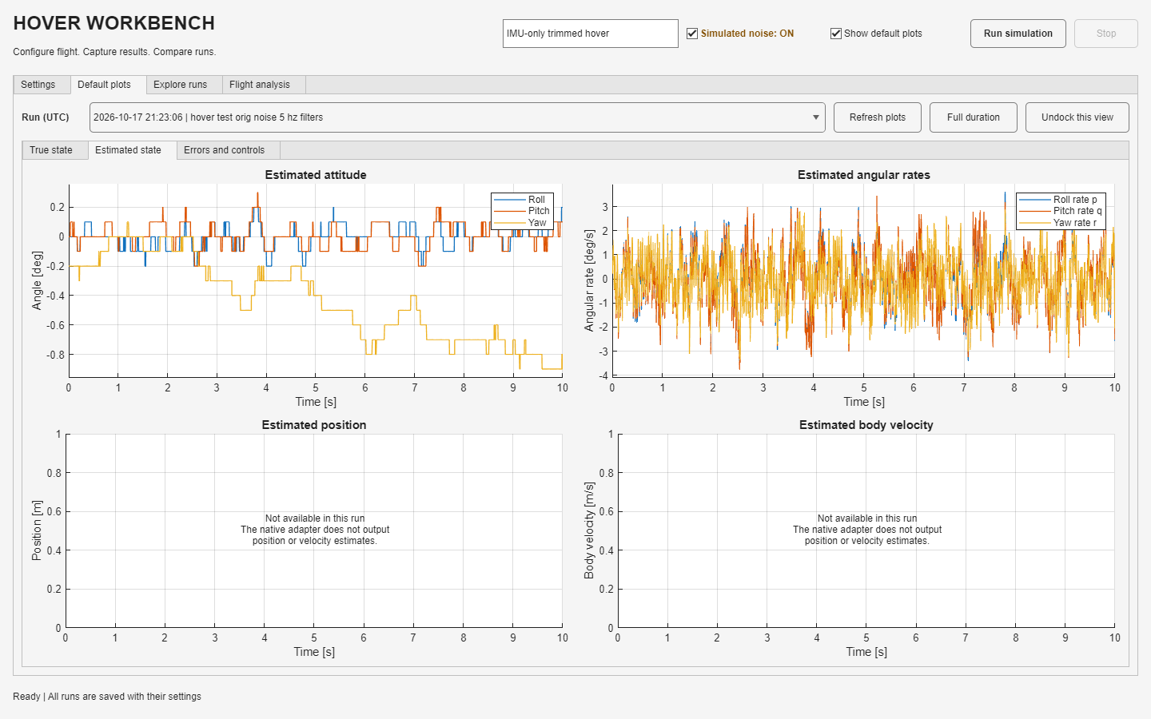
Estimated state and measurement detail
Feedback signals have different meanings from the true plant state
Estimated attitude
Roll, pitch and yaw come from the firmware attitude solution.
Estimated rates
The displayed rate feedback is the native filtered gyro signal.
Navigation
Position and velocity estimates are unavailable in the default case.
21
Notes:
Betaflight internally evolves a floating-point attitude solution, but this bridge exports native Euler values at 0.1-degree resolution. The steps visible in attitude plots are output quantization, not PWM attitude commands. The adapter reserves the first six estimate channels as zeros, and the default plots mark them unavailable rather than suggesting working navigation. Do not interpret those placeholder channels as valid zero position/velocity estimates in custom plots. The plots show the loaded saved run, not a rerun with the current editor settings. Estimator error means true angle minus estimated angle; that differs from true command-tracking error.
Source: UCI_FWMAV_Flight_Control_Simulation_and_Development, commit 1a25d4a.
- Betaflight/host/bf_host.c: makeResponse
- Betaflight/+bf/FlightController.m: stepImpl
- +hover/defaultPlots.m
- +hover/collectSignals.m

Slide 22
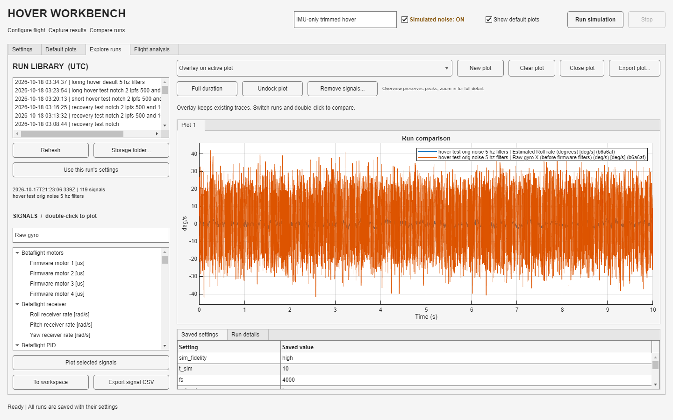
Explore runs and custom plots
Select a run, find a signal and double-click it
Choose a plot mode
Overlay, replace, or create a new plot before adding signals.
Inspect raw IMU
Search Raw gyro or Raw accel. Select SI or display units.
Manage the traces
Remove signals deletes selected traces. Clear plot removes all traces.
22
Notes:
The signal tree supports multiselect plus Plot selected signals. Double-clicking follows the active plot mode. Raw gyro offers rad/s and deg/s; raw accelerometer offers m/s² and g. The signal data is before firmware calibration/filtering. The example overlays raw gyro X with the filtered roll-rate feedback in the same units. Full-scale raw noise can visually hide smaller filtered motion; zoom or separate the plots. New plot creates a fresh axis and Close plot removes its tab. Missing raw logs in older records cannot be reconstructed, but older records that contain IMU logs gain the friendly names at load time.
Source: UCI_FWMAV_Flight_Control_Simulation_and_Development, commit 1a25d4a.
- HoverWorkbenchController.m: buildExplorer, signalDoubleClick, plotSignals, removePlotSignals
- +hover/addImuSignals.m
- +hover/loadRun.m

Slide 23
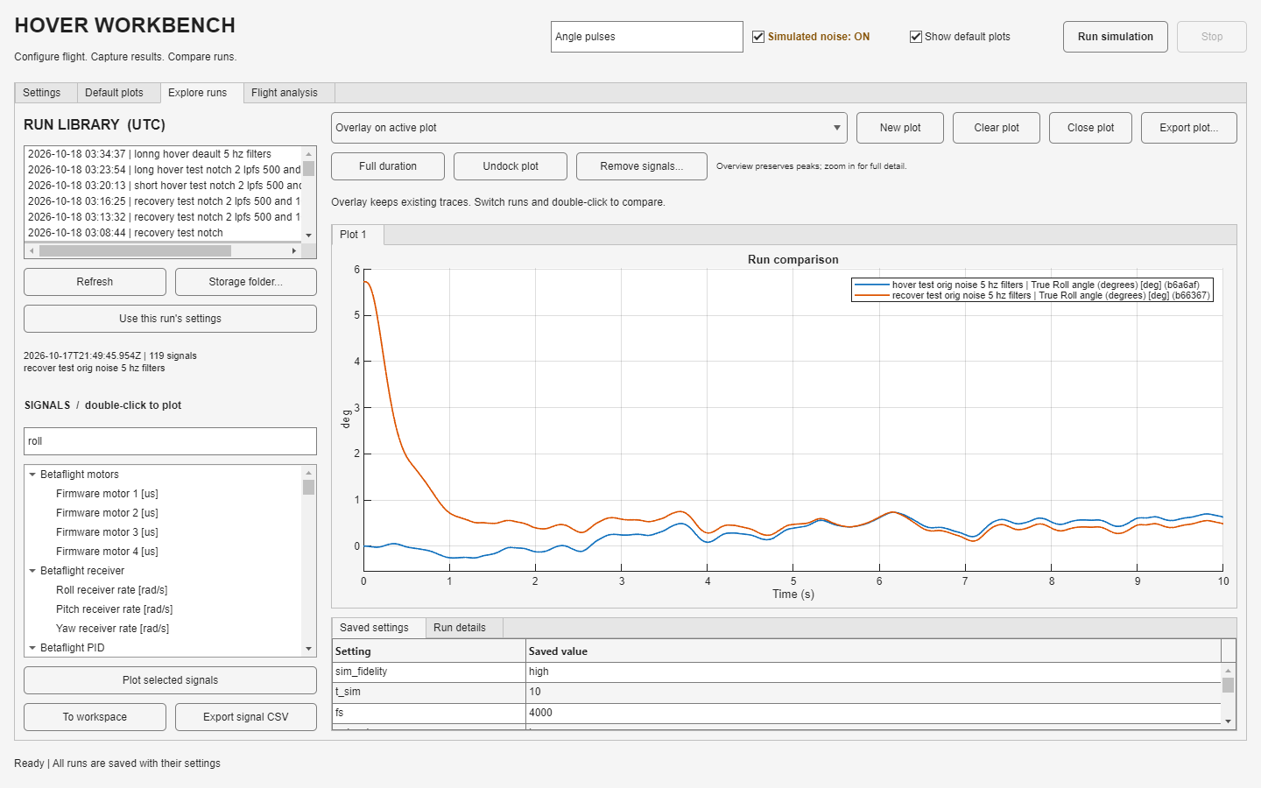
Comparing saved runs
Overlay traces while keeping each run’s identity and settings
First run
Select a run and add the signal to an empty plot.
Second run
Keep Overlay active, select another run and add its matching signal.
Saved settings
Use the saved settings to explain differences in the response.
23
Notes:
The screenshot illustrates the mechanics with a level-hover and recovery run, so it is not a controlled comparison of one gain change. For a tuning comparison, hold initial state, reference, duration, seed and plant settings constant. Change one parameter family, then repeat. Legends identify run and signal. Loading another run does not erase existing overlays. Use this run’s settings explicitly copies saved inputs into the editor for a future simulation; simply selecting a run does not change the next-run configuration. Match signal units and time bases, especially when overlaying raw and display channels.
Source: UCI_FWMAV_Flight_Control_Simulation_and_Development, commit 1a25d4a.
- HoverWorkbenchController.m: activateRecord, plotSignals, useRunSettings
- +hover/loadRun.m
- Screenshots: 21-explore-comparison.png

Slide 24
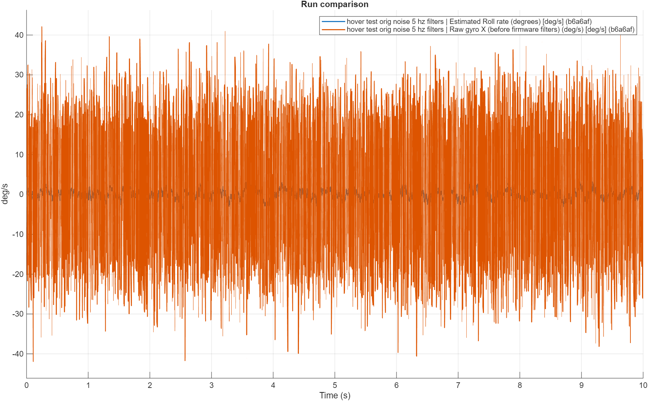
Zoom, undock and export
The displayed overview retains access to the complete logged samples
Zoom for detail
A short time window shows the original samples in that interval.
Undock plot
Open an independent MATLAB figure outside the app.
Export the result
Export a figure, CSV signals, or the run and timeseries to the workspace.
24
Notes:
Home and Full duration restore the loaded data extent. Overview rendering reduces only the number of drawn points and preserves extrema. Undocked snapshots retain the original samples and remain usable after selecting another run or closing the app. Default plots offers Undock this view, Explore offers Undock plot, and Flight analysis offers Undock plots. To workspace exports hoverRun and selected timeseries in hoverSignals. Export signal CSV preserves each selected signal’s own time vector; a common resampling grid is not required. Large files can still take time to load/save.
Source: UCI_FWMAV_Flight_Control_Simulation_and_Development, commit 1a25d4a.
- +hover/displaySamples.m
- +hover/refreshPlot.m
- +hover/undockPlots.m
- HoverWorkbenchController.m: exportWorkspace, exportCSV, exportPlot

Slide 25
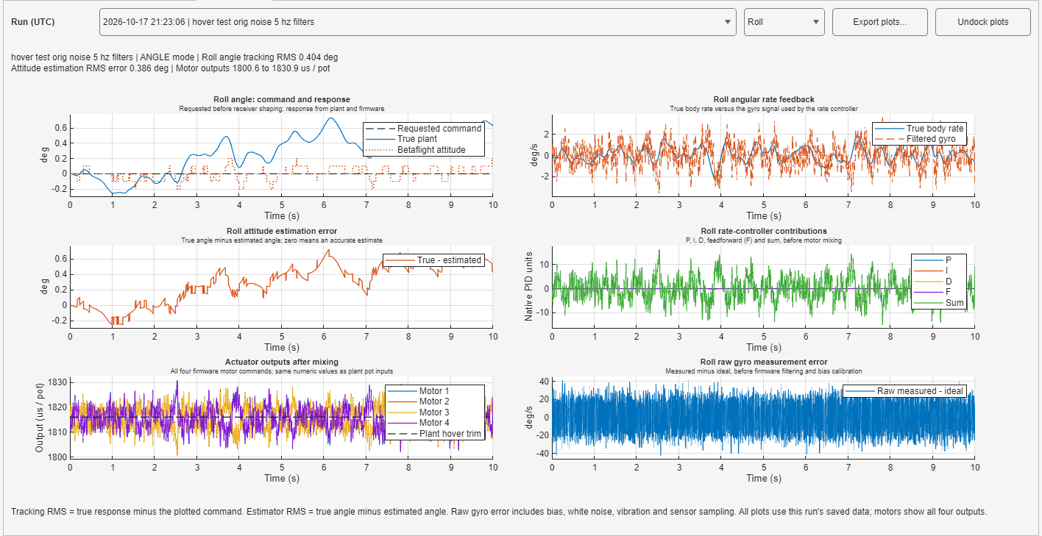
Flight analysis
A saved-run view of tracking, estimation, control effort and sensor error
25
Notes:
Choose the saved run and Roll/Pitch/Yaw from the top bar. The selected axis applies to tracking, attitude error, PID terms and raw gyro error; motor output always shows all four channels. Every panel includes its inputs and units. Home restores full duration. Export plots writes the group to PNG/PDF; Undock plots opens independent axes. The saved hover screenshot shows 10 s of the user’s 5 Hz filter experiment. The page uses the run’s saved variables and signals, never current editor values.
Source: UCI_FWMAV_Flight_Control_Simulation_and_Development, commit 1a25d4a.
- +hover/plotFlightAnalysis.m
- HoverWorkbenchController.m: drawFlightAnalysis, exportFlightAnalysis
- Screenshot: 13-flight-analysis.png

Slide 26
What the six analysis panels mean
Panel | Question it answers | Units
Command and response | How closely does the true motion follow the requested command? | deg or deg/s
Rate feedback / attitude | How does the other motion view compare with firmware feedback? | deg/s or deg
Attitude estimation error | How far is the estimate from truth? Error = true − estimated. | deg
Rate-controller contributions | How much do P, I, D and F contribute before mixing? | Native PID units
Actuator outputs | What commands reach the four motors relative to hover trim? | µs / pot
Raw gyro measurement error | How far is the measured gyro from ideal before firmware filtering? | deg/s
Tracking RMS compares truth with command. Estimator RMS compares truth with estimate.
26
Notes:
ANGLE roll/pitch track angle; RATE and yaw track angular rate. Requested physical commands precede native receiver shaping. Raw receiver mode can use logged native receiver-rate commands. The second panel switches to rate feedback in ANGLE roll/pitch and attitude in rate/yaw cases. The attitude error wraps at ±180 degrees. Whole-run RMS is weighted by elapsed time and includes release/command transients. PID sum appears alongside P/I/D/F in native units, not torque or direct ESC pulses. Motor range is independent of the selected axis and excludes the constant trim reference from its metric. Raw gyro error includes bias, white noise, vibration and sampling effects. Missing older logs receive a clear unavailable message.
Source: UCI_FWMAV_Flight_Control_Simulation_and_Development, commit 1a25d4a.
- +hover/plotFlightAnalysis.m
- +hover/collectSignals.m

Slide 27
Presets and saved simulation data
Settings stay attached to the results they produced
Save preset...
Every completed run
Stores a reusable workbench configuration.
Load preset restores it for a later run.
Saves settings, signals and provenance
in a unique folder in the results library.
File in each run folder | Contents
settings.json | Portable simulation and firmware input settings
metadata.json | Run label, status, notes, timestamps and source hashes
run.mat | Raw output, named time series, settings and derived variables
run.mat already uses HDF5-backed MATLAB v7.3. Source scripts and models are not copied.
27
Notes:
The default results library is 1_Hover Simulation Work/HoverWorkbench/data/. Storage folder on Explore selects another library. Run folder names use UTC timestamp and unique ID; repeated labels do not overwrite earlier data. The UI displays run times in UTC. Run archives are data/settings/metadata only, with source hashes for provenance rather than source-file copies. Existing records are independent of current presets. Use this run’s settings restores the selected record’s configuration to the next-run editor. Stop keeps partial data and marks the run stopped. The nested v7.3 record currently loads as a whole. Merely changing the filename extension to .h5 would not provide partial signal loading. Save JSON in Configurator stores firmware only, while Save preset in Workbench stores the complete simulation inputs.
Source: UCI_FWMAV_Flight_Control_Simulation_and_Development, commit 1a25d4a.
- +hover/saveRun.m
- +hover/savePreset.m
- +hover/loadRun.m
- HoverWorkbenchController.m: refreshLibrary, useRunSettings, chooseDataRoot

Slide 28
A repeatable tuning workflow
A comparison is useful when the conditions are clear
Step | Action
Baseline | Load the complete hover example. Save the preset and run it with noise on.
Controlled change | Keep plant, initial state, reference, duration and seed fixed. Change one parameter family.
Response check | Use recovery or a small angle/rate sequence to expose settling, lag and overshoot.
Measurement check | Compare true motion, estimate error, raw IMU and motor output. Smooth plots alone do not prove accuracy.
Repeat and retain | Repeat with other noise seeds, then save the chosen preset with descriptive notes.
28
Notes:
Use small, unsaturated perturbations first so the torque-gain conversion remains meaningful. The converted PI baseline is a starting point for this simulated plant. More aggressive filtering can make a signal look smoother while adding delay. Keep estimator gains separate from rate PID gains. If the true vehicle tilts while the firmware thinks it is level, inspect estimator error and sensor assumptions before raising rate P. If the firmware remains unarmed, check calibration, receiver pulse ranges and mode mapping. If behavior changes after loading a preset, inspect its saved native filters; older user presets retain their own values.
Source: UCI_FWMAV_Flight_Control_Simulation_and_Development, commit 1a25d4a.
- Betaflight/README.md: gain conversion and fidelity boundaries
- +hover/flightExample.m
- +hover/plotFlightAnalysis.m

Slide 29
Interpreting the limits of this build
The default case tests attitude control at fixed throttle
Observation or option | How to interpret it
Position or height drifts | There is no altitude/position feedback in the IMU-only example.
Yaw drifts | The default plant has zero yaw authority and no absolute heading sensor.
Attitude appears stepped | Exported Euler angles have 0.1° resolution. Internal attitude remains floating point.
A hardware setting exists | The CLI catalog includes features whose hardware inputs may be absent.
An advanced sensor field changes | Bandwidth affects noise power. Legacy resolution fields do not change the host ADC scales.
Simulation takes longer than real time | Local process communication and solver work add overhead. Normal mode is required.
29
Notes:
These limitations describe this implementation, not every possible Betaflight simulation. Navigation sensor flags exist but are disabled by the example and not validated as navigation/rescue controllers. The nonlinear yaw dynamics currently hard-code zero yaw torque. Native host algorithms are upstream, but no CPU execution cost, interrupt contention, ESC protocol waveform, or RPM telemetry is modeled. Sensor noise/vibration are correlated across axes in the inherited setup. The physical Accel Bandwidth block is commented through and the GUI resolution fields derive legacy LSB values; the host sensor conversion uses the native gyro scale and 256-count/g accel scale. Ideal bench calibration assumes known bias. Flight results are simulation behavior, not a physical-aircraft tuning approval.
Source: UCI_FWMAV_Flight_Control_Simulation_and_Development, commit 1a25d4a.
- Betaflight/README.md: Fidelity boundaries
- Betaflight/host/bf_host.c
- lin_hover_sim/Accelerometer Model
- lin_hover_sim/Gyro Model
- +hover/buildVariables.m

Slide 30
Quick reference
The controls you will use most often
Task | Where to go
Configure the next flight | Settings > Run setup, Initial conditions, Reference command
Change native PID or firmware options | BETAFLIGHT CONFIGURATOR, then Apply to bfConfig
Change the active 5 Hz filters | Settings > Sensors and estimator
Inspect overall motion | Default plots > choose a state or error view
Make or compare custom plots | Explore runs > plot mode > double-click a signal
Restore a past configuration | Explore runs > Use this run’s settings
Analyze tracking and control effort | Flight analysis > select run and axis
Detailed references: HoverWorkbench/README.md and Betaflight/README.md
30
Notes:
The workbench README is located at 1_Hover Simulation Work/HoverWorkbench/README.md. The firmware integration, build instructions and limitations are in Betaflight/README.md. Betaflight/VALIDATION.md records historical tests with their exact configurations; results from older configurations are not current default benchmarks. The presentation refers to source commit 1a25d4a, pinned upstream Betaflight c78d9e7bd24ef60f4324dffde11df26c53d4f29f (2026.12.0-alpha). User-created presets and saved runs can differ from the shipped defaults. Screenshots are direct MATLAB exportapp/Simulink print captures, except the explicitly conceptual architecture illustration.
Source: UCI_FWMAV_Flight_Control_Simulation_and_Development, commit 1a25d4a.
- 1_Hover Simulation Work/HoverWorkbench/README.md
- Betaflight/README.md
- Betaflight/VALIDATION.md

