Slide 1
Optimizing Ready Meal Stock Management at Lotts & Co. Using Data Analytics
Morgane Tassoneiro - 2021327

Slide 2
Overview
Lost sales due to stockouts: When popular ready meals run out, customers experience dissatisfaction which can lead to competitors
Financial loss from overstock: Excess inventory of meals causes waste and additional storage costs.
Solution:
.
Data analytics to forecast demand: Historical sales data to predict demand.
Waste and availability: using predictive analyses to optimize stock level, minimise waste and guaranteeing customers satisfaction

Slide 3
SWOT Analysis
Weaknesses:
Frequent stockouts.
Overstock leading to waste.
Strengths:
High demand, strong brand.
Reliable suppliers.
Loyal customers.
Opportunities:
Stock alignment via analytics.
Real-time sales insights.
Threats:
Competitor efficiency.
Supplier delays.

Slide 4
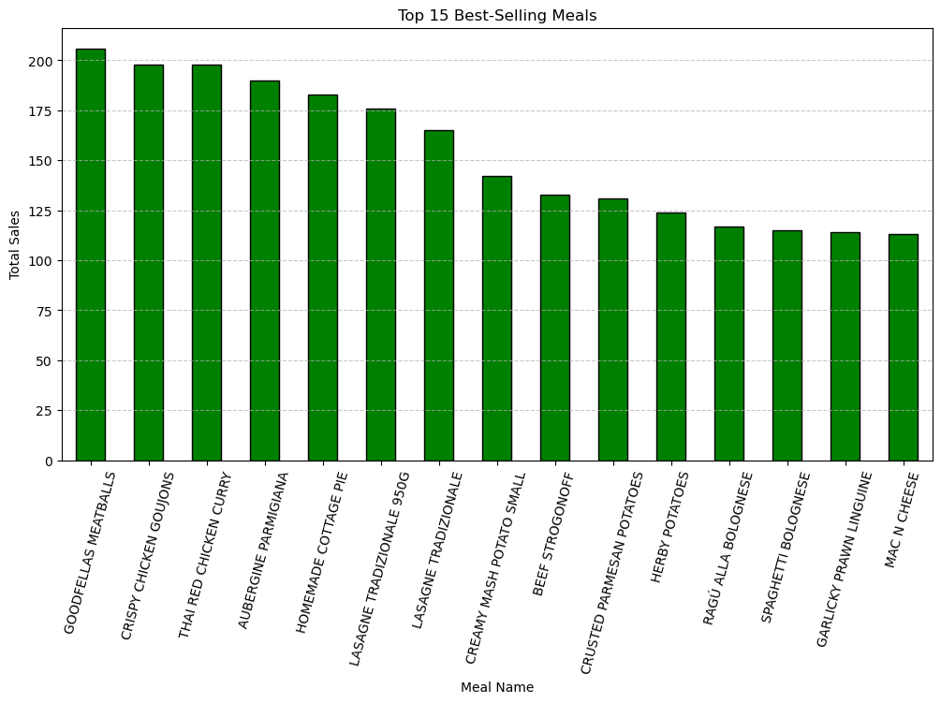
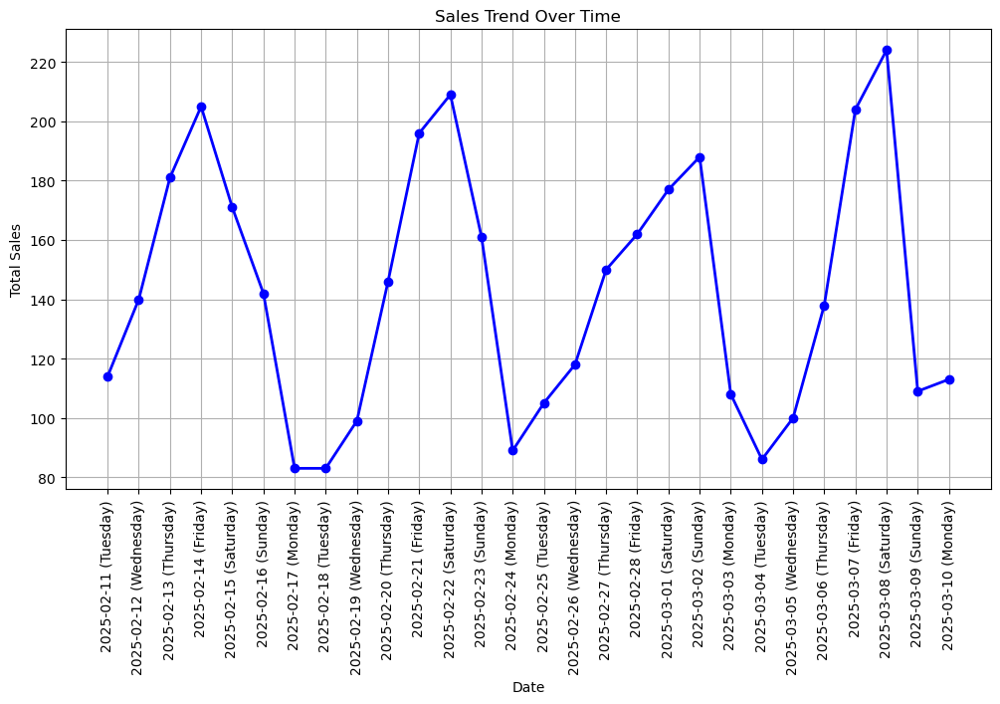
Key Data Insights & Strategic Impact
Peak Days:
Highest: Fri/Sat, Lowest: Mon/Tue
Action: Replenish before peak days.
Best-selling Meals:
Meatballs, Thai Curry, Goujons, Aubergine Parmigiana, Cottage Pie.
Action: Prioritize these meals.
Overstock & Waste:
Example: Teriyaki Beef Noodles.
Action: Adjust orders based on data.

Slide 5
Technology Selection
Chosen Technology: Python (Open Source)
Alternative: Excel (Proprietary)
The analyses of large datasets can be limited and challenging for Excel.
Require paid subscription for advanced features, and increases operation expenses as needs grow
Less effective in adapting to future business needs or integration with emerging technologies. (Gomes, 2024)
No license fees allow scalability at no extra cost as the business will grow.
Powerful, established libraries (Pandas, matplotlib) will handle large-scale, complex data analyses with efficiency. (Python, 2024)
Python is great for long-term growth to Lotts and Co. and has sophisticated data-driven decision-making without license cost or technology limitation

Slide 6
Conclusion
Data analytics has created a clear opportunity for improvement in inventory management of ready meals. Dynamic demand forecasting reduces waste considerably, preventing the costly consequences of stockouts, enhancing competitive advantage, and increasing customer loyalty.
Recommendations:
Use predictive analytics in Python to make weekly predictions of meal consumption with a focus on days like Fridays and Saturdays.
Training sessions for management / relevant staff to interpret the forecasts and handle inventory.
Month review of performance to improve performance metrics.

Slide 7
References
Corsten, D. & Gruen, T., 2004. Harvard Business Review. [Online] Available at: https://hbr.org/2004/05/stock-outs-cause-walkouts [Accessed 01 03 2025].
Czuczman, R., 2024. Nutritics. [Online] Available at: https://www.nutritics.com/en/blog/lets-say-no-to-food-waste-in-2023/ [Accessed 03 03 2025].
Python, 2024. Noble Desktop. [Online] Available at: https://www.nobledesktop.com/learn/python/transitioning-from-excel-to-python-for-data-analysis-key-differences [Accessed 2025 03 01]
Gomes, J., 2024. Layer. [Online] Available at: https://golayer.io/blog/excel/excel-limitations/ [Accessed 14 03 2025].

