Slide 1

Open Source Combustion Instability Low Order Simulator for Annular Combustors
(OSCILOS_ann)
Version 1.0
User Guide
Dr. Dong Yang* (main developer), Dr. Davide Laera, Prof. Aimee S. Morgans† (project lead)
Published under the BSD Open Source license
Programmed with MATLAB 2017a First released on 29 Dec, 2018 Website: http://www.oscilos.com/ Contact: *d.yang13@imperial.ac.uk and † a.morgans@imperial.ac.uk

Slide 2
What is OSCILOS_ann?
OSCILOS is an “Open Source Combustion Instability Low-Order Simulator”. It is written in Matlab®/Simulink®.
OSCILOS_ann is the version for simulating annular-shaped combustors. It is written in in Matlab®. A simpler version (OSCILOS_long) for longitudinal combustors can be found at http://www.oscilos.com/.
OSCILOS_ann is based on a low order network approach. This means that a given combustion system is simplified geometrically into a network of connected modules, each module being either a thin annulus or a group of straight ducts of constant cross sectional area. Flames are modelled as discontinuities which induce a step change in the flow across them.
Each module contains a constant, uniform mean flow. If the mean flow is prescribed at the inlet, it can be inferred throughout the network by applying the flow conservation equations across module joins. The fuel and combustion efficiency or temperature ratio across all flames also needs to be prescribed.

Slide 3
What is OSCILOS_ann?
Within a given geometry module, the flow is taken to comprise the mean flow plus perturbations. The perturbations have four components: an acoustic wave propagating upstream, an acoustic wave propagating downstream, an entropy wave and a vorticity wave. The latter two advect with the mean flow.
Flow perturbations in each module are taken to be modelled as the sum of a finite number of circumferential wave components.
The response of the flame to acoustic waves is captured via a flame model. Flame models ranging from linear n-τ models to non-linear flame describing functions, either defined analytically or fitted from experimental / CFD data, can be prescribed.
A variety of inlet and exit acoustic boundary conditions are possible, including open, closed, choked and user defined boundary conditions.

Slide 4
Who is developing OSCILOS_ann?
OSCILOS_ann is being developed by Prof. Aimee S. Morgans, Dr. Dong Yang and co-workers in the Department of Mechanical Engineering, Imperial College London, UK. See details at: http://www.oscilos.com/
The latest version of OSCILOS_ann is available from our Github repository: https://github.com/MorgansLab/
Contributions are welcome and can be submitted with GitHub pull request. These will be reviewed by the team.
Required Matlab toolbox: Optimization Toolbox

Slide 5
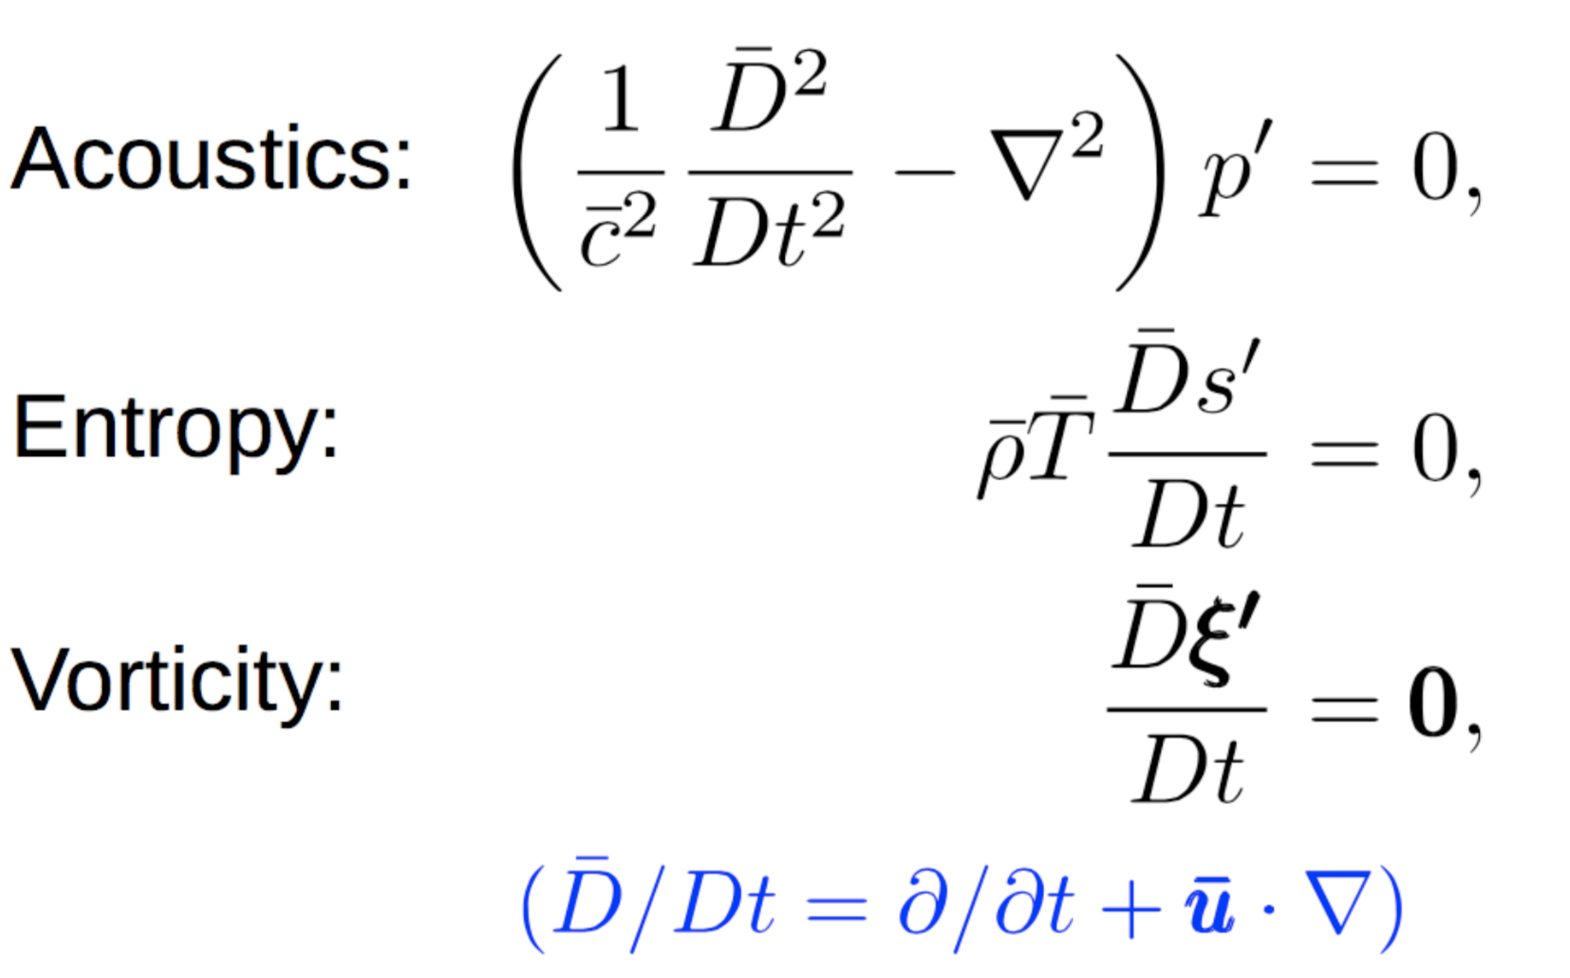
Underpinning theory
The system is geometrically represented as a network of connected modules, annular or cylindrical in shape. A mean flow is assumed in the longitudinal direction. The mean flow within a given module is uniform and constant.
Flow perturbations are assumed small compared to the mean flow. Flow perturbations in each module are comprised of acoustic, vorticity and entropy waves [1] (See Fig.1).
Figure 1, Perturbations in a thin annular duct with uniform low Mach number mean flow.

Slide 6
Underpinning theory
Version 1.0 performs frequency-domain calculations. Time-domain calculations may be included in later versions.
The frequencies relevant to combustion instability are usually low. This means that acoustic radial modes are “cut-off” [1]. We then only need to consider acoustic waves which propagate longitudinally (planar waves) and circumferentially (azimuthal waves) within each annular module (Fig. 1). Within cylindrical modules, only longitudinal planar waves propagate. Within each annular module, we represent fluctuations as a sum of spinning circumferential waves with mode number n (this capturing periodicity around the circumference) and truncate at mode N.

Slide 7
Underpinning theory
The spatial extent of any flames is assumed small compared to the fluctuation wavelengths. Flames then act as a spatial “impulse function” providing heat release rate to the flow. In typical annular arrangements as in Fig 2, the heat release rate occurs at the outlet of each burner.
OSCILOS requires the “flame model” – the way in which the flame responds to acoustic excitation – to be prescribed. Flames are taken to respond to the normalised longitudinal velocity fluctuation at the outlet of the relevant burner. The flame model can be prescribed through an analytical expression or through experimental or CFD “flame transfer function” or “flame describing function” data. Note that a nonlinear flame model is needed to capture saturation into limit cycle oscillations.
The number of flames (or, equivalently, premix ducts or burners), D, is assumed to be larger than (2N+1).
Acoustic dampers, such as Helmholtz resonators and perforated liners, are not included in Version 1.0 (they are included in OSCILOS_long).

Slide 8
Example thermoacoustic network representation [2]:
Represent geometry as a network of modules: here an annular plenum connected by cylindrical premix ducts to an annular combustor.
In annuli, represent waves as sum of circumferential components. In cylinders, only longitudinal (n=0) component exists.
Figure 2, Schematic of annular system, comprising a plenum connected by D burners with flames at their outlets to an annular combustor

Slide 9
Example thermoacoustic network representation [2]:
To link flow perturbations between modules:
N.B. All conservation equations can be “linearised” due to the small fluctuations
Apply the inlet and outlet acoustic boundary conditions.
Across flow contractions, apply mass conservation, energy conservation and the isentropic condition. Assume that the longitudinal flow perturbation fluxes between (ψ_{d}-π/D) and (ψ_{d}+π/D) just ahead of the premix duct inlet enter the d^{th} duct.
Across flow expansions, apply mass conservation, longitudinal momentum balance and energy conservation. Momentum balance can account for mean flow stagnation pressure losses across the expansion. Assume the longitudinal perturbation fluxes just before the d^{th} burner outlet match those between (ψ_{d}-π/D) and (ψ_{d}+π/D) just after the premix duct exit.
Across the flame, apply conservation of mass, longitudinal momentum, circumferential momentum, and energy. Also apply the prescribed flame models.

Slide 10
Two model versions [2]:
Linearly uncoupled model: if all burners are identical and have identical linear flame models, circumferential modes are uncoupled and behave independently. Then for each n:
where is the n^{th} component wave strength at the inlet. The system transfer matrix, M_{i2o}, which is 1x1 now, depends only on the complex angular frequency ω.
Nonlinearly coupled model: if nonlinear flame models are used or if the burners/flames differ around the circumference, different circumferential modes, n, are coupled across the flames (the matrix is used to obtain velocity perturbations just before the d^{th} flame).
where .
M_{i2o}, now depends on λ and ω.
Figure 3, Schematic of the matrix system. Waves in black are reflected waves from either end of the system.

Slide 11
Using the code:
System configuration. This needs to be set up in ./System_setup/System_step.m. It includes combustor geometry, acoustic boundary conditions, inlet mean flow parameters, mean temperature jump across the flame, and flame models.
The mean radius is currently assumed the same for all annular ducts. The only cylindrical ducts currently permitted are those which connect annular ducts.
Three example acoustic boundary conditions (“open”, “closed”, “choked”) are provided. User-defined boundary conditions can be incorporated in ./Subprogram/Fcn_Oscillation/Fcn_DetEqn_Linear.m or Fcn_DetEqn_NonLinear.m.

Slide 12

Using the code:
System configuration
An $n−τ$ model is given as an example for linear flame models, other user-defined linear flame models can be incorporated in ./Subprogram/Fcn_Oscillation/Fcn_DetEqn_Linear.m.
Two nonlinear flame models are used an examples for nonlinear flame models, other user user-defined analytical nonlinear flame models can be incorporated in ./Subprogram/Fcn_Oscillation/Fcn_flame_model.m.
FDF (Flame Describing Function) data obtained from experiment or CFD can also be incorporated into ./Subprogram/Fcn_Oscillation/Fcn_flame_model.m by interpolating between the data points in both the frequency and perturbation amplitude directions.

Slide 13
Using the code:
Setting up the calculation. This is done in ./Main.m. It includes setting the frequency and growth rate ranges, and choosing between the linearly uncoupled model solver and the nonlinearly coupled model solver.
For the linearly uncoupled model:
The circumferential wave number, n, (CI.setup.n) to be analysed needs to be given.
The scan range for the frequency and growth rate should be set in CI.EIG.Scan.FreqMin, FreqMax, GRMin, and GRMax.
The numbers of (frequency, growth rate) initial guesses within the above scan range needs to be prescribed in CI.EIG.Scan.FreqNum and GRNum.

Slide 14
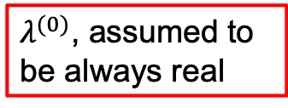
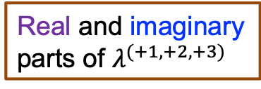
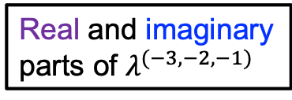
Using the code:
Setting up the calculation
The nonlinearly coupled model
For the modal expansion, the modal truncation number, N, should be given. This should satisfy (2N+1) < D.
For a given combustor configuration and nonlinear flame model, each thermoacoustic mode will evolve with oscillation amplitude to exhibit a range of frequencies and growth rates. The method used to resolve a given mode is to prescribe the targeted growth rate (CI.fixed_growthrate) and to search for the corresponding frequency and oscillation amplitude. If the growth rate chosen is not in the range of solutions for that mode then no solution may be found.
An initial guess of the mode frequency (CI.f_iniguess) and the strengths of all the modal components (see example below) needs to be given.
e.g. CI.lambda_iniguess = [0, 0, 3.2, 0, 0, 0, 6.9, 3.2, 0, 0, 0, 0, 0]
Real and imaginary parts of $λ^{(−3,−2,−1)}$
$λ^{(0)}$, assumed to be always real
Real and imaginary parts of $λ^{(+1, +2, +3)}$

Slide 15
Using the code:
Results
The linearly uncoupled model
A contour plot over the frequency and growth rate scan range set up in 2) is generated. The resolved thermoacousic modes correspond to the locations where the function (Fcn_Det_Linear) equals zero, using all of the initial guesses set in 2).
A “Mode_number” from the resolved thermoacoustic modes is chosen. A plot of its longitudinal pressure and velocity mode shape at a given circumferential angle (“Angle2plot”) is generated. As the linearly uncoupled method yields only longitudinal and circumferentially spinning modes, the mode strength does not vary with “Angle2plot”.

Slide 16
Using the code:
Results
The nonlinearly coupled model
A plot of the longitudinal pressure and velocity mode shape of selected modal component(s) (“n_2plot”) at a given circumferential angle (“Angle2plot”) is generated. Note that some modes may have a main circumferential modal component, n, such as longitudinal or spinning modes, but others may have multiple modal components, such as standing or slanted modes.
The overall pressure and velocity perturbations at each of the burner outlets (just ahead of the flames), and the overall heat release perturbation for each flame are also plotted.

Slide 17
Using the code:
Results
The nonlinearly coupled model
For the resolved mode, the evolution of its frequency and growth rate with the strengths of its associated modal components is tracked. Starting with a growth rate of CI.fixed_growthrate. “Fcn_calculation_tracking_one_nonlinear_mode” tries to resolve the mode evolving towards a growth rate of “Stop_growth_rate”, this being given by the user. If it is not properly chosen, a mode with the “Stop_growth_rate” may not exist.

Slide 18
Some useful tips:
For the nonlinearly coupled model, for the prescribed growth rate, if the initial guess of frequency and modal strengths are not close to a mode solution of the system, the solver may not be able to find a solution.
In order to ensure that a linearly unstable mode can be tracked, it is suggested to first identify its location using the linearly uncoupled model with a linear flame model deduced from the limit of the nonlinear flame model at small amplitudes. Following this, the nonlinearly coupled model (with nonlinear flame model) should find an unstable mode nearby, with a slightly lower growth rate, similar frequency, and small modal strengths. Finally “Fcn_calculation_tracking_one_nonlinear_mode” can be used to find its corresponding limit cycle [2,3].

Slide 19
Some useful tips:
For the nonlinearly coupled model, if the system parameters are changed too much then the mode solution may be too different to be found using the previous solution as an initial guess.
The change to the system parameters should then be split into smaller changes so that the mode solution of each step can be found using the previous step results as an initial guess.
The default case given with the code is the same as that studied in [2]. It is suggested to start using the code by repeating calculations in [2].

Slide 20
References:
[1] A. P. Dowling, S. R. Stow, Acoustic analysis of gas turbine combustors, J. Propul. Power 19 (2003) 751–764.
[2] D. Yang, D. Laera, A. S. Morgans, A systematic study of nonlinear coupling of thermoacoustic modes in annular combustors, J. Sound. Vib. 456 (2019) 137–161.
[3] S. R. Stow, A. P. Dowling, Low-order modelling of thermoacoustic limit cycles, ASME Turbo Expo (2004), paper GT2004–54245.

