Slide 1
TruLabel
An Agentic AI System for Verifying Product Marketing Claims
Against Credible Evidence
Morgan John | Roll No: [FILL IN]
MCA, CHRIST (Deemed to be University), Delhi NCR Campus
GitHub: [LINK — FILL IN]

Slide 2
THE PROBLEM
Marketing gimmicks make cheap products look premium
A product marketed as a “healthy snack” may contain more sugar than an actual candy.
“100% Natural”, “No Added Sugar” and “Immunity Boosting” are used loosely, often without basis.
Existing consumer tools (reviews, generic ingredient databases) don't check the marketing itself against the actual data.
Real example pattern
CCPA has fined brands for claiming “100% Natural” on products containing other additives — documented, real cases exist.
2

Slide 3
OBJECTIVES
What the project sets out to do
1
2
3
4
Automatically extract checkable claims from marketing text
Verify claims against credible ingredient/nutrition data
Produce a transparent, evidence-cited accuracy score
Compare products and recommend better alternatives
SDG Alignment
SDG 12 — Responsible Consumption and Production
Primary: helps consumers verify claims before purchase.
SDG 3 — Good Health and Well-being
Secondary: verifies health/wellness claims specifically.
3

Slide 4
PROPOSED SYSTEM
TruLabel: an agentic verification pipeline
A user searches for a product. Instead of just showing reviews, TruLabel autonomously investigates the product's own marketing claims — checking them against real ingredient data, regulatory rules, and known misleading-advertising cases — and returns a transparent, evidence-backed verdict.
Single-product verification
Compare Mode
Recommend Mode
Extract, check, and score a product's claims
See multiple products' verdicts side by side
Discover a genuinely better-scoring alternative
4

Slide 5
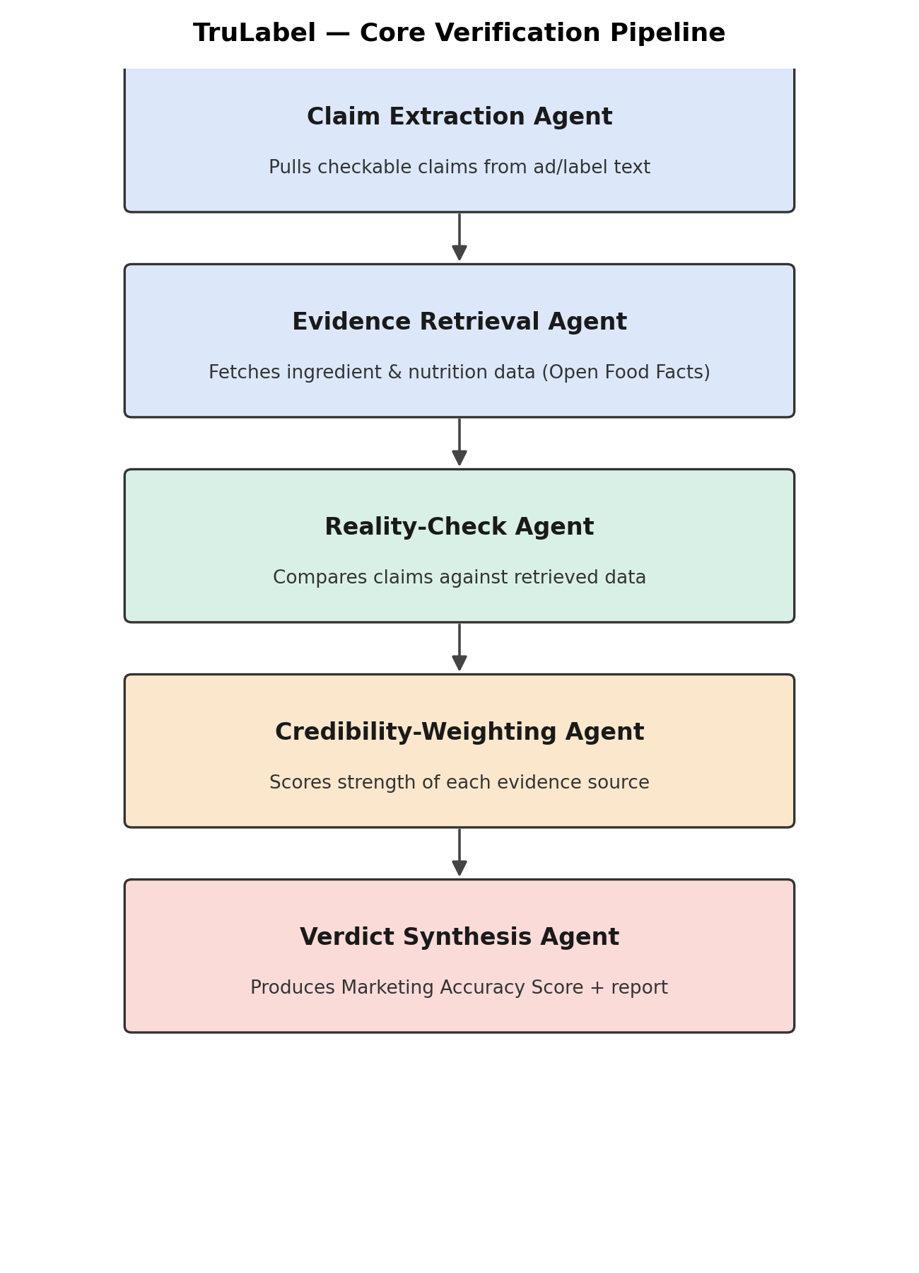
HOW IT WORKS
Core verification pipeline — five agents
Claim Extraction
Pulls specific claims from ad text
Evidence Retrieval
Fetches real ingredient/nutrition data
Reality Check → Credibility Weighting → Verdict Synthesis
Cross-checks, weighs evidence, produces the final score
5

Slide 6
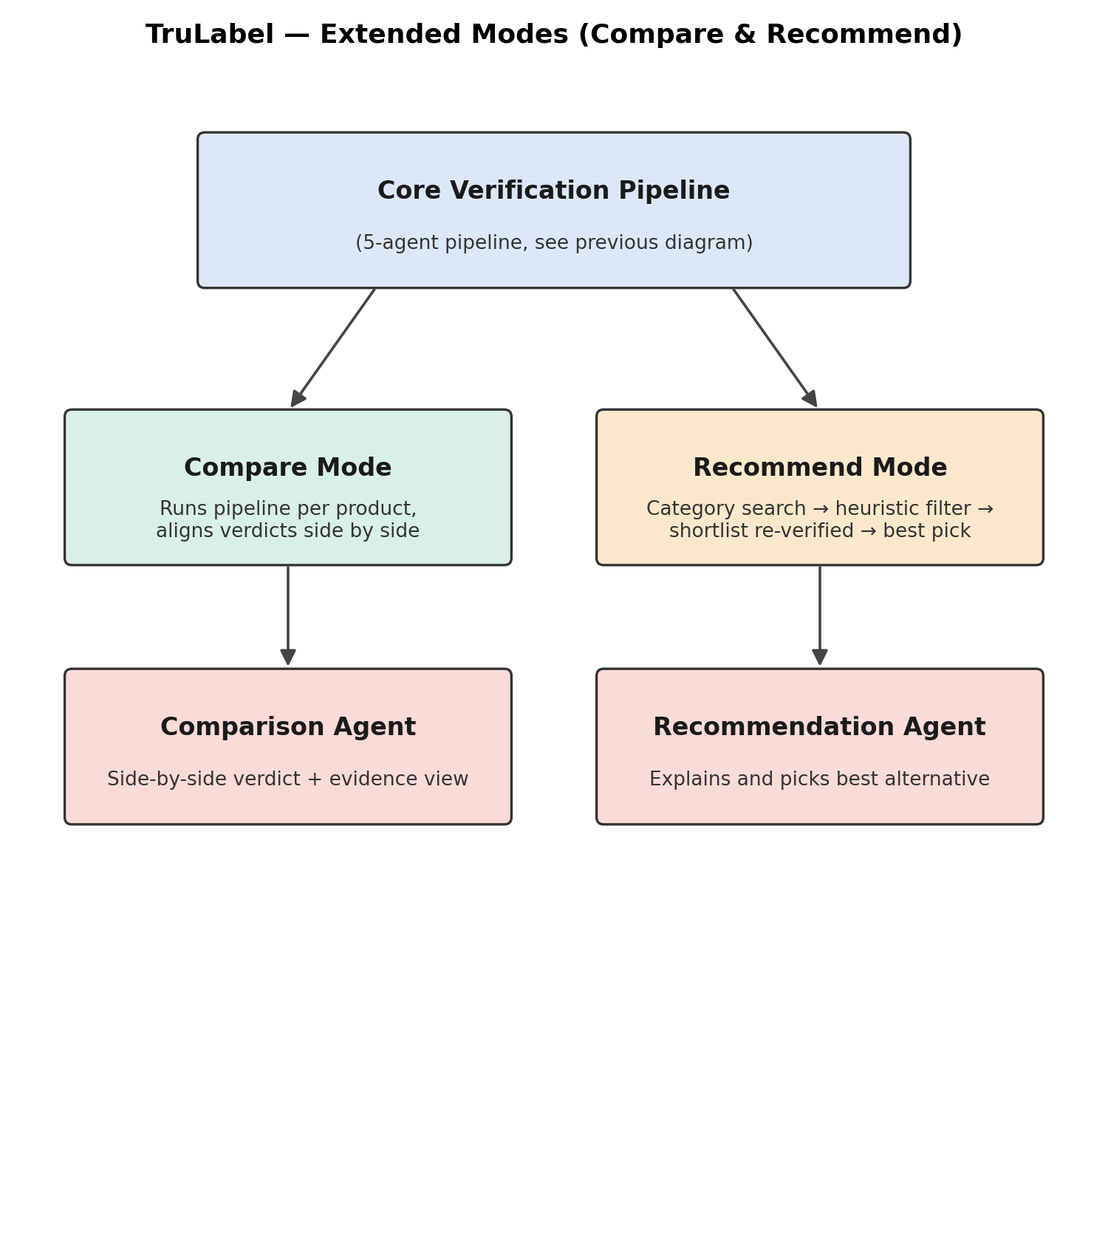
KEY FEATURES
Compare Mode & Recommend Mode
Compare Mode
Runs the same pipeline per product and aligns the verdicts side by side.
Recommend Mode
Filters an entire category cheaply first (no LLM cost), then runs full verification only on the shortlist — keeping it fast and affordable.
6

Slide 7
REQUIREMENTS
Key functional requirements
ID | Requirement
FR-3 | Extract checkable claims from marketing text
FR-4/5 | Retrieve and cross-reference ingredient/nutrition evidence
FR-7/8 | Compute Marketing Accuracy Score and present a report
FR-11 | Compare two or more products side by side
FR-13/14 | Filter and verify category alternatives, recommend the best
7

Slide 8
REQUIREMENTS
Key non-functional requirements
Performance
Usability
Report generated in 15–30 seconds
Plain-language output, no technical jargon
Reliability
Transparency
Graceful degradation if a data source is down
Every verdict traceable to its evidence source
8

Slide 9
SYSTEM DESIGN
Module breakdown
Frontend (React)
API Orchestrator (FastAPI)
Claim Extraction Agent
Evidence Retrieval Agent
Reality-Check Agent
Credibility-Weighting Agent
Verdict Synthesis Agent
Comparison Agent
Recommendation Agent
9

Slide 10
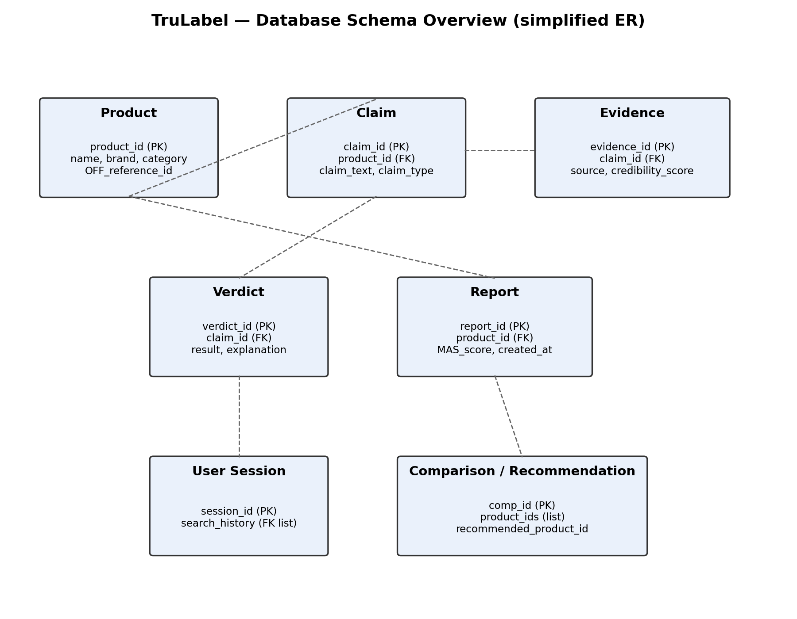
SYSTEM DESIGN
Database schema overview
Product
Claim
Evidence
Verdict
Report
10

Slide 11
TECHNOLOGY
Technology stack
Backend
Agent Orchestration
LLM
Python (FastAPI)
LangGraph / CrewAI
Claude / GPT API
Frontend
Database
Evidence Source
React
PostgreSQL
Open Food Facts API
11

Slide 12
Expected Impact
Helping consumers see past the marketing
A working, deployed system that verifies real product claims against real evidence
A validated scoring methodology, tested against known misleading-marketing cases
A foundation extendable beyond food — to cosmetics, supplements, and beyond
GitHub: [LINK — FILL IN]

