Slide 1

ES6 methods
Stephan Hug

Slide 2
Modernes JS
Array methods
Ternary operators
Arrow functions

Slide 3
Array methods
forEach
map
filter
sort

Slide 4
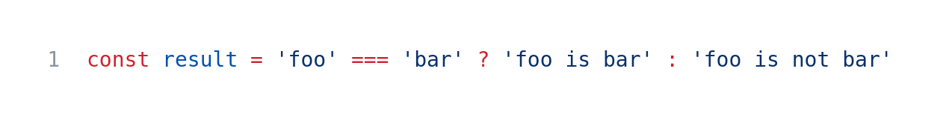
Ternary operator

Slide 5
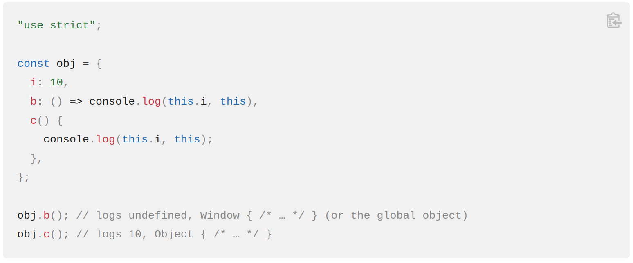
Arrow functions

Slide 6
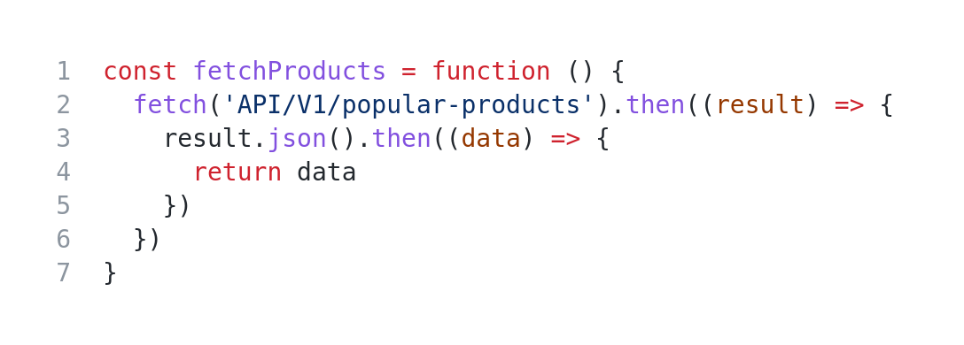
Async/await functions

Slide 7
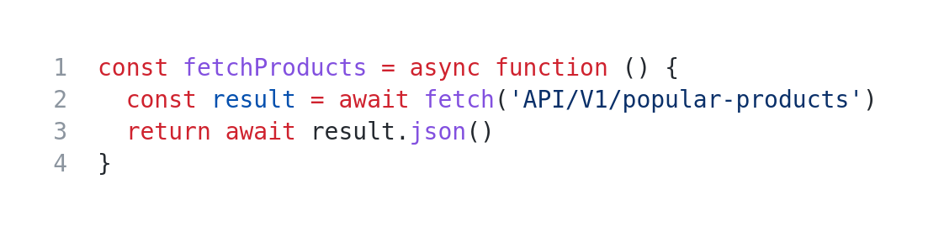
Async/await functions

