Slide 1
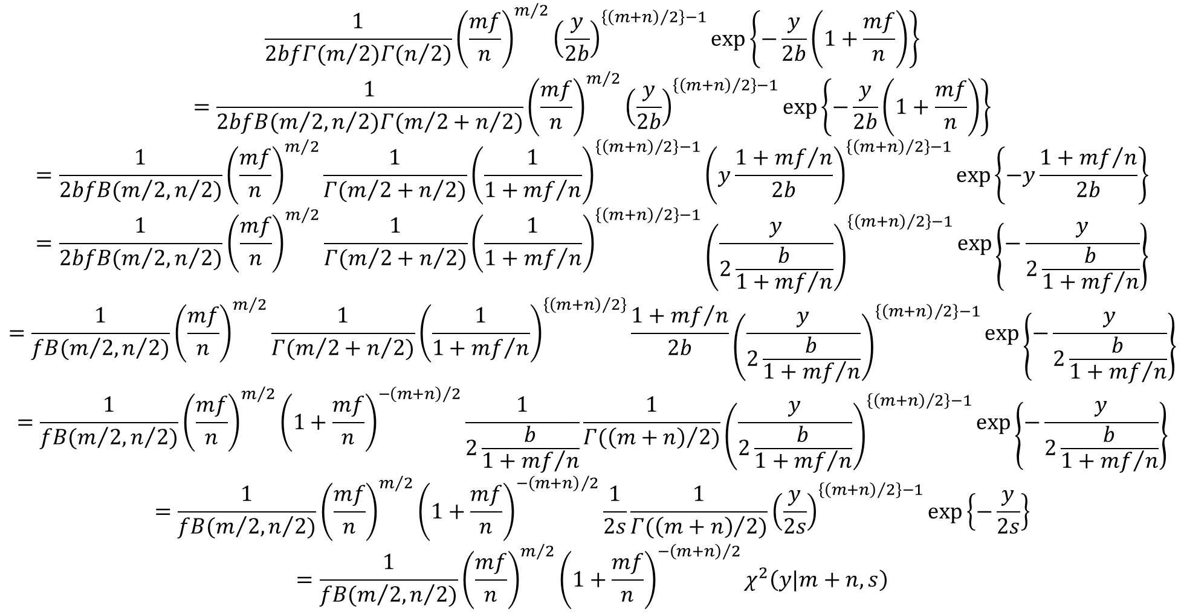
$$\frac{1}{2bfΓ(m/2)Γ(n/2)}{\left(\frac{mf}{n}\right)}^{m/2}{\left(\frac{y}{2b}\right)}^{\left\{{\left(m+n\right)}/2\right\}−1}exp\left\{−\frac{y}{2b}\left(1+\frac{mf}{n}\right)\right\}$$
$$=\frac{1}{2bfB(m/{2,n/2})Γ(m/2+n/2)}{\left(\frac{mf}{n}\right)}^{m/2}{\left(\frac{y}{2b}\right)}^{\left\{{\left(m+n\right)}/2\right\}−1}exp\left\{−\frac{y}{2b}\left(1+\frac{mf}{n}\right)\right\}$$
$$=\frac{1}{2bfB(m/{2,n/2})}{\left(\frac{mf}{n}\right)}^{m/2}\frac{1}{Γ(m/2+n/2)}{\left(\frac{1}{1+{mf}/n}\right)}^{\left\{{\left(m+n\right)}/2\right\}−1}{\left(y\frac{1+{mf}/n}{2b}\right)}^{\left\{{\left(m+n\right)}/2\right\}−1}exp\left\{−y\frac{1+{mf}/n}{2b}\right\}$$
$$=\frac{1}{2bfB(m/{2,n/2})}{\left(\frac{mf}{n}\right)}^{m/2}\frac{1}{Γ(m/2+n/2)}{\left(\frac{1}{1+{mf}/n}\right)}^{\left\{{\left(m+n\right)}/2\right\}−1}{\left(\frac{y}{2\frac{b}{1+{mf}/n}}\right)}^{\left\{{\left(m+n\right)}/2\right\}−1}exp\left\{−\frac{y}{2\frac{b}{1+{mf}/n}}\right\}$$
$$=\frac{1}{fB(m/{2,n/2})}{\left(\frac{mf}{n}\right)}^{m/2}\frac{1}{Γ(m/2+n/2)}{\left(\frac{1}{1+{mf}/n}\right)}^{\left\{{\left(m+n\right)}/2\right\}}\frac{1+{mf}/n}{2b}{\left(\frac{y}{2\frac{b}{1+{mf}/n}}\right)}^{\left\{{\left(m+n\right)}/2\right\}−1}exp\left\{−\frac{y}{2\frac{b}{1+{mf}/n}}\right\}$$
$$=\frac{1}{fB(m/{2,n/2})}{\left(\frac{mf}{n}\right)}^{m/2}{\left(1+\frac{mf}{n}\right)}^{−{\left(m+n\right)}/2}\frac{1}{2\frac{b}{1+{mf}/n}}\frac{1}{Γ({\left(m+n\right)}/2)}{\left(\frac{y}{2\frac{b}{1+{mf}/n}}\right)}^{\left\{{\left(m+n\right)}/2\right\}−1}exp\left\{−\frac{y}{2\frac{b}{1+{mf}/n}}\right\}$$
$$=\frac{1}{fB(m/{2,n/2})}{\left(\frac{mf}{n}\right)}^{m/2}{\left(1+\frac{mf}{n}\right)}^{−{\left(m+n\right)}/2}\frac{1}{2s}\frac{1}{Γ({\left(m+n\right)}/2)}{\left(\frac{y}{2s}\right)}^{\left\{{\left(m+n\right)}/2\right\}−1}exp\left\{−\frac{y}{2s}\right\}$$
$$=\frac{1}{fB(m/{2,n/2})}{\left(\frac{mf}{n}\right)}^{m/2}{\left(1+\frac{mf}{n}\right)}^{−{\left(m+n\right)}/2}χ^{2}\left(y|m+n,s\right)$$

