Slide 1
Programovanie
Arduino UNO cez registre (INT)

Slide 2
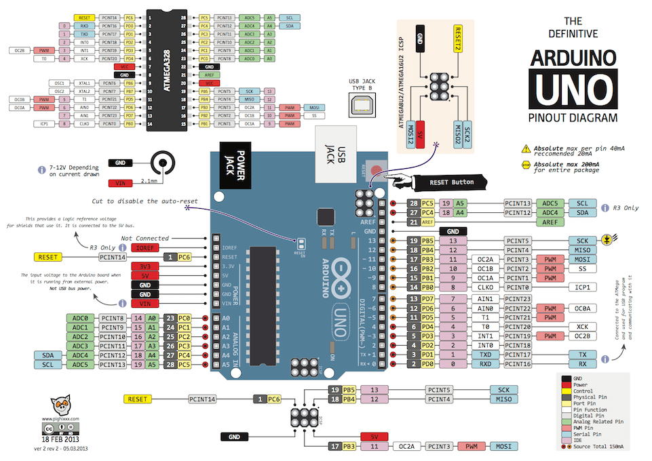
Arduino UNO a ATmega328p pinout

Slide 3
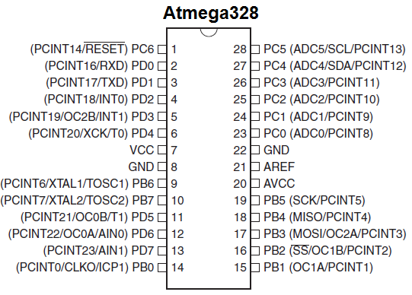
Arduino UNO a ATmega328p pinout

Slide 4
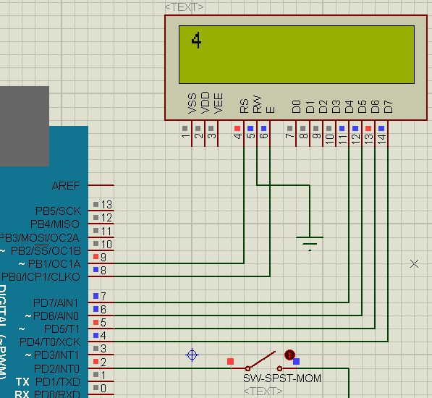
Schéma príkladu: LCD counter

Slide 5
Zdrojový kód príkladu: LCD counter (cez f*)
#include <LiquidCrystal.h>
LiquidCrystal lcd(9, 8, 7, 6, 5, 4);
volatile int cislo = 0;
void p()
{
cislo = 0;
}
void setup()
{
lcd.begin(16,2); pinMode(2,INPUT_PULLUP);
attachInterrupt(digitalPinToInterrupt(2), p, FALLING);
}
void loop()
{
cislo++;
lcd.setCursor(0,0);
lcd.print(cislo);
delay(1000);
}

Slide 6
Zdrojový kód príkladu: LCD counter (cez r*)
#include <LiquidCrystal.h>
LiquidCrystal lcd(9, 8, 7, 6, 5, 4);
volatile int cislo = 0;
ISR( INT0_vect )
{
cislo = 0;
}
void setup()
{
lcd.begin(16,2);
DDRD &= ~(1<<2);
PORTD |= 1<<2;
EIMSK |= 1<<INT0;
SREG |= 1<<7;
EICRA |= 1<<ISC01;
EICRA &= ~(1<<ISC00);
}
void loop()
{
cislo++;
lcd.setCursor(0,0);
lcd.print(cislo);
delay(1000);
}

Slide 7

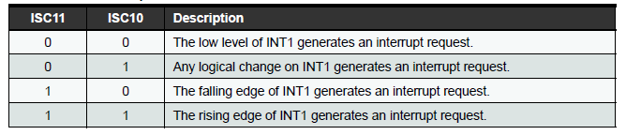
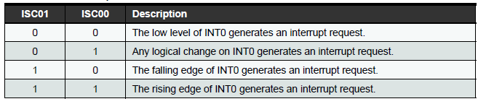
Registre pre INT0 a INT1

Slide 8



Registre pre INT0 a INT1

Slide 9
Vektory prerušení
1 Reset
2 External Interrupt Request 0 (pin D2) (INT0_vect)
3 External Interrupt Request 1 (pin D3) (INT1_vect)
4 Pin Change Interrupt Request 0 (pins D8-D13) (PCINT0_vect)
5 Pin Change Interrupt Request 1 (pins A0-A5) (PCINT1_vect)
6 Pin Change Interrupt Request 2 (pins D0-D7) (PCINT2_vect)
7 Watchdog Time-out Interrupt (WDT_vect)
8 Timer/Counter2 Compare Match A (TIMER2_COMPA_vect)
9 Timer/Counter2 Compare Match B (TIMER2_COMPB_vect)
10 Timer/Counter2 Overflow (TIMER2_OVF_vect)
11 Timer/Counter1 Capture Event (TIMER1_CAPT_vect)
12 Timer/Counter1 Compare Match A (TIMER1_COMPA_vect)
13 Timer/Counter1 Compare Match B (TIMER1_COMPB_vect)
14 Timer/Counter1 Overflow (TIMER1_OVF_vect)
15 Timer/Counter0 Compare Match A (TIMER0_COMPA_vect)
16 Timer/Counter0 Compare Match B (TIMER0_COMPB_vect)
17 Timer/Counter0 Overflow (TIMER0_OVF_vect)
18 SPI Serial Transfer Complete (SPI_STC_vect)
19 USART Rx Complete (USART_RX_vect)
20 USART, Data Register Empty (USART_UDRE_vect)
21 USART, Tx Complete (USART_TX_vect)
22 ADC Conversion Complete (ADC_vect)
23 EEPROM Ready (EE_READY_vect)
24 Analog Comparator (ANALOG_COMP_vect)
25 2-wire Serial Interface (I2C) (TWI_vect)
26 Store Program Memory Ready (SPM_READY_vect)

Slide 10
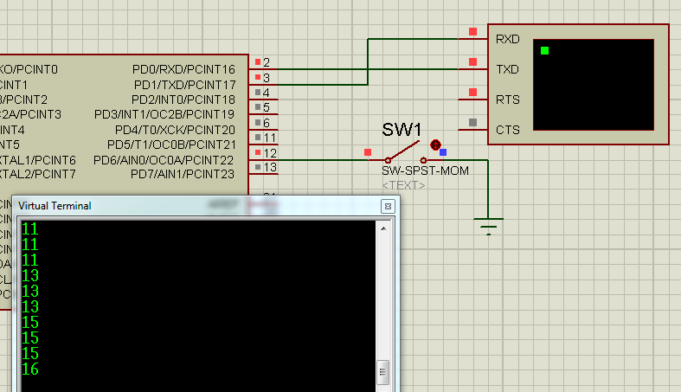
Schéma príkladu: Serial counter

Slide 11
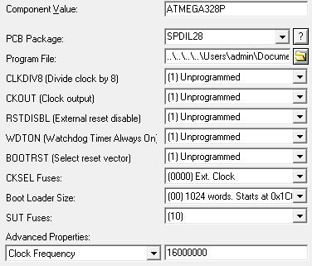
Schéma príkladu: Serial counter

Slide 12
Zdrojový kód príkladu: Serial counter (cez r*)
volatile int cislo = 0;
ISR( PCINT2_vect )
{
cislo++;
}
void loop()
{
Serial.println(cislo);
delay(100);
}
void setup()
{
Serial.begin(9600);
DDRD &= ~(1<<6);
PORTD |= 1<<6;
PCICR |= 1<<PCIE2;
SREG |= 1<<7;
PCMSK2 |= 1<<PCINT22;
}

Slide 13

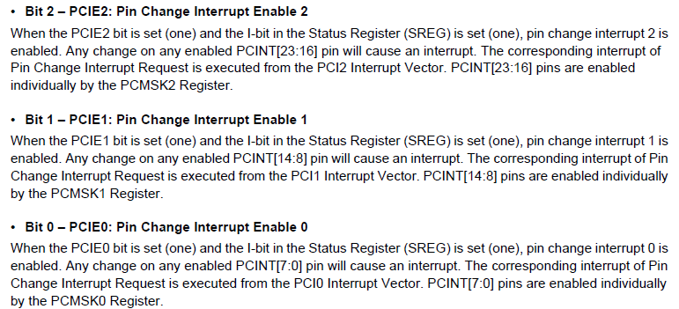
Registre pre Pin Change Interrupt

Slide 14




Registre pre Pin Change Interrupt

