Slide 1
Quantum computation
Density Matrix vs Stabilizer Formalism

Slide 2
Quantum systems
Introdurre sistemi quantistici, spazio hilbertiano, qubit, postulati valgono per A tecnologia
Preliminary knowledges
FINALE: Majorana I qubit topologici
Quantum systems
Description
Example
Pure states
Mixed states
Venus is the second planet to the Sun
It’s terribly hot, even hotter than Mercury
Its atmosphere is extremely poisonous
Mercury is the closest planet to the Sun
It’s the smallest one in the Solar System
This name has nothing to do with the metal
Earth is the third planet from the Sun
It’s the only one that harbors life
This is the planet where we all live on
Jupiter is a gas giant and the biggest planet
It's the fourth-brightest object in the night sky
It was named after a Roman god

Slide 3
Tecnologie realizzative a confronto
 | Ottica | Superconduttiva
Definition | Earth is the third planet from the Sun | Mercury is the closest planet to the Sun
Spin | One | Zero
Discovery | Paul Dirac | Peter Higgs
Particles | Vector boson | Scalar boson
Color charge | Color charged | Zero

Slide 4
Tecnologie realizzative a confronto
SCEGLIERE QUESTA O PRECEDENTE
Ottica
Mercury is the closest planet to the Sun and the smallest one in the Solar System
Venus has a beautiful name and is the second planet from the Sun. It’s terribly hot
Earth is the beautiful planet where we all live. It’s full of life
Superconduttiva
Saturn is a gas giant and has several rings. It's composed mostly of hydrogen
Neptune is the farthest planet from the Sun. It's also the fourth-largest object
Pluto is so small that it is no longer considered a planet, but a dwarf
A
B
C

Slide 5
Superposizione
Valutare se inserire questa slide o meno
Mercury
A
D
The Sun
Mercury is the smallest planet of the Solar System
The Sun is the star at the center of the Solar System
Jupiter
B
E
Venus
Jupiter is the fourth brightest object in the sky
Venus has a beautiful name and high temperatures
Saturn
C
F
Mars
It’s a gas giant composed of hydrogen and helium
Despite being red, Mars is actually a cold place

Slide 6
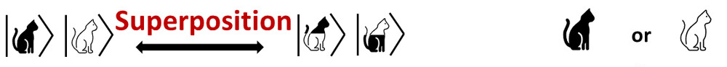
Decoherence
More about quantum field theory
Mercury
Decoerenza porta in stato misto che è insieme probabilistico
700
Mercury is the closest planet to the Sun and the smallest one in the Solar System
p₁
p₂
Venus
400
It’s terribly hot, even hotter than Mercury, and its atmosphere is extremely poisonous
Jupiter
100
It's the fourth-brightest object in the night sky. It was named after a Roman god
Follow the link in the graph to modify its data and then paste the new one here. For more info, click here

Slide 7
Bloch Sphere
Quando un sistema quantistico interagisce con l'ambiente, l'entanglement risultante può "mescolare" gli stati quantistici del sistema, portando a uno stato misto.
Tuttavia, gli stati misti possono anche sorgere per altri motivi, come l'incertezza nella preparazione del sistema.
Uno stato misto descrive un sistema quantistico la cui condizione è incerta, rappresentata da una combinazione statistica di stati puri.
La decoerenza, attraverso l'interazione con l'ambiente, "mescola" gli stati puri, portando alla formazione di uno stato misto.
Qubit: basic unit of quantum information
Pure states
Mercury is the closest planet to the Sun and the smallest one in the Solar System. This planet's name has nothing to do with the liquid metal
Mixed states
Stato misto rappresenta la nostra mancanza di conoscenza completa sullo stato del sistema.

Slide 8
Common quantum rapresentation
Models of atomic structure
Pure states
General
Ket
Density Matrix
Mercury is the closest planet to the Sun and the smallest one
Despite being red, Mars is actually a cold place. It's full of iron oxide dust

Slide 9
Common quantum rapresentation
Alternativa a slide precedente
Pure states
General
Ket
Density Matrix
Mercury is the closest planet to the Sun and the smallest one
Despite being red, Mars is actually a cold place. It's full of iron oxide dust

Slide 10
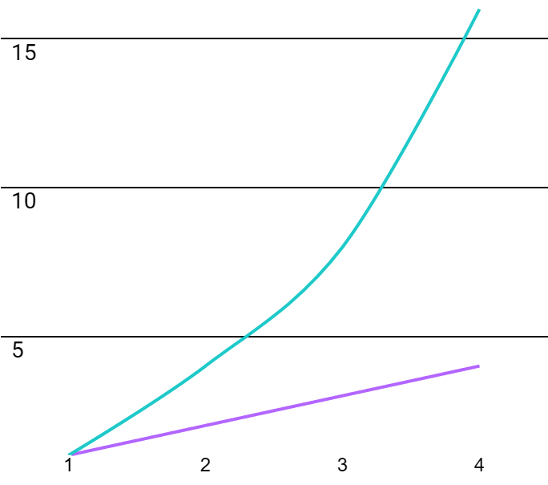
Multiple qubit systems
Crescita esponenziale vs lineare
Mercury
700
Mercury is the closest planet to the Sun and the smallest one in the Solar System
Venus
400
It’s terribly hot, even hotter than Mercury, and its atmosphere is extremely poisonous
STATE SPACE
Jupiter
100
It's the fourth-brightest object in the night sky. It was named after a Roman god
QUBIT / BIT

Slide 11
Density matrix exponential growth
Mi ricordano coupling map
Parlare crescita esponenziale density matrix
Costo computazionale elevato.
1
2
7
2x2
4x4
7x7
Neptune is the farthest planet from the Sun
Mercury is the closest planet to the Sun
Venus is the second planet from the Sun

Slide 12
Stabilizer formalism
+ aggiungere che stato stabilizzatore è anche uno stato che può essere generato tramite un circuito stabilizzatore
Descrizione del formalismo e unicità rappresentazione (polinomiale) stato con generatori dello stabilizzatore
A
200
C
400
Neptune
Saturn
It's the fourth-largest object by diameter
Saturn is a gas giant and has several rings
B
300
D
500
Earth
Venus
Earth is the third planet from the Sun
Venus is the second planet from the Sun

Slide 13
Comparition
Parlare anche di come si ottiene la rappresentazione tramite stabilizzatore (harder)
Overview (Parlare di cosa abbiamo fatto)
A
Venus
Venus is the second planet from the Sun
B
Mars
Despite being red, Mars is a cold place
C
Mercury
Mercury is the closest planet to the Sun
D
Jupiter
Jupiter is the biggest planet
E
Saturn
It’s a gas giant composed of hydrogen

Slide 14
Comparition
Overview (alternativa a slide precedente)
A
B
C
Neptune
Venus
Saturn
Neptune is the farthest planet from the Sun. It is the fourth-largest
Venus has a beautiful name and is the second planet from the Sun
Saturn is one of the biggest planets. It is composed of hydrogen

Slide 15
Simulation tools
Models of atomic structure
95%
75%
Mercury
Mars
Mercury is the closest planet to the Sun and the smallest one
Despite being red, Mars is actually a cold place. It's full of iron oxide dust
85%
65%
Venus
Jupiter
Venus has a beautiful name and is the second planet from the Sun
Jupiter is the biggest planet in the Solar System. It's the fourth-brightest object

Slide 16
Parlare di cosa abbiamo fatto nel notebook e quali confronti sono stati utilizza + eventuali risultati

Slide 17
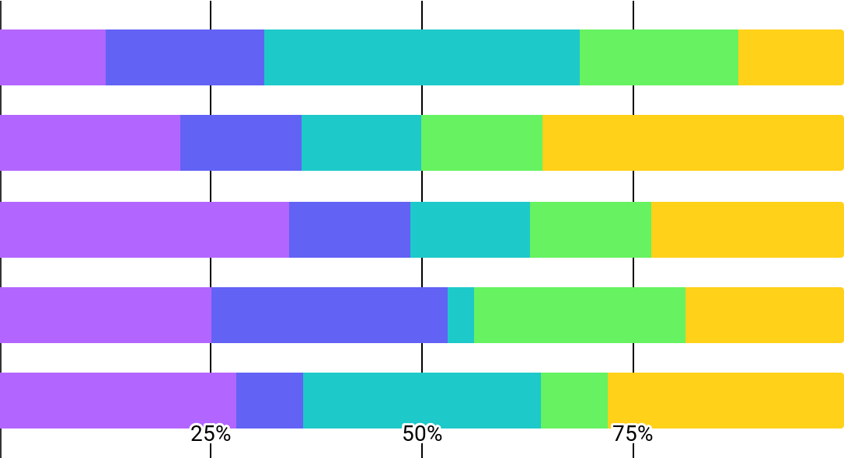
Quantum physics infographics
USARE QUESTO GRAFICO PER RIASSUMERE CONFRONTO TEMPI TRA LE RAPPRESENTAZIONI
Venus
20%
Venus is extremely hot
Mars
15%
Mars is actually a cold place
Mercury
15%
Mercury is a small planet
Jupiter
15%
Jupiter is a gas giant
Neptune
35%
Follow the link in the graph to modify its data and then paste the new one here. For more info, click here
Neptune is far from the Sun

Slide 18
Use cases
Density matrix vs. Stabilizer
Density Matrix
Stabilizer
3,400
2,900
Mercury
Mars
Mercury is the closest planet to the Sun
Despite being red, Mars is actually a cold place
1,200
5,600
Venus
Jupiter
Venus is the second planet from the Sun
Jupiter is the biggest planet in the Solar System

Slide 19
Aggiungere esempio di utilizzo dello stabilizer formalism ( es. Quantum correction, …) Vedere come verificare se stato è ‘stabilizzabile’
Vedere cosa sono Clifford Gate
Ricavare generatori (brute force, sfruttare vincoli come in https://quantumcomputing.stackexchange.com/a/3868, …)

Slide 20
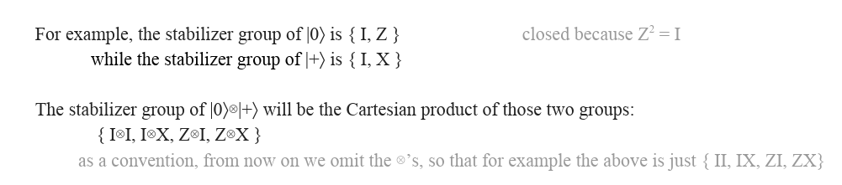
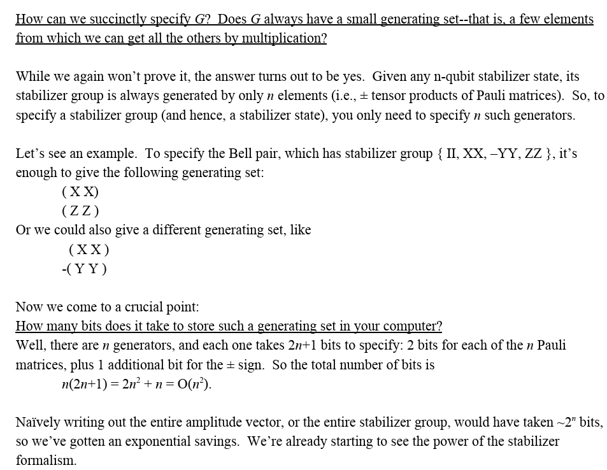
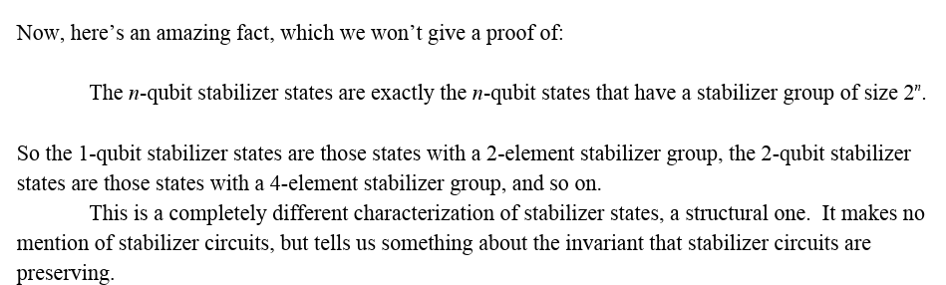
Idee
https://www.scottaaronson.com/qclec/28.pdf

Slide 21
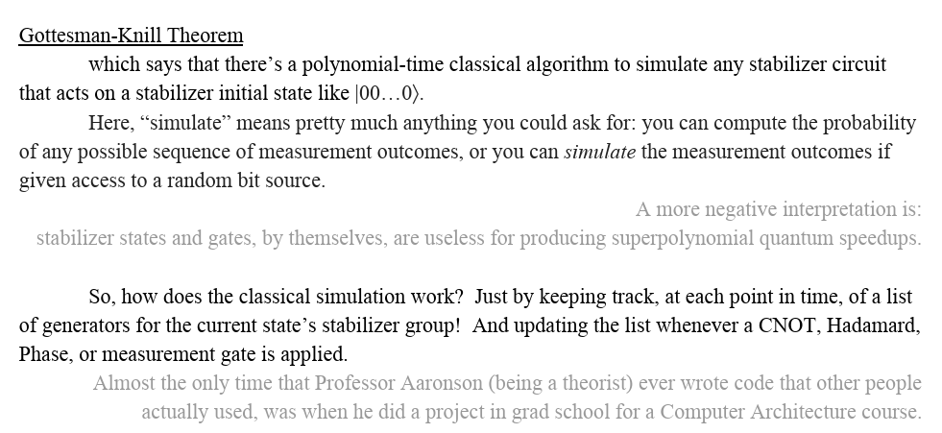
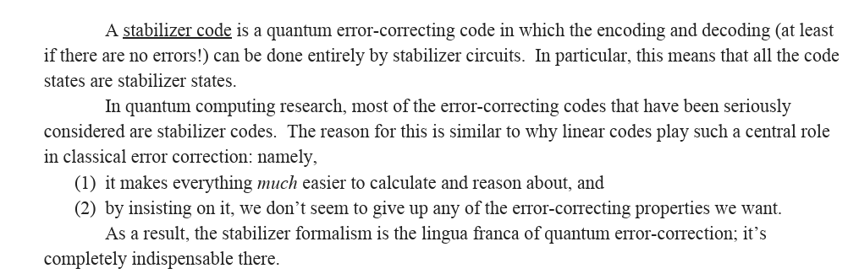
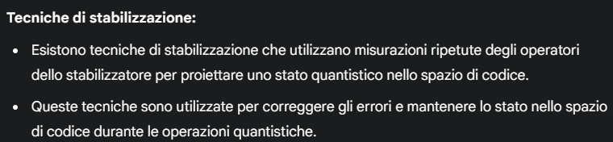
Nel paper viene spiegato anche il funzionamento (pag. 5):
In pratica ad ogni trasformazione aggiorniamo la lista degli stabilizzatori
+ sfrutta Tableau Rapresentation
Condizioni: trasformazioni solo H, CNOT e P altrimenti stato non è più stato stabilizzatore (questo vale in generale)
Ragioni per qui si usa nella QEC

Slide 22
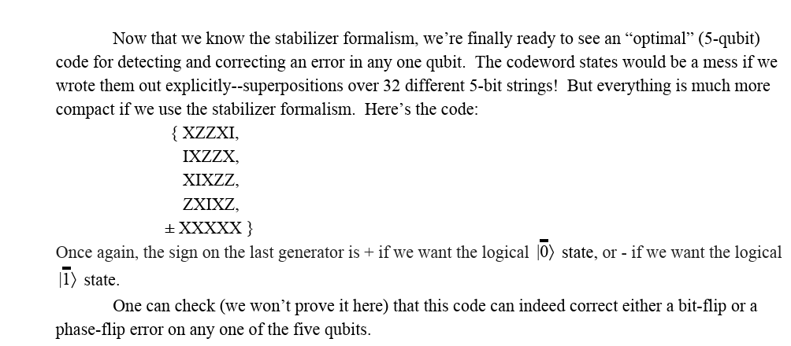
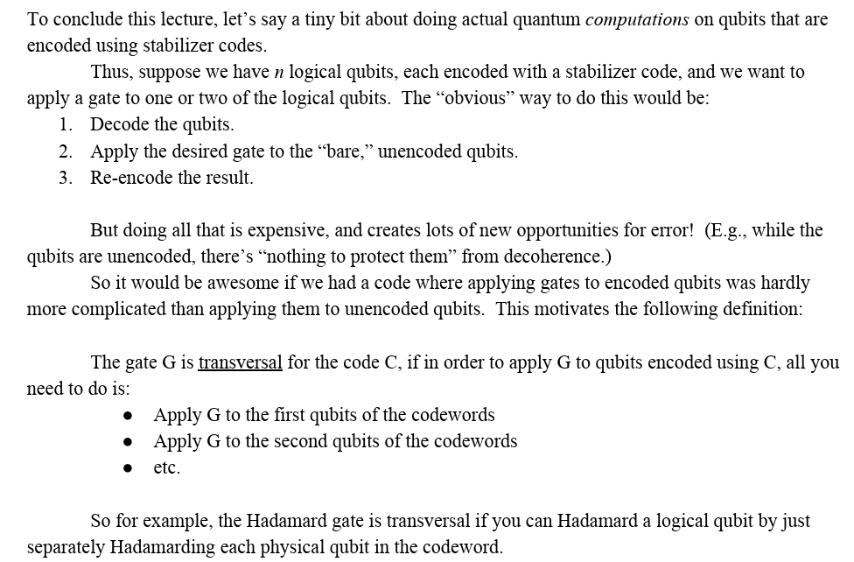
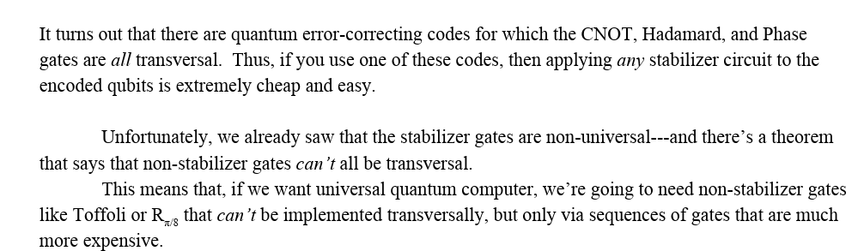

Slide 23
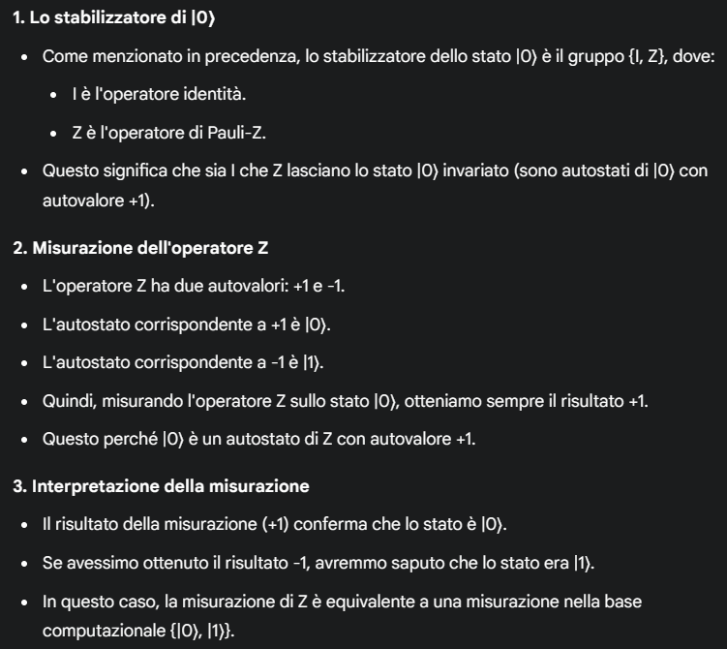
Esempio misurazione dello stabilizzatore
+ info extra a più qubit https://gemini.google.com/app/081854131bbd01d4?utm_source=app_launcher&utm_medium=owned&utm_campaign=base_all
Passaggio da rapp. stabilizzatore a ket o density https://gemini.google.com/app/b2dfacd7e2820133?utm_source=app_launcher&utm_medium=owned&utm_campaign=base_all

Slide 24
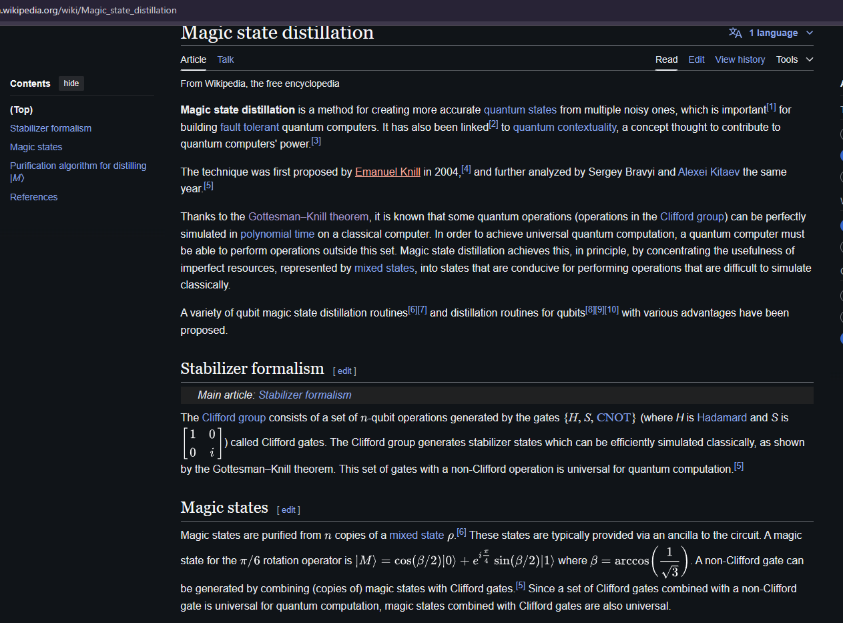
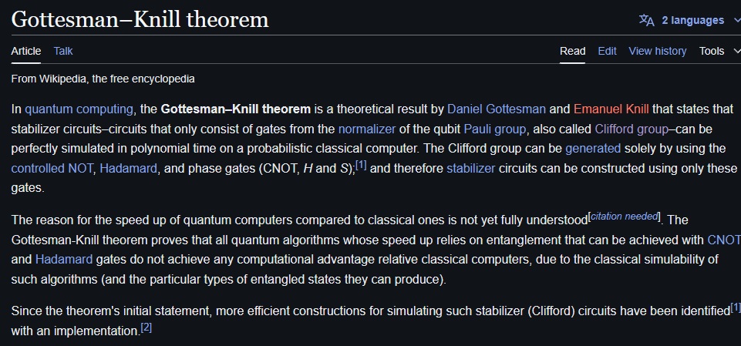

Slide 25
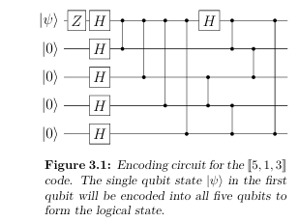
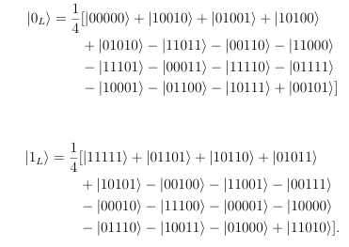
5 qubit quantum error correction https://odr.chalmers.se/server/api/core/bitstreams/ede708ff-f237-4a83-bfc2-523bebc91332/content

Slide 27
Quantum physics infographics
What is quantum physics?
25%
50%
75%
100%
Particles
Matter
Forces
Interaction
Saturn is one of the biggest planets. It is composed of hydrogen
Neptune is the farthest planet from the Sun. It is the fourth-largest
Mercury is the closest planet to the Sun and the smallest of them all
Venus has a beautiful name and is the second planet to the Sun

Slide 28
Quantum physics infographics
Quantum physics in the world
1ST
Venus
It’s the second planet from the Sun
2ND
Mars
Despite being red, Mars is a cold place
3RD
Mercury
Mercury is the closest planet to the Sun
4RT
Jupiter
Jupiter is the biggest planet of them all
5TH
Saturn
It’s a gas giant composed of hydrogen

Slide 29
Quantum physics infographics
About quantum theory
Quantum theory
Atomic particles
Nuclear physics
Molecules
Quantum optics
Venus is the second planet to the Sun
It’s terribly hot, even hotter than Mercury
Its atmosphere is extremely poisonous
Mercury is the closest planet to the Sun
It’s the smallest one in the Solar System
This name has nothing to do with the metal
Earth is the third planet from the Sun
It’s the only one that harbors life
This is the planet where we all live on
Jupiter is a gas giant and the biggest planet
It's the fourth-brightest object in the night sky
It was named after a Roman god

Slide 30
Quantum physics infographics
Qubit: basic unit of quantum information
Mercury
Z
Mercury is the closest planet to the Sun and the smallest one in the Solar System. This planet's name has nothing to do with the liquid metal
Venus
Y
Venus has a beautiful name and is the second planet from the Sun. It’s terribly hot, even hotter than Mercury, and its atmosphere is extremely poisonous
Jupiter
-Z
Jupiter is a gas giant and the biggest planet in the Solar System. It's the fourth-brightest object in the night sky. It was named after a Roman god

Slide 31
Quantum physics infographics
Quantum field theory
1,200
3,400
Neptune
Saturn
Neptune is the farthest planet from the Sun
Saturn is one of the biggest planets
2,300
4,500
Earth
Venus
Earth is the third planet from the Sun
Venus is the second planet from the Sun

Slide 32
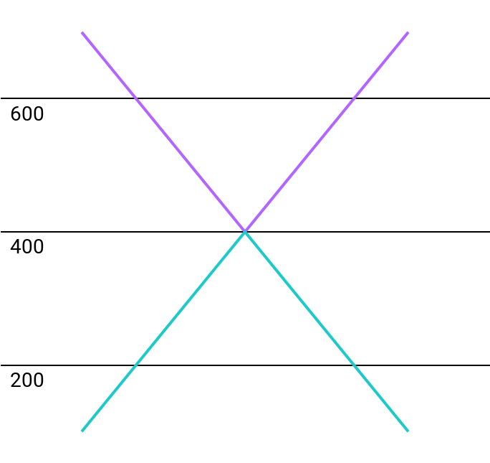
Quantum physics infographics
More about quantum field theory
Mercury
700
Mercury is the closest planet to the Sun and the smallest one in the Solar System
Venus
400
TIME
It’s terribly hot, even hotter than Mercury, and its atmosphere is extremely poisonous
Jupiter
100
It's the fourth-brightest object in the night sky. It was named after a Roman god
SPACE
Follow the link in the graph to modify its data and then paste the new one here. For more info, click here

Slide 33
Quantum physics infographics
Different fields interact with each other
A
Venus
Venus is the second planet from the Sun
B
Mars
Despite being red, Mars is a cold place
C
Mercury
Mercury is the closest planet to the Sun
D
Jupiter
Jupiter is the biggest planet
E
Saturn
It’s a gas giant composed of hydrogen

Slide 34
Quantum physics infographics
Condensed matter physics
A
200
C
400
Neptune
Saturn
It's the fourth-largest object by diameter
Saturn is a gas giant and has several rings
B
300
D
500
Earth
Venus
Earth is the third planet from the Sun
Venus is the second planet from the Sun

Slide 35
Quantum physics infographics
More about condensed matter
Mercury
01
04
Neptune
Mercury is the closest planet to the Sun
Neptune is the farthest planet from the Sun
Jupiter
02
05
Venus
Jupiter is the fourth brightest object
Venus is the second planet to the Sun
Saturn
03
06
Mars
It’s a gas giant composed of hydrogen
Despite being red, Mars is a cold place

Slide 36
Quantum physics infographics
Quantum molecules
A
B
C
Neptune
Venus
Saturn
Neptune is the farthest planet from the Sun. It is the fourth-largest
Venus has a beautiful name and is the second planet from the Sun
Saturn is one of the biggest planets. It is composed of hydrogen

Slide 37
Quantum physics infographics
Quantum energy on a molecular scale
450
550
Jupiter
Pluto
Jupiter is the biggest in the Solar System
Pluto is now considered a dwarf planet
400
500
600
Neptune
Earth
Saturn
Neptune is the farthest planet from the Sun
Earth is the only planet that harbors life
Saturn is one of the biggest planets

Slide 38
Quantum physics infographics
More about molecules
100
200
300
400
500
600
Neptune
Mercury
Venus
Earth
Mars
Pluto
Neptune is the farthest planet from the Sun
Mercury is the closest planet to the Sun
Venus is the second planet from the Sun
Earth is the planet we all live on
Despite being red, Mars is a cold place
Pluto is now considered a dwarf planet

Slide 39
Quantum physics infographics
Quantum mechanics
Neptune
Earth
Saturn
Venus
Neptune is the farthest planet from the Sun. It is the fourth-largest
Earth is the third planet from the Sun. We all live here
Saturn is one of the biggest planets. It is composed of hydrogen
Venus has a beautiful name and very high temperatures

Slide 40
Quantum physics infographics
Quantum tunneling
2,000
5,000
10,000
Neptune
Venus
Saturn
Neptune is the farthest planet from the Sun. It is the fourth-largest planet
Venus has a beautiful name and high temperatures
Saturn is one of the biggest planets. It is composed of hydrogen

Slide 41
Quantum physics infographics
About the standard model
Theory of relativity
Mercury is the closest planet to the Sun and the smallest one in the Solar System
Electromagnetism
Venus has a beautiful name and is the second planet from the Sun
1964
Strong nuclear force
Earth is the third planet from the Sun and the only one that harbors life
Standard model
Mars is actually a cold place. It's full of iron oxide dust
Weak nuclear force
Mars is full of iron oxide dust, which gives the planet its reddish cast

Slide 42
Quantum physics infographics
Particles of the standard model
01
Quarks
Venus has a beautiful name and is the second planet from the Sun. It’s terribly hot
02
Leptons
Mercury is the closest planet to the Sun and the smallest one in the Solar System
03
Gauge bosons
Jupiter is a gas giant and the biggest planet. Jupiter is the fourth brightest object
04
Higgs boson
Saturn is the only planet with rings. It’s a planet without solid surface

Slide 43
Quantum physics infographics
Particle organization chart
First
Fermions
Bosons
Photon, W and Z bosons, Gluon, Graviton
Jupiter is a gas giant and the biggest planet
Second
Hadrons
Leptons
Electron, Muon, etc
Saturn is the only planet with rings of them all
Third
Baryons
E. barions
Mesons
Pion, Kaon, etc
Despite being red, Mars is actually a cold place
Fourth
Hyperons
Nucleons
Proton, Neutron
Neptune is the farthest planet from the Sun

Slide 44
Quantum physics infographics
Elementary particles in the standard model
Fermions |  |  | Force-carriers
Up | Charm | Top | Photon
Down | Strange | Bottom | Gluon
Electron neutrino | Muon neutrino | Tau neutrino | Weak Force
Electron | Muon | Tau | Weak Force
Quarks
Bosons
Leptons

Slide 45
Quantum physics infographics
Quark synthesis
320
480
540
Cell
Proton
Quark
Neptune is the farthest planet from the Sun
Despite being red, Mars is a very cold place
Venus is the second planet from the Sun

Slide 46
Quantum physics infographics
Gauge boson vs. Higgs boson
 | Gauge boson | Higgs boson
Definition | Earth is the third planet from the Sun | Mercury is the closest planet to the Sun
Spin | One | Zero
Discovery | Paul Dirac | Peter Higgs
Particles | Vector boson | Scalar boson
Color charge | Color charged | Zero

Slide 47
Quantum physics infographics
The Higgs mechanism
20%
40%
60%
80%
Photon
Electron
Quark
Higgs boson
Neptune is the farthest planet from the Sun
Earth is the third planet from the Sun
Saturn is one of the biggest planets
Venus is the second planet from the Sun

Slide 48
Quantum physics infographics
Higgs boson vs. String theory
Higgs boson
Mercury is the closest planet to the Sun and the smallest one in the Solar System
Venus has a beautiful name and is the second planet from the Sun. It’s terribly hot
Earth is the beautiful planet where we all live. It’s full of life
String theory
Saturn is a gas giant and has several rings. It's composed mostly of hydrogen
Neptune is the farthest planet from the Sun. It's also the fourth-largest object
Pluto is so small that it is no longer considered a planet, but a dwarf
A
B
C

Slide 49

Quantum physics infographics
The atomic theory
Neptune
Mercury
15%
15%
Neptune is very far from the Sun
Mercury is the smallest planet
Mars
Saturn
25%
20%
Mars is a cold place
Saturn is a planet with rings
Earth
Venus
10%
15%
Earth is the planet with life
Venus has a beautiful name
Follow the link in the graph to modify its data and then paste the new one here. For more info, click here

Slide 50
Quantum physics infographics
Models of atomic structure
95%
75%
Mercury
Mars
Mercury is the closest planet to the Sun and the smallest one
Despite being red, Mars is actually a cold place. It's full of iron oxide dust
85%
65%
Venus
Jupiter
Venus has a beautiful name and is the second planet from the Sun
Jupiter is the biggest planet in the Solar System. It's the fourth-brightest object

Slide 51
Quantum physics infographics
History of the atom
1803
1904
1911
1913
1926
Dalton
Thomson
Rutherford
Bohr
Schrödinger
Neptune is the farthest planet from the Sun
Jupiter is a gas giant and the biggest planet
Earth the only planet that harbors life of them all
Saturn is a gas giant and has several rings
Despite being red, Mars is actually a cold place

Slide 52
Quantum physics infographics
Atomic spectra
Jupiter
Pluto
Mars
Jupiter is the biggest in the Solar System
Pluto is now considered a dwarf planet
Despite being red, Mars is actually a cold place
450
550
650
400
500
600
Neptune
Earth
Saturn
Neptune is the farthest planet from the Sun
Earth is the only planet that harbors life
Saturn is one of the biggest planets

Slide 53
Quantum physics infographics
Understanding Schrodinger's Cat
Mercury
A
D
The Sun
Mercury is the smallest planet of the Solar System
The Sun is the star at the center of the Solar System
Jupiter
B
E
Venus
Jupiter is the fourth brightest object in the sky
Venus has a beautiful name and high temperatures
Saturn
C
F
Mars
It’s a gas giant composed of hydrogen and helium
Despite being red, Mars is actually a cold place

Slide 54
Quantum physics infographics
About the born rule
1,300
1,600
2,100
2,400
Period
Crest
Trough
Amplitude
Neptune is the farthest planet from the Sun
Venus is the second planet from the Sun
Saturn is one of the biggest planets
Earth is the third planet from the Sun

Slide 55
Quantum physics infographics
Classical computing vs. quantum computing
Classical computing
Quantum computing
3,400
2,900
Mercury
Mars
Mercury is the closest planet to the Sun
Despite being red, Mars is actually a cold place
1,200
5,600
Venus
Jupiter
Venus is the second planet from the Sun
Jupiter is the biggest planet in the Solar System

Slide 56
Quantum physics infographics
More about quantum computing
A
Neptune
Mercury
E
It’s the farthest planet from the Sun
It’s the closest planet to the Sun
B
Mars
Pluto
F
Despite being red, Mars is a cold place
It’s now considered a dwarf planet
C
Earth
Venus
G
Earth is the third planet from the Sun
It’s the second planet from the Sun
D
Saturn
Jupiter
H
Saturn is a gas giant and has several rings
It’s a gas giant and the biggest planet

Slide 57
Quantum physics infographics
About quantum cryptography
Venus
20%
Venus is extremely hot
Mars
15%
Mars is actually a cold place
Mercury
15%
Mercury is a small planet
Jupiter
15%
Jupiter is a gas giant
Neptune
35%
Follow the link in the graph to modify its data and then paste the new one here. For more info, click here
Neptune is far from the Sun

Slide 58
Instructions for use
In order to use this template, you must credit Slidesgo in your final presentation.
You are allowed to:
- Modify this template.
- Use it for both personal and commercial projects.
You are not allowed to:
- Sublicense, sell or rent any of Slidesgo Content (or a modified version of Slidesgo Content).
- Distribute Slidesgo Content unless it has been expressly authorized by Slidesgo.
- Include Slidesgo Content in an online or offline database or file.
- Offer Slidesgo templates (or modified versions of Slidesgo templates) for download.
- Acquire the copyright of Slidesgo Content.
For more information about editing slides, please read our FAQs or visit Slidesgo School:
https://slidesgo.com/faqs and https://slidesgo.com/slidesgo-school

Slide 59
Instructions for use (premium users)
As a Premium user, you can use this template without attributing Slidesgo
You are allowed to:
Modify this template.
Use it for both personal and commercial purposes.
Hide or delete the “Thanks” slide and the mention to Slidesgo in the credits.
Share this template in an editable format with people who are not part of your team.
You are not allowed to:
Sublicense, sell or rent this Slidesgo Template (or a modified version of this Slidesgo Template).
Distribute this Slidesgo Template (or a modified version of this Slidesgo Template) or include it in a database or in any other product or service that offers downloadable images, icons or presentations that may be subject to distribution or resale.
Use any of the elements that are part of this Slidesgo Template in an isolated and separated way from this Template.
Register any of the elements that are part of this template as a trademark or logo, or register it as a work in an intellectual property registry or similar.
For more information about editing slides, please read our FAQs or visit Slidesgo School:
https://slidesgo.com/faqs and https://slidesgo.com/slidesgo-school

Slide 60
Infographics
You can add and edit some infographics to your presentation to present your data in a visual way.
Choose your favourite infographic and insert it in your presentation using Ctrl C + Ctrl V or Cmd C + Cmd V in Mac.
Select one of the parts and ungroup it by right-clicking and choosing “Ungroup”.
Change the color by clicking on the paint bucket.
Then resize the element by clicking and dragging one of the square-shaped points of its bounding box (the cursor should look like a double-headed arrow). Remember to hold Shift while dragging to keep the proportions.
Group the elements again by selecting them, right-clicking and choosing “Group”.
Repeat the steps above with the other parts and when you’re done editing, copy the end result and paste it into your presentation.
Remember to choose the “Keep source formatting” option so that it keeps the design. For more info, please visit Slidesgo School.

