Slide 1
Quantum computation
Density Matrix vs Stabilizer Formalism

Slide 2
Quantum systems
A quantum system can be made using different technologies, but regardless of this they are governed by many universal postulates
Key Concepts
Hilbert Space
Measurement
Multi-qubit
Transformations
A system can be modelled by a complex Hilbert Space
State described by state vector up to a global phase in the system state space
Superposition
Basis dependent
Probabilistic
Transform system state in one of the preferred state
Systems combine by tensor product
Exponential growth of space state
Can still exists in superposition
Entanglement
Isolated quantum system evolves with reversible unitary operators
Open systems affected by decoherence
No cloning theorem

Slide 3
Most Common technologies
Optical
Use photons as qubit
Polarization, …
Coaxial or fiber technology
Low Decoherence, Slow gates
Superconductive
Use superconductive circuits manipulated by microwaves
System phase, Charge, …
Need system at cryogenics temperature
High Decoherence, Fast gates

Slide 4
Bloch Sphere
Qubit: geometric definition
Pure states
Represented by unitary vector that always lives on Bloch Sphere’s surface
Mixed states
Represent a probabilistic ensemble of pure state due to uncertainty about system’s state, where graphically it’s a non unitary vector contained inside the Bloch Sphere.
Usually caused by decoherence, that ‘mixes’ pure states or uncertainty about system initialization

Slide 5
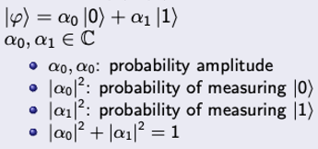
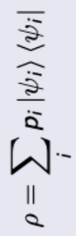


Common quantum representation
Pure states
General
Ket
Density Matrix
Denotes column vector
Coefficients are the amplitude factor
Only pure states
Matrix representation
On main diagonal there are classic probabilities of pure states
On secondary diagonal there are coherence elements
Universal representation (isolated closed system)

Slide 6
Density matrix exponential growth
As seen previously, quantum system combines by tensor product and the density matrix representation uses matrix of dimension 2^{n}x2^{n}.
This imply an enormous computational cost for every kind of process that we would simulate, especially on classical computers, that would allow to only simulate systems with just a few qubits.
1
2
7
2x2
4x4
7x7
4 elements
16 elements
49 elements

Slide 7
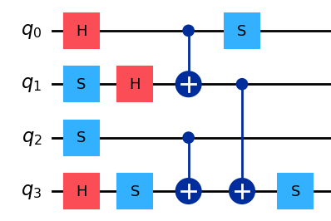



Stabilizer formalism
Stabilizer
Stabilizer State
Allows to represent a quantum state (or space state) by its stabilizer. A stabilizer (S) is an operator's subgroup of the Pauli group on n qubits, that applied on a quantum state (or a space state) doesn’t change it
Equivalently, a state is called a stabilizer state of S, if is stabilized by it.
We can also view it as a state that can be generated by a stabilizer (Clifford) circuit (only CNOT, H, S)
Why
Gain
Now we can uniquely represent a stabilizer state by its stabilizer’s generator (log₂(|n|)), instead of using an 2^{n}x2^{n} matrix, also if only for pure state or uniform mixed states.
Furthermore, we can track the evolution of the system due to Clifford gates, directly in this representation
As we can directly see, we obtain a big gain in terms of required memory. But now, thanks to many researches we’ve also reached a big improvement in terms of simulation on classical computers (for Clifford circuits) passing from exponential to polynomial time
U Clifford gate

Slide 8
Gottesman–Knill theorem
A quantum circuit using only the following elements can be simulated efficiently on a classical computer by a polynomial-time algorithm:
Preparation of qubits in computational-basis states
Clifford Gates
Efficient classical simulation
Measurements in the computational basis
In this case, classical simulation will just track, at each point in time, of a list of generators for the current state’s stabilizer group, updating it whenever a Clifford gate is applied.

Slide 9
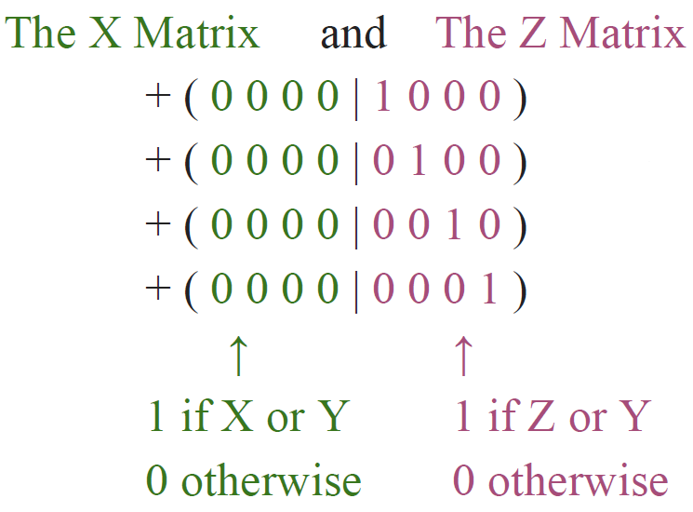
Gottesman–Knill algorithm
How it works
First of all, starting with a stabilizer state we need to get its stabilizer representation (the generators list).
Now we write them with the Tableau Representation, that use 2 nxn matrix of 0s and 1s, where each row represent a generator.
After that, we just need to apply the rules to update the state when a gate its applied
Time
Memory
ZIII
IZII
IIZI
IIIZ
Updates corresponding unitary gates require O(n) for gate.
But for measurement gates, a random outcome require O(n²) while a deterministic outcome require O(n³)
n generators, each one takes 2n +1 bits: 2 bits for each of the n Pauli matrices, plus 1 additional bit for the ± sign. So, total number of bits is n(2n+1) = O(n²), while writing out the entire amplitude vector, would have taken ~2^{n} bits,
|0000>
{ZIII, IZII, IIZI, IIIZ}

Slide 10
Gottesman–Knill algorithm
Update rules
MEASUREMENTS
H
S
CNOT
To measure the i^{th} qubit, first check if the i^{th} column of the X matrix is all zeros: - yes, the result is deterministic based on the i^{th} row of the Z matrix
- no, the result is random, then pick a row where the i^{th} entry of the X matrix is 1 and reduce other rows using bitwise XOR (Gaussian elimination), and update the Z matrix accordingly. Finally, if the measurement result is +1, add it to the stabilizer; if -1, flip the sign of the corresponding stabilizer generator
To apply H on i^{th}, swap i^{th} column of X matrix with i^{th} column of Z matrix
Bitwise XOR the i^{th} column of the X matrix into the i^{th} column of the Z matrix
Bitwise XOR the i^{th} [j^{th}] column of the X [Z] matrix into the j^{th} [i^{th}]column of the X [Z] matrix

Slide 11
Further improvements
Gottesman-Knill algorithm
CHP
GraphSim
O(n²) memory
O(n) unitary gates
O(n²) random measurements
O(n³) deterministic measurements
2 * O(n²)=O(n²) memory
O(n) unitary gates
O(n²) all measurements remove Gaussian elimination
O(nlogn) memory
O(1) single qubit gates
O(logn) Z base measurements
O(logn²) X, Y basis measurements
Use graph representation
(generic times)

Slide 12
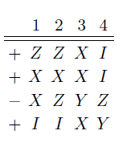
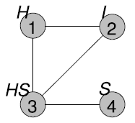
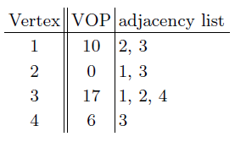
Graph Representation
Graph
Stabilizer – Graph
A graph is a mathematical structure of vertices and edges. In this case, the vertex are the qubits while edges represents entanglements or interactions
Every graph state is a stabilizer state, but also every stabilizer state is equivalent
to a graph state in the following sense: any stabilizer state can be transformed to a graph state by applying a tensor product of local Clifford (LC) operations (vertex operations VOPs).
So, we can say that a stabilizer state is always Local-Clifford equivalent* (LC-equivalent) to its respective graph state representation.
We can always choose what representation use by the problem we’re facing, where this will be shown that allows to further improve stabilizers circuit simulations
Example
On the left are shown three equivalent representation of the state 1/√2 ( |0000> + |1111> ), respectively stabilizer representation, graph representation and adjacency list of the graph representation (mathematical form of a graph).
In graph representation, on every qubit appears the gates to apply over them and connections indicates the entanglement, while in the adjacency list the operations are labelled with VOP code (1 to 24) while connections are a list in every qubit
Really interesting fact about graph state topology of GHZ here.
* equivalent ≠ is a graph state

Slide 13
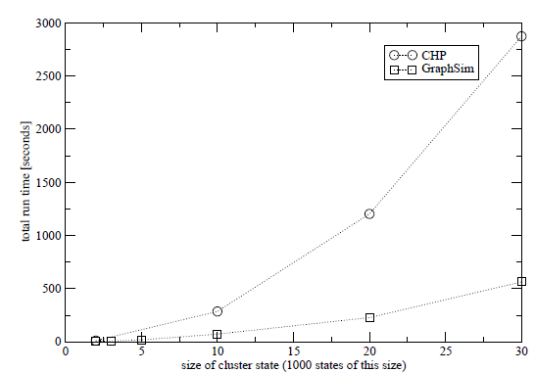
Implementation
Similarly to what seen previously, also here the key to update system’s state is following specific rules (not mentioned here)
memory
Time
The transformation from stabilizer to graph can be done with a sort of Gaussian elimination O(n³) from Tableau representation, so we want to avoid it when possible.
This approach allows us to reach:
Single qubit gates requires just a lookup in a table O(1)
Z measurement requires to remove the deg a edges of the measured vertex a O(d)
Y, X measurements require local complementation O(d²)
Two qubit gates require 5 local complementation O(d²)
Tableau matrix requires O(n²) memory, while a graph representation that uses adjacent list took O(nd) where d is the average number of neighbours + a O(n) list of the VOPs (numbered from 1 to 24) that take us to stabilizer state.
Usually the neighbours are O(logn), but in worst case are O(n) and in this case we have no improvements in confront of CHP
Entanglement purification benchmark

Slide 14
Use cases
Density matrix vs Stabilizer
Mixed State
Clifford Circuits
Non-Pure states, partial trace of an entangled system…
Efficient simulation for stabilizer states and Clifford circuits
Open Quantum Systems
Quantum Error Correction
Decoherence apply non unitary transformation of a system taking it to a mixed state
It offers a structured approach to designing and analyzing quantum error-correcting codes that simplify calculations and reasoning. At cost of approximating quantum errors as Pauli Gates (not too far from common cases) and encoding / decoding must be done by Clifford circuits
Allows entanglement and state distillation, …

Slide 15

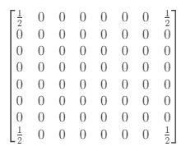



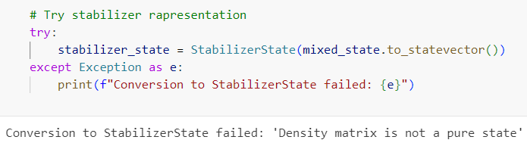
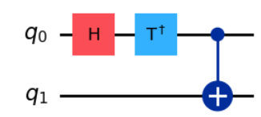
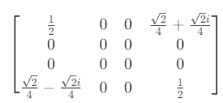
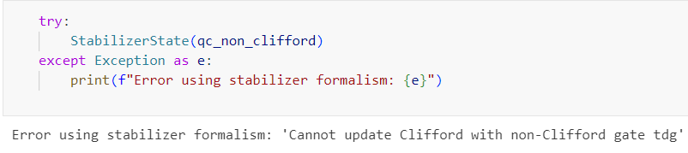

Notebook Epilogue
Representation
Circuit simulation
3 qubit GHZ state
60 qubit benchmark
vs [+XXX, +IZZ, +ZIZ]
Mixed states
1000 qubit, depth 800 benchmark (~2 min.)
Process tomography
Simulators with method stabilizer currently not available for process tomography
Non-Clifford Circuit simulation
Quantum error correction

Slide 16
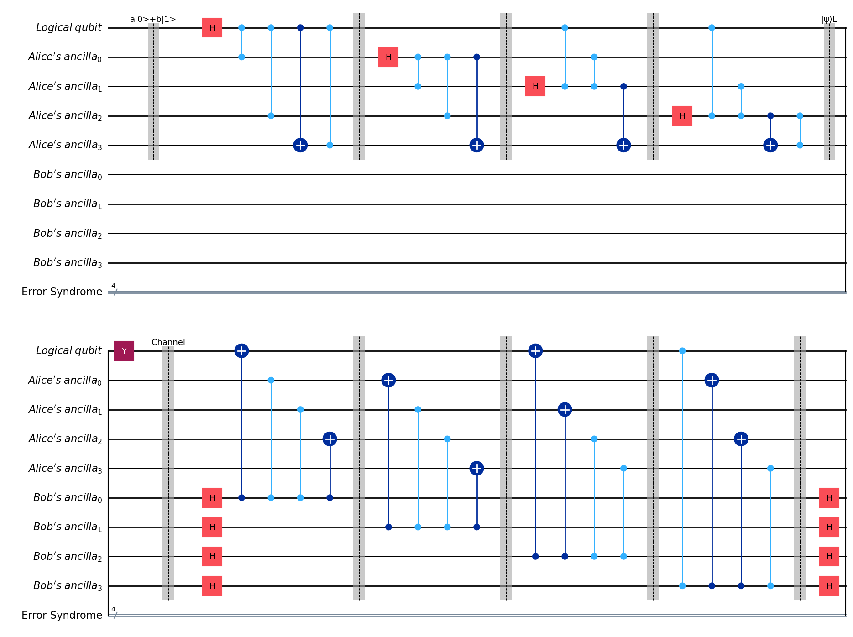

5 qubit QECC example

Slide 17
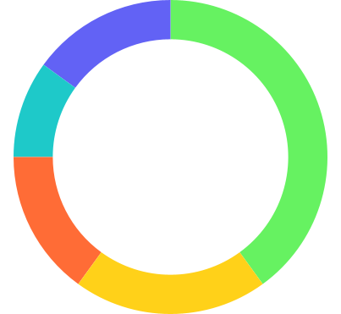
Sources
GitHub Repo
Other
15%
40%
Course material
Wikipedia, StackExchange,
…
Improved Simulation of Stabilizer Circuits
Scott Aaranson
Lecture
10%
20%
15%
Fast simulation of stabilizer circuits using a graph state representation
Template from Slidesgo

