Slide 1
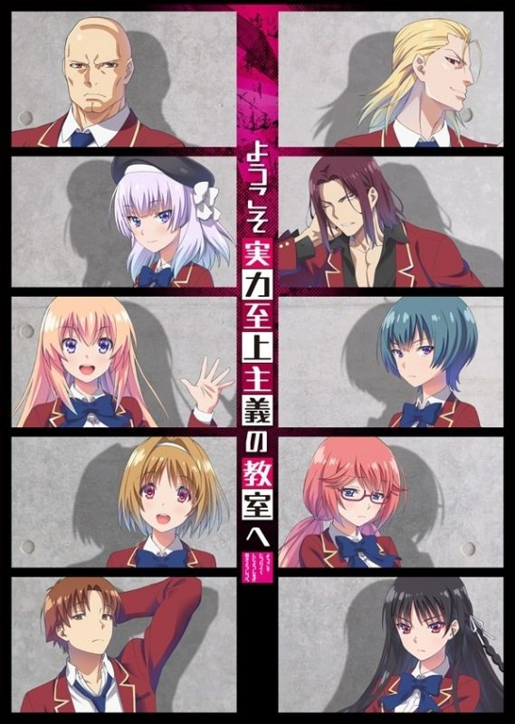
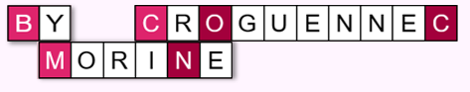
Analyzing Topics in
Classroom of the Elite
Notes:
Analyzing Topics in Classroom of the Elite:
How Japanese Light Novels Unveil the Shortcomings of Topic Modelling

Slide 2
Introduction

Slide 3


Introduction
Japanese Visual Novel Series
About high school students competing to be the ‘best’ class within their year through various competitions.
Under the premise that graduates from the best class in this school can get any position in society they would like.
15 translated volumes, 3 translated sub volumes
3

Slide 4
Research Question

Slide 5
Research
Question
How do topics change over time
in the main volumes of Classroom of the Elite
covering each trimester of high school for the protagonist?
5

Slide 6
Data

Slide 7
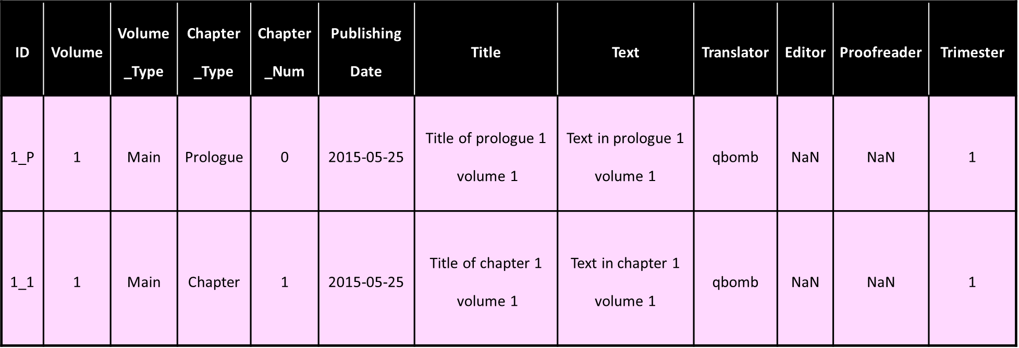
Main
Data
Manually compiled data frame
Includes all 15 translated main volumes
Tsv Format
7
Notes:
I was going to count the amount of tokens in each volume, as suggested by the professors but I lacked time to do so,

Slide 8
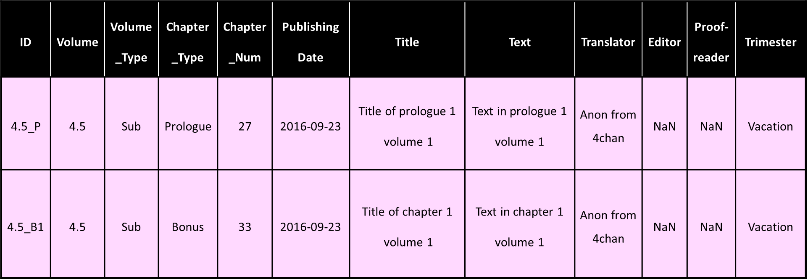
Pretraining
Data
Sub Volumes, Bonus Chapters and Afterwords
Similar to main data
Counts 193,177 tokens
8

Slide 9
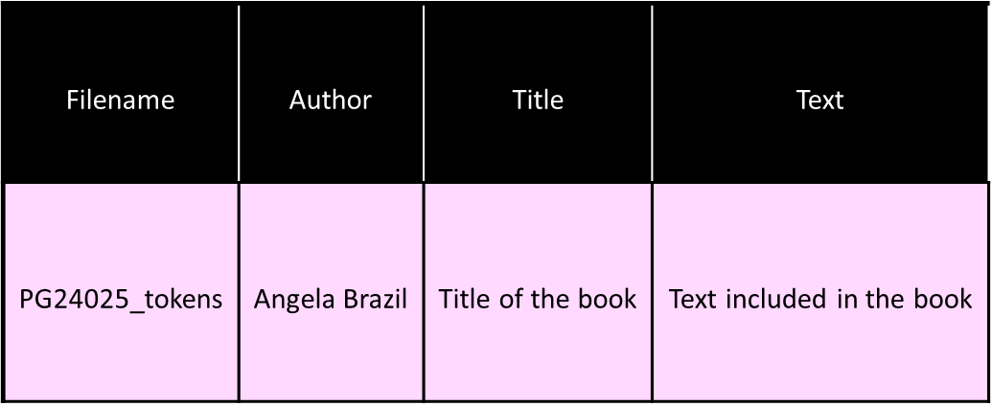
Pretraining
Data
Gutenberg Corpus selection
23 Boarding school stories
Counts 1,402,919 tokens
9
Merged Data: Counts 1,596,096 tokens

Slide 10
Methodology

Slide 11
Methodology
Pre-processing
Text was lowercased
Stop words were removed
(nltk list English stopwords + ‘kun’, ‘san’, ‘chan’)
Punctuation and special characters were removed
11

Slide 12
Methodology
Non-Negative Matrix Factorization (NMF)
n_features = 5000
Maximum number of most common words included in vocabulary
max_df = 0.50
Words should not appear in more than 50 per cent of the documents to be included in the vocabulary
min_df = 9
Words should appear in at least 9 out of 84 documents (±10%) to be included in the vocabulary
n_topics = 75
The total amount of topics to be generated based on the pretraining data
12
Classroom of the Elite pretraining data contains 61 documents (chapters)
Gutenberg Selection contains 23 documents (books)

Slide 13
Methodology
Topics grouped by trimester
Trimester | 1 | 2 | 3 | 4
Volumes | 1 - 4 | 5 - 7 | 8 - 11 | 12 - 15
Sub Volume (marking the end of each trimester) | 4.5 | 7.5 | 11.5 | /
Value of topic presence was calculated
(for each topic in each trimester group)
13

Slide 14
Hypotheses

Slide 15
Hypotheses
1st year, 1st trimester:
Most info covering the protagonist class
and their internal relations
1st year, 2nd trimester:
Less superficial connections
Mentions of protagonist’s newly established friend group
1st year, 3rd trimester:
Protagonist is noticed by the first-year class leaders,
Increasing interaction with older students
2nd year, 4th trimester:
More interclass interaction, between all schoolyears
Uninhabited island exam
Introduction of new first years
Friction with new acting director
15

Slide 16
Results & Discussion

Slide 17
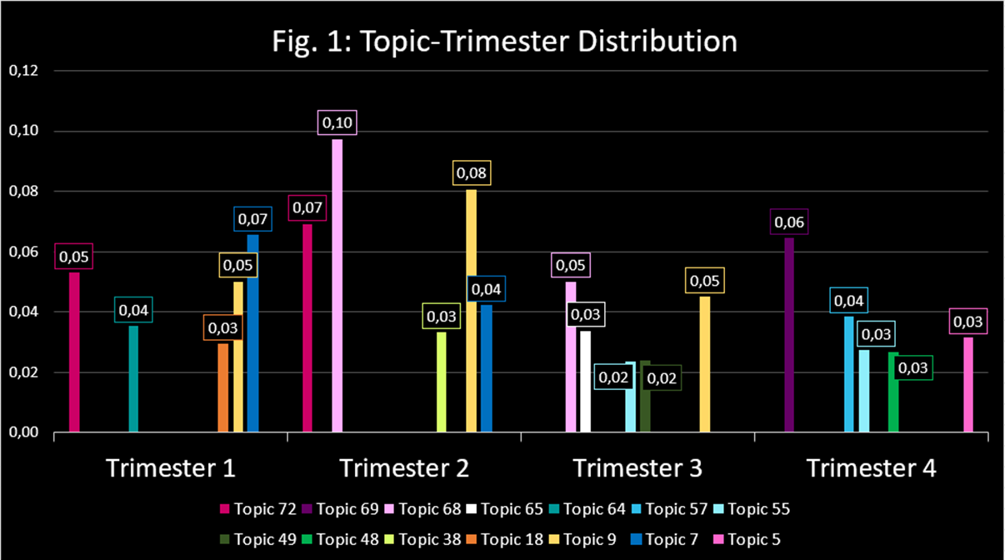
Results
17

Slide 18
Results &
Discussion
Trimester 1
Hypothesis 1st Trimester:
Most info covering the protagonist class
and their internal relations
CORRECT
18
Notes:
Overall, the topics discussed here seem to correlate to the content present in the volumes covering the 1st trimester. As predicted in the hypothesis section, the first trimester mostly covered topics depicting the internal relations within class D (the protagonist’s class). The protagonist, Ayanokouji has more of an observing function in this trimester. As a consequence, the most present topics revolve more around his classmates’ actions rather than his own.

Slide 19
Results &
Discussion
Top 5 Topic Clusters:
Topic 7: sudou, ike, yamauchi, council, birthday, …
Trimester 1
Topic 9: karuizawa, nagumo, hirata, date, love, …
Topic 72: sensei, reception, ayanokouji, sakayanagi, permission, …
Topic 64: changing, ike, car, peeping, pool, …
19
Topic 18: hair, image, kushida, sudou, love, …
Notes:
Topic 7(sudou, ike, yamauchi, council, birthday, …): Sudou, Ike and Yamauchi are three guys from the protagonist’s class that quickly grew into a close friend group. On the first day of classes they form a group of boys to discuss different matters. Amongst other matters, they discuss how stern the student council president looked at the welcoming ceremony for the first years. The word birthday does not occur in the volumes covering the 1st trimester.
Topic 9(karuizawa, nagumo, hirata, date, love, …): At the start of the schoolyear, it quickly becomes clear that Karuizawa and Hirata start dating. They are two of the three most popular people in class D and end up taking a leading role during class activities and discussions. The name nagumo does not show up in any of the volumes included in the 1st trimester. This name refers to the second year who later becomes the new student council president. His name seems to be included in this topic based on the content of one of the sub volumes. In this particular sub volume (volume 7.5), Nagumo briefly interrupts a double date Karuizawa and Hirata are on. However, in the story Nagumo is unrelated to Karuizawa and Hirata’s relationship.
Topic 72(sensei, reception, ayanokouji, sakayanagi, permission, …): This topic is hard to make sense of since the words included do not seem related to one another in a clear way. The Japanese word ‘sensei’ refers to a teacher. However, teachers were not involved in the club receptions at the start of the year. Of course, sometimes students such as the protagonist Ayanokouji or Sakayanagi(the leader of class A) ask teachers for permission in order to do something but there is no such specific moment to refer to within the contents of the 1st trimester.
Topic 64(changing, ike, car, peeping, pool, …): The boys in class D, led by Ike, show interest in what the girls will look like after changing into their bathing suits for a swimming class. Ike even contemplates going into their changing room.
Topic 18(hair, image, kushida, sudou, love, …): This topic could refer to Kushida, the most popular girl in class D and her secret personality. While she has the image of a goody-two-shoes who tries to get along with everyone, secretly she curses and complains about how much everyone bothers her. She often tends to twirl her hair when exposing this secret side of hers to others. However, the words Sudou and love do not seem to have a connection with Kushida’s secret personality.

Slide 20
Results &
Discussion
Trimester 2
Hypothesis, 2nd trimester:
Less superficial connections
Mentions of protagonist’s newly established friend group
INCORRECT
20
Notes:
The most ‘present’ topics generated for the second trimester are similar to those of the first. Only two differ, of which one is difficult to interpret in relation to the story. While topic 68 does indicate that the protagonist is starting to make interpersonal connections, it does not prove the hypothesis provided for this trimester. A topic regarding the creation of the protagonist’s new friend group was expected to show up but it did not.

Slide 21
Results &
Discussion
Top 5 Topic Clusters:
Topic 68: ryuuen, nagumo, council, older, points, …
Trimester 2
Topic 9: karuizawa, nagumo, hirata, date, love, …
Topic 72: sensei, reception, ayanokouji, sakayanagi, permission, …
Topic 7: sudou, ike, yamauchi, council, birthday, …
21
Topic 38: months, importantly, reliable, kinugasa, refrain, …
Notes:
Topic 68(ryuuen, nagumo, council, older, points, …): Ryuuen, class C’s leader takes a leading role in the second semester as he tries to identify the mastermind behind class D; Ayanokouji. Ryuuen’s style of leadership was compared with those of the former and current student council presidents’. At the end of the second trimester, Ayanokouji comes into contact with the now ‘former’ student council president Horikita Manabu. The former president is concerned about the new president; Nagumo. He fears Nagumo intends to change the school too extremely. He hopes to entrust Ayanokouji with the task of revoking Nagumo from his position. While Ayanokouji is not particularly interested he owes Horikita Manabu a favor since he ensured Ayanokouji’s victory against Ryuuen.
Topic 9(karuizawa, nagumo, hirata, date, love, …): At the end of the first trimester, it is revealed to the protagonist that Karuizawa and Hirata are in a fake relationship. Karuizawa was bullied in middle school and wanted to protect herself from being looked down on by dating the most popular guy in class; Hirata. Hirata was kind enough to help her out even though he was not interested in a relationship. Throughout the second trimester, Ayanokouji points out how proficient the two are at pretending to be a couple multiple times. Though again, it is hard to link Nagumo to this topic cluster.
Topic 72(sensei, reception, ayanokouji, sakayanagi, permission, …): As mentioned earlier the words in this topic do not have a clear connection to one another, thus this cluster is hard to contextualize.
Topic 7(sudou, ike, yamauchi, council, birthday, …): Sudou, Ike and Yamauchi remain a close group of friends throughout the second trimester. They often appear as a trio. This trimester, however, they did not discuss anything related to the student council. The word birthday, again does not occur in the volumes covering the second trimester either.
Topic 38(months, importantly, reliable, kinugasa, refrain, …): This topic was likely generated from the epilogues written by the author of classroom of the elite, Kinugasa Syougo. It does not seem to tie in with the story.

Slide 22
Results &
Discussion
Trimester 3
Hypothesis 3rd trimester:
Protagonist is noticed by the first-year class leaders,
Increasing interaction with older students
CORRECT
22
Notes:
The generated topics for this trimester tie in well with the predictions made in the hypothesis section. Topic 65 relates to the intensifying contest between the first years’ class leaders. From topics 68 and 55, it can also be derived that the first years have more contact fist senior students. The third years’ graduation is also subtly reflected in these topics. Horikita Manabu wants Ayanokouji to defeat Nagumo, since he himself would be unable as he has too little time before he graduates.

Slide 23
Results &
Discussion
Top 5 Topic Clusters:
Topic 68: ryuuen, nagumo, council, older, points, …
Trimester 3
Topic 9: karuizawa, nagumo, hirata, date, love, …
Topic 65: sakayanagi, ichinose, ryuuen, watch, theater, …
Topic 55: council, nagumo, brother, join, president, …
23
Topic 49: ayanokouji, boy, amazing, cup, formidable, …
Notes:
Topic 68(ryuuen, nagumo, council, older, points, …): Ayanokoji encounters president Nagumo and former president Horikita during an exam involving all school years. He observes their interactions and secures information about the older students. Ryuuen however is not tied in with this occurrence. He does not have much contact with the senior students at all during the third trimester.
Topic 9(karuizawa, nagumo, hirata, date, president, …): Karuizawa becomes stable enough to live independently from Hirata. In volume 9, he decides to break up with him for both of their sakes. This information becomes shocking gossip to their fellow students who were unaware of the fake nature of their relationship. Again, Nagumo has no significant connection to their relationship in the story.
Topic 65(sakayanagi, ichinose, ryuuen, watch, theater, …): At this point in time; Ayanokouji has been recognized as the mastermind of class D by the leaders of all other classes in his year; Sakayanagi(class A), Ichinose(class B) and Ryuuen(class C). The word theater is not present in any of the volumes included in the third trimester.
Topic 55(council, nagumo, brother, join, president, …): Ajanokouji aims to interfere with president Nagumo through his classmate Horikita Suzune. However, she does not seem like she would willingly cooperate. To convince her, he lies that her brother (Horikita Manabu), the former president wants her to join the student council. Once she joins the council, his goql is to extract information from her.
Topic 49(ayanokouji, boy, amazing, cup, formidable, …): During the first exam of the third trimester, Ayanokouji is grouped together with his classmate Kouenji, amongst other students. Koenji calls him ‘Ayanokouji boy’.

Slide 24
Results &
Discussion
Trimester 4
Hypothesis 4th trimester:
More interclass interaction, between all schoolyears
Uninhabited island exam
Introduction of new first years
Friction with new acting director
CORRECT
24
Notes:
As speculated in the hypothesis, the topics generated for the fourth trimester mostly revolve around the introduction of new 1st year students (topic 57) and the survival exam including students from all school years (topics 69, 48 And 5). Lastly, topic 48 could be related to the fact that the new acting director’s goal of getting Ayanokouji expelled.

Slide 25
Results &
Discussion
Top 5 Topic Clusters:
Topic 69: senpai, understood, detail, human, ayanokouji, …
Trimester 4
Topic 57: senpai, ayanokouji, answering, partners, okay, …
Topic 55: council, nagumo, brother, join, president, …
Topic 48: senpai, climbing, catch, definitely, ayanokouji, …
25
Topic 5: senpai, ayanokouji, beach, win, flag, …
Notes:
Topic 69(senpai, understood, detail, human, Ayanokouji, …): This topic is on the vague side. It may refer to a set of occasions that occur during the uninhabited island exam which takes place in volume 14. During this exam, Ayanokoiji spends most of his time travelling with a junior student of his. Since they are originally from different groups, Ayanokouji decides not to reveal his thought processes in detail. The junior student (Nanase), naturally understood this.
Topic 57(senpai, ayanokouji, answering, partners, okay, …): Ayanokouji, has now become a second year faces and thus a ‘senpai’ or senior student. He quickly faces a new academic exam. However, for this exam, second years need to pair up with the newly introduced first years. All second years are looking for a partner, and after a long process of consideration, Ayanokouji settles on a partner for the exam as well.
Topic 55(council, nagumo, brother, join, president, …): Horikita Suzune becomes determined and is eventually allowed to join the student council.
Topic 48(senpai, climbing, catch, definitely, Ayanokouji, …): As events during the uninhabited island exam unravel, it becomes clear that a very large bounty (20 million points) has been placed on his head by the acting director. All first years are aware of this bounty and either as separate groups or as individuals, they try to catch Ayanokouji off guard and take the bounty for themselves. The largest confrontation between the first years and the protagonist takes place after Ayanokouji has climbed a mountain to avoid being followed.
Topic 5(senpai, ayanokouji, beach, win, flag, …): During the uninhabited island exam, students come across multiple events they can choose to participate in to win points. One of these events is called: ‘Beach Flags Showdown’. During the exam, Ayanokouji wants to participate in this event. However, a senpai notices him and takes up the last spot left to participate, though Ayanokouji still ends up spectating the event.

Slide 26
Conclusion
Notes:
Topics for later 2 trimesters make more sense, maybe more tokens? Shoulda checked if I had more time
Topic models are a helpful aid when it comes to literary analysis though they should not be utilized mindlessly. Research based on topic modelling is useful only when possible caveats are understood and taken into account. This case study exemplifies that topic models need to be pretrained well for them to create understandable topic clusters. Some topic clusters generated during this project were not as intuitively comprehensible as others. However, considering the scarcity of pretraining data suited for Japanese visual novel research the topic model did a fairly good job at interpreting the given input. Most returned topics were easily related to the content of the Classroom of the Elite.

Slide 27
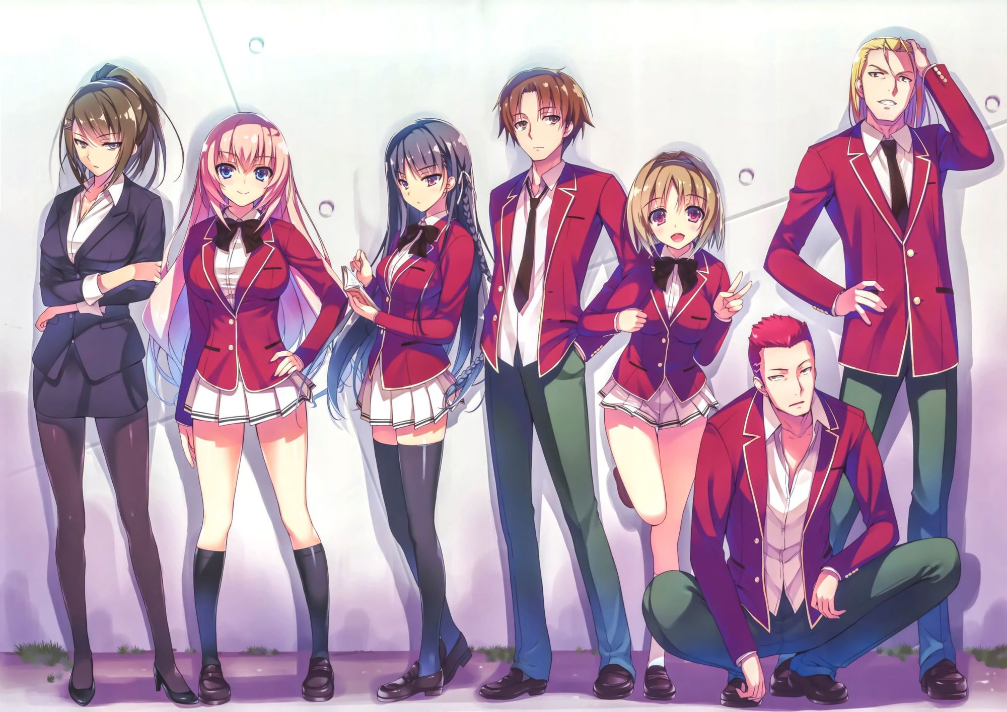
Thank you for paying attention
Any questions?

