Slide 1
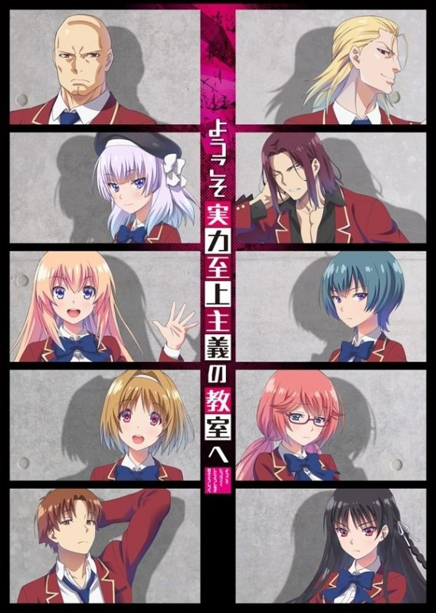
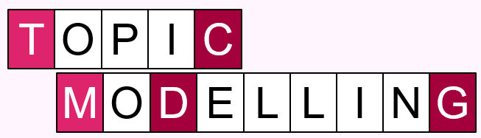
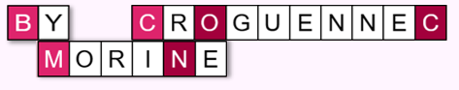

Slide 2
Data

Slide 3


Data
Japanese Visual Novel
About high school students competing to be the ‘best’ class within their year through various competitions.
Under the premise that graduates from the best class in this school can get them any position in society they would like.
14 translated volumes, 3 translated ‘sub volumes’
3

Slide 4
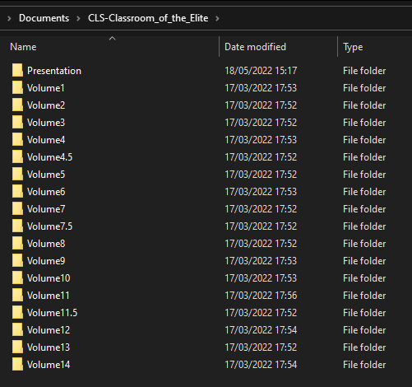
Dataset
4

Slide 5
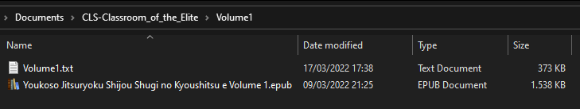
Dataset
5

Slide 6
Research Question

Slide 7
Hypothesis
How do topics change in between the main volumes
and ‘sub volumes’ of Classroom of the Elite?
How do topics change in between the main volumes of Classroom of the Elite covering each trimester of high school for the protagonist?
7

Slide 8
Hypothesis

Slide 9
Hypothesis
Main Volumes:
Competition, rankings
General info about classes
School related topics
Sub Volumes:
More personal developments
Focus on intercharacter relationships
Vacation/break related topics
9

Slide 10
Hypothesis
1st year, 1st trimester:
Explanations of school system (Volume 1)
More info about first years, less about other students/classes
1st year, 2nd trimester:
Less superficial connections, more in depth character descriptions
1st year, 3rd trimester:
Mentions of graduation of older students,
moving onto the 2nd year
2nd year, 4th trimester:
Interclass interaction, all schoolyears
10

Slide 11
Methodology

Slide 12
Methodology
Topic Modelling
Using a pretrained topic model
Books Corpus
(Zhu et al., 'Aligning Books and Movies: Towards Story-like Visual Explanations by Watching Movies and Reading Books’, arXiv (2015))
- Large collection of contemporary, self-published, English-language, novel-length fiction
- Generally self-published, not heavily edited or mediated
Non-Negative Matrix Factorization (NMF)
(Or another topic model if I deem it more suitable)
12

Slide 13
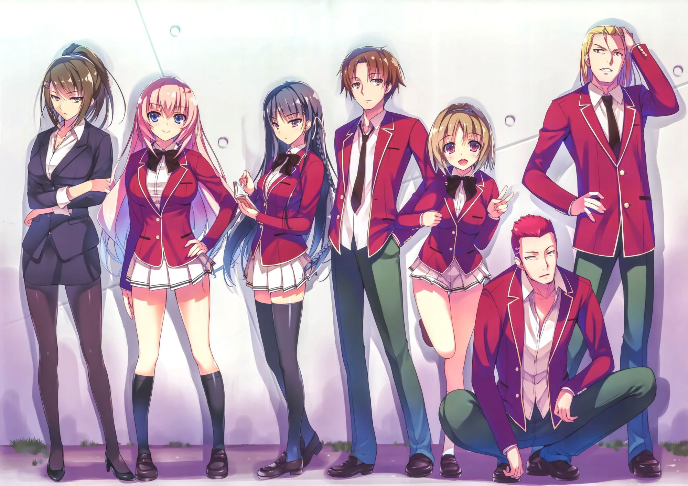
Thank you for paying attention
Any questions?

