Slide 1
PyCloudy, a tool to manage Cloudy
C. Morisset
Instituto de Astronomia
UNAM, Mexico

Slide 2
PyCloudy: what for?
History, need for 3D code
Site, forum, pip, manual
Examples:
  Inputs/outputs
  grids
  3D nebulae
  3MdB (Mexican Million Models database)
  Changing atomic data

Slide 3
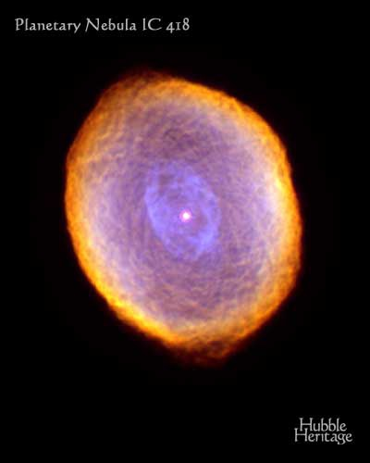
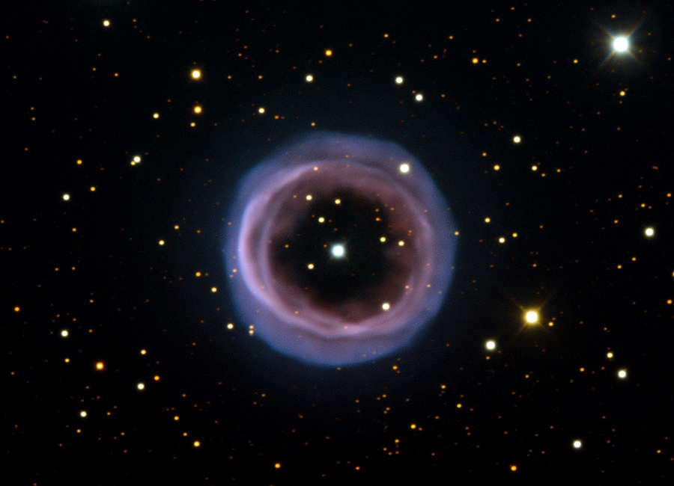
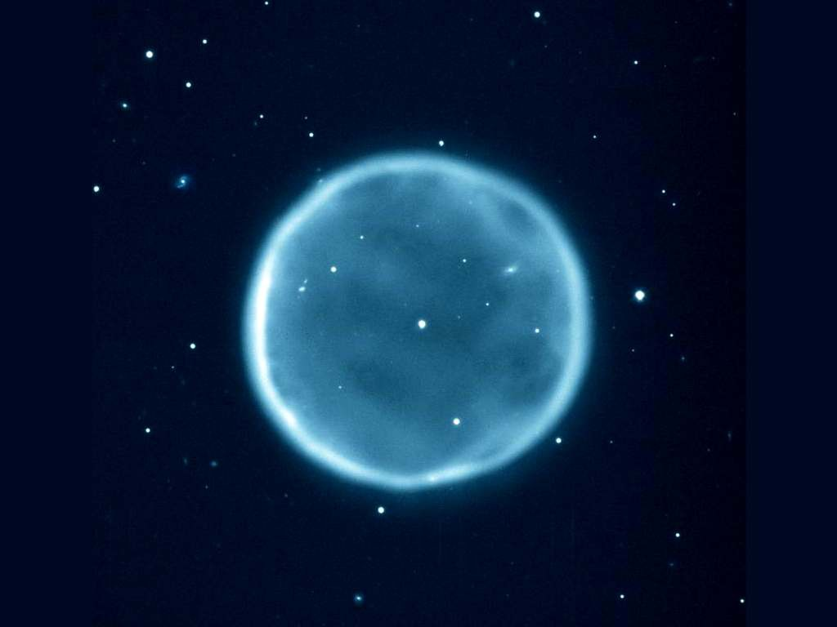
Why 3D ?
●
As we all know, PN are spherical, and HII
regions plan parallels :-)

Slide 4
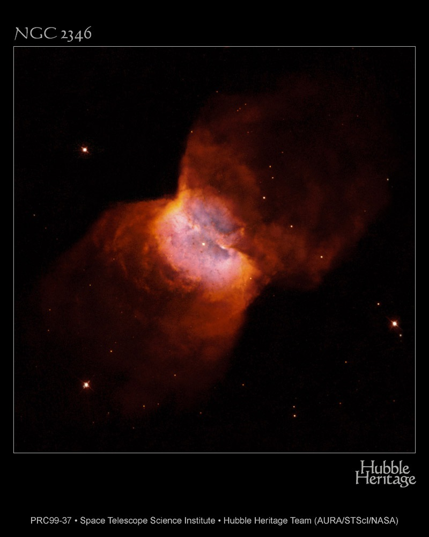
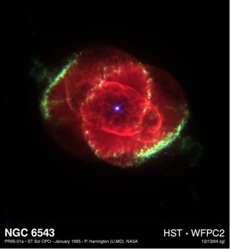
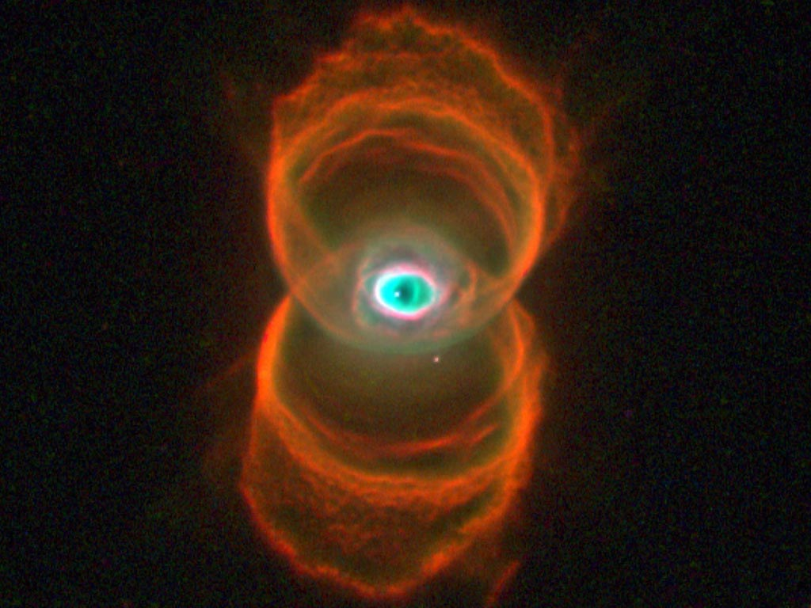
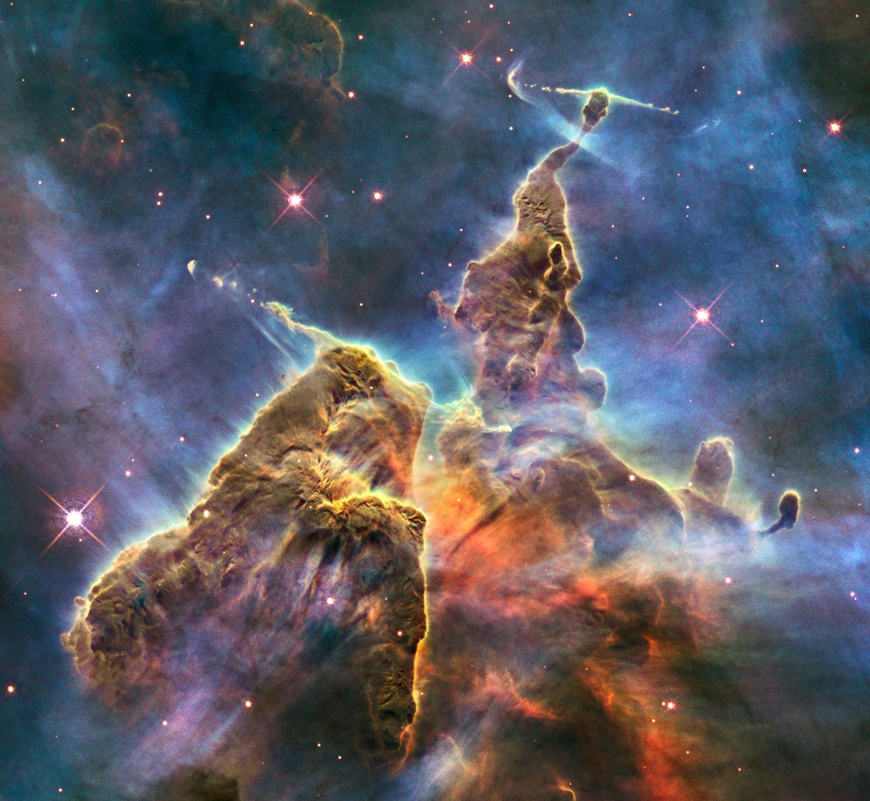
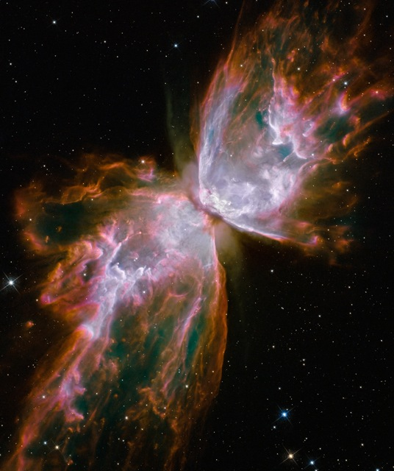
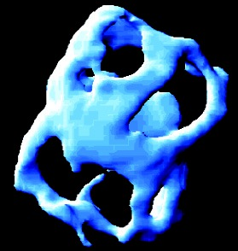
Not O nor //

Slide 5

Aperture effects
●
Color = dominating
emission line.
●
Position : different
line ratios.

Slide 6
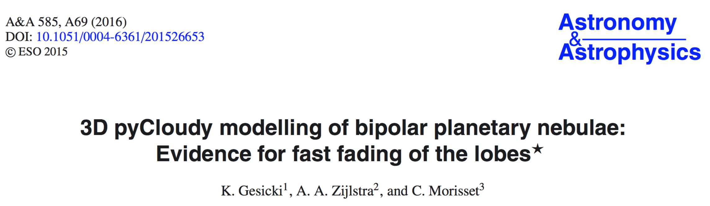
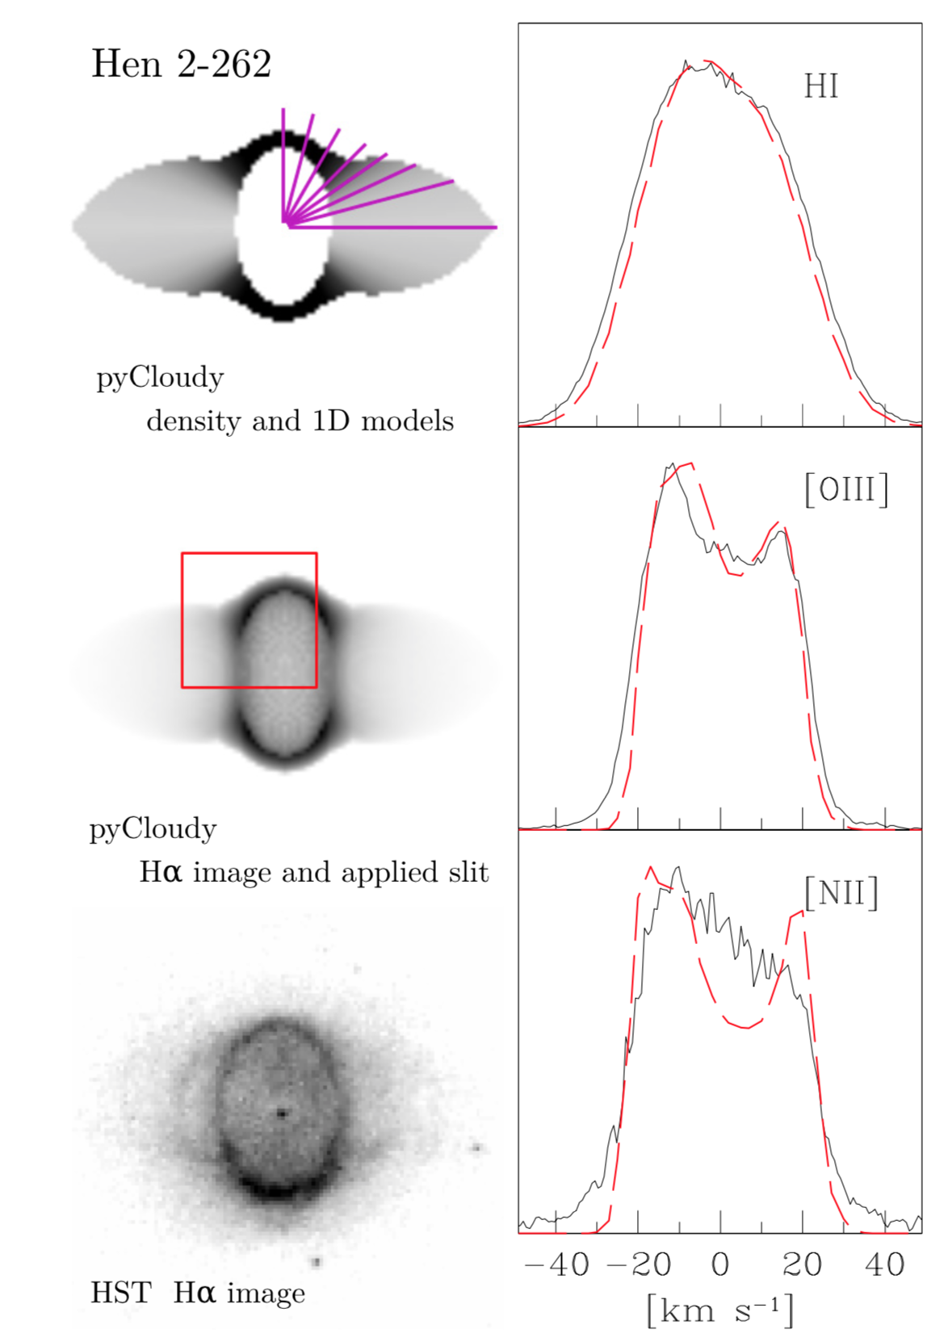
Velocity field

Slide 7

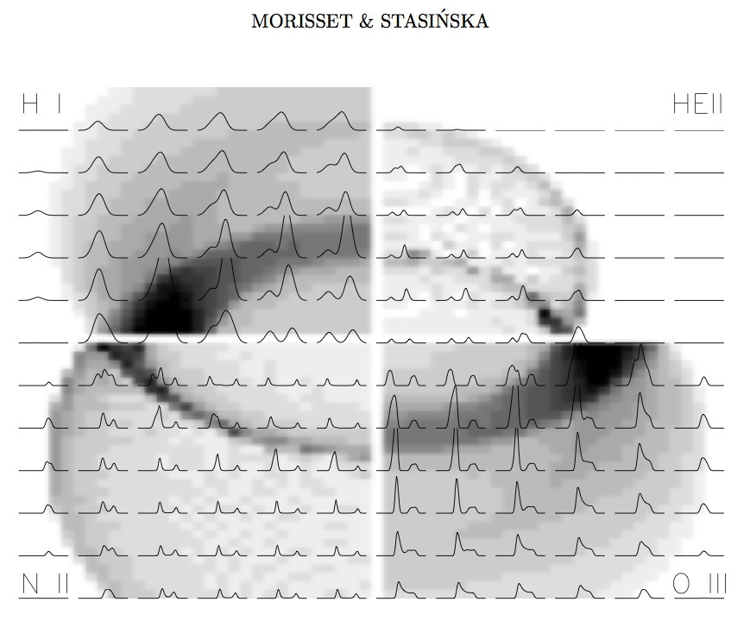

Slide 8
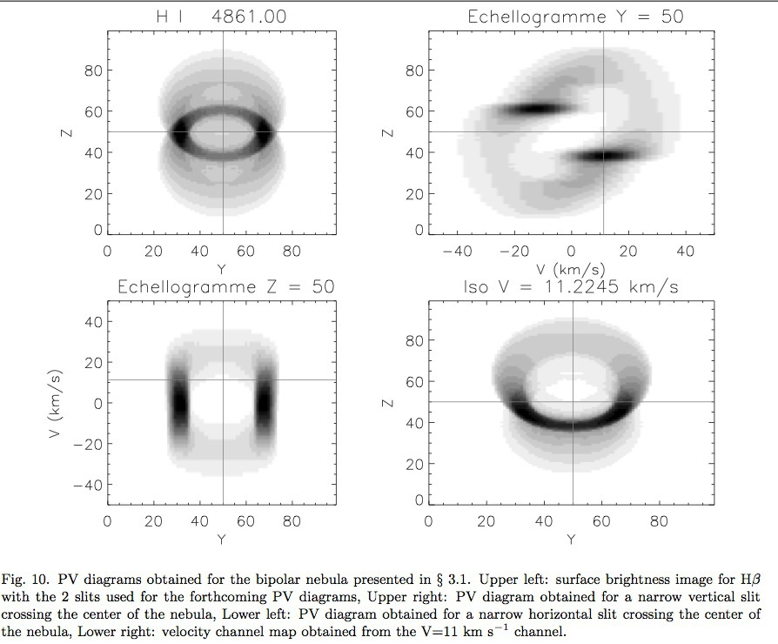
PV-diagrams

Slide 9
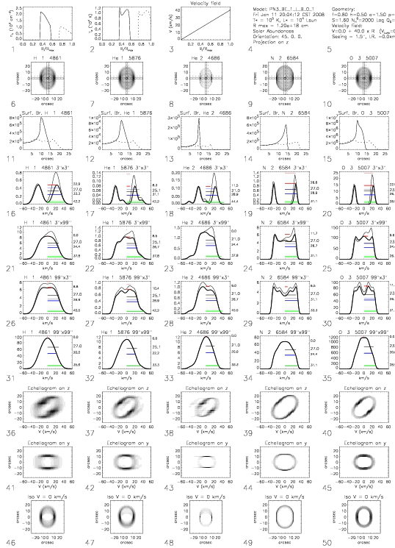


Slide 10
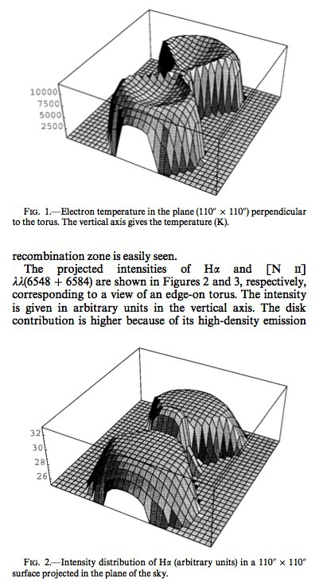
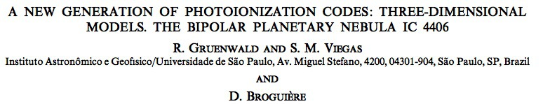
3D photoionization
codes

Slide 11
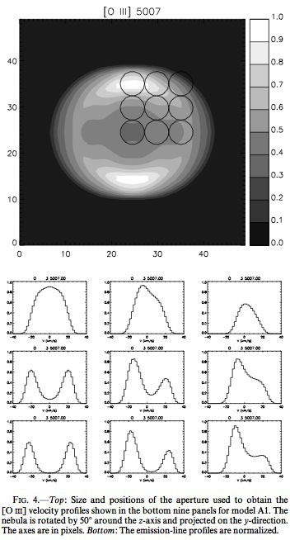
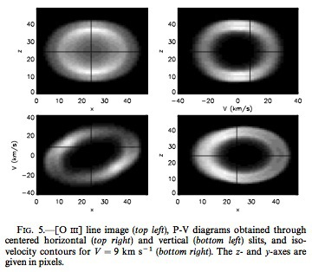

Slide 12
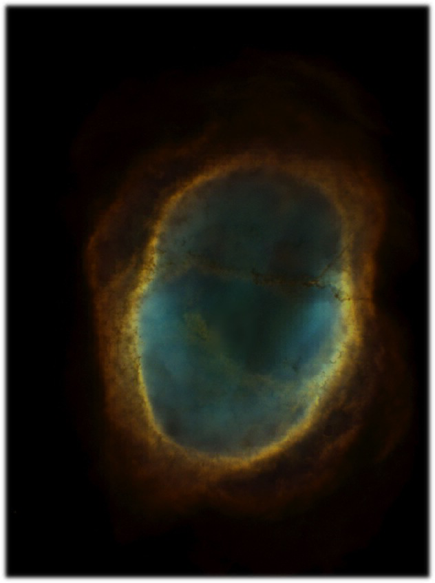

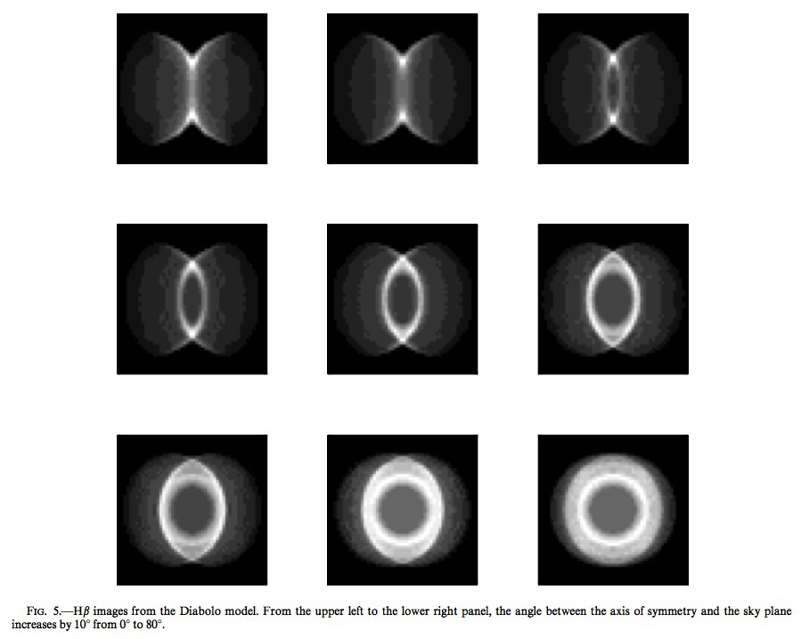
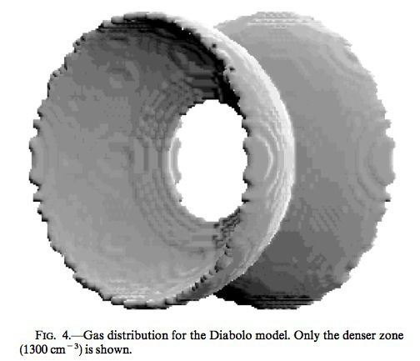

Slide 13
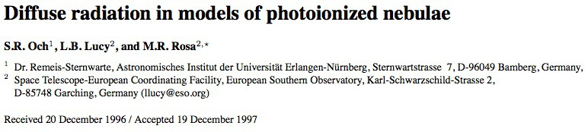
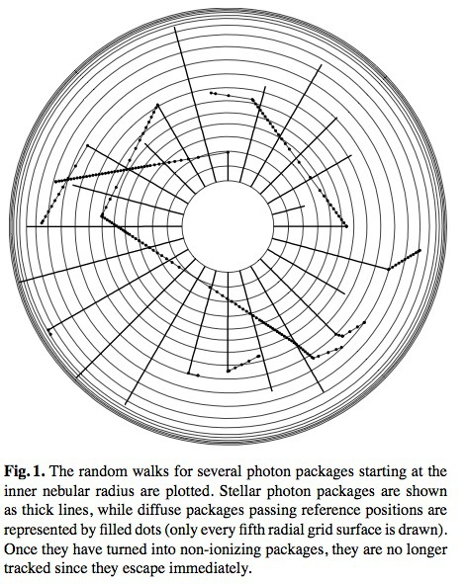
Och's Monte-Carlo code

Slide 14
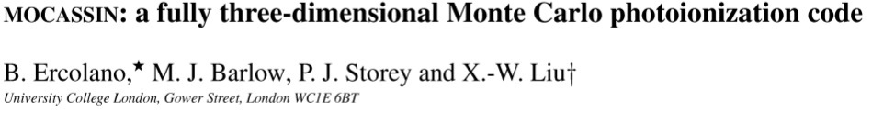
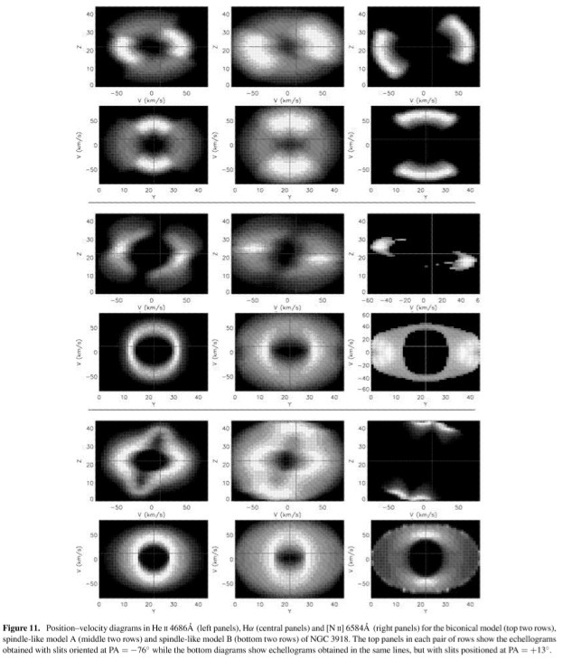
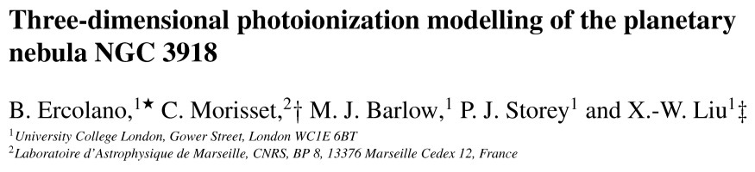
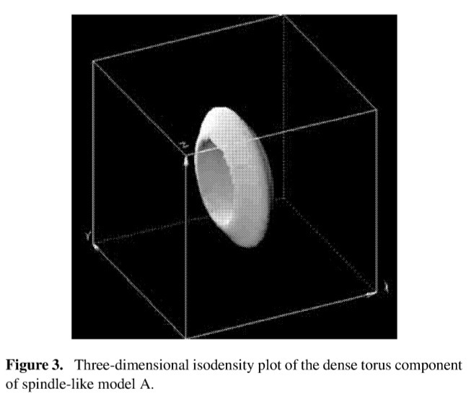

Slide 15
MOCASSIN and Cloudy_3D
●
MOCASSIN : A full 3D photoionization code, using
Monte-Carlo.
●
F90 MPI code, running on cluster.
●
Few hours to days to run/converge a model (cluster
allocation time policies).
●
→ need for a quick (but not so dirty) code to obtain
« pseudo-3D » models
●
Cloudy_3D : we're loosing the « full » 3D, but a few
minutes to run a model :-)

Slide 16
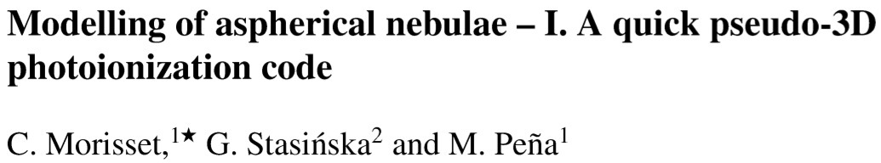
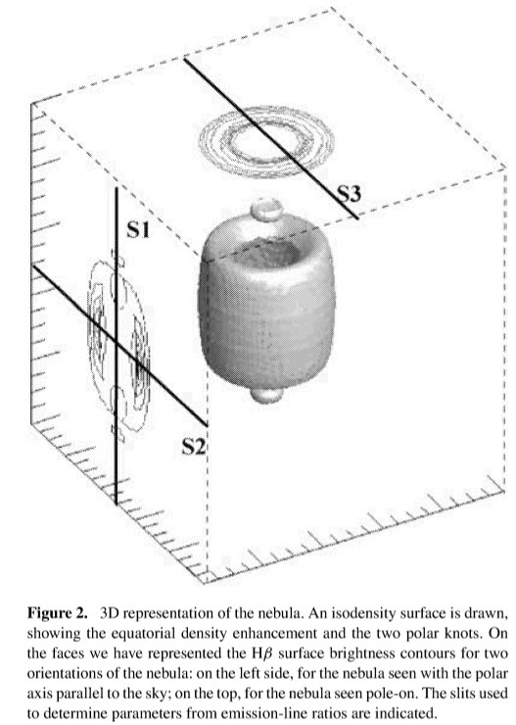

Cloudy_3D
●
Various runs of Cloudy (1D),
corresponding to different
angles.
●
3D reconstruction in a
coordinate cube by
interpolation between the 1D
runs. IDL package

Slide 17
C3D: faster but limited ?
Cloudy_3D is not a “full” 3D code. It only considers radial radiation (as a combination of 1D runs)
Limitation: when no-radial radiation dominates a process (e.g. photoionization)
Mainly 2 cases:
  Shadows
  Multiple stars
Otherwise: OK

Slide 18
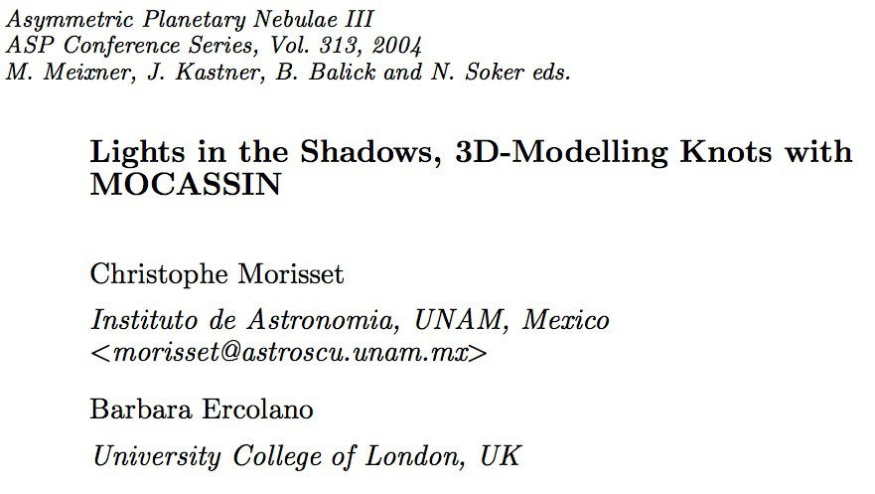
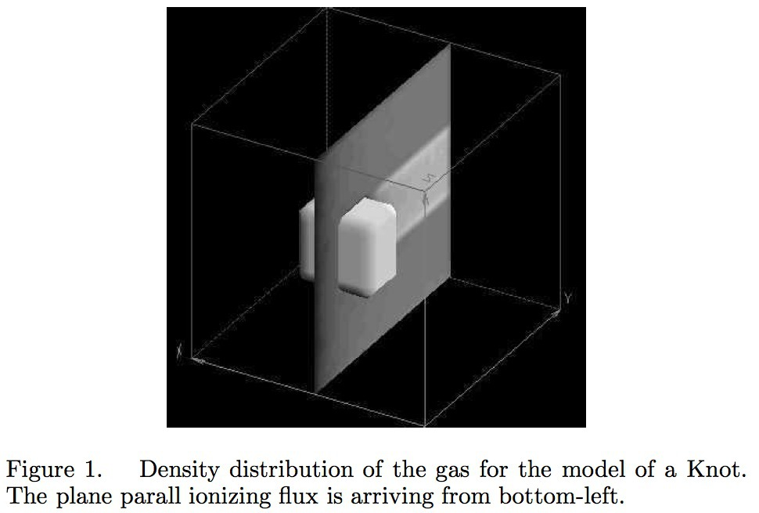
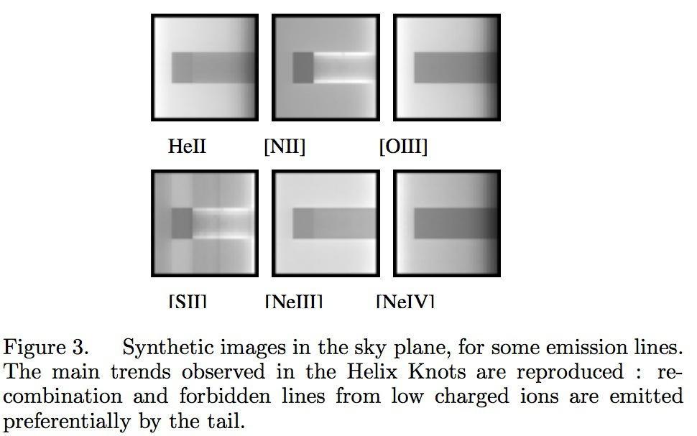
Shadows

Slide 19
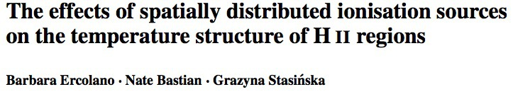
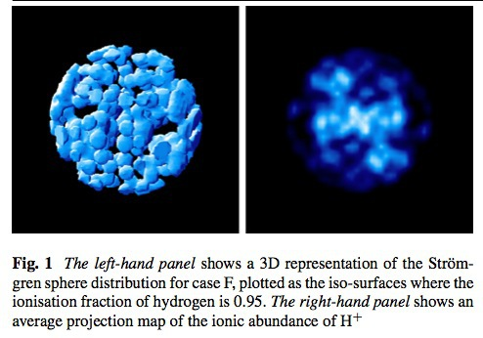
Multiple stars

Slide 20
C3D → pyCloudy
In 2011, I translated C3D from IDL to python to have all the benefits of python: free language, widely used by the community, very well supported.
I also took the opportunity to increase the facilities (e.g. parallelisation, a lot of new methods, MdB, ...).

Slide 21
pyCloudy
PyCloudy is not only a pseudo-3D code, it's more than this.
It's a python library used to manage the inputs and the outputs of Cloudy.
It allows to
  easily run a model and play with the results (including plotting them).
  easily compute grids of models, running Cloudy in parallel.
  Compute pseudo 3D models
It can interact with the 3MdB database.

Slide 22
pyCloudy galaxy on the web
Site: https://sites.google.com/site/pycloudy/
Forum: https://groups.google.com/forum/#!forum/pycloudy
Pip: https://pypi.python.org/pypi/pyCloudy/
Reference Manual: https://pythonhosted.org/pyCloudy/
Sources: https://github.com/Morisset/pyCloudy

Slide 23
Installation
Some libraries are needed for pyCloudy to run:
  Numpy
  Matplotlib
  Scipy
  Image (to make 3 colors images)
  Pyneb (to change atomic physics)
  PyMySQL (to interact with 3MdB, better than MySQL)

Slide 24
Installation of Python
The best seems to install a full package that comes with everything an astronomer may need. The STSCI team collaborate to such a package named Anaconda:
https://www.anaconda.com
It comes with almost everything (even IRAF in astroconda)

Slide 25
Using PIP
Once Anaconda installed, from a terminal, the installation of the remaining libraries and of pyCloudy itself is trivial:
  pip install pyneb (optionnal)
  pip install pyCloudy
  Developpment version:
    pip install -U git+https://github.com/Morisset/pyCloudy.git

Slide 26
Managing input and output files
https://github.com/Morisset/pyCloudy/blob/master/pyCloudy/docs/Using_pyCloudy_1.ipynb

Slide 27
Grids of models
https://github.com/Morisset/pyCloudy/blob/master/pyCloudy/docs/Using_pyCloudy_2.ipynb

Slide 28
3D model
https://github.com/Morisset/pyCloudy/blob/master/pyCloudy/docs/Using_PyCloudy_3.ipynb

Slide 29
How to take the aperture size and position into account
https://github.com/Morisset/pyCloudy/blob/master/pyCloudy/docs/Using%20PyCloudy%204.ipynb

Slide 30
Huge grids of models
Sometimes one needs to compute huge grids of models (from a few 10³ to 10⁶ models...).
In this case one cannot rely on reading all the output files, it would take tooooo much time and memory (RAM and ROM).
The solution is to store the results of the models into a database.
This is the main idea behind 3MdB (Mexican Million Models dataBase).

Slide 31
3MdB
https://sites.google.com/site/mexicanmillionmodels/

Slide 32
Example of use of 3MdB from pyCloudy
https://github.com/Morisset/pyCloudy/blob/master/pyCloudy/docs/Using%20pyCloudy%20MdB.ipynb
A paper on 3MdB:
http://adsabs.harvard.edu/abs/2014arXiv1412.5349M

Slide 33
Changing atomic data in Cloudy
It is possible to extract from the Cloudy model the electron temperature and density and the ionic fractions to re-compute at each zone of the nebula the emissivities of the lines, using the PyNeb code. This is NOT coherent in the fact that changing the line emissivities change the cooling and then the electron temperature. And only collisional effects are taken into account. But this can nevertheless helps to understand the effect of choosing one set of atomic data or another one in the analysis of a nebula.
https://github.com/Morisset/pyCloudy/blob/master/pyCloudy/docs/Using%20PyCloudy%20with%20PyNeb.ipynb

