Slide 1
Title
Subtitle

Slide 2
EDIFACT messages
Kind of hard to read …
UNA:+,?'UNB+UNOC:3+9905048000007:500+9985046000001:500+241225:1153+CS0000000FSZVU++TL'UNH+1+MSCONS:D:04B:UN:2.4c'BGM+Z48+CS0000000FSZVU1+9'DTM+137:202412251153?+00:303'RFF+Z13:13025'NAD+MS+9905048000007::293'NAD+MR+9985046000001::293'UNS+D'NAD+DP'LOC+172+50120962218'DTM+163:202412162300?+00:303'DTM+164:202412172300?+00:303'LIN+1'PIA+5+11?:1.29.0:SRW'QTY+220:0,827'DTM+163:202412162300?+00:303'DTM+164:202412162315?+00:303'QTY+220:1,034'DTM+163:202412162315?+00:303'DTM+164:202412162330?+00:303'QTY+220:1,22'DTM+163:202412162330?+00:303'DTM+164:202412162345?+00:303'QTY+220:1,366'DTM+163:202412162345?+00:303'DTM+164:202412170000?+00:303'QTY+220:1,409'DTM+163:202412170000?+00:303'DTM+164:202412170015?+00:303'QTY+220:1,718'DTM+163:202412170015?+00:303'DTM+164:202412170030?+00:303'QTY+220:1,515'DTM+163:202412170030?+00:303'DTM+164:202412170045?+00:303'QTY+220:1,102'DTM+163:202412170045?+00:303'DTM+164:202412170100?+00:303'QTY+220:2,223'DTM+163:202412170100?+00:303'DTM+164:202412170115?+00:303'QTY+220:1,928'DTM+163:202412170115?+00:303'DTM+164:202412170130?+00:303'QTY+220:2,449'DTM+163:202412170130?+00:303'DTM+164:202412170145?+00:303'QTY+220:2,484'DTM+163:202412170145?+00:303'DTM+164:202412170200?+00:303'QTY+220:1,313'DTM+163:202412170200?+00:303'DTM+164:202412170215?+00:303'QTY+220:3,193'DTM+163:202412170215?+00:303'DTM+164:202412170230?+00:303'QTY+220:2,407'DTM+163:202412170230?+00:303'DTM+164:202 [...]

Slide 3
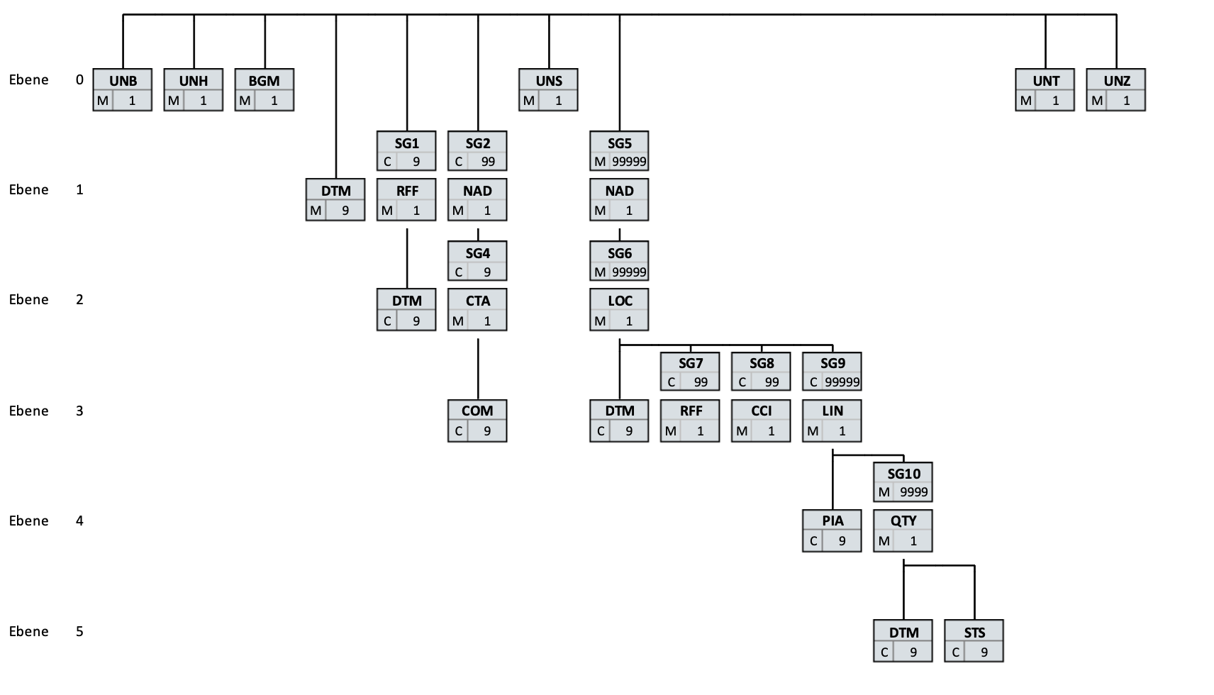
Hierarchical Structure

Slide 4
Hierarchical Structure
Repeated Segments
Optional
Attachment requires logic

Slide 5
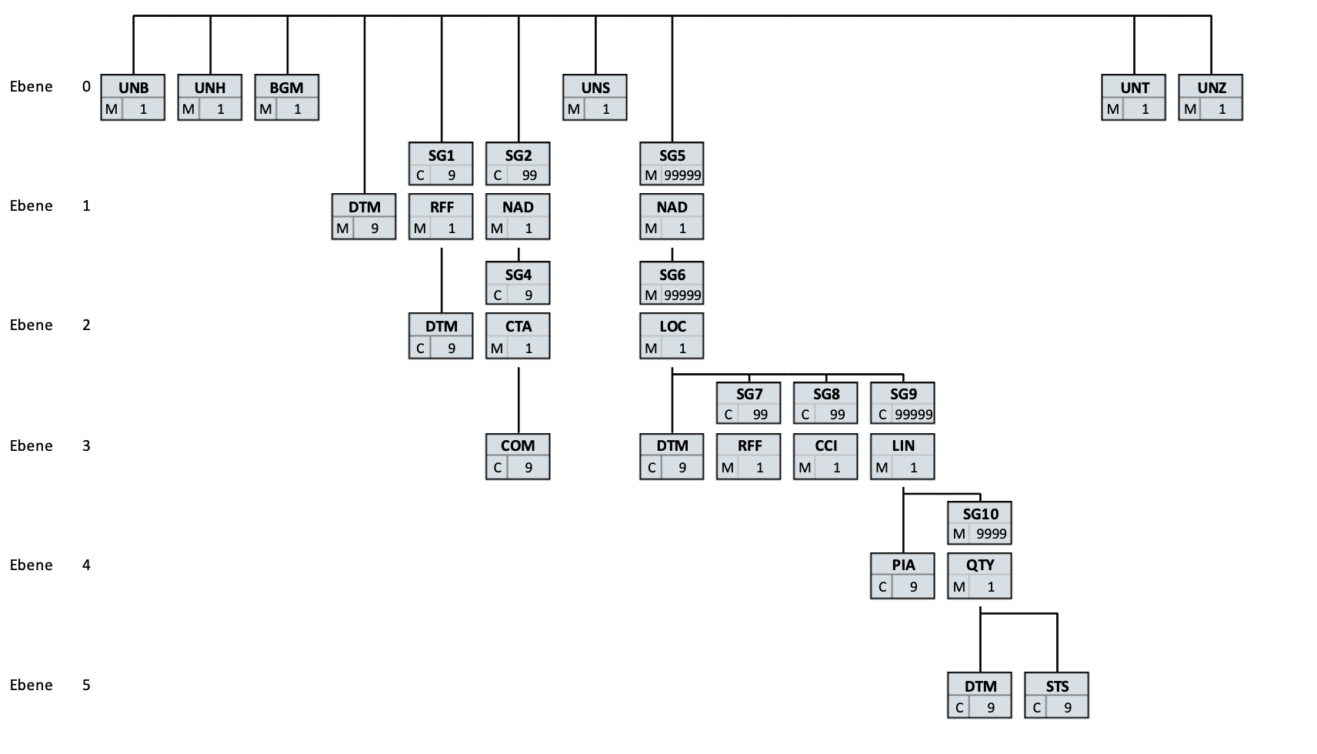
Get An Overview
Interchange
Segment Group (SG)
Segment
Components :
SG
STS+1+MSCONS:D:04B:UN:2.4c
Elements +

Slide 6
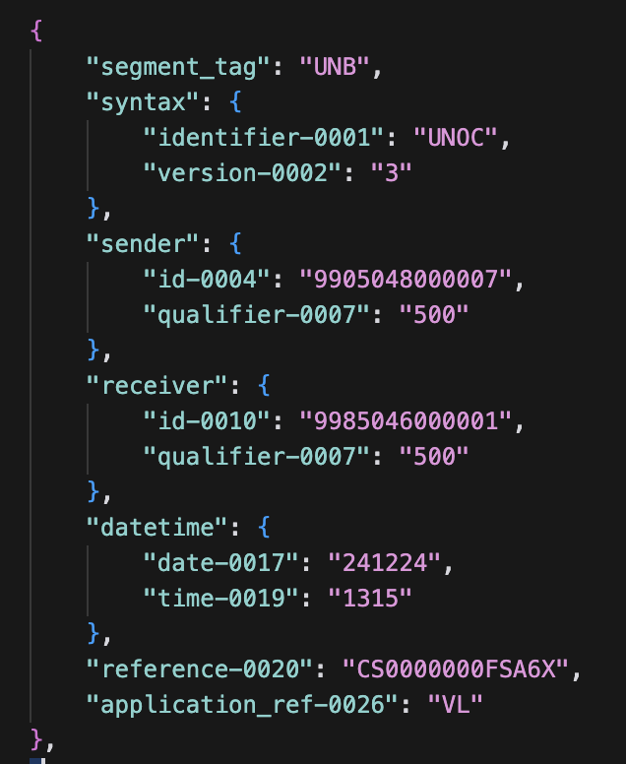
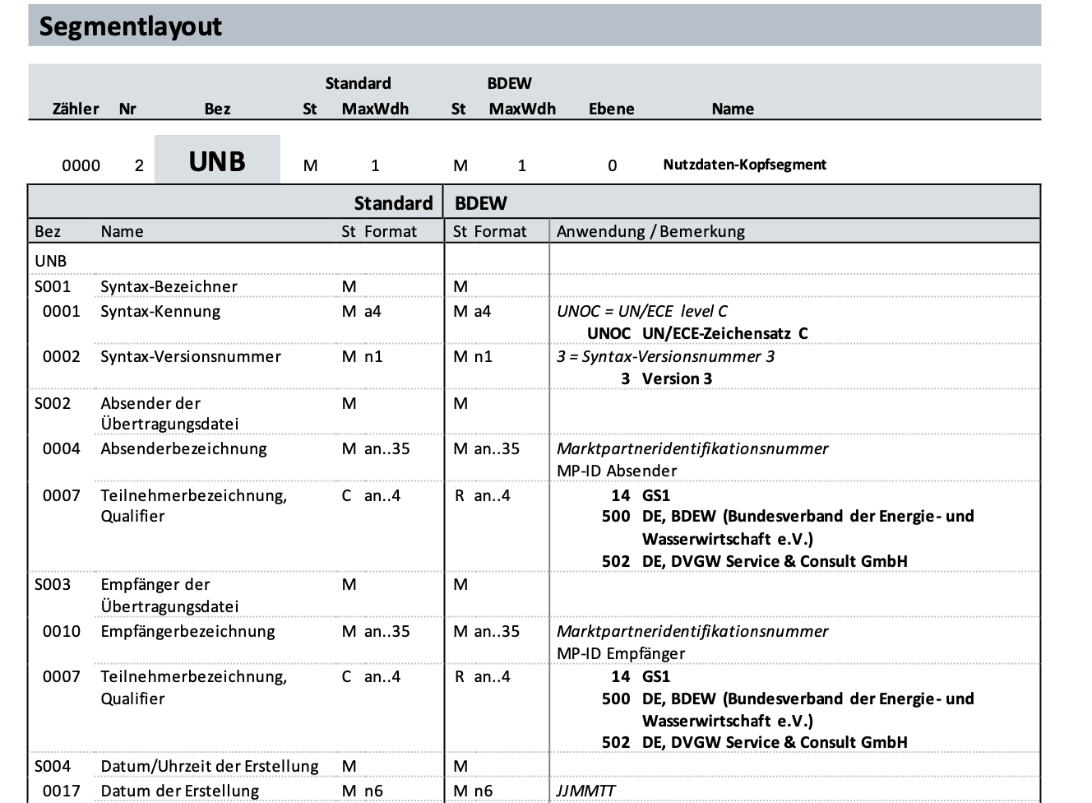
Make Segment Interpretable
UNB
+UNOC:3
+9905048000007:500
+9985046000001:500
+241224:1315
+CS0000000FSA6X
+
+VL

Slide 7
Encode Hierarchy
Knot SG5.2.SG6.4.SG9.1.SG10.1
Leaf SG5.2.SG6.4.SG9.1.SG10.1.DTM.1

Slide 8
Read out Interchange
Sender
Message type
Quantities with Qualifier (220, 67, Z18)
Times OBIS number
Put into one table
Drop duplicate times with lower qualifier

Slide 9
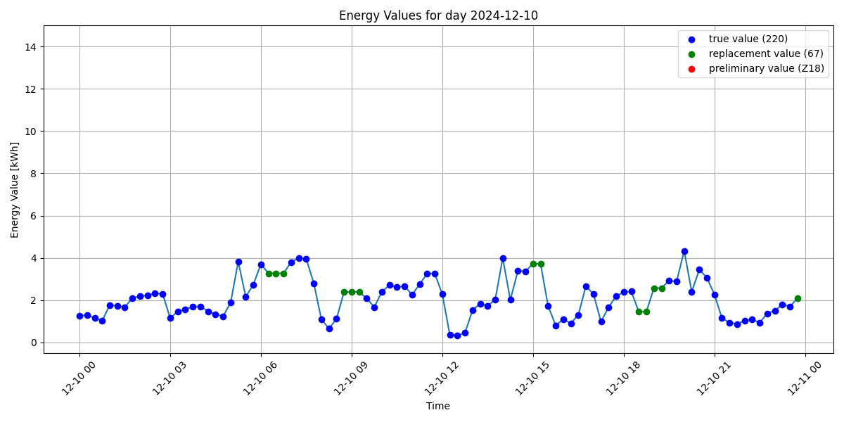
Visualize Day
From completed month

Slide 10
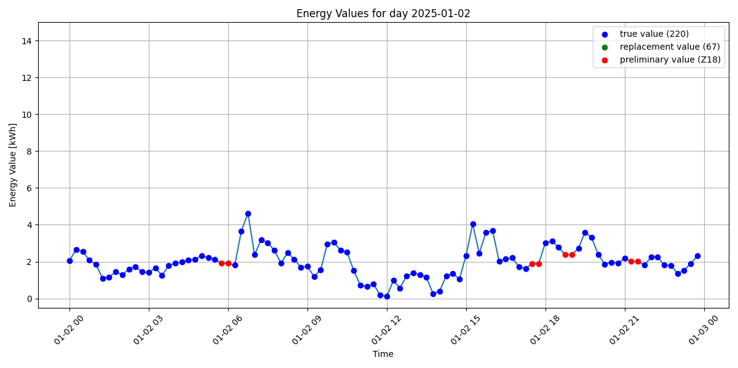
Visualize Day
From ongoing month

Slide 11
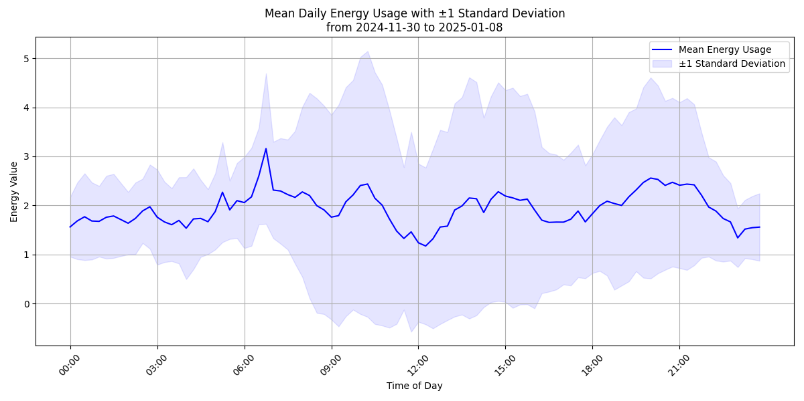
Visualize Average Daily Consumption
Across full month

Slide 12
Testing
Hierarchy
Segment parsing
UNB+UNOC:3+9905048000007:500+9985046000001:500+241224:1315+CS0000000FSA6X++VL
Compare
Manually create and look up SG5.2.SG6.4.SG9.1.SG10.1
For tag in set(tags)
If hierarchy.count(tag) != all_seg.count(tag) Error
Check: len(segments) == len (parsed segments)
For segments, parsed segments:
if segment_tag != parsed_segment tag:
Error

