Slide 1
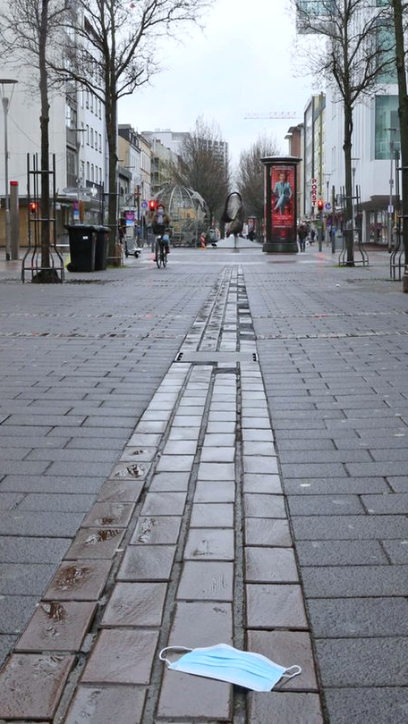
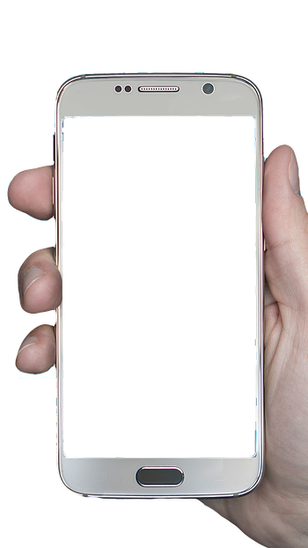
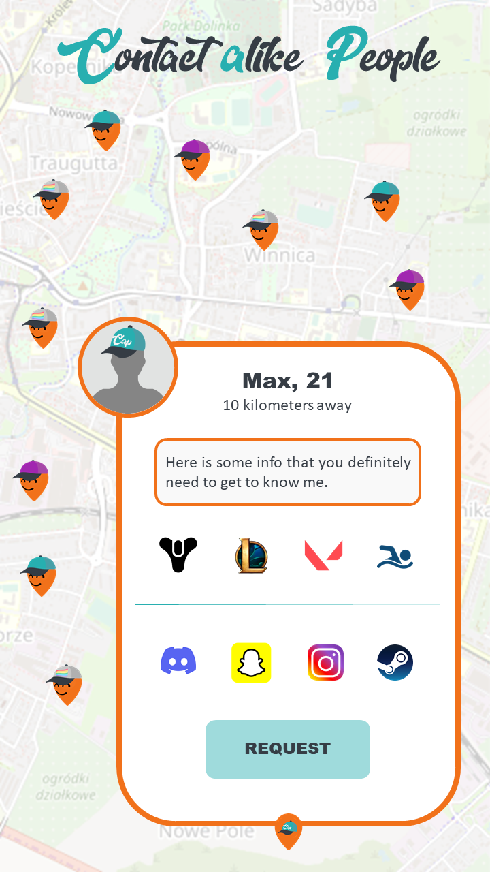

Slide 2
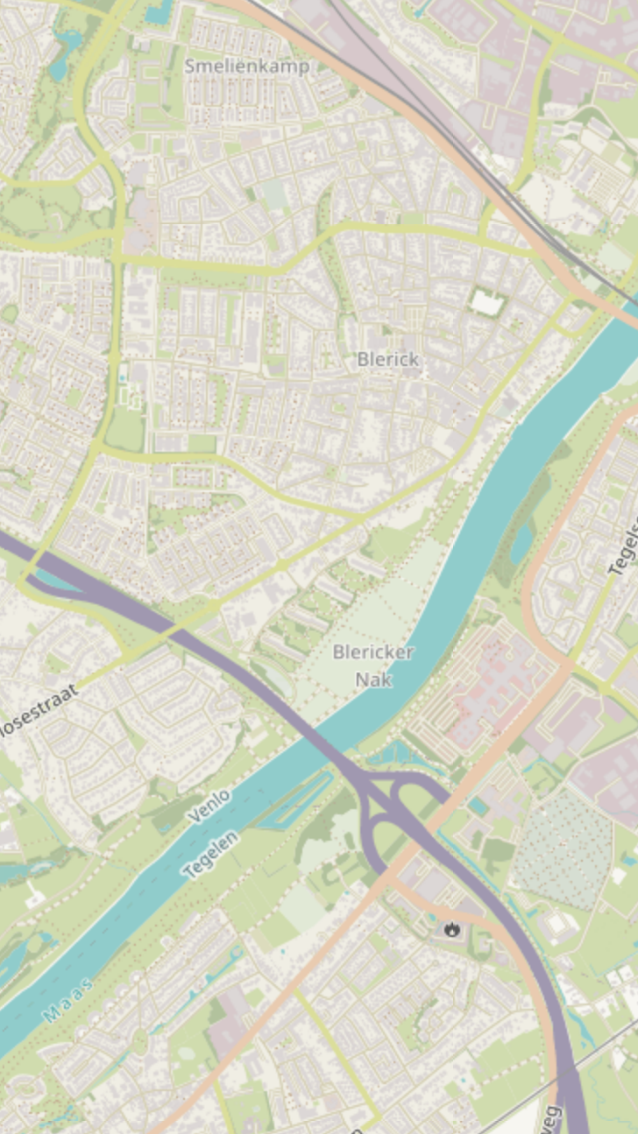
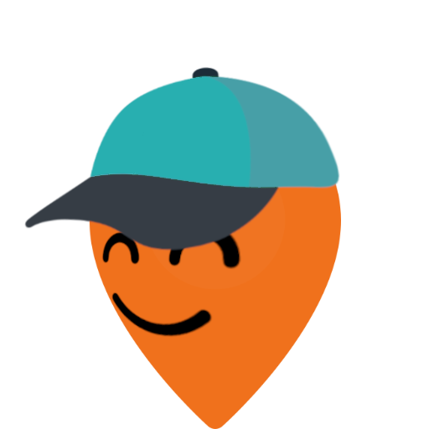













Max, 21
10 kilometers away
Here is some info that you definitely need to get to know me.
REQUEST

Slide 3
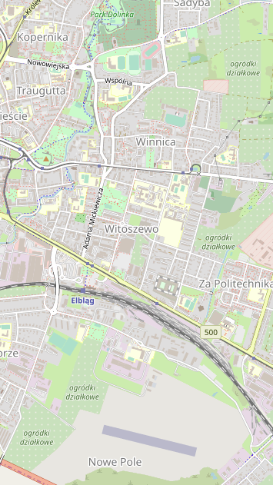
Max, 21
10 kilometers away
Here is some info that you definitely need to get to know me.
REQUEST

Slide 4
Contact alike People
Max, 21
10 kilometers away
Here is some info that you definitely need to get to know me.
REQUEST

Slide 5


Simon, 31
REQUEST
187 kilometers away
Could you please send me 10.000€? My enemies are hunting me!
Contact alike People

Slide 6
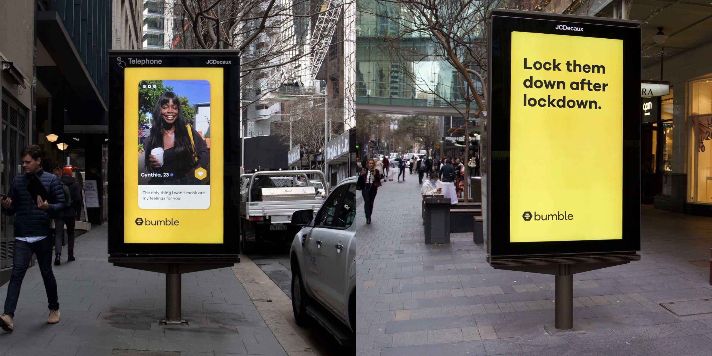

Slide 7
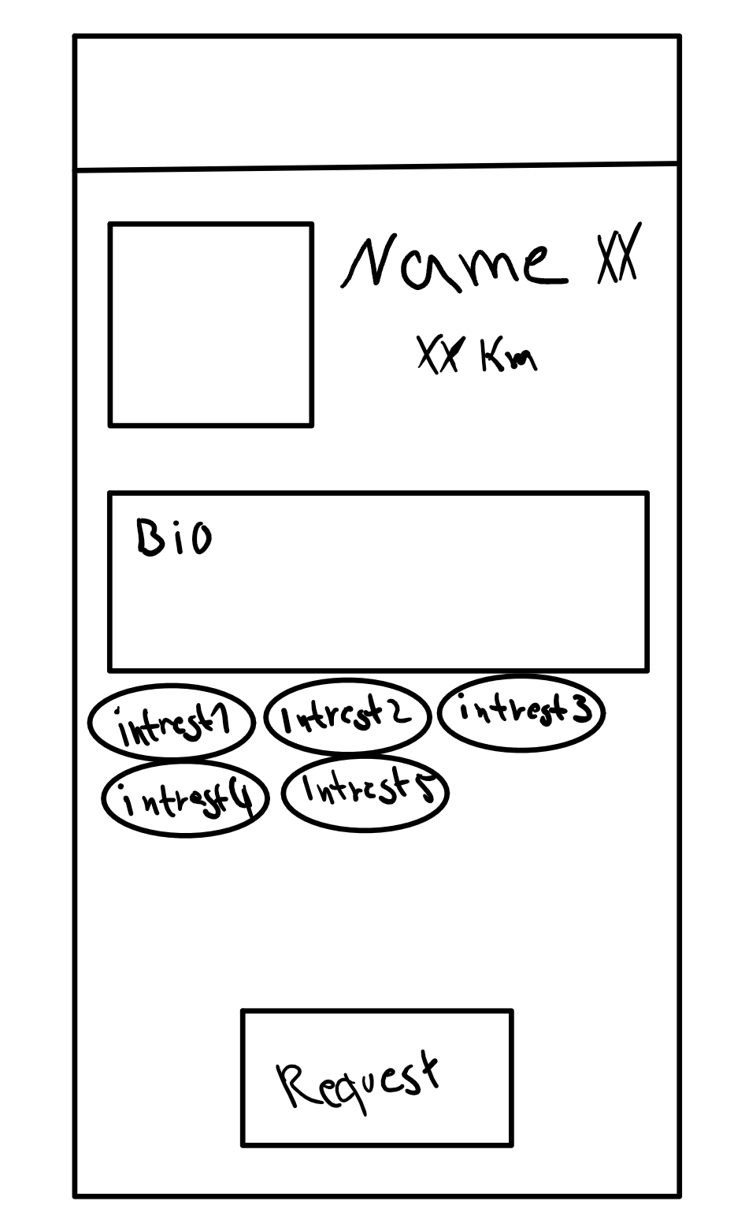

Slide 8
Max Mustermann
Venlo
Venlo
Max#5555
MaxSnaps
MaxInsta
MaxSteam12
Destiny 2
LoL

Slide 9





Contact alike People
Jonas, 21
187 kilometer(s) away
Send me a request and I‘ll carry you in Destiny lol
REQUEST

