Slide 1
Kademlia DHT
Projektarbeit
Moritz Goeckel

Slide 2
Goal of this work
Learning about DHTs by implementing one

Slide 3
Choosing a DHT

Slide 4
Choosing a DHT
Kademlia
  Newest DHT
Chord
  Simple
CAN
  Worse look-up complexity
  Handles churn well
Pastry
  Topology aware
Tapestry
  More complex than Pastry

Slide 5
Choosing a DHT
Kademlia
  Newest DHT
Chord
  Simple
CAN
  Worse look-up complexity
  Handles churn well
Pastry
  Topology aware
Tapestry
  More complex than Pastry

Slide 6
Architecture

Slide 7
Technology
Language: Java
  Widely used
  Powerful networking libraries
  Easy to use
Communication: Java RPC
  Easy to use
  Well integrated in Java
Architecture
Two operationals modes for communication:
  Within process for benchmarking
  Across network for live operation

Slide 8
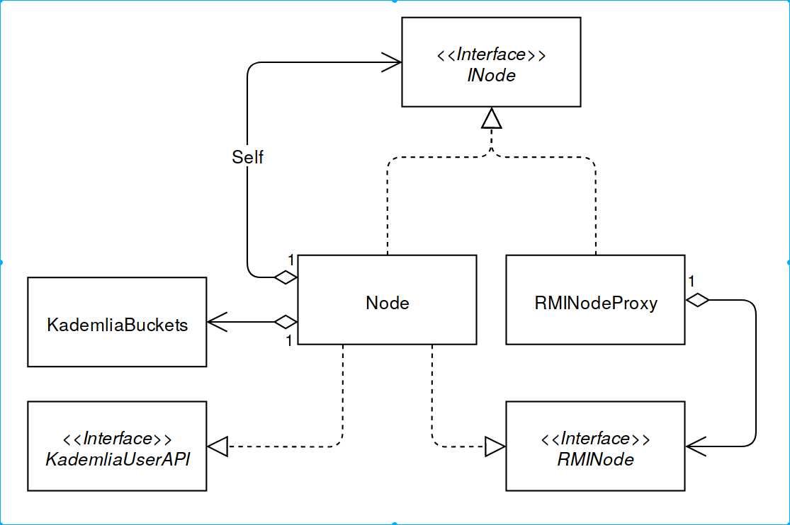

Slide 9
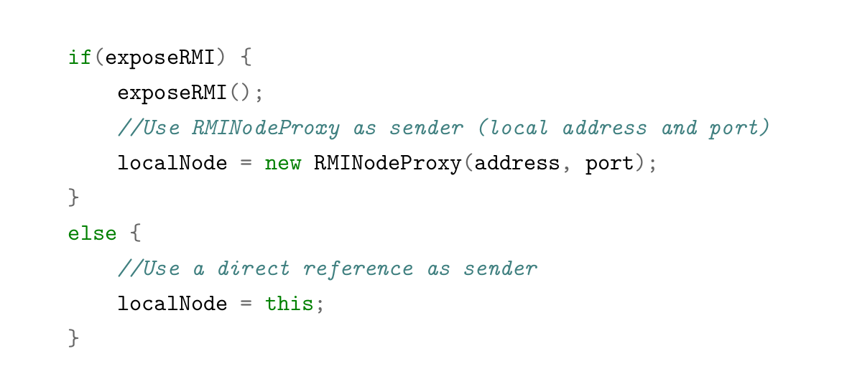

Slide 10
Churn tests

Slide 11
Churn test one
Set value x on n nodes
Remove n - 1 nodes
Lookup x to validate that x is still available
Churn test two
Remove random nodes
Make nodes join the network
Repeat 100 times
Store and lookup values on random nodes to validate network integrity

Slide 12
Benchmarks

Slide 13
Generate a network
Spawn a new node
Connect it to one random node already in the network
Repeat n times
Benchmark the network
Generate a random value x
Make a random node store it on the network
Lookup x on a random node
Repeat 3000 times

Slide 14
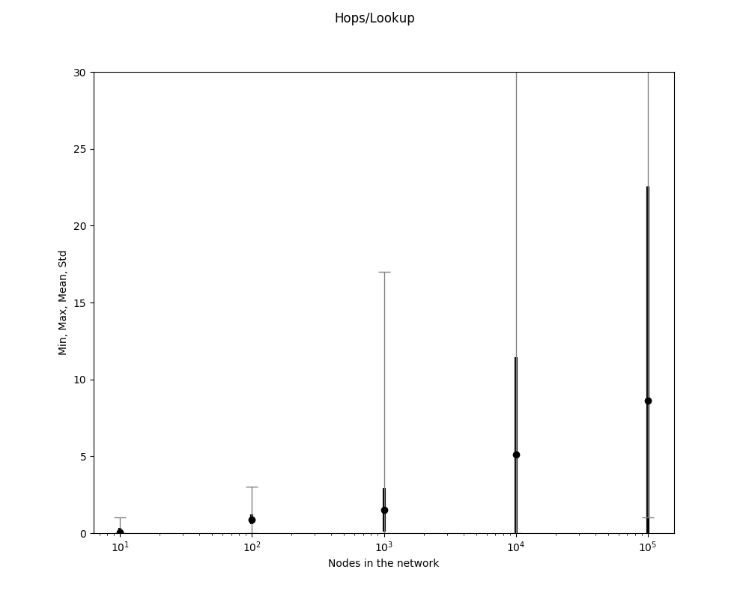

Slide 15
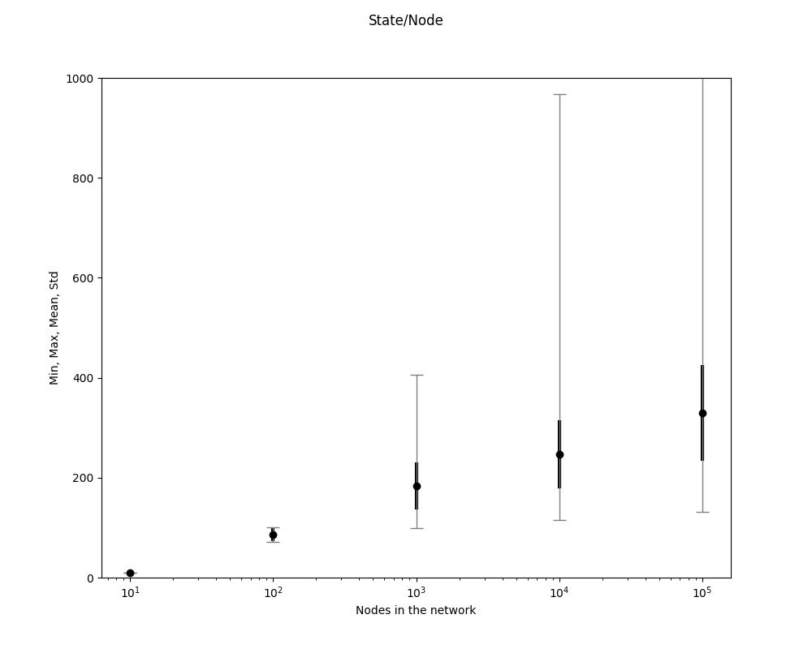

Slide 16
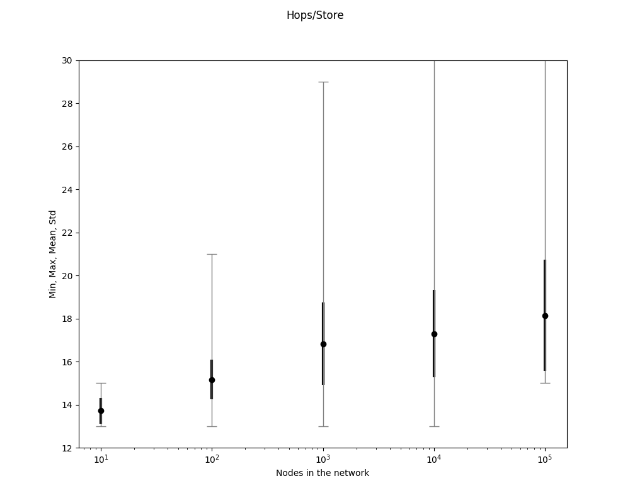

Slide 17
Conclusion / Outlook

Slide 18
Not implemented in this work
Parallel lookup
Caching
Communication via UDP
Topology awareness
Achieved in this work
Understanding the principles of DHTs by reading the papers
Implementing one DHT
Benchmarking the implementation

Slide 19
Thank you

