Slide 1
A Multiagent-System for
a smart factory
Moritz Kemp
Multiagent and Agent Systems, H-BRS

Slide 2
Content
Requirements
Concept
Agent design
Coordination design
Critical review

Slide 3
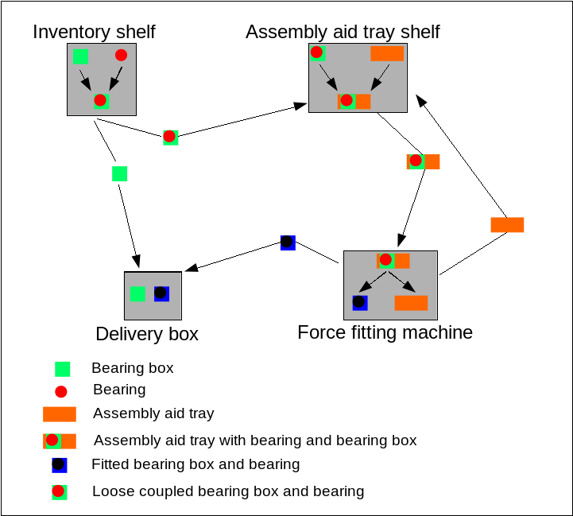
Requirements

Slide 4
Requirements
benevolent agents
no communication constraints
no movement constraints
dynamic environment

Slide 5
Concept
BDI architecture
closed world
mulit-purpose agents
common goal
some plans form a tree
  inter-nodes as meta-plans
  leaves as plans with actions
coordination techniques
  social law (programmer is authority)
  auction
  CNP
FIPA ACL for communication

Slide 6
Agent design
Delivered
bearing box
Have
bearing box
Dropped
bearing box

Slide 7
Agent design
Delivered force-fitted
bearing box
Have force-fitted
bearing box
Delegated Task:
„Returned Assembly Aid“
Dropped force-fitted
bearing box
Having
assembly parts
Loaded
force-fitting machine

Slide 8
Coordination design
Contract Net Protocol
Task sharing
  purpose: faster delivery
Using CNP
  fixed agent for task from environment
  leader uses CNP for order delegation
  other agents for sub-tasks

Slide 9
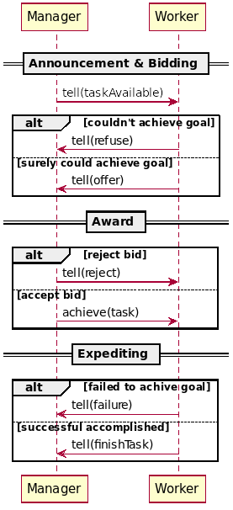
Coordination design
Contract Net Protocol

Slide 10
Coordination design
Auction of leader position
Chairman for auction
  determined by social law (offline)
  can bid too
First-Price, Sealed-Bid, One-Shot
  first price: benevolent environment
  sealed bid: avoid broadcast
  one shot: no profit for auctioneer

Slide 11
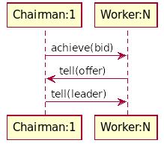
Coordination design
Auction of leader position

Slide 12
Critical Review
Voting instead of auction
Specialized vs. Multipurpose
  increasing plan library
Insufficient failure handling
  death of leader is not recognized
No reactive behauviour

Slide 13
Demo

