Slide 1
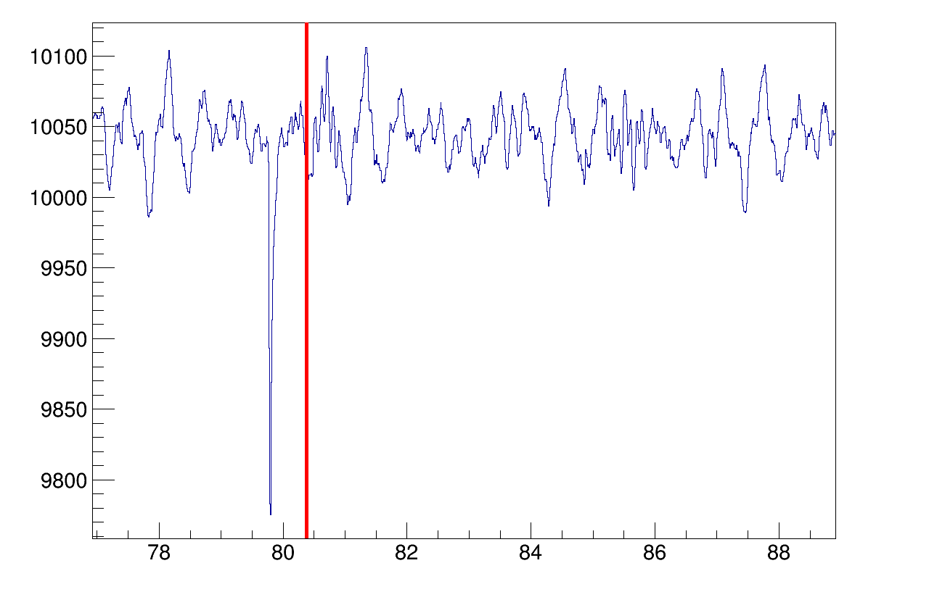
Lower limit of the standard veto time frame
Pre-coincedence signal

