Slide 1
Advanced Computer Graphics Practical Session
Programming Assignment 1

Slide 2
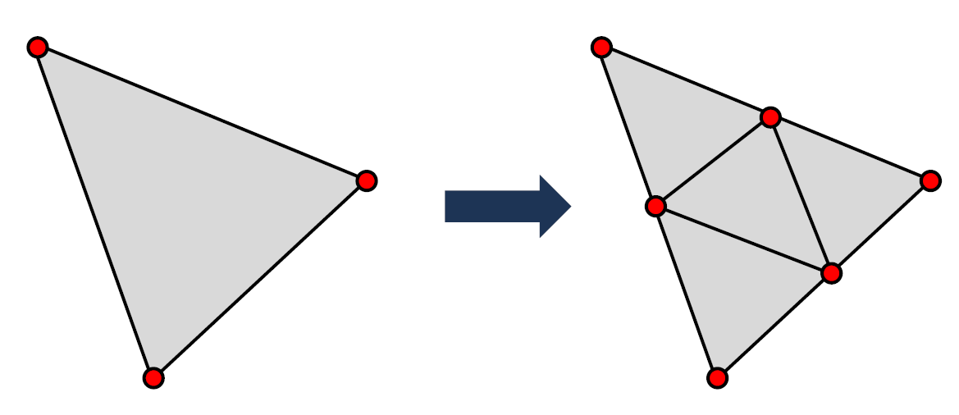
1. Change the scene description to triangles (and triangular patches).
Patches are Triangle-instances

Slide 3
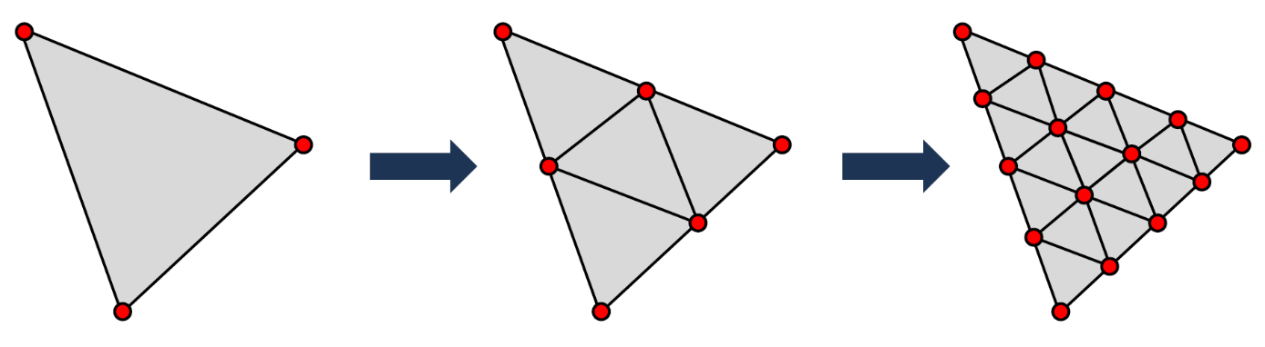
1. Change the scene description to triangles (and triangular patches).
Depth 0 Depth 1 Depth 2

Slide 4



1. Change the scene description to triangles (and triangular patches).
$$\vec{a}$$
$$\vec{b}$$
$$\vec{p_{0}}$$

Slide 5



1. Change the scene description to triangles (and triangular patches).
$$\vec{a}$$
$$\vec{b}$$
$$\vec{\frac{a}{2}}$$
$$\frac{\vec{b}}{2}$$
$$\vec{p_{0}}$$

Slide 6



1. Change the scene description to triangles (and triangular patches).
$$\vec{a}$$
$$\vec{\frac{a}{2}}$$
$$\frac{\vec{b}}{2}$$
$$\vec{b}$$
$$\vec{p_{0}}+\vec{\frac{a}{2}}$$
$$\vec{p_{0}}$$

Slide 7



1. Change the scene description to triangles (and triangular patches).
$$\vec{a}$$
$$\vec{\frac{a}{2}}$$
$$\vec{b}$$
$$\frac{\vec{b}}{2}$$
$$\vec{p_{0}}+\vec{\frac{b}{2}}$$
$$\vec{p_{0}}$$

Slide 8



1. Change the scene description to triangles (and triangular patches).
$$\vec{a}$$
$$\vec{p_{0}}+\vec{\frac{a}{2}}+\vec{\frac{b}{2}}$$
$$\vec{b}$$
$$−\frac{\vec{b}}{2}$$
$$−\vec{\frac{a}{2}}$$
$$\vec{p_{0}}$$

Slide 9
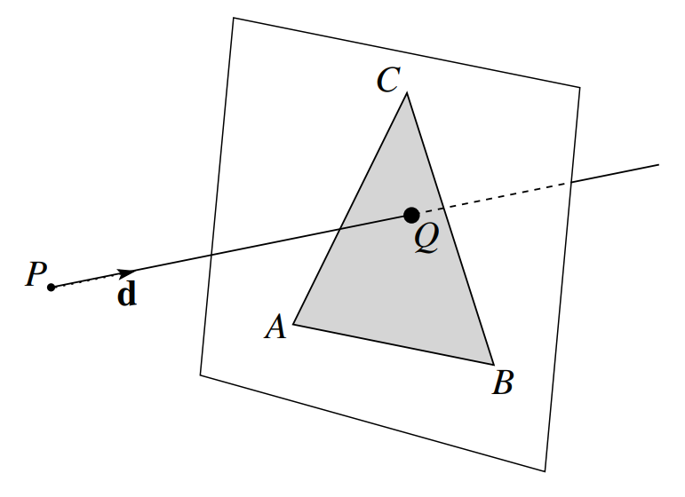
2. Implement a ray-triangle intersection test.
Ray-Plane intersection testing

Slide 10
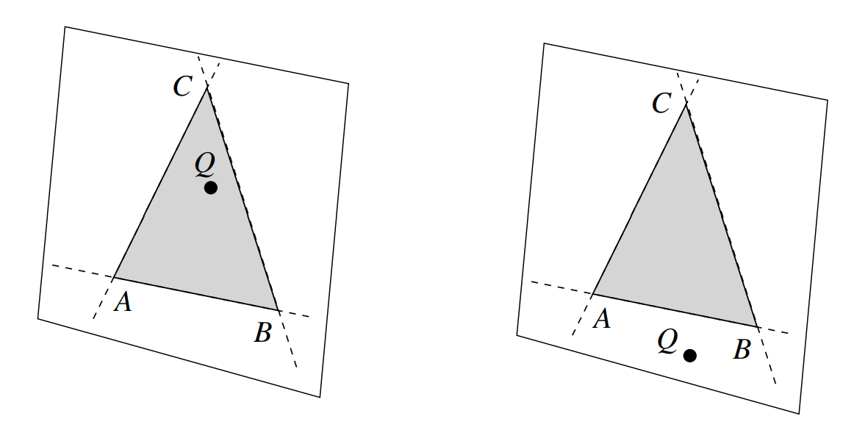
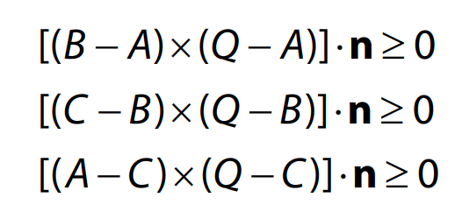
2. Implement a ray-triangle intersection test.
Triangle inside-outside testing

Slide 11
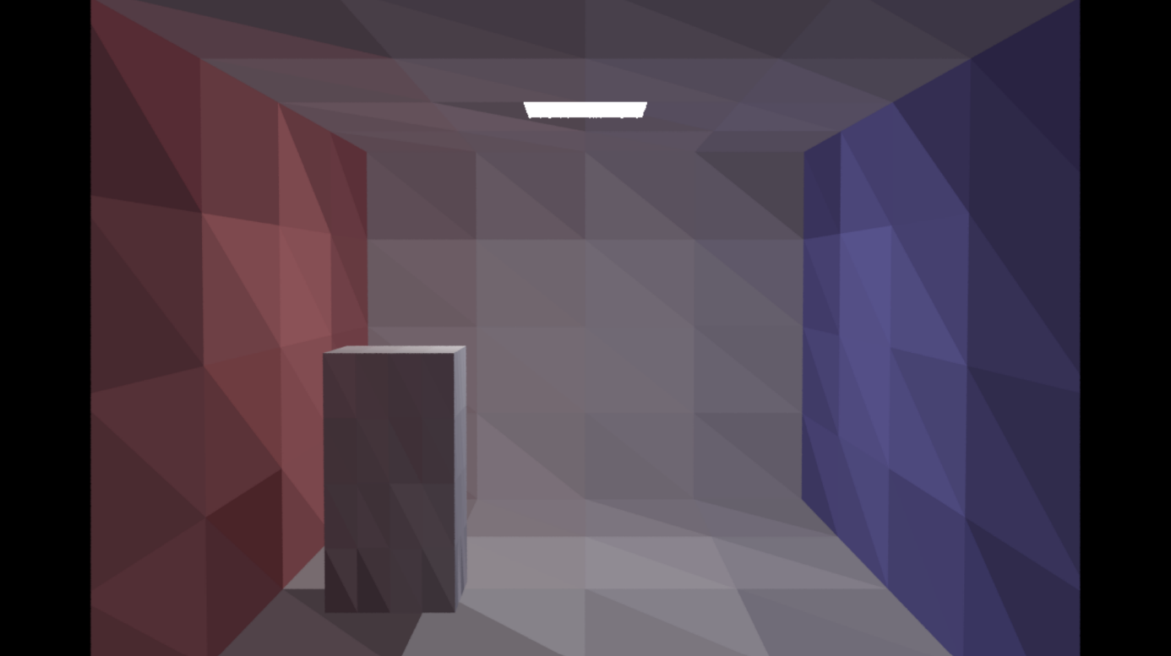
3. Change the Monte-Carlo integration to triangles, thus requiring a uniform sampling method in the triangle area.
Done as described in the practical sessions
However, contains small mistake: colors are not fully coherent

Slide 12
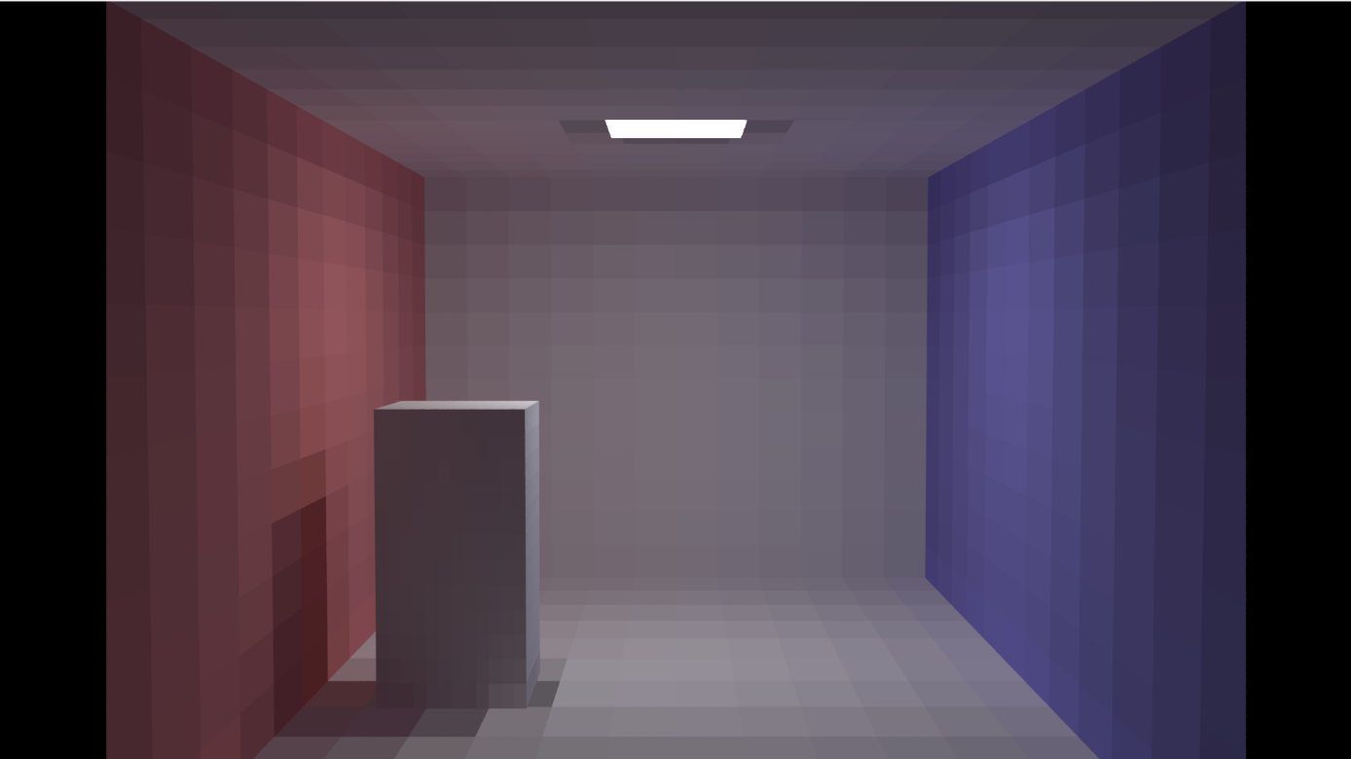
4. Compare the resulting renderings with those obtained with the original code.
Given Code

Slide 13
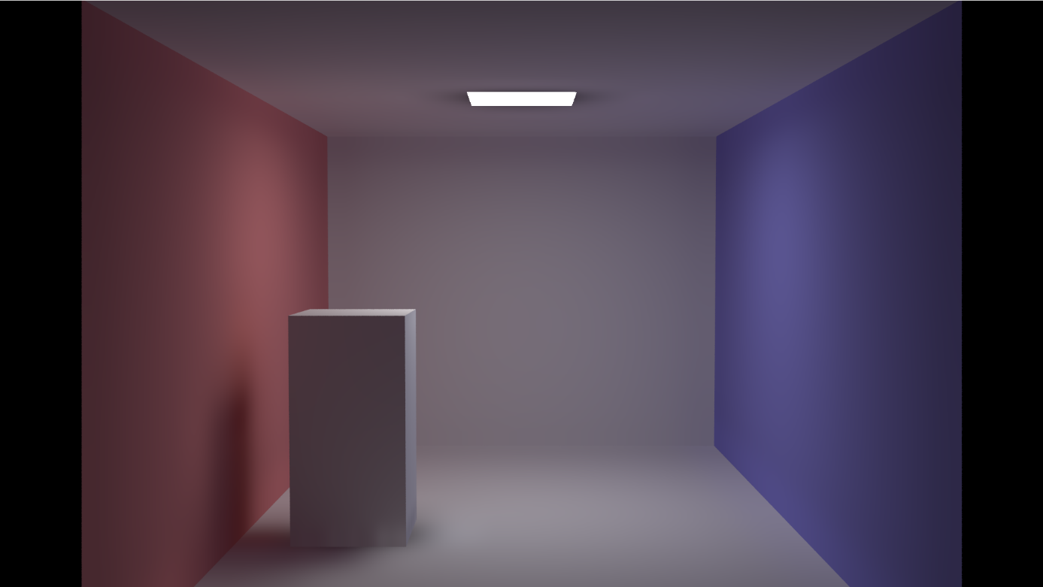
4. Compare the resulting renderings with those obtained with the original code.
Given Code

Slide 14

4. Compare the resulting renderings with those obtained with the original code.
Our Solution: Depth 0

Slide 15
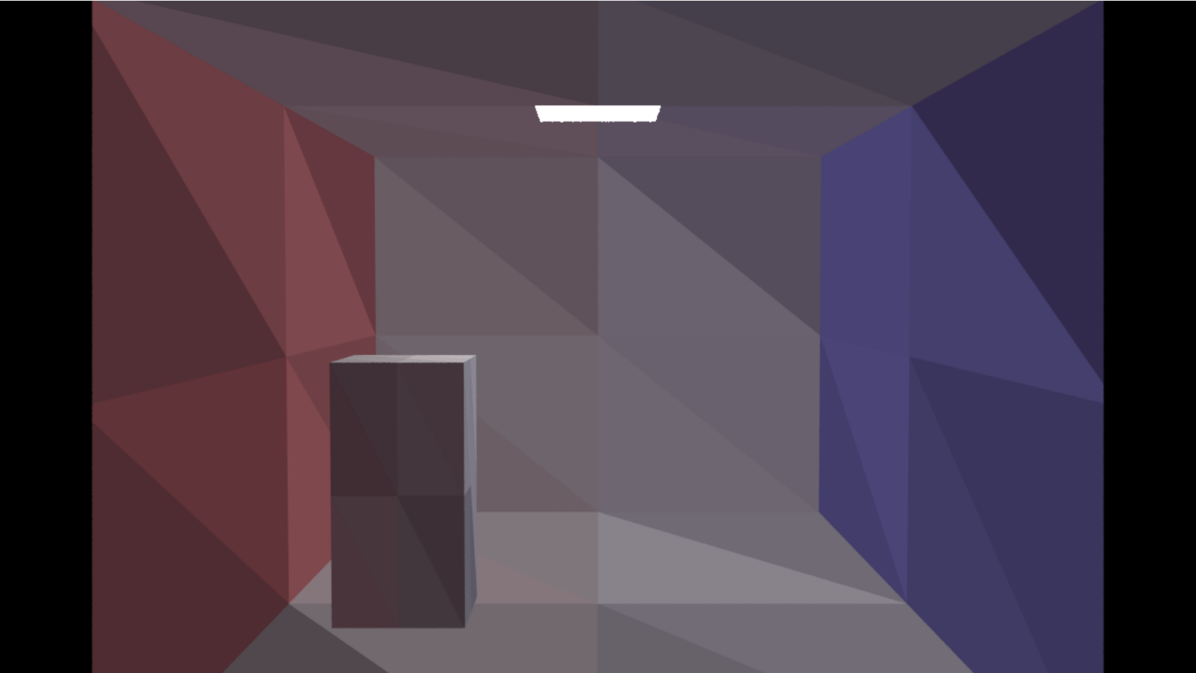
4. Compare the resulting renderings with those obtained with the original code.
Our Solution: Depth 1

Slide 16
4. Compare the resulting renderings with those obtained with the original code.
Our Solution: Depth 2
Code quite slow
Colors not as coherent as in original code

Slide 17

A short look through our code

