Slide 1
SupeYou
„Adding another layer to democracy.“

Slide 2
Scenario „Entry via Invitation“
This scenario describes Markus following an invitation from of one of his friends.

Slide 3
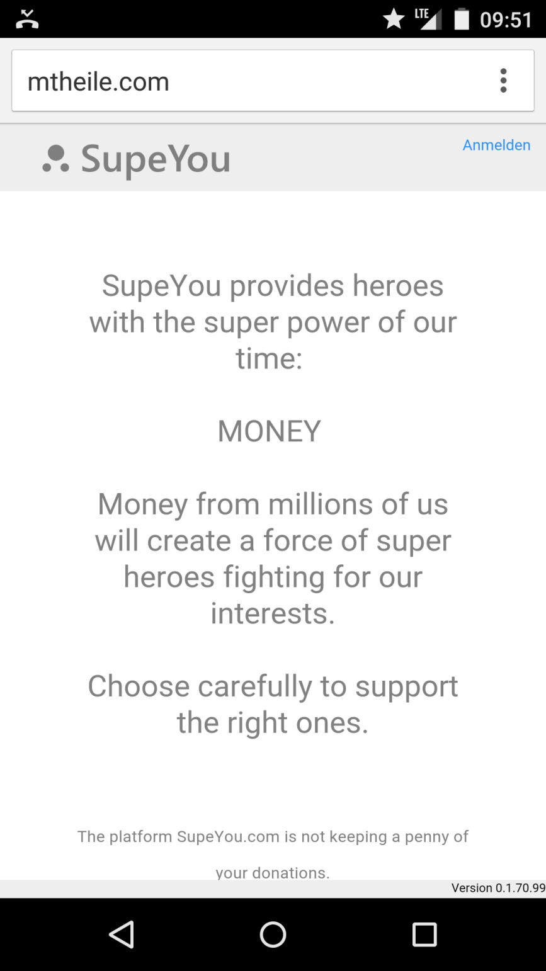
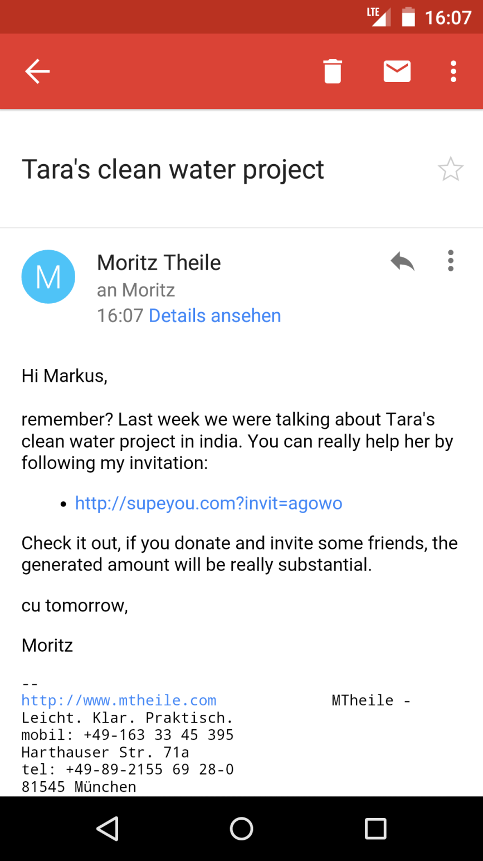

Yes, sure I remember. I would really like to help Tara. She is doing a great job.
supeyou.com
Maria Richter
Touch
Markus

Slide 4
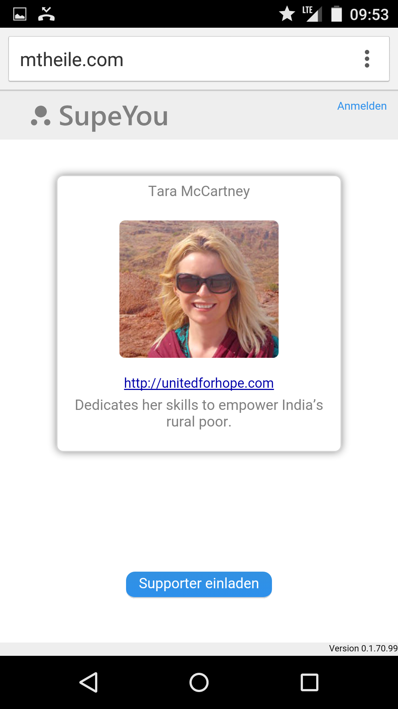


Hm, Tara, well I would like to help her, but how does it work?
supeyou.com
0 €
Generated by you.
0 €
Dontated by you.
You
Markus
Invite friends
Scroll Down
How it works

Slide 5
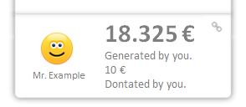
Oh, that‘ s interesting. I can invite friends and see how much we spend all together. Let‘s see…
supeyou.com
How it works
With a few invitations you can generate an enormous amount of money. And the best thing is, that you can visually see how your invitation spreads. This might look like this:
0€
15€
Adam
Eva
Markus
5€
0€
10€
5€
0€
5€
0€
10€
0€
5€
100€
5€
10€
20€
+
+
+
+
+
+

Slide 6
… I‘ll invite someone. I want to see if they donate.
supeyou.com
0 €
Generated by you.
0 €
Dontated by you.
You
Markus
Touch
Invite friends
How it works

Slide 7


I talked recently with Adam and Eva about Taras project. I‘m sure they are interested.
X
Invite friends to donate
supeyou.com
Send this link to one or more friends.
You will see if someone clicked on it.
Don‘t forget to send a convincing text along ;-)
http://supeyou.com/invit=f39z2
Copy this link to Email, WhatsApp, Facebook...
12.08.2013 14:33:09
Change the link name to remember whom you sent it
(e.g. Link for Adam):
Markus

Slide 8
Oh, great, Adam already followed my invitation.
Tomorrow I will have a look if Eva also clicked the invitation link.
supeyou.com
0 €
Generated by you.
0 €
Dontated by you.
You
Invite friends
Markus
0€
Adam

Slide 9
Next day…

Slide 10
What happened? 180€?!? Thats great! How come?
supeyou.com
180 €
Generated by you.
0 €
Dontated by you.
You
Markus
Invite friends
Scroll Down
155€
15€
+
Adam
Eva

Slide 11
Ah, thats why , Adam also invited some supporter and they donated.
Amazing how this adds up!
Maybe I should look for other heros to support.
supeyou.com
180 €
Generated by you.
0 €
Dontated by you.
You
Invite friends
Markus
150€
15€
Adam
Eva
5€
120€
25€
+

Slide 12
Uh, I didn‘t contribute any money. Let me also donate. Lets say 10 €.
supeyou.com
180 €
Generated by you.
0 €
Dontated by you.
You
Touch
Invite friends
Markus
150€
15€
Adam
Eva
5€
120€
25€
+

Slide 13
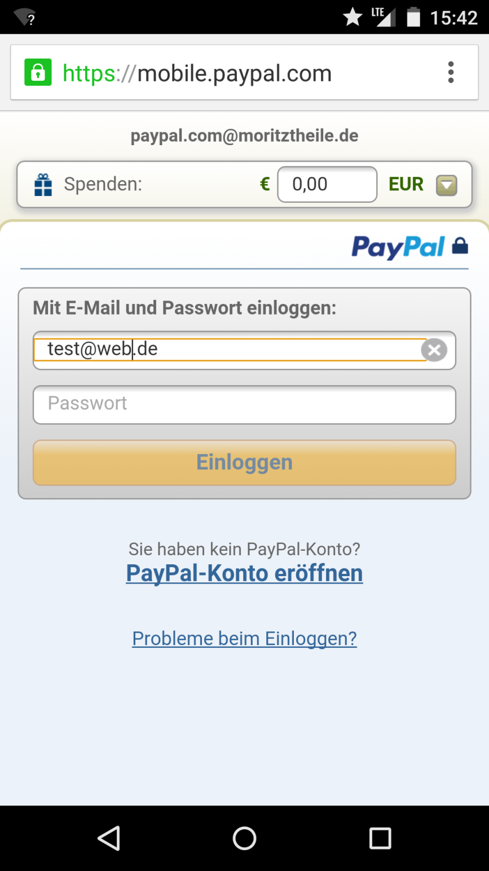
OK, thats easy with Paypal.
supeyou.com
Tara@unitedforhope.org
10,00
Markus

Slide 14
What‘s that?
supeyou.com
Touch
190 €
Generated by you.
10 €
Dontated by you.
You
Markus
Invite friends
155€
15€
Adam
Eva

Slide 15
Ah, thats nice. I can show what I have done for Tara on my business website.
X
Show what you have generated
supeyou.com
Use the code on bottom to embed this SupeYou result in your website.
190 €
Generated by you.
10 €
Dontated by you.
You
Embed code in site
<webcomponent url=„xyz“/>

Slide 16
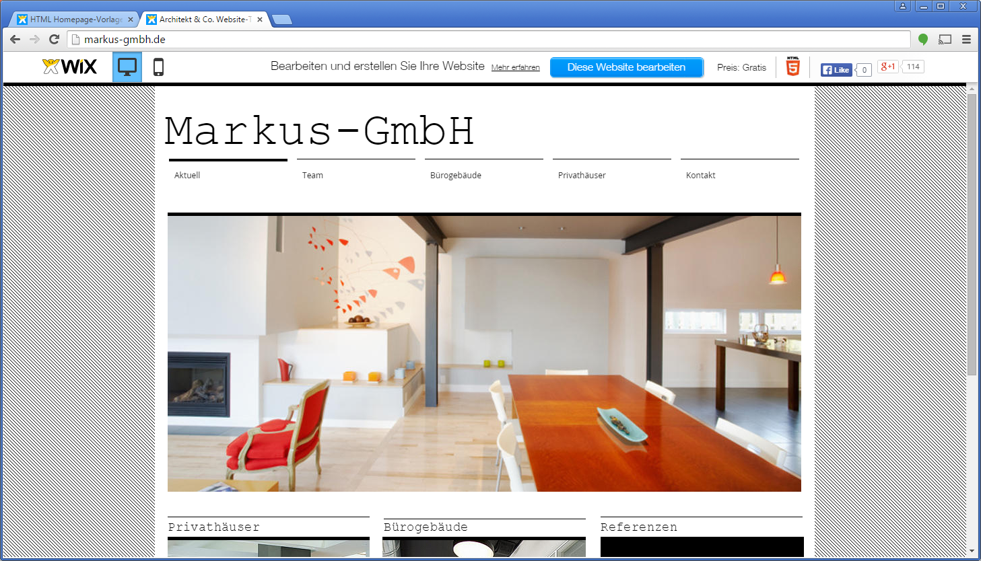
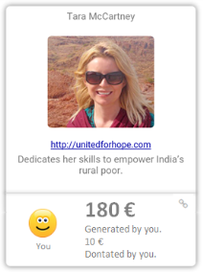
Our CSR-Contribution
The sum of generated money is constantly updated.
If someone clicks, the one will be added to Markus invitated supporter.

Slide 17
Scenario „Entry via Landing Page“
This scenario assumes that the user found SupeYou e.g. by using a search engine.
(The visitor is not invited by a friend to support a hero.)

Slide 18
supeyou.com
Scroll Down

Slide 19
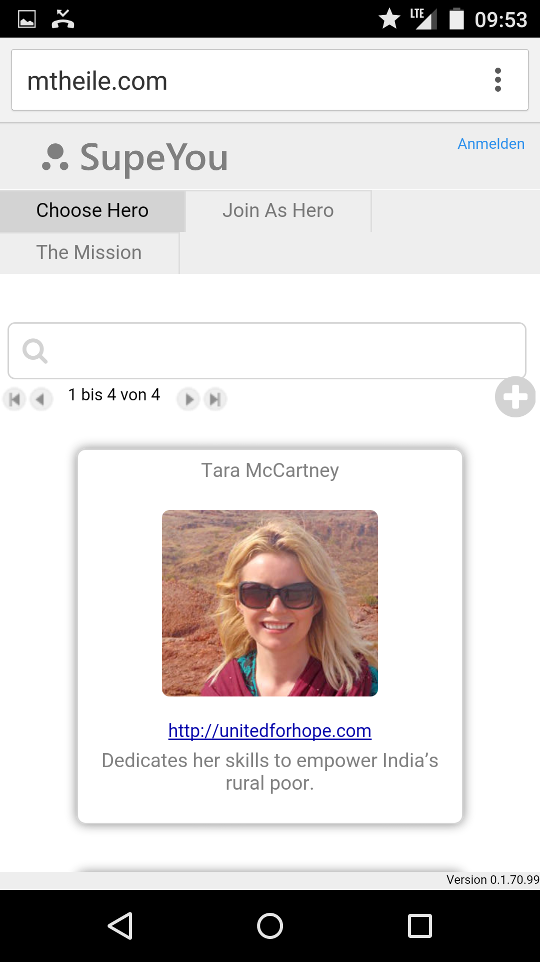
supeyou.com
Touch
From here the screens are the same as described in Scenario „Entry via Invitation“.

Slide 20
Media (TV, Blogs, Radio, Newspaper, etc.)
Government
Industry
Lobby
Heroes
People
Industry
Also Leute, spendet für unsere Heroes! Wir können da was bewegen.

Slide 21
supeyou.com
0 €
Generated by you.
0 €
Dontated by you.
You
0€
+
Adam

Slide 22
Pitch
Elevator statement:
SupeYou ermöglicht eine Lobby für das Volk. Aktivisten werden durch Ihre Supporter-Community finanziert.
USP:
Observable Invitations / Beobachtbare Einladungen
Fokussierung auf Personenmarken
Wer sind Sie?
Informatiker und erfolgreicher Gründer (TeamTable, Individualsoftware, Portalentwicklung )
Welches gesellschaftliche Problem lösen Sie?
Fehlende Lobby für Gesellschaftsinteressen.
Mit welchen Mitteln?
Crowdsourcing
Was macht Sie einzigartig?
Kombination von Know How in
Entwicklung von Large-Scale-WebApplikationen (DocSafe von Swisscom > 1Mio. Benutzer)
Erfolgreiche Softwareprodukte (FastWorks, TeamTable)
Tiefe theoretische Grundlagen von Datenstrukturen.
Kreative und durchdachte Ideen
Wie sieht das Geschäftsmodell aus?
Siehe Kickstarter oder Finanzierung durch SupeYou-Community
Wo stehen Sie?
Orientierung, Überprüfung von Annahmen
Wohin wollen Sie?
Weltweiter Quasistandard für die finanzielle Unterstützung von Aktivisten (wie Kickstarter für Projekte)
Was sind die nächsten Schritte?
Validierung der Funktion von Oberservable Invitations
Welchen Beratungsbedarf haben Sie konkret?
Sparring

Slide 23
Crowd-Finanzierung für Aktivisten
Spenden – Einladen – Beobachten
Spendentracker für Spender
Building a system that rocks the world

Slide 24


Slide 25
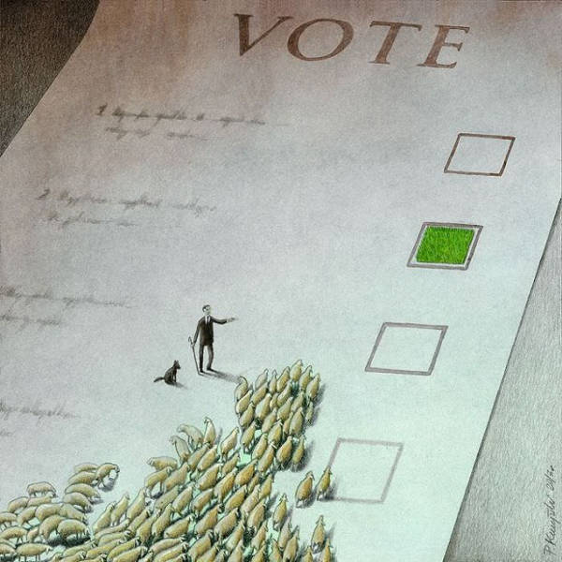

Slide 26
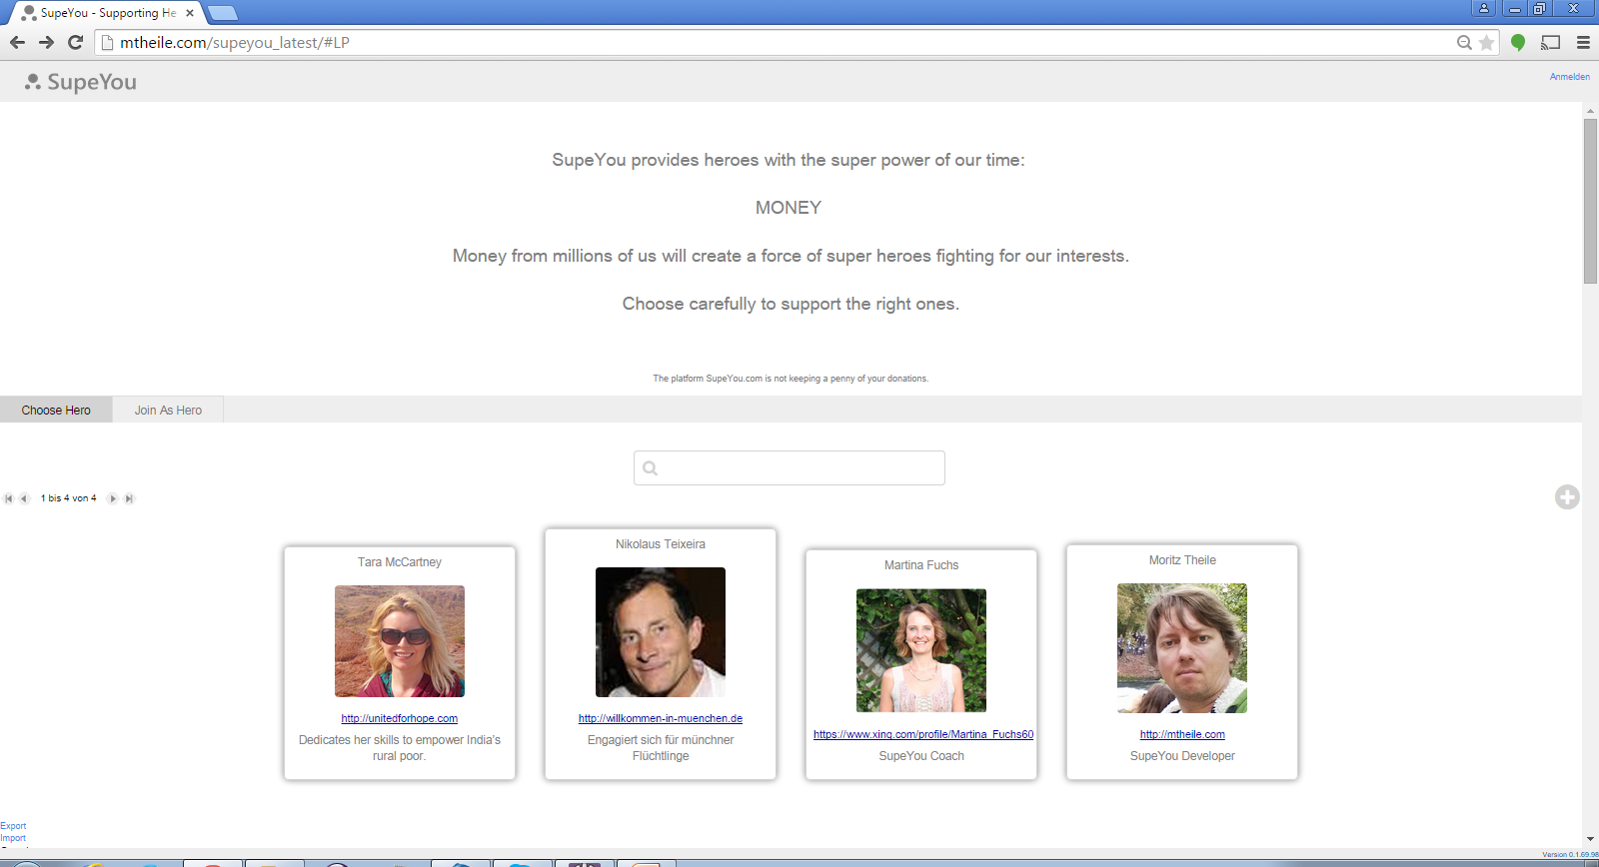
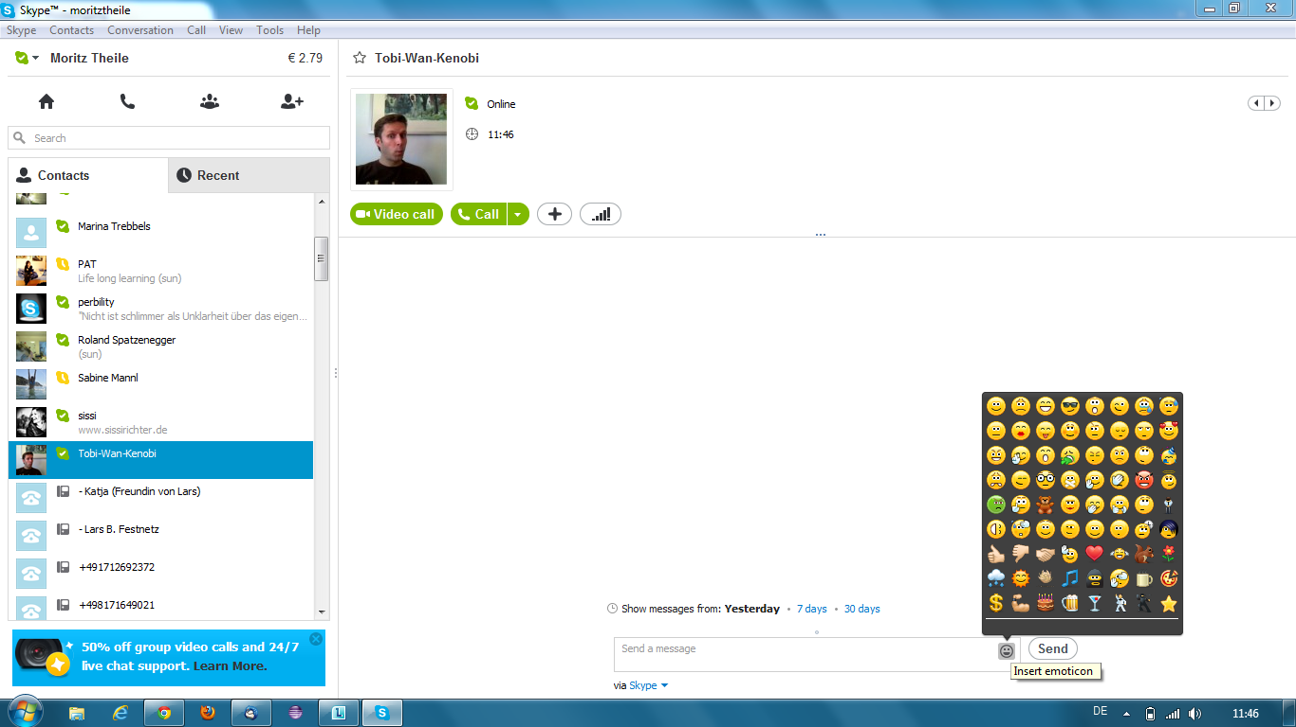
SupeYou
There are people out there who are giving all their energy to do good things without looking for their own advantage.
SupeYou helps to give these heroes the super power of our time – MONEY.
Money from millions of us will create a force of super heroes fighting for our interests.
Choose carefully to support the right ones.
<!-- Repetition area start -->
The platform SupeYou.com isn‘t keeping a penny of your donations. 100% of the collected money is going to your hero.
Heros
Your hero isn‘t registered? – Ask him to do so.
Tobias Stone
Whale Body Guard

Slide 27
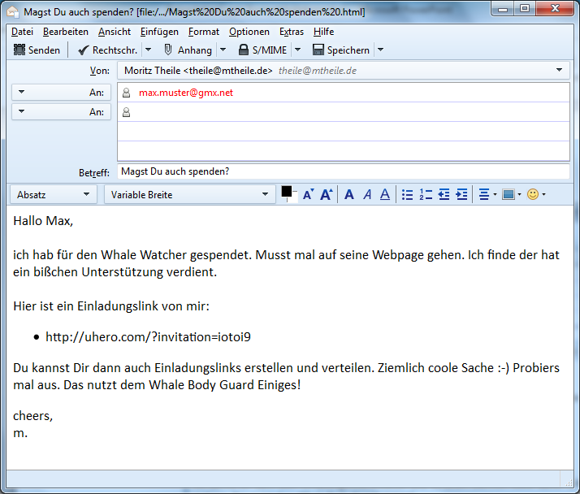
Einladung via E-Mail

Slide 28
SupeYou | Login
yesterday:
This month I need to flight to Japan.
Thank you guys!
Tobias Stone
Fighting for survival of whales
My Website
You
0 Euro donated by your Supporter Community last 30 days.
YOU
0 Euro donated by you.
Donate
click
Supporter invited by you
You can generate enormous support by inviting others.
They will be shown here.
Invite supporter to your community
Supporter invited by you indirectly
Here you will see supporter invited by members of your community.
All Supporter
Show

Slide 29
ToDo: Login or Registering

Slide 30
SupeYou | Your Heroes | Your Account
yesterday:
This month I need to flight to Japan.
Thank you guys!
Tobias Stone
X
Donate
Whale Body Guard
My Website
The best thing you can do for your hero is to donate regulary over a longer period of time.
You
0 Euro donated by your Supporter Community last 30 days.
Donate regulary
Donate
(You can stop donating any time.)
YOU
0 Euro donated by you.
Of course your hero will be very greatful for a one time donation as well.
Supporter invited by you
Donate once
Invite Supporter to your Community
Supporter invited by you indirectly
All Supporter
Show

Slide 31
ToDo: Paying-Processs (PayPal?)

Slide 32
SupeYou | Your Heroes | Your Account
yesterday:
This month I need to flight to Japan.
Thank you guys!
Tobias Stone
Fighting for survival of whales
My Website
You
10 Euro donated by your Supporter Community last 30 days.
YOU
10 Euro donated by you.
Donate
Supporter invited by you
You can generate enormous support by inviting others.
They will be shown here.
Invite supporter to your community
click
Supporter invited by you indirectly
Here you will see supporter invited by members of your community.
All Supporter
Show

Slide 33
More Heros
yesterday:
This month I need to flight to Japan.
Thank you guys!
Tobias Stone
X
Invite a Supporter
Whale Body Guard
My Website
Send this link to one or more friends.
You will see if someone clicked on it.
You
0 Euro donated by your Supporter Community last 30 days.
http://supeyou.com/invit=f39z249
Donate
(Copy this link to Email, WhatsApp, Facebook...)
YOU
0 Euro donated by you.
Supporter invited by you
You can change the name of the link to remember whom you sent it:
12.08.2013 14:33:09
Invite Supporter to your Community
Supporter invited by you indirectly
Done
click
All Supporter
Show

Slide 34

SupeYou | Your Heroes | Your Account
yesterday:
This month I need to flight to Japan.
Thank you guys!
Tobias Stone
Whale Body Guard
My Website
You
41 Euro
donated by your Supporter Community last 30 days.
Donate
YOU
10 Euro donated by you.
Supporter invited by you
Hans
Hubi
Herbert
Joschi
Pending
1 click
signed up
8 Euro
Invite Supporter to your Community
Supporter invited by you indirectly
20 Euro
10 Euro
3 Euro
All Supporter
2526 Euro donated by all Supporter last 30 days.

Slide 35
yesterday:
This month I need to flight to Japan.
Thank you guys!
Tobias Stone
Whale Body Guard
My Website
You
1410 Euro donated by your Supporter Community last 30 days.
Donate
YOU
100 Euro donated by you.
Supporter invited by you
Hans
Hubi
Herbert
Joschi
Pending
1 click
signed up
80 Euro
Invite Supporter to your Community
Supporter invited by you indirectly
200 Euro
1000 Euro
30 Euro
All Supporter
25260 Euro donated by all Supporter last 30 days.

Slide 36
SupeYou | Login
There are people out there who are giving all their energy to do good things without looking for their own advantage.
SupeYou helps to give these heros the super power of our time – MONEY. Money from the millions of us will create a force of Super Heros fighting in our interests.
Choose careful to support the right ones.
The platform SupeYou.com isn‘t keeping a penny of your donations. 100% of the collected money is going to your hero!
Heros
Your hero isn‘t registered? – Ask him to do so.
click
Tobias Stone
Whale Body Guard

Slide 37
SupeYou
Login
There are real heros out there who are giving all their energy to do somethig good without looking for their own advantage.
SupeYou helps to give these heros the super power of our time – MONEY. Money from the millions of us will create a force of Super Heros fighting in our interests.
Choose careful to support the right ones:
Applying as Hero
X
For applying as a hero, pleas send an email to register@supeyou.com.
Following content is requiered:
Copy/Picture of ID
Short description of your goal
Links to show your successes
Picture for your profil
Banking details
SupeYou staff will contact you.
Heros
Your hero isn‘t registered? – Ask him to do so.
Tobias Stone
OK
Whale Body Guard
This way of registration is only during beta phase.
A full automated registering process will follow.

Slide 38
SupeYou | Login
click
There are people out there who are giving all their energy to do good things without looking for their own advantage.
SupeYou helps to give these heroes the super power of our time – MONEY. Money from the millions of us will create a force of Super Heros fighting in our interests.
Choose careful to support the right ones.
The platform SupeYou.com isn‘t keeping a penny of your donations. 100% of the collected money is going to your hero!
Heros
Your hero isn‘t registered? – Ask him to do so.
Tobias Stone
Whale Body Guard

Slide 39
TODO: Login-Process and Account Management

Slide 40
SupeYou | Admin Panel | Your Supporter | Your Heroes | Your Account
There are people out there who are giving all their energy to do good things without looking for their own advantage.
SupeYou helps to give these heros the super power of our time – MONEY. Money from the millions of us will create a force of Super Heros fighting in our interests.
Choose careful to support the right ones.
The platform SupeYou.com isn‘t keeping a penny of your donations. 100% of the collected money is going to your hero.
Heros
Your hero isn‘t registered? – Ask him to do so.
Tobias Stone
Whale Body Guard

Slide 41
SupeYou | Admin Panel | Your Supporter | Your Heroes | Your Account
TobiasStein
Details Hero Supporter
described in „Admin Panel“

Slide 42
SupeYou | Admin Panel | Your Supporter | Your Heroes | Your Account
TobiasStein
Details Hero Supporter
TobiasStein
Details Messages Transactions
described in „Admin Panel“

Slide 43
SupeYou | Admin Panel | Your Supporter | Your Heroes | Your Account
TobiasStein
Details Hero Supporter
TobiasStein
Details Messages Transactions
described in „Admin Panel“

Slide 44
SupeYou | Admin Panel | Your Supporter | Your Heroes | Your Account
TobiasStein
Details Hero Supporter
TobiasStein
Details Messages Transactions
described in „Admin Panel“

Slide 45
SupeYou | Admin Panel | Your Supporter | Your Heroes | Your Account
TobiasStein
Details Hero Supporter
described in „Admin Panel“

Slide 46
SupeYou | Admin Panel | Your Supporter | Your Heroes | Your Account
yesterday:
This month I need to flight to Japan.
Thank you guys!
1
more
3
more
Tobias Stone
Whale Body Guard
My Website
You
41 Euro donated by your Supporter Community last 30 days.
Donate
YOU
10 Euro donated by you.
Supporter invited by you
Hans
Hubi
Herbert
Joschi
Pending
1 click
signed up
8 Euro
Invite Supporter to your Community
Supporter invited by you indirectly
20 Euro
10 Euro
3 Euro
All Supporter
2526 Euro donated by all Supporter last 30 days.

Slide 47
SupeYou | Admin Panel | Your Supporter | Your Heroes | Your Account
yesterday:
This month I need to flight to Japan.
Thank you guys!
Tobias Stone (You)
Whale Body Guard
My Website
2364 Euro donated by your Supporter Community last 30 days.
Account Balance: 2593 Euro
Last Transaction: 04.05.2013, 1968 Euro
Transaction History
Change Details
Supporter invited by you
Hans
Hubi
Herbert
Joschi
Pending
1 click
signed up
8 Euro
Invite Supporter to your Community
Supporter invited by you indirectly
20 Euro
10 Euro
3 Euro
All Supporter
2526 Euro donated by all Supporter last 30 days.

Slide 48
SupeYou | Admin Panel | Your Supporter | Your Heroes | Your Account
All Users Accounting
Username | MobileNumber | Email | IsAdmin | IsHero | IsSupporter
TobiasStein | 062529998 |  | false | true | true
JuliaWeber |  | julia33@web.de | true | true | true
MoritzTheile |  |  | true | false | false
Hubi |  |  | false | false | false
click

Slide 49
SupeYou | Admin Panel | Your Supporter | Your Heroes | Your Account
All Users Accounting
TobiasStein
Details Hero Supporter
Admin:
UserName:
MobileNr:
Email:
Sprache:
de

Slide 50
SupeYou
SupeYou | Admin Panel | Your Supporter | Your Heroes | Your Account
All Users Accounting
TobiasStein
Details Hero Supporter
Make TobiasStein a Hero

Slide 51
SupeYou | Admin Panel | Your Supporter | Your Heroes | Your Account
All Users Accounting
TobiasStein
Details Hero Supporter
TobiasStein
AdminSettings Details Messages Transactions
enabled:

Slide 52
SupeYou | Admin Panel | Your Supporter | Your Heroes | Your Account
All Users Accounting
TobiasStein
Details Hero Supporter
TobiasStein
AdminSettings Details Messages Transactions
Picture:
Upload
Website:
Mission:
Save

Slide 53
SupeYou
SupeYou | Admin Panel | Your Supporter | Your Heroes | Your Account
All Users Accounting
TobiasStein
Details Hero Supporter
TobiasStein
AdminSettings Details Messages Transactions
New Message:
add
History:
yesterday:
This month I need to flight to Japan.
Thank you guys!
02.04.2013::
…
yesterday:
…
yesterday:
…

Slide 54
SupeYou
SupeYou | Admin Panel | Your Supporter | Your Heroes | Your Account
All Users Accounting
TobiasStein
Details Hero Supporter
TobiasStein
AdminSettings Details Messages Transactions
Day | Remark | Category | Source/Target | Amount | Balance
 |  | DONATION | User:Hubi | +24,00
 |  | PAYOUT | HeroesAccount | -2968,90

Slide 55
User
String loginId
Donation
1
0..*
User2Supporters
1
1
1
1
Supporter2Donations
1
0..*
0..1
Supporter
long creationTimestamp
enum MOOD
String shoutout
Hero
String name
File profilePic
File idScan
String homepageLink
String description
boolean enabled
1
1
0..*
0..1
1
issued
0..*
1
Supporter2Invitation
long timestamp
Invitation2Supporter
long timestamp
0..*
(=Invitationclicks)
1
acceoted
1
1
Invitation
long creationTimestamp
String name
String invitID

Slide 56
Invitation
0€
15€
First level
Adam
Eva
5€
0€
10€
5€
0€
Level > 1
Supporter
+
+
+
Issued by Mr. Example
Invitation2Supporter
Adam
List<Invitation2Supporter>

Slide 57
Admin
AdminPointer
AdminCollection
User
String userID
File
String mimeType
String name
byte[] data
0..1
1
1
1
Attitude
Mood mood
String shoutout
veraltet
0..*
0..*
parent
previous
1
0..*
0..1
1
next
0..1
1
Supporter
long creationTimestamp
enum MOOD
String shoutout
HeroMessage
long timestamp
String text
boolean deleted
1
Hero
String name
File profilePic
File idScan
String homepageLink
String description
boolean enabled
0..*
children
1
1
1
0..1
0..*
last
last
issued
accepted
Transaction
enum CURRENCY
long date
int centvalue
String receipient
next
0..*
1
1
1
0..*
0..1
ResultOfDay
int daySince1Jan1970
int cachedSum
int cachedSumOfSubtrees
1
Invitation
long creationTimestamp
String name
String invitID
0..*
0..1
previous
1
0..*
Click
long timestamp

Slide 58
Login
click
There are people out there who are giving all their energy to do good things without looking for their own advantage.
SupeYou helps to give these heros the super power of our time – MONEY. Money from the millions of us will create a force of Super Heros fighting in our interests.
Choose careful to support the right ones.
The platform SupeYou.com isn‘t keeping a penny of your donations. 100% of the collected money is going to your hero.
Heros
Your hero isn‘t registered? – Ask him to do so.
Tobias Stone
Whale Body Guard

Slide 59
SupeYou
Login
There are real heros out there who are giving all their energy to do somethig good without looking for their own advantage.
SupeYou helps to give these heros the super power of our time – MONEY. Money from the millions of us will create a force of Super Heros fighting in our interests.
Choose careful to support the right ones:
Login
X
Username:
FranzF
Forgot username?
Password:
*******
click
Forgot password?
Heros
With this browser you will be logged in automatically if checked.
Your hero isn‘t registered? – Ask him to do so.
Remember Login
Create new Account
Tobias Stone
OK
Whale Body Guard

Slide 60
SupeYou
Login
There are real heros out there who are giving all their energy to do somethig good without looking for their own advantage.
SupeYou helps to give these heros the super power of our time – MONEY. Money from the millions of us will create a force of Super Heros fighting in our interests.
Choose careful to support the right ones:
Retrieve Username
X
Your Email:
AND/OR
Your Mobile:
Heros
Your hero isn‘t registered? – Ask him to do so.
Send Username
Tobias Stone
Whale Body Guard

Slide 61
SupeYou
Login
There are real heros out there who are giving all their energy to do somethig good without looking for their own advantage.
SupeYou helps to give these heros the super power of our time – MONEY. Money from the millions of us will create a force of Super Heros fighting in our interests.
Choose careful to support the right ones:
Reset Password
X
Username:
FranzF
A link for resetting the password will be send via email. Click on it to choose a new password.
Heros
Your hero isn‘t registered? – Ask him to do so.
Reset Password
Tobias Stone
Whale Body Guard

Slide 62
SupeYou
Login
There are real heros out there who are giving all their energy to do somethig good without looking for their own advantage.
SupeYou helps to give these heros the super power of our time – MONEY. Money from the millions of us will create a force of Super Heros fighting in our interests.
Choose careful to support the right ones:
Retrieve Username
X
Your Email:
SupeYou will send the username associated with this email address.
AND/OR
Your Mobile:
SupeYou will send the username associated with this mobile.
Heros
Your hero isn‘t registered? – Ask him to do so.
Send Login
Tobias Stone
Whale Body Guard

Slide 63
Use Cases of System
Inform Supporter of new Supsupporter
Receive Money per Supporter
Calculate balance of Supporters account
Pay out Supporter

Slide 64
Use Cases of Admin
Monitor growth
Control growth
Send information messages to user
Select user (subtree)

Slide 65
Use Cases of Supporter
Read invitation
Click on invitation link
Read infos
Donate Money (Abo-Donation?)
Invite Supporter
Ask for invitation status of invited Supporter
Watch own supporter network.
Getting informed about new Supporter
Unsubscribe from updates
Step out of System

Slide 66
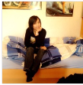


Some peope are doing good things. They deserve to get supported. This site helps to support these people in a very effective way.
If you want to be a supporter you can and should do this by donating money.
The unusual part is, however, that you also can invite supporter who can invite supporter themselves and so on and you will get 1% of the collected money. This 1% can be pretty rewarding… :-)
Yes, this is a full grown snowballsystem, but in the end everybody is the winner!
All donations goes to the supported one and a small part to the supporter themselves. This site doesn‘t get a penny.
Why did we set up this site?
Supported People
apply for support
more
donate

Slide 67


SupeYou

Slide 68
SupeYou

Slide 69
SupeYou

Slide 70
SupeYou

Slide 72






Why did we set up this site?
We want the heros of our time being able to focus on what their designation is.
We want to set a counterweight to the industrial lobby by creating money flows to the right people.

Slide 73
Apply for Support
We are happy to accept you as a hero if your work matches the descriptions below.
Your work helps common welfare
You can show appreciable results of your work
Your work is not due to financial self-interest
Your work is legal
Send us a convincing e-mail, we will answer promptly.
Eg. http://www.ndr.de/fernsehen/sendungen/das/media/dasx3431.html

Slide 74
Einladung via E-Mail

Slide 75
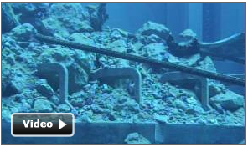
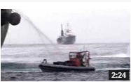

This month I need to flight to Japan.
Thank you guys!
4. Apr. 2013
23. Mrz. 2013
4. Mrz. 2013
Tobias Stone
3490$
(5 days left in April)
Whale Body Guard
My Website
I cut a a movie about the beauty of whales.
10000 clicks already! Have a look too ☺
1276$
12,76$
10$
Donate
YOU
Supporter invited by you directly (5)
307$
Invite Supporter
Gunther.Groß
Supporter invited by you indirectly (75)

Slide 76
Give me money!
I will train for being the best surfer in the world.
I need money!
1200$ last 5 days
15400 last year
You are the best!
Great! crazy

Slide 77
Give me money!
I will train for being the best surfer in the world.
I need money!
1200$ last 5 days
15400 last year
I want to see success!

Slide 78
Give me money!
I will train for being the best surfer in the world.
I need money!
1200$ last 5 days
15400 last year
Loved your last video

Slide 79
Tobias fights for free surfing!
Talked to major of Manly (see video)
I will train for being the best surfer in the world.
I need money!
1200$ last 5 days
15400 last year
1x
19x
Great job.

Slide 80
More Heros
yesterday:
This month I need to flight to Japan.
Thank you guys!
Tobias Stone
X
Invite Someone
Whale Body Guard
My Website
Your Email (Mail is send CC to you)
You
Max.Feldbach@t-online.de
0 Euro donated by your Supporter Community last 30 days.
Your Friends Email Address
Fred.Steiger@gmx.de
Donate
Your Name (used in subject of mail)
YOU
0 Euro donated by you.
Max
Supporter invited by you
Your Text
Hallo Fred,
hier kannst Du dem Tobias Stone unterstützen von dem wir neulich das Interview gesehen hatten.
Viele Grüße,
Max
Invite Supporter to your Community
Supporter invited by you indirectly
<< Back
Preview >>
click
All Supporter
Show

Slide 81
More Heros
yesterday:
This month I need to flight to Japan.
Thank you guys!
Tobias Stone
X
Invite Someone
Whale Body Guard
My Website
Preview of your invitation mail:
You
To: Fred.Steiger@gmx.de
CC: Max.Feldbach@t-online.de
Max invites you to support Tobias Stone
Hallo Fred,
hier kannst Du dem Tobias Stone unterstützen von dem wir neulich das Interview gesehen hatten.
Viele Grüße,
Max
-----------------------------------------------------------------------
http://support4heros.com/?urlid=9falf0ga
(With this link you automatically join Maxs support community.)
---------------------------------------------------------------------------------------------------
0 Euro donated by your Supporter Community last 30 days.
Supporter invited by you
Supporter invited by you indirectly
<< Back
Send >>
click
All Supporter
Show

