Slide 1
Scenario „Entry via Invitation“
This scenario describes Markus following an invitation from his friend Maria. Markus is a Munich citizen.

Slide 2
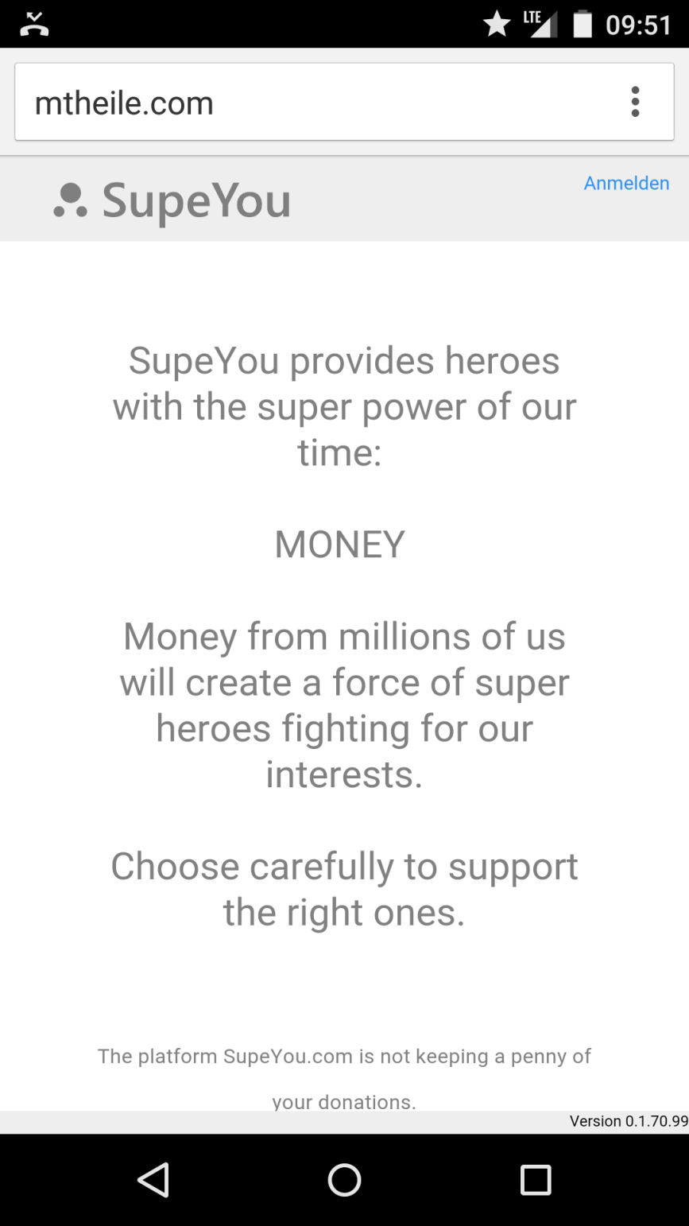
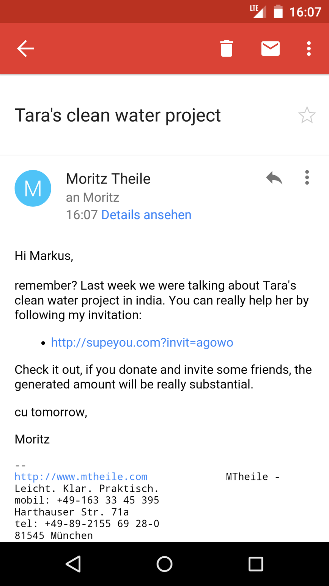

Yes, sure I remember. I would really like to help Nikolaus. I heard about his platform on radio.
supeyou.com
You can help Nikolaus on SupeYou
Maria Richter
Hi Markus,
remember? Last week we were talking about Nikolaus internet platform to channel help from germans for refugees.
If you want to support him please follow my invitation below:
http://supeyou.com/?invit=3t345
It‘s an interesting way to raise donations because you can follow how much money will be created by your invitations.
Cu tomorrow,
Maria
Touch
Markus
Maria

Slide 3
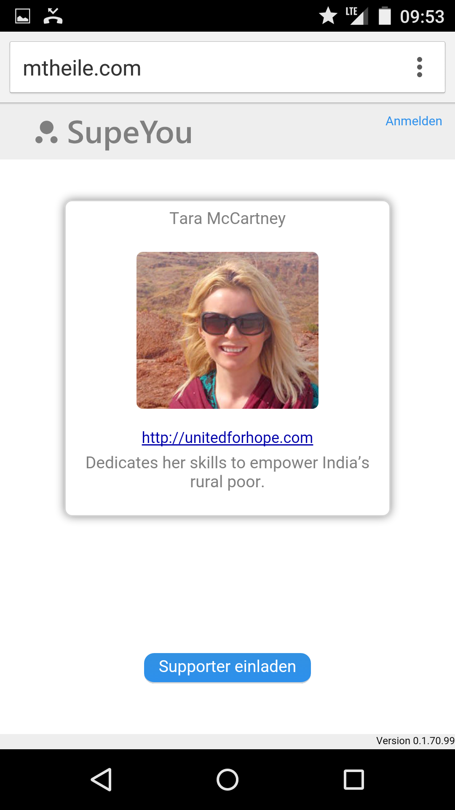
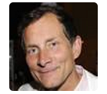


Ahh, a video, lets see…
supeyou.com
Nikolaus Teixeira
Touch
http://willkommen-in.de/help
Creating a platform to channel help from citizens for refugees.
0 €
Generated by you.
0 €
Dontated by you.
You
Markus
Invite friends
How it works

Slide 4
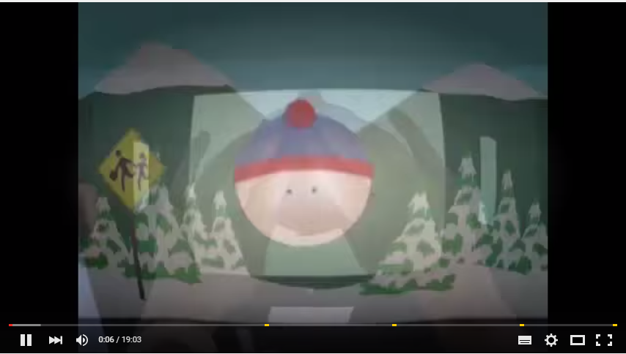
X
Video Nikolaus Teixeira
Hallo,
mein Name ist Nikolaus Teixeira.
Meine Mission ist es Flüchtlingen zu helfen. Dafür betreue und entwickle ich mit meinem Team die Seite willkommen-in.de. Mit der Seite wird die unglaubliche Hilfsbereitschaft aus der Bevölkerung für Flüchtlinge an die richtigen Stellen gebracht. Für weitere Informationen klickt einfach den Link unten.
Um die Seite weiter zu betreuen braucht mein Team Deine Unterstützung. Ein Euro/Monat und eine persönliche Einladung an einige Deiner Freunde würden uns helfen mit 100% bei der Sache zu bleiben.
Ich garantiere persönlich, dass alle Spenden gemäß meiner Mission eingesetzt werden und werde die Verwendung detailliert veröffentlichen.
Vielen Dank!
supeyou.com

Slide 5
This is probably the info link Nikolaus was talking about. Lets see.
supeyou.com
Nikolaus Teixeira
Touch
http://willkommen-in.de/help
Creating a platform to channel help from citizens for refugees.
0 €
Generated by you.
0 €
Dontated by you.
You
Markus
Invite friends
How it works

Slide 6
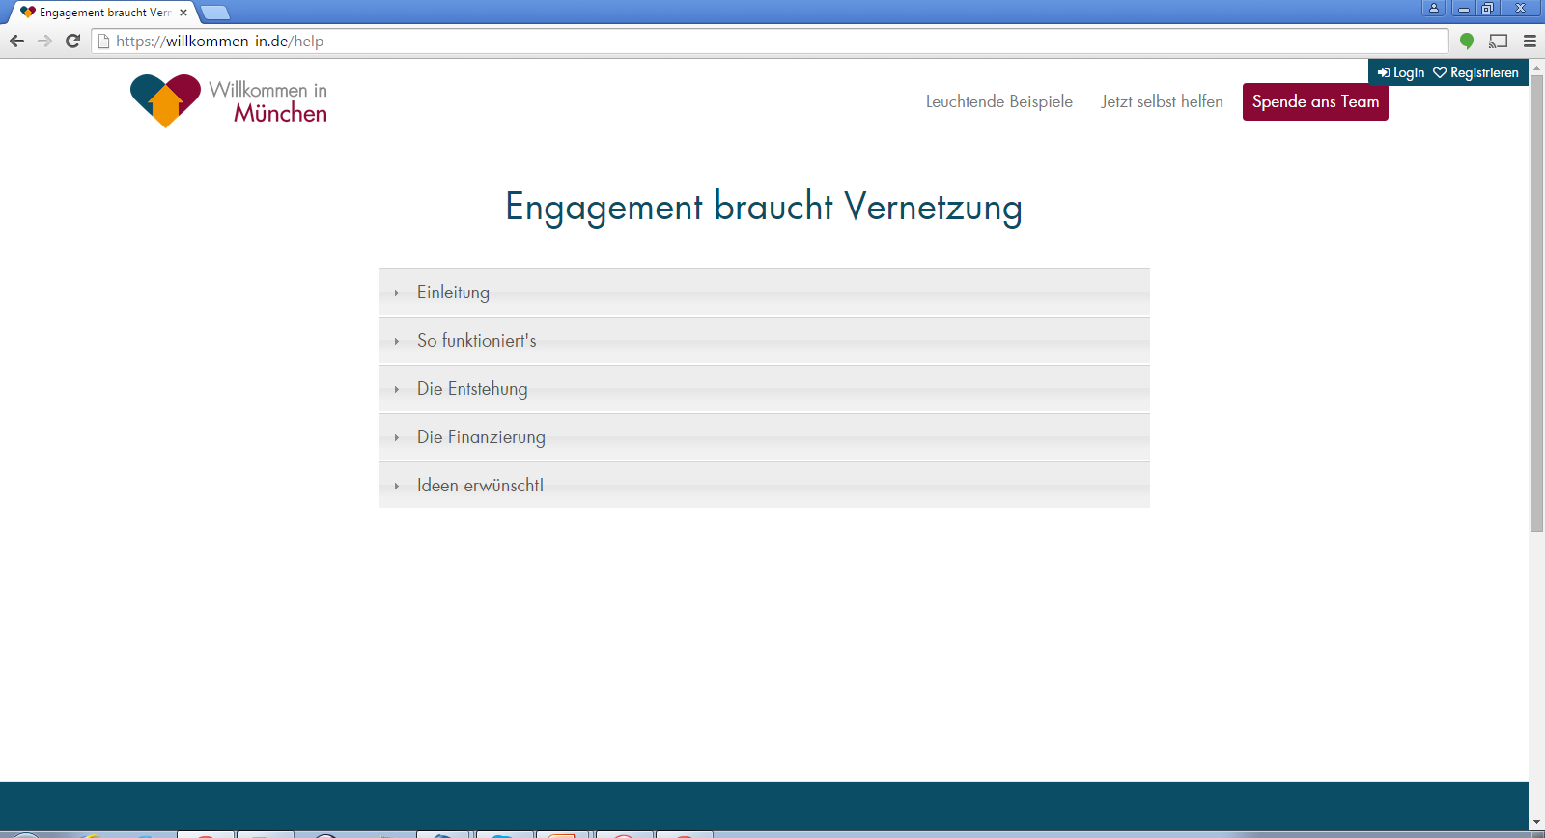
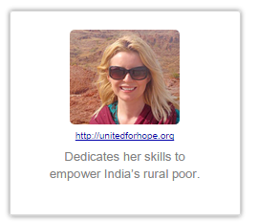
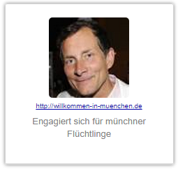
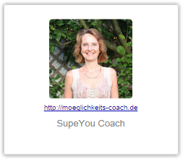
Spende ans Team
Wir sind das Team, dass diese Seite aufgebaut hat. Ohne Eure Unterstützung müssen wir unser Engagement trotz riesiger Erfolge bald einstellen. Bitte benutzt die SupeYou-HeroCards unten, um uns zu helfen und Eure Freunde zum Helfen aufzurufen.
Wir garantieren über jeden eingesammelten Euro Rechenschaft abzulegen und jeden Euro für willkommen-in.de einzusetzen. Überflüssiges Geld leiten wir an Hilfsorganisationen für Flüchtlinge weiter. Es spielt keine Rolle an welches Teammitglied eine Spende geht. Wir arbeiten als Team und entscheiden gemeinsam wie das Geld am besten eingesetzt wird.
Makes sense to me.
20.439€
105.897€
5.294€
Press Back button
Markus

Slide 7
Sounds all good! Well I would like to help him, but how does it work?
supeyou.com
Nikolaus Teixeira
http://willkommen-in.de/help
Creating a platform to channel help from citizens for refugees.
0 €
Generated by you.
0 €
Dontated by you.
You
Markus
Invite friends
Scroll Down
How it works

Slide 8
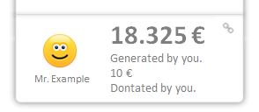
Oh, that‘ s interesting. I can invite friends and see how much we spend all together. Let‘s see…
supeyou.com
How it works
With a few invitations you can generate an enormous amount of money. And the best thing is, that you can visually see how your invitation spreads. This might look like this:
12.869€
5456€
Adam
Eva
Markus
130€
256€
5700€
5€
5451€
Scroll Up
120€
5€
134€
117€
5€
5690€
5€
4445€
1001€
+
+
+
+
+
+
+

Slide 9
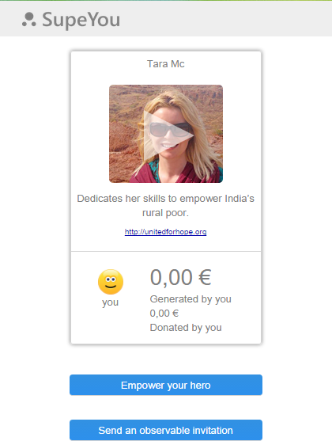

Inviting with an email is very simple and personal.
We recommend it!
In case your email or WhatsApp didn‘t open you can copy the link manually.
This button is special.
You will see how your invitation spreads!
It might look like the example below:
Try it :-)

Slide 10
… I‘ll invite someone. I want to see if they donate.
supeyou.com
Nikolaus Teixeira
http://willkommen-in.de/help
Creating a platform to channel help from citizens for refugees.
0 €
Generated by you.
0 €
Dontated by you.
You
Markus
Touch
Invite friends
How it works

Slide 11
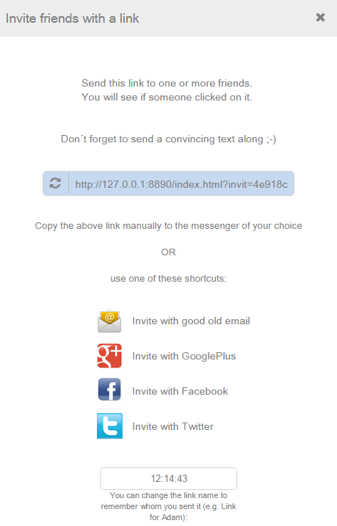


OK, if it‘s recommendet I will choose this option.
Send Invitation
supeyou.com
Please choose:
Invite single person
(recommendet)
Touch
Invite group of persons
Markus

Slide 12



Her name is Anna. Why do I have to type it in? No idea :-(
I‘ll use email.
Send Invitation
supeyou.com
What‘s the name of the person?
Anna
Choose one of these options:
Touch
Good old email
(recommendet)
WhatsApp
Markus
Copy and paste link to a messenger of your choice

Slide 13
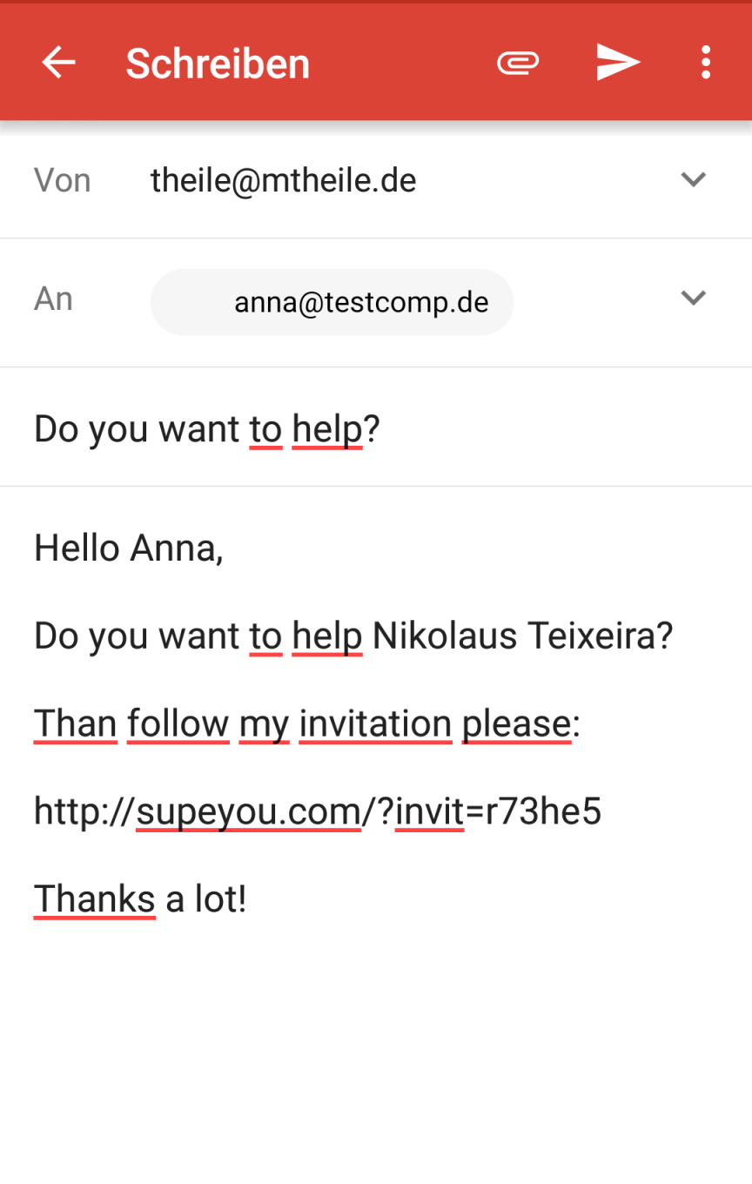
That text is ok, I just send it without editing.
supeyou.com
Touch
Do you also want to help?
Hi Anna,
Do you also want to help Nikolaus Teixeira?
I created an invitation for you:
http://supeyou.com/?Anna&invit=qe9t
I think he is doing a great job and deserves our support.
Thanks a lot!
Markus

Slide 14
Yeah, I want to be updated if someone follows my invitation.
Stay informed
supeyou.com
We will send an email to you as soon as someone accepts an invitation.
Please leave your email address:
OK
Markus

Slide 15
Ok, understandable.
What‘s your name?
supeyou.com
Your friends would love to know that it‘s you.
Please leave a name to show them:
OK
Markus

Slide 16
Send Invitation
supeyou.com
In our experience inviting a group of persons is very ineffective. Since they are not addressed personally it‘s very likely that they click your invitation away.
Are you sure you want to invite a group of persons?
Yes
Touch
Markus
No

Slide 17



Send Invitation
supeyou.com
Invite single person
What‘s the name of the person?
Anna
The name you insert is only for your eyes.
Send as email
Touch
Send as WhatsApp
Copy to clipboard
Markus
Invite group of persons

Slide 18
Send Invitation
supeyou.com
The name you insert is only for your eyes.
Send as email
Send as WhatsApp
Copy to clipboard
Invite group of persons
What‘s the name of the group?
Markus
The name you insert is only for your eyes.
Send as email
Send as WhatsApp
Copy to clipboard

Slide 19
Send Invitation
supeyou.com
To see where your clicks come from you can name your link.
(e.g. link on facebook)
Next >>
Markus

Slide 20
Send Invitation
supeyou.com
How do you want to share?
Facebook
Google+
Twitter
Markus
Copy and paste link

Slide 21

Oh, great, Adam already followed my invitation.
Tomorrow I will have a look if Eva also clicked the invitation link.
supeyou.com
0 €
Generated by you.
0 €
Dontated by you.
You
Invite friends
Markus
0€
Adam

Slide 22
Next day…

Slide 23
What happened? 180€?!? Thats great! How come?
supeyou.com
Nikolaus Teixeira
http://willkommen-in.de/help
Creating a platform to channel help from citizens for refugees.
180 €
Generated by you.
0 €
Dontated by you.
You
Markus
Invite friends
Scroll Down
155€
15€
+
Adam
Eva

Slide 24
Ah, thats why , Adam also invited some supporter and they donated.
Amazing how this adds up!
supeyou.com
180 €
Generated by you.
0 €
Dontated by you.
You
Invite friends
Markus
150€
15€
Adam
Eva
5€
120€
25€
+

Slide 25
Uh, I didn‘t contribute any money. Let me also donate. Lets say 10 €.
supeyou.com
180 €
Generated by you.
0 €
Dontated by you.
You
Touch
Invite friends
Markus
150€
15€
Adam
Eva
5€
120€
25€
+

Slide 26
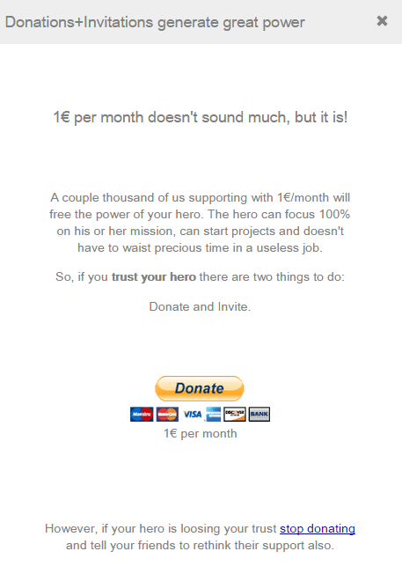
Yes, I guess I trust Nikolaus, and anyways, if he is not acting as I expect I just stop donating.
supeyou.com
Touch
Markus

Slide 27
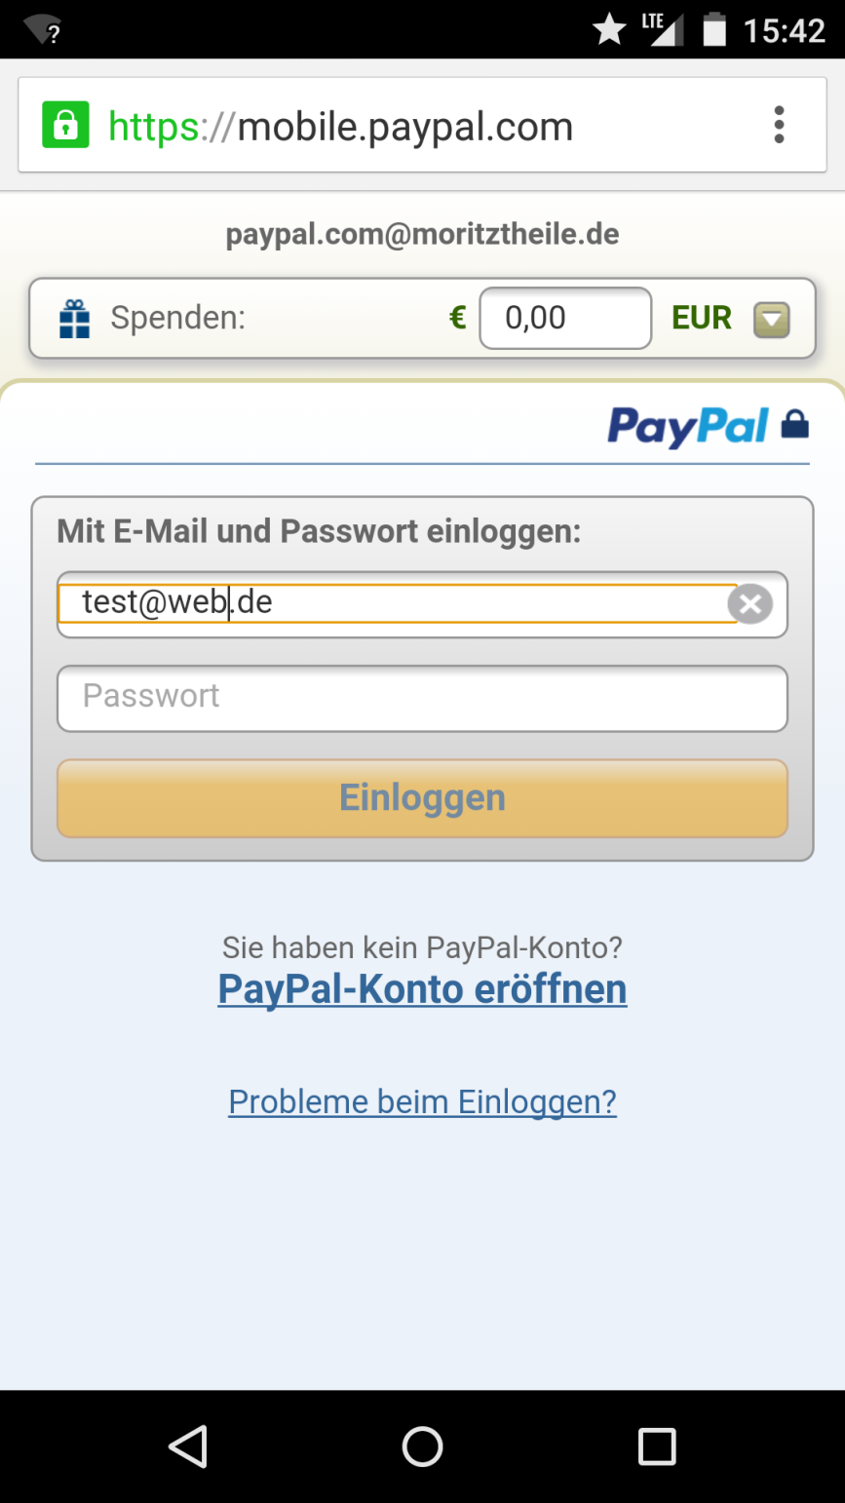
OK, thats easy with Paypal. Instead of 1 € I‘ll donate 10.
supeyou.com
nikolaus@willkommen-in.de
10,00
Markus

Slide 28
Makes Sense: 180 € of others plus 10 € from me makes 190 € all together.
I should invite some more friends this really helps Nikolaus.
supeyou.com
Nikolaus Teixeira
http://willkommen-in.de/help
Creating a platform to channel help from citizens for refugees.
190 €
Generated by you.
10 €
Dontated by you.
You
Markus
Invite friends
155€
15€
Adam
Eva

Slide 29
Next week…

Slide 30
supeyou.com
Wow, 3.506 €!
Lets see how this money was spend.
Nikolaus Teixeira
http://willkommen-in.de/help
Creating a platform to channel help from citizens for refugees.
3.506 €
Generated by you.
10 €
Dontated by you.
You
Markus
Invite friends
2.470€
15€
1011€
0€
Adam
Eva
Benedikt
Jens

Slide 31
supeyou.com
Nikolaus Teixeira
What‘s that?
http://willkommen-in.de/help
Creating a platform to channel help from citizens for refugees.
Touch
190 €
Generated by you.
10 €
Dontated by you.
You
Markus
Invite friends
155€
15€
Adam
Eva

Slide 32
Ah, thats nice. I can show what I have done for Nikolaus on my business website.
X
Show what you have generated
supeyou.com
Use the code on bottom to embed this SupeYou result in your website.
Nikolaus Teixeira
http://willkommen-in.de/help
Creating a platform to channel help from citizens for refugees.
190 €
Generated by you.
10 €
Dontated by you.
You
Embed code in site
<webcomponent url=„xyz“/>

Slide 33
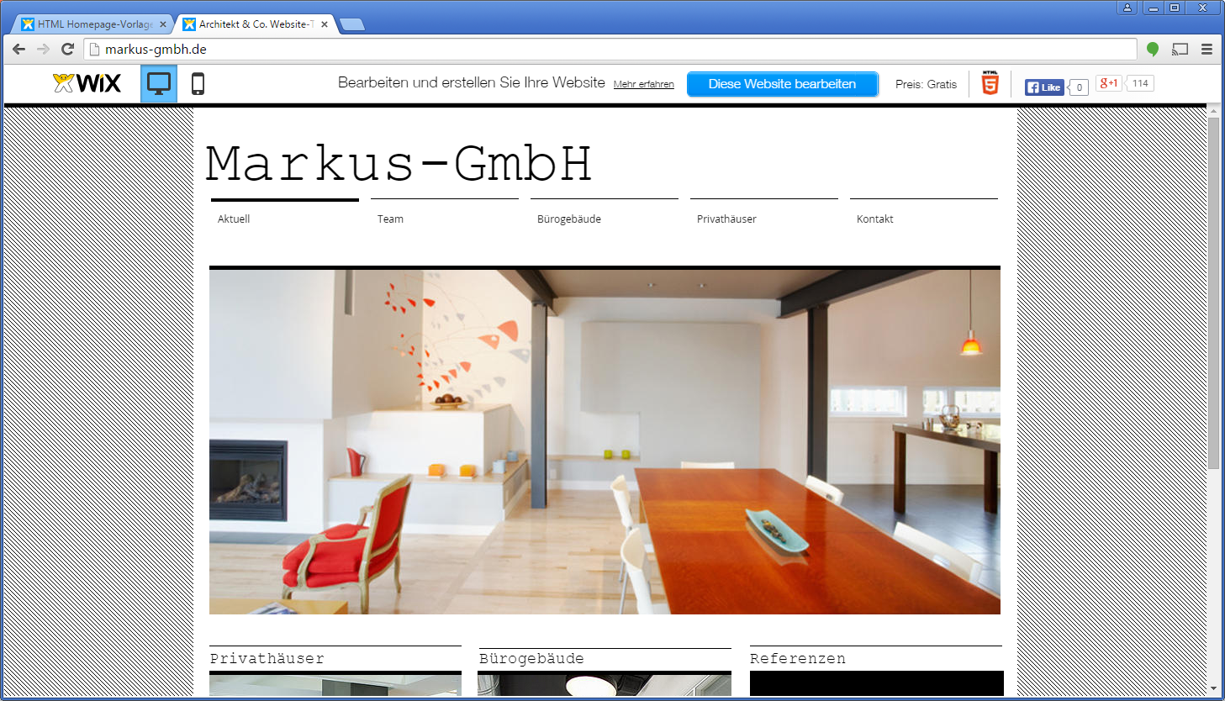
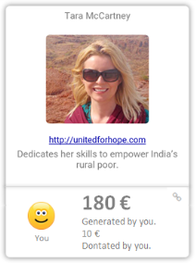
Our CSR-Contribution
Our CSR-Contribution
The sum of generated money is constantly updated.
If someone clicks, the one will be added to Markus invitated supporter.

