Slide 1
Pitch
Elevator statement:
SupeYou ermöglicht eine Lobby für das Volk. Aktivisten werden durch Ihre Supporter-Community finanziert.
USP:
Observable Invitations / Beobachtbare Einladungen
Fokussierung auf Personenmarken
Wer sind Sie?
Informatiker und erfolgreicher Gründer (TeamTable, Individualsoftware, Portalentwicklung )
Welches gesellschaftliche Problem lösen Sie?
Fehlende Lobby für Gesellschaftsinteressen.
Mit welchen Mitteln?
Crowdsourcing
Was macht Sie einzigartig?
Kombination von Know How in
Entwicklung von Large-Scale-WebApplikationen (DocSafe von Swisscom > 1Mio. Benutzer)
Erfolgreiche Softwareprodukte (FastWorks, TeamTable)
Tiefe theoretische Grundlagen von Datenstrukturen.
Kreative und durchdachte Ideen
Wie sieht das Geschäftsmodell aus?
Siehe Kickstarter oder Finanzierung durch SupeYou-Community
Wo stehen Sie?
Orientierung, Überprüfung von Annahmen
Wohin wollen Sie?
Weltweiter Quasistandard für die finanzielle Unterstützung von Aktivisten (wie Kickstarter für Projekte)
Was sind die nächsten Schritte?
Validierung der Funktion von Oberservable Invitations
Welchen Beratungsbedarf haben Sie konkret?
Sparring

Slide 2
SupeYou
Crowd-Finanzierung für Aktivisten.
Spenden – Einladen – Beobachten

Slide 3
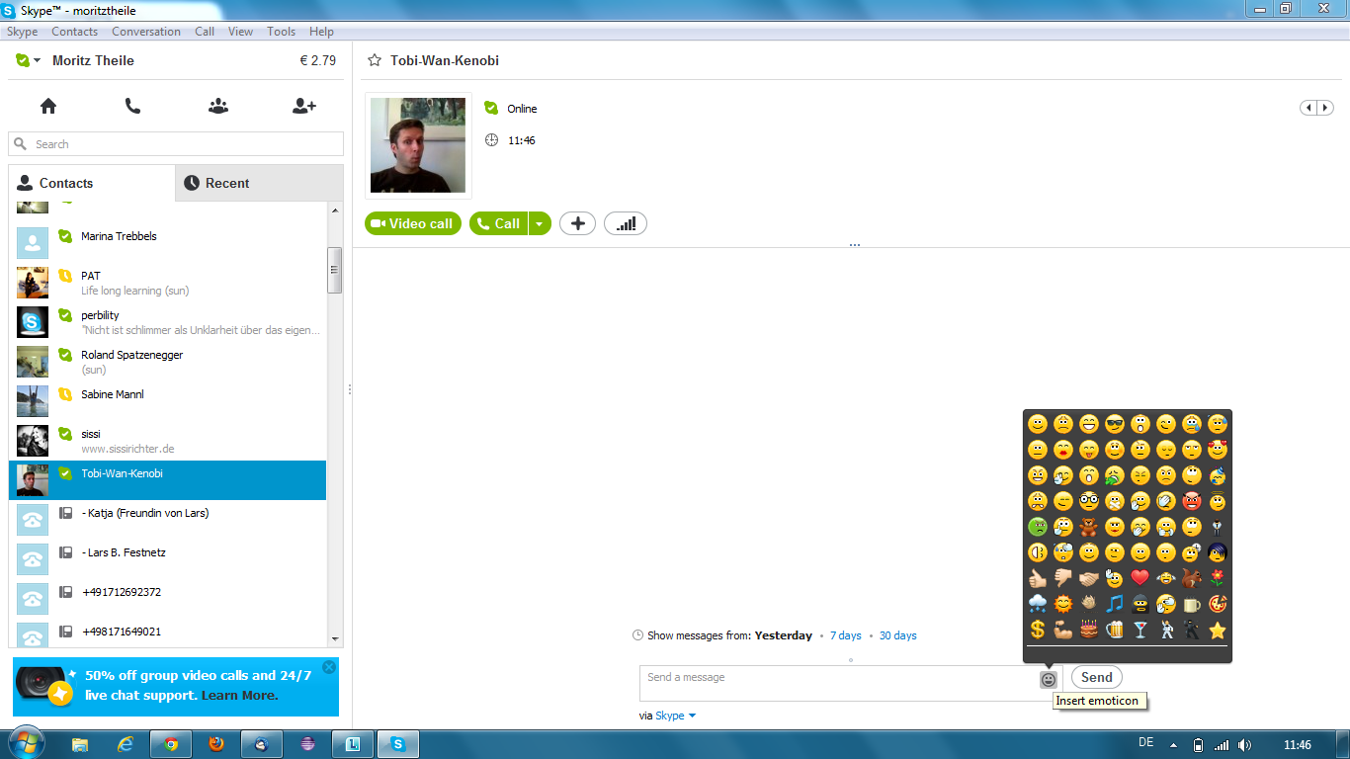
SupeYou
There are people out there who are giving all their energy to do good things without looking for their own advantage.
SupeYou helps to give these heroes the super power of our time – MONEY.
Money from millions of us will create a force of super heroes fighting for our interests.
Choose carefully to support the right ones.
The platform SupeYou.com isn‘t keeping a penny of your donations. 100% of the collected money is going to your hero.
Heros
Your hero isn‘t registered? – Ask him to do so.
Tobias Stone
Whale Body Guard

Slide 4
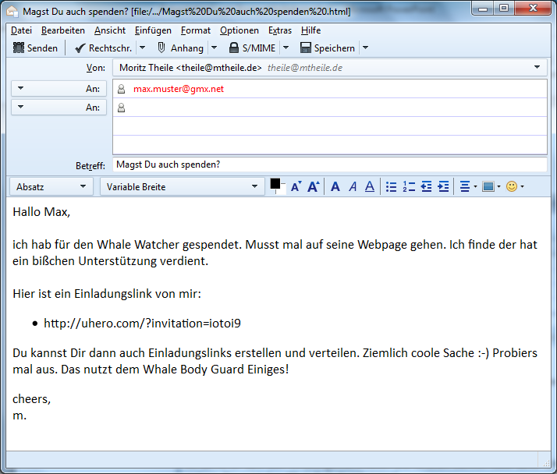
Einladung via E-Mail

Slide 5
SupeYou | Login
yesterday:
This month I need to flight to Japan.
Thank you guys!
Tobias Stone
Fighting for survival of whales
My Website
You
0 Euro donated by your Supporter Community last 30 days.
YOU
0 Euro donated by you.
Donate
click
Supporter invited by you
You can generate enormous support by inviting others.
They will be shown here.
Invite supporter to your community
Supporter invited by you indirectly
Here you will see supporter invited by members of your community.
All Supporter
Show

Slide 6
ToDo: Login or Registering

Slide 7
SupeYou | Your Heroes | Your Account
yesterday:
This month I need to flight to Japan.
Thank you guys!
Tobias Stone
X
Donate
Whale Body Guard
My Website
The best thing you can do for your hero is to donate regulary over a longer period of time.
You
0 Euro donated by your Supporter Community last 30 days.
Donate regulary
Donate
(You can stop donating any time.)
YOU
0 Euro donated by you.
Of course your hero will be very greatful for a one time donation as well.
Supporter invited by you
Donate once
Invite Supporter to your Community
Supporter invited by you indirectly
All Supporter
Show

Slide 8
ToDo: Paying-Processs (PayPal?)

Slide 9
SupeYou | Your Heroes | Your Account
yesterday:
This month I need to flight to Japan.
Thank you guys!
Tobias Stone
Fighting for survival of whales
My Website
You
10 Euro donated by your Supporter Community last 30 days.
YOU
10 Euro donated by you.
Donate
Supporter invited by you
You can generate enormous support by inviting others.
They will be shown here.
Invite supporter to your community
click
Supporter invited by you indirectly
Here you will see supporter invited by members of your community.
All Supporter
Show

Slide 10

More Heros
yesterday:
This month I need to flight to Japan.
Thank you guys!
Tobias Stone
X
Invite a Supporter
Whale Body Guard
My Website
Send this link to one or more friends.
You will see if someone clicked on it.
You
0 Euro donated by your Supporter Community last 30 days.
http://supeyou.com/invit=f39z249
Donate
(Copy this link to Email, WhatsApp, Facebook...)
YOU
0 Euro donated by you.
Supporter invited by you
You can change the name of the link to remember whom you sent it:
12.08.2013 14:33:09
Invite Supporter to your Community
Supporter invited by you indirectly
Done
click
All Supporter
Show

Slide 11

SupeYou | Your Heroes | Your Account
yesterday:
This month I need to flight to Japan.
Thank you guys!
Tobias Stone
Whale Body Guard
My Website
You
41 Euro
donated by your Supporter Community last 30 days.
Donate
YOU
10 Euro donated by you.
Supporter invited by you
Hans
Hubi
Herbert
Joschi
Pending
1 click
signed up
8 Euro
Invite Supporter to your Community
Supporter invited by you indirectly
20 Euro
10 Euro
3 Euro
All Supporter
2526 Euro donated by all Supporter last 30 days.

Slide 12
yesterday:
This month I need to flight to Japan.
Thank you guys!
Tobias Stone
Whale Body Guard
My Website
You
1410 Euro donated by your Supporter Community last 30 days.
Donate
YOU
100 Euro donated by you.
Supporter invited by you
Hans
Hubi
Herbert
Joschi
Pending
1 click
signed up
80 Euro
Invite Supporter to your Community
Supporter invited by you indirectly
200 Euro
1000 Euro
30 Euro
All Supporter
25260 Euro donated by all Supporter last 30 days.

Slide 13
SupeYou | Login
There are people out there who are giving all their energy to do good things without looking for their own advantage.
SupeYou helps to give these heros the super power of our time – MONEY. Money from the millions of us will create a force of Super Heros fighting in our interests.
Choose careful to support the right ones.
The platform SupeYou.com isn‘t keeping a penny of your donations. 100% of the collected money is going to your hero!
Heros
Your hero isn‘t registered? – Ask him to do so.
click
Tobias Stone
Whale Body Guard

Slide 14
SupeYou
Login
There are real heros out there who are giving all their energy to do somethig good without looking for their own advantage.
SupeYou helps to give these heros the super power of our time – MONEY. Money from the millions of us will create a force of Super Heros fighting in our interests.
Choose careful to support the right ones:
Applying as Hero
X
For applying as a hero, pleas send an email to register@supeyou.com.
Following content is requiered:
Copy/Picture of ID
Short description of your goal
Links to show your successes
Picture for your profil
Banking details
SupeYou staff will contact you.
Heros
Your hero isn‘t registered? – Ask him to do so.
Tobias Stone
OK
Whale Body Guard
This way of registration is only during beta phase.
A full automated registering process will follow.

Slide 15
SupeYou | Login
click
There are people out there who are giving all their energy to do good things without looking for their own advantage.
SupeYou helps to give these heroes the super power of our time – MONEY. Money from the millions of us will create a force of Super Heros fighting in our interests.
Choose careful to support the right ones.
The platform SupeYou.com isn‘t keeping a penny of your donations. 100% of the collected money is going to your hero!
Heros
Your hero isn‘t registered? – Ask him to do so.
Tobias Stone
Whale Body Guard

Slide 16
TODO: Login-Process and Account Management

Slide 17
SupeYou | Admin Panel | Your Supporter | Your Heroes | Your Account
There are people out there who are giving all their energy to do good things without looking for their own advantage.
SupeYou helps to give these heros the super power of our time – MONEY. Money from the millions of us will create a force of Super Heros fighting in our interests.
Choose careful to support the right ones.
The platform SupeYou.com isn‘t keeping a penny of your donations. 100% of the collected money is going to your hero.
Heros
Your hero isn‘t registered? – Ask him to do so.
Tobias Stone
Whale Body Guard

Slide 18
SupeYou | Admin Panel | Your Supporter | Your Heroes | Your Account
TobiasStein
Details Hero Supporter
described in „Admin Panel“

Slide 19
SupeYou | Admin Panel | Your Supporter | Your Heroes | Your Account
TobiasStein
Details Hero Supporter
TobiasStein
Details Messages Transactions
described in „Admin Panel“

Slide 20
SupeYou | Admin Panel | Your Supporter | Your Heroes | Your Account
TobiasStein
Details Hero Supporter
TobiasStein
Details Messages Transactions
described in „Admin Panel“

Slide 21
SupeYou | Admin Panel | Your Supporter | Your Heroes | Your Account
TobiasStein
Details Hero Supporter
TobiasStein
Details Messages Transactions
described in „Admin Panel“

Slide 22
SupeYou | Admin Panel | Your Supporter | Your Heroes | Your Account
TobiasStein
Details Hero Supporter
described in „Admin Panel“

Slide 23
SupeYou | Admin Panel | Your Supporter | Your Heroes | Your Account
yesterday:
This month I need to flight to Japan.
Thank you guys!
1
more
3
more
Tobias Stone
Whale Body Guard
My Website
You
41 Euro donated by your Supporter Community last 30 days.
Donate
YOU
10 Euro donated by you.
Supporter invited by you
Hans
Hubi
Herbert
Joschi
Pending
1 click
signed up
8 Euro
Invite Supporter to your Community
Supporter invited by you indirectly
20 Euro
10 Euro
3 Euro
All Supporter
2526 Euro donated by all Supporter last 30 days.

Slide 24
SupeYou | Admin Panel | Your Supporter | Your Heroes | Your Account
yesterday:
This month I need to flight to Japan.
Thank you guys!
Tobias Stone (You)
Whale Body Guard
My Website
2364 Euro donated by your Supporter Community last 30 days.
Account Balance: 2593 Euro
Last Transaction: 04.05.2013, 1968 Euro
Transaction History
Change Details
Supporter invited by you
Hans
Hubi
Herbert
Joschi
Pending
1 click
signed up
8 Euro
Invite Supporter to your Community
Supporter invited by you indirectly
20 Euro
10 Euro
3 Euro
All Supporter
2526 Euro donated by all Supporter last 30 days.

Slide 25
SupeYou | Admin Panel | Your Supporter | Your Heroes | Your Account
All Users Accounting
Username | MobileNumber | Email | IsAdmin | IsHero | IsSupporter
TobiasStein | 062529998 |  | false | true | true
JuliaWeber |  | julia33@web.de | true | true | true
MoritzTheile |  |  | true | false | false
Hubi |  |  | false | false | false
click

Slide 26
SupeYou | Admin Panel | Your Supporter | Your Heroes | Your Account
All Users Accounting
TobiasStein
Details Hero Supporter
Admin:
UserName:
MobileNr:
Email:
Sprache:
de

Slide 27
SupeYou
SupeYou | Admin Panel | Your Supporter | Your Heroes | Your Account
All Users Accounting
TobiasStein
Details Hero Supporter
Make TobiasStein a Hero

Slide 28
SupeYou | Admin Panel | Your Supporter | Your Heroes | Your Account
All Users Accounting
TobiasStein
Details Hero Supporter
TobiasStein
AdminSettings Details Messages Transactions
enabled:

Slide 29
SupeYou | Admin Panel | Your Supporter | Your Heroes | Your Account
All Users Accounting
TobiasStein
Details Hero Supporter
TobiasStein
AdminSettings Details Messages Transactions
Picture:
Upload
Website:
Mission:
Save

Slide 30
SupeYou
SupeYou | Admin Panel | Your Supporter | Your Heroes | Your Account
All Users Accounting
TobiasStein
Details Hero Supporter
TobiasStein
AdminSettings Details Messages Transactions
New Message:
add
History:
yesterday:
This month I need to flight to Japan.
Thank you guys!
02.04.2013::
…
yesterday:
…
yesterday:
…

Slide 31
SupeYou
SupeYou | Admin Panel | Your Supporter | Your Heroes | Your Account
All Users Accounting
TobiasStein
Details Hero Supporter
TobiasStein
AdminSettings Details Messages Transactions
Day | Remark | Category | Source/Target | Amount | Balance
 |  | DONATION | User:Hubi | +24,00
 |  | PAYOUT | HeroesAccount | -2968,90

Slide 32
User
String loginId
Donation
1
0..*
User2Supporters
1
1
1
1
Supporter2Donations
1
0..*
0..1
Supporter
long creationTimestamp
enum MOOD
String shoutout
Hero
String name
File profilePic
File idScan
String homepageLink
String description
boolean enabled
1
1
0..*
0..1
1
issued
0..*
1
Supporter2Invitations
long timestamp
Invitation2Supporters
long timestamp
1
0..*
acceoted
1
1
Invitation
long creationTimestamp
String name
String invitID

Slide 33
Hugo
01.05.
19:45
01.05.
19:48
Andrea
Manfred
Otto
01.05.
22:25
01.05.
22:32
02.05.
10:45
02.05.
12:43
02.05.
12:45
02.05.
12:48
Emma
Hermann
Marie
Gunnar
Christian
Herbert
01.05.
23:22
03.05.
19:48
04.05.
09:45
Eugen
Thomas
02.05.
07:34
Melanie
Marion

Slide 34
Admin
AdminPointer
AdminCollection
User
String userID
File
String mimeType
String name
byte[] data
0..1
1
1
1
Attitude
Mood mood
String shoutout
0..*
0..*
parent
previous
1
0..*
0..1
1
next
0..1
1
Supporter
long creationTimestamp
enum MOOD
String shoutout
HeroMessage
long timestamp
String text
boolean deleted
1
Hero
String name
File profilePic
File idScan
String homepageLink
String description
boolean enabled
0..*
children
1
1
1
0..1
0..*
last
last
issued
accepted
Transaction
enum CURRENCY
long date
int centvalue
String receipient
next
0..*
1
1
1
0..*
0..1
ResultOfDay
int daySince1Jan1970
int cachedSum
int cachedSumOfSubtrees
1
Invitation
long creationTimestamp
String name
String invitID
0..*
0..1
previous
1
0..*
Click
long timestamp

Slide 35
Login
click
There are people out there who are giving all their energy to do good things without looking for their own advantage.
SupeYou helps to give these heros the super power of our time – MONEY. Money from the millions of us will create a force of Super Heros fighting in our interests.
Choose careful to support the right ones.
The platform SupeYou.com isn‘t keeping a penny of your donations. 100% of the collected money is going to your hero.
Heros
Your hero isn‘t registered? – Ask him to do so.
Tobias Stone
Whale Body Guard

Slide 36
SupeYou
Login
There are real heros out there who are giving all their energy to do somethig good without looking for their own advantage.
SupeYou helps to give these heros the super power of our time – MONEY. Money from the millions of us will create a force of Super Heros fighting in our interests.
Choose careful to support the right ones:
Login
X
Username:
FranzF
Forgot username?
Password:
*******
click
Forgot password?
Heros
With this browser you will be logged in automatically if checked.
Your hero isn‘t registered? – Ask him to do so.
Remember Login
Create new Account
Tobias Stone
OK
Whale Body Guard

Slide 37
SupeYou
Login
There are real heros out there who are giving all their energy to do somethig good without looking for their own advantage.
SupeYou helps to give these heros the super power of our time – MONEY. Money from the millions of us will create a force of Super Heros fighting in our interests.
Choose careful to support the right ones:
Retrieve Username
X
Your Email:
AND/OR
Your Mobile:
Heros
Your hero isn‘t registered? – Ask him to do so.
Send Username
Tobias Stone
Whale Body Guard

Slide 38
SupeYou
Login
There are real heros out there who are giving all their energy to do somethig good without looking for their own advantage.
SupeYou helps to give these heros the super power of our time – MONEY. Money from the millions of us will create a force of Super Heros fighting in our interests.
Choose careful to support the right ones:
Reset Password
X
Username:
FranzF
A link for resetting the password will be send via email. Click on it to choose a new password.
Heros
Your hero isn‘t registered? – Ask him to do so.
Reset Password
Tobias Stone
Whale Body Guard

Slide 39
SupeYou
Login
There are real heros out there who are giving all their energy to do somethig good without looking for their own advantage.
SupeYou helps to give these heros the super power of our time – MONEY. Money from the millions of us will create a force of Super Heros fighting in our interests.
Choose careful to support the right ones:
Retrieve Username
X
Your Email:
SupeYou will send the username associated with this email address.
AND/OR
Your Mobile:
SupeYou will send the username associated with this mobile.
Heros
Your hero isn‘t registered? – Ask him to do so.
Send Login
Tobias Stone
Whale Body Guard

Slide 40
Use Cases of System
Inform Supporter of new Supsupporter
Receive Money per Supporter
Calculate balance of Supporters account
Pay out Supporter

Slide 41
Use Cases of Admin
Monitor growth
Control growth
Send information messages to user
  Select user (subtree)

Slide 42
Use Cases of Supporter
Read invitation
Click on invitation link
Read infos
Donate Money (Abo-Donation?)
Invite Supporter
Ask for invitation status of invited Supporter
Watch own supporter network.
Getting informed about new Supporter
  Unsubscribe from updates
Step out of System

Slide 43
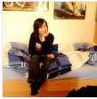


Some peope are doing good things. They deserve to get supported. This site helps to support these people in a very effective way.
If you want to be a supporter you can and should do this by donating money.
The unusual part is, however, that you also can invite supporter who can invite supporter themselves and so on and you will get 1% of the collected money. This 1% can be pretty rewarding… :-)
Yes, this is a full grown snowballsystem, but in the end everybody is the winner!
All donations goes to the supported one and a small part to the supporter themselves. This site doesn‘t get a penny.
Why did we set up this site?
Supported People
apply for support
more
donate

Slide 44


SupeYou

Slide 45
SupeYou

Slide 46
SupeYou

Slide 47
SupeYou

Slide 49






Why did we set up this site?
We want the heros of our time being able to focus on what their designation is.
We want to set a counterweight to the industrial lobby by creating money flows to the right people.

Slide 50
Apply for Support
We are happy to accept you as a hero if your work matches the descriptions below.
Your work helps common welfare
You can show appreciable results of your work
Your work is not due to financial self-interest
Your work is legal
Send us a convincing e-mail, we will answer promptly.
Eg. http://www.ndr.de/fernsehen/sendungen/das/media/dasx3431.html

Slide 51
Einladung via E-Mail

Slide 52
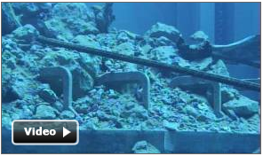
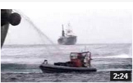

This month I need to flight to Japan.
Thank you guys!
4. Apr. 2013
23. Mrz. 2013
4. Mrz. 2013
Tobias Stone
3490$
(5 days left in April)
Whale Body Guard
My Website
I cut a a movie about the beauty of whales.
10000 clicks already! Have a look too ☺
1276$
12,76$
10$
Donate
YOU
Supporter invited by you directly (5)
307$
Invite Supporter
Gunther.Groß
Supporter invited by you indirectly (75)

Slide 53
Give me money!
I will train for being the best surfer in the world.
I need money!
1200$ last 5 days
15400 last year
You are the best!
Great! crazy

Slide 54
Give me money!
I will train for being the best surfer in the world.
I need money!
1200$ last 5 days
15400 last year
I want to see success!

Slide 55
Give me money!
I will train for being the best surfer in the world.
I need money!
1200$ last 5 days
15400 last year
Loved your last video

Slide 56
Tobias fights for free surfing!
Talked to major of Manly (see video)
I will train for being the best surfer in the world.
I need money!
1200$ last 5 days
15400 last year
1x
19x
Great job.

Slide 57
More Heros
yesterday:
This month I need to flight to Japan.
Thank you guys!
Tobias Stone
X
Invite Someone
Whale Body Guard
My Website
Your Email (Mail is send CC to you)
You
Max.Feldbach@t-online.de
0 Euro donated by your Supporter Community last 30 days.
Your Friends Email Address
Fred.Steiger@gmx.de
Donate
Your Name (used in subject of mail)
YOU
0 Euro donated by you.
Max
Supporter invited by you
Your Text
Hallo Fred,
hier kannst Du dem Tobias Stone unterstützen von dem wir neulich das Interview gesehen hatten.
Viele Grüße,
Max
Invite Supporter to your Community
Supporter invited by you indirectly
<< Back
Preview >>
click
All Supporter
Show

Slide 58
More Heros
yesterday:
This month I need to flight to Japan.
Thank you guys!
Tobias Stone
X
Invite Someone
Whale Body Guard
My Website
Preview of your invitation mail:
You
To: Fred.Steiger@gmx.de
CC: Max.Feldbach@t-online.de
Max invites you to support Tobias Stone
Hallo Fred,
hier kannst Du dem Tobias Stone unterstützen von dem wir neulich das Interview gesehen hatten.
Viele Grüße,
Max
-----------------------------------------------------------------------
http://support4heros.com/?urlid=9falf0ga
(With this link you automatically join Maxs support community.)
---------------------------------------------------------------------------------------------------
0 Euro donated by your Supporter Community last 30 days.
Supporter invited by you
Supporter invited by you indirectly
<< Back
Send >>
click
All Supporter
Show

