Slide 1
DonationStream for Mein-Papa-Kommt
Good work will raise financial support from the crowd
02.11.2016, Moritz Theile

Slide 2
DonationStream
Like WhatsApp,
with a „Send Donation“ functionality.
with viral inviting.
with community.
Replacing a simple donate button with an DonationStream will increase the donations dramatically

Slide 3
Let‘s have a look at a conventional Donate Button:

Slide 4
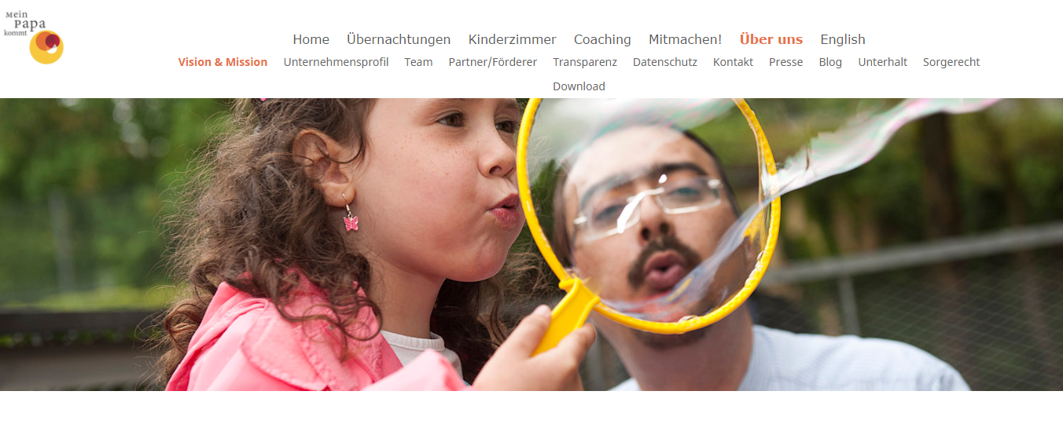
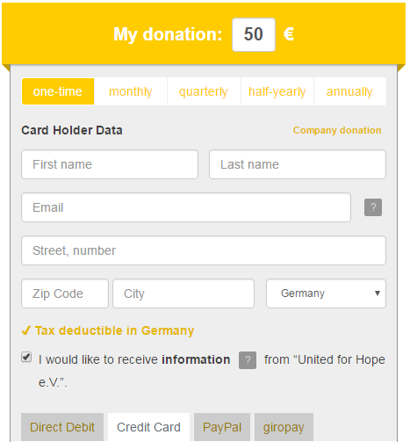
Donate
Nobody clicks here anyways…
Nothing interesting to see.
=> Ignored by most users
A Donation will give no Feedback.
=> Boooring

Slide 5
How can we make it better?

Slide 6
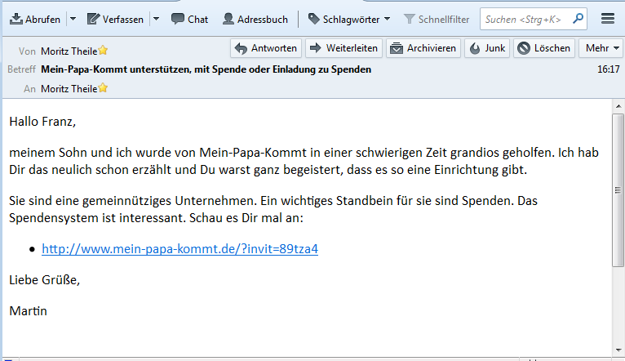
A personal invitation from a friend
Martin
Franz
click

Slide 7


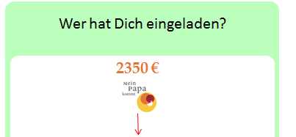
2350 €
Franz sees that small donatations sum up.
5 €
Super Arbeit, weiter so!
Susanne
02.11.16, 07:12
Franz reads comments and gets involved and interested.
Ihr habt mir sehr geholfen,
Danke Euch!
10 €
Bernhard
02.11.16, 08:12
1 €
Einfach nur so :-*
Felix
02.11.16, 08:42
Franz can leave something for others to see with a donation.
25 €
Ein großes Dankeschön!
Bernhard
02.11.16, 10:12
1 €
Dein Text
Du

Slide 8

W
Wer hat Dich eingeladen?
2350 €
1250 €
…
Simon
10 €
…
Martin
0 €
5 €
30€
Du
Brigitte
Markus
…
Nun kannst Du wiederum neue
Spender einladen
und der Kreis schließt sich ☺

