Slide 1
Scenario „Entry via Invitation“
This scenario describes Markus following an invitation from his friend Maria. Markus is a Munich citizen.

Slide 2
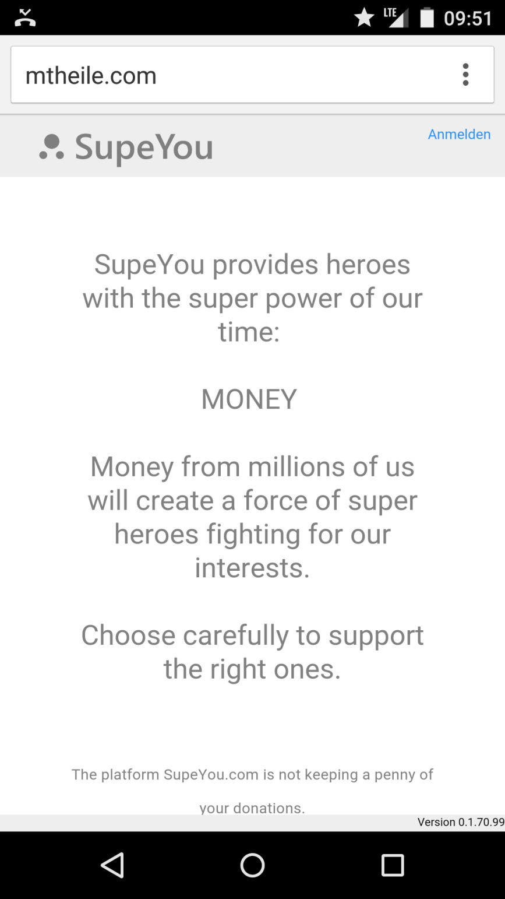
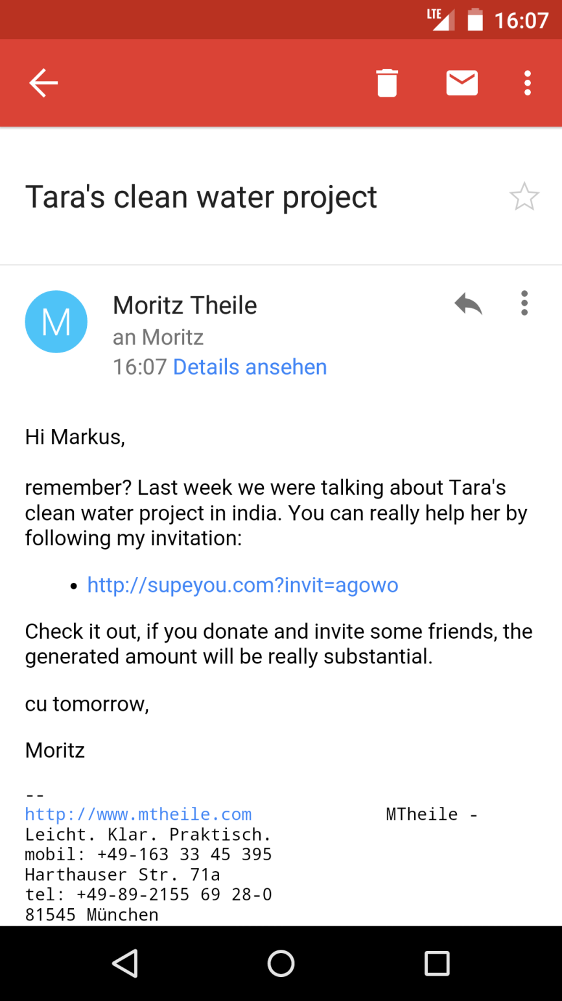

Yes, sure I remember. I would really like to help Nikolaus. I heard about his platform on radio.
supeyou.com
Nikolaus helping refugees
Maria Richter
Hi Markus,
remember? Last week we were talking about Nikolaus internet platform to channel help from germans for refugees.
If you want to support him please follow my invitation below:
http://supeyou.com/?invit=3t345
It‘s an interesting way to raise donations because you can follow how much money will be created by your invitations.
Cu tomorrow,
Maria
Touch
Markus
Maria

Slide 3
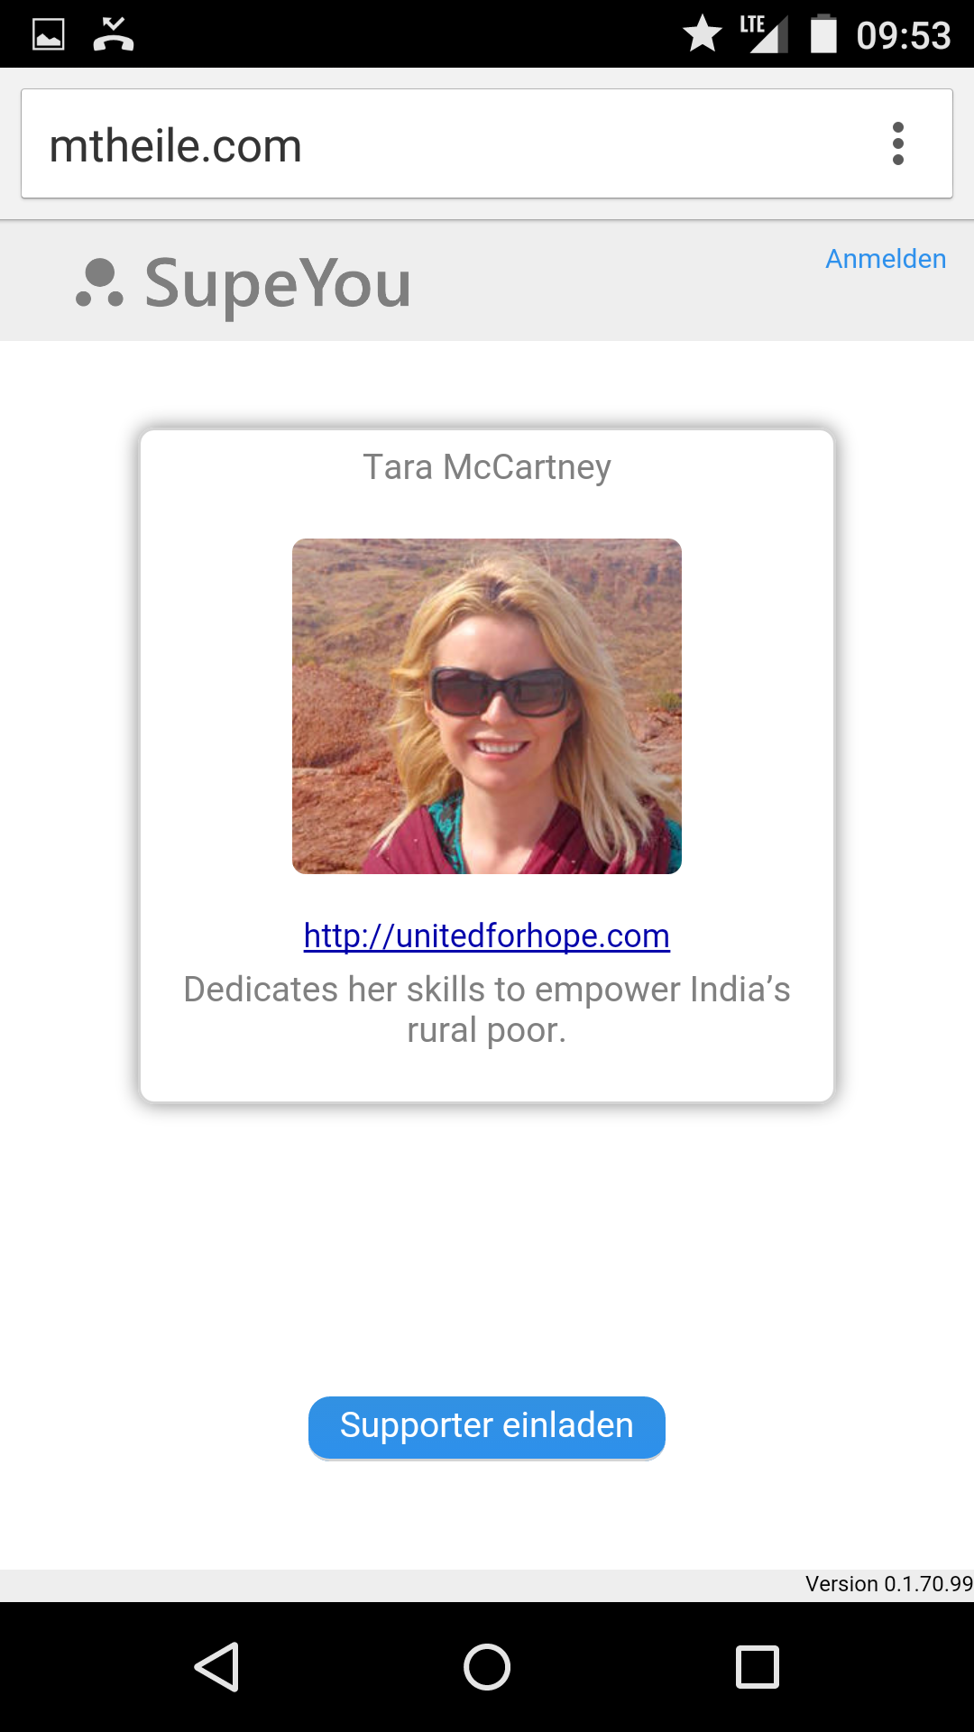
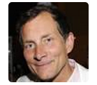


Ahh, a video, lets see…
supeyou.com
Nikolaus Teixeira
Touch
http://willkommen-in.de/help
Creating a platform to channel help from citizens for refugees.
0 €
Generated by you.
0 €
Dontated by you.
You
Markus
Invite friends
How it works

Slide 4
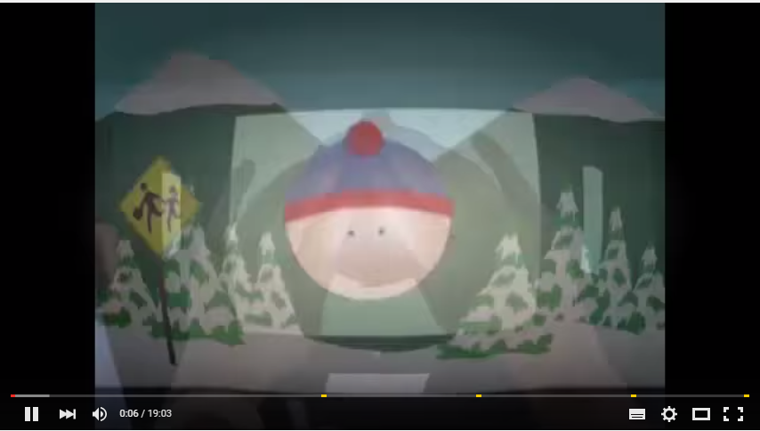
X
Video Nikolaus Teixeira
Hallo,
mein Name ist Nikolaus Teixeira.
Meine Mission ist es Flüchtlingen zu helfen. Dafür betreue und entwickle ich mit meinem Team die Seite willkommen-in.de. Mit Hilfe der Seite wird die unglaubliche Hilfsbereitschaft aus der Bevölkerung für Flüchtlinge an die richtigen Stellen gebracht.
Für weitere Informationen klickt einfach den Link unten.
Um die Seite weiter zu betreuen braucht mein Team Deine Unterstützung. Ein Euro/Monat und eine Einladung an einige Deiner Freunde würden uns helfen mit 100% bei der Sache zu bleiben.
Ich garantiere persönlich, dass alle Spenden gemäß meiner Mission eingesetzt werden. Ich werde die Verwendung detailliert veröffentlichen.
Vielen Dank!
supeyou.com

Slide 5
This is probably the info link Nikolaus was talking about. Lets see.
supeyou.com
Nikolaus Teixeira
Touch
http://willkommen-in.de/help
Creating a platform to channel help from citizens for refugees.
0 €
Generated by you.
0 €
Dontated by you.
You
Markus
Invite friends
How it works

Slide 6
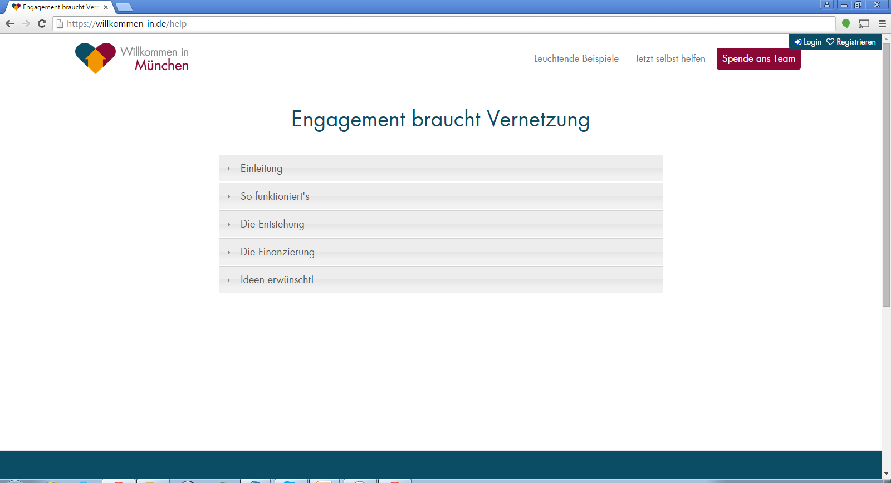
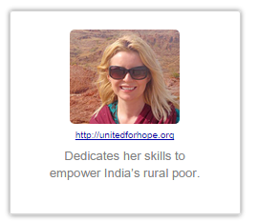
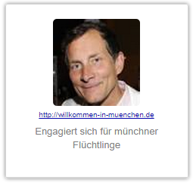
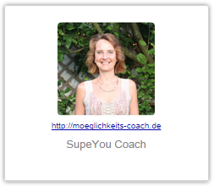
Spende ans Team
Wir sind das Team, dass diese Seite aufgebaut hat. Ohne Eure Unterstützung müssen wir unser Engagement trotz riesiger Erfolge bald einstellen. Bitte benutzt die SupeYou-HeroCards unten, um zu Spenden und Eure Freunde zum Spenden aufzurufen.
Wir garantieren über jeden eingesammelten Euro Rechenschaft abzulegen und jeden Euro für willkommen-in.de einzusetzen. Es spielt keine Rolle an welches Teammitglied eine Spende geht. Wir arbeiten als Team und entscheiden gemeinsam wie das Geld am besten eingesetzt wird.
Makes sense to me.
20.439€
105.897€
5.294€
Press Back button
Markus

Slide 7
Sounds all good! Well I would like to help him, but how does it work?
supeyou.com
Nikolaus Teixeira
http://willkommen-in.de/help
Creating a platform to channel help from citizens for refugees.
0 €
Generated by you.
0 €
Dontated by you.
You
Markus
Invite friends
Scroll Down
How it works

Slide 8
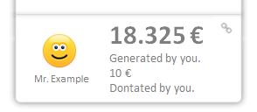
Oh, that‘ s interesting. I can invite friends and see how much we spend all together. Let‘s see…
supeyou.com
How it works
With a few invitations you can generate an enormous amount of money. And the best thing is, that you can visually see how your invitation spreads. This might look like this:
0€
15€
Adam
Eva
Markus
5€
0€
10€
5€
0€
Scroll Up
5€
0€
10€
0€
5€
100€
5€
10€
20€
+
+
+
+
+
+

Slide 9
… I‘ll invite someone. I want to see if they donate.
supeyou.com
Nikolaus Teixeira
http://willkommen-in.de/help
Creating a platform to channel help from citizens for refugees.
0 €
Generated by you.
0 €
Dontated by you.
You
Markus
Touch
Invite friends
How it works

Slide 10


I talked recently with Adam and Eva about Nikolaus project. I‘m sure they are interested.
X
Invite friends to donate
supeyou.com
Send this link to one or more friends.
You will see if someone clicked on it.
Don‘t forget to send a convincing text along ;-)
http://supeyou.com/invit=f39z2
Copy this link to Email, WhatsApp, Facebook...
12.08.2013 14:33:09
Change the link name to remember whom you sent it
(e.g. Link for Adam):
Markus

Slide 11

Oh, great, Adam already followed my invitation.
Tomorrow I will have a look if Eva also clicked the invitation link.
supeyou.com
0 €
Generated by you.
0 €
Dontated by you.
You
Invite friends
Markus
0€
Adam

Slide 12
Next day…

Slide 13
What happened? 180€?!? Thats great! How come?
supeyou.com
Nikolaus Teixeira
http://willkommen-in.de/help
Creating a platform to channel help from citizens for refugees.
180 €
Generated by you.
0 €
Dontated by you.
You
Markus
Invite friends
Scroll Down
155€
15€
+
Adam
Eva

Slide 14
Ah, thats why , Adam also invited some supporter and they donated.
Amazing how this adds up!
supeyou.com
180 €
Generated by you.
0 €
Dontated by you.
You
Invite friends
Markus
150€
15€
Adam
Eva
5€
120€
25€
+

Slide 15
Uh, I didn‘t contribute any money. Let me also donate. Lets say 10 €.
supeyou.com
180 €
Generated by you.
0 €
Dontated by you.
You
Touch
Invite friends
Markus
150€
15€
Adam
Eva
5€
120€
25€
+

Slide 16
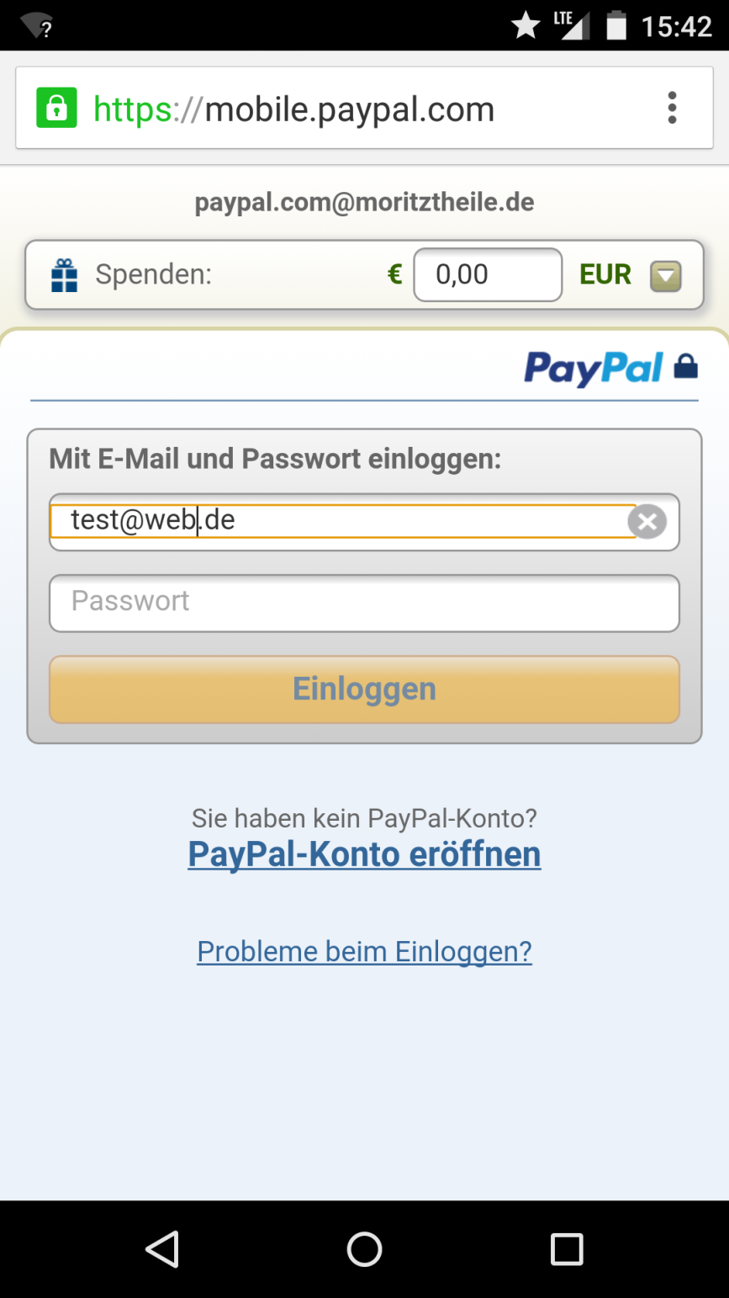
OK, thats easy with Paypal.
supeyou.com
Tara@unitedforhope.org
10,00
Markus

Slide 17
What‘s that?
supeyou.com
Nikolaus Teixeira
http://willkommen-in.de/help
Creating a platform to channel help from citizens for refugees.
Touch
190 €
Generated by you.
10 €
Dontated by you.
You
Markus
Invite friends
155€
15€
Adam
Eva

Slide 18
Ah, thats nice. I can show what I have done for Tara on my business website.
X
Show what you have generated
supeyou.com
Use the code on bottom to embed this SupeYou result in your website.
Nikolaus Teixeira
http://willkommen-in.de/help
Creating a platform to channel help from citizens for refugees.
190 €
Generated by you.
10 €
Dontated by you.
You
Embed code in site
<webcomponent url=„xyz“/>

Slide 19
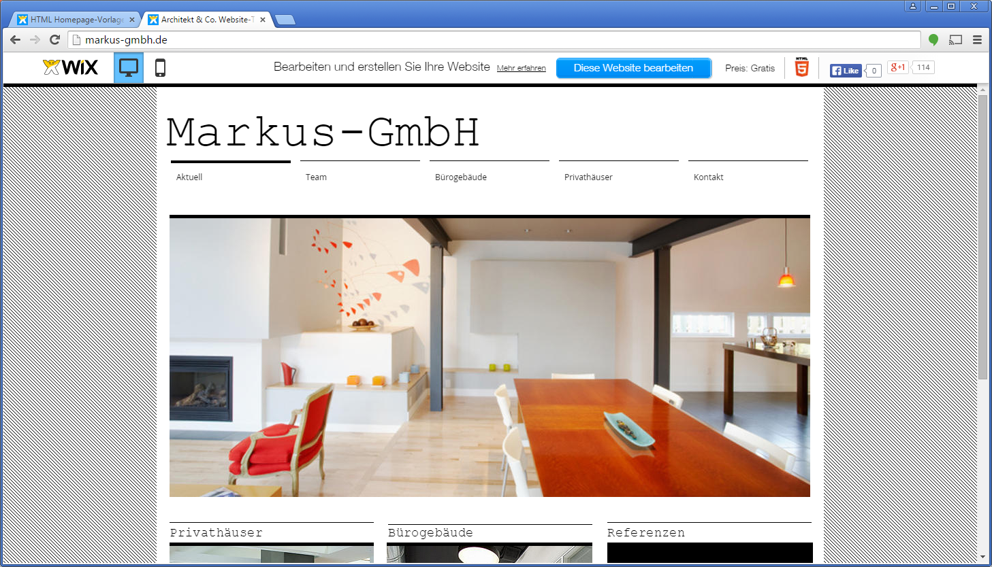
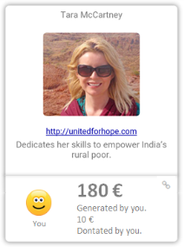
Our CSR-Contribution
Our CSR-Contribution
The sum of generated money is constantly updated.
If someone clicks, the one will be added to Markus invitated supporter.

