Slide 1
SupeYou
„Adding another layer to democracy.“

Slide 2
Scenario „Entry via Invitation“
This scenario describes Markus following an invitation from one of his friends.

Slide 3
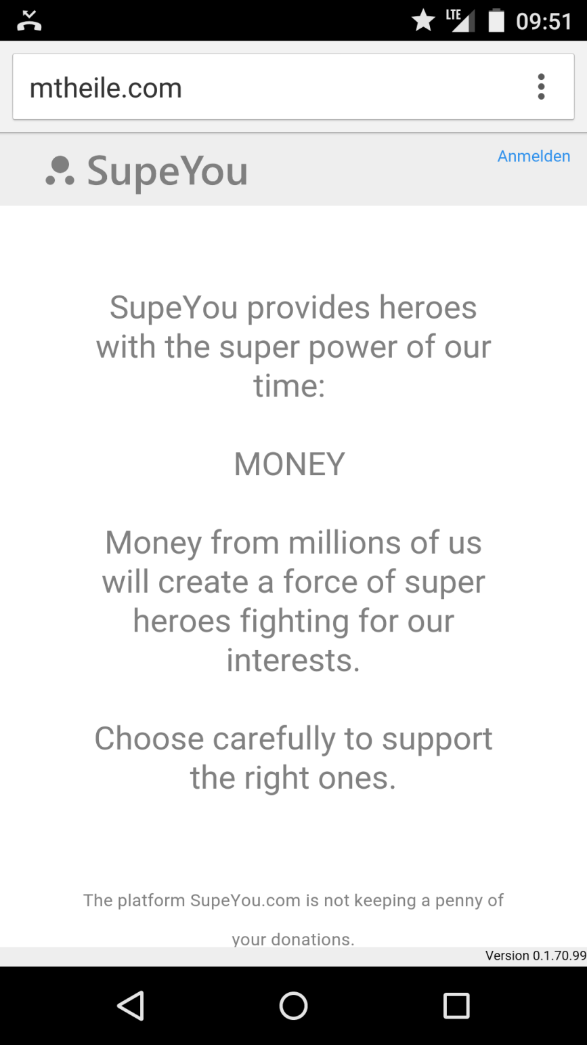
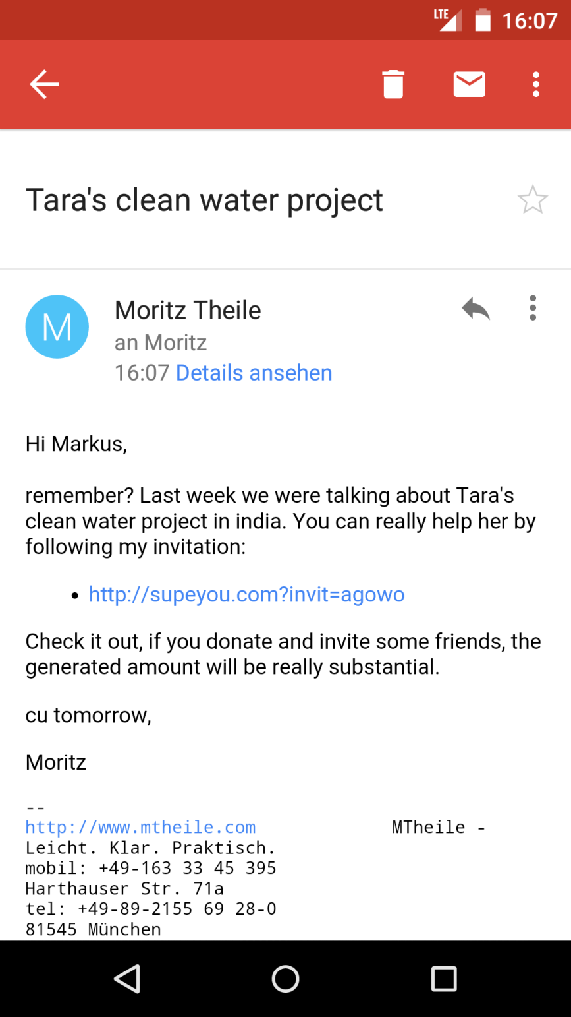

Yes, sure I remember. I would really like to help Tara. She is doing a great job.
supeyou.com
Maria Richter
Touch
Markus
Maria

Slide 4
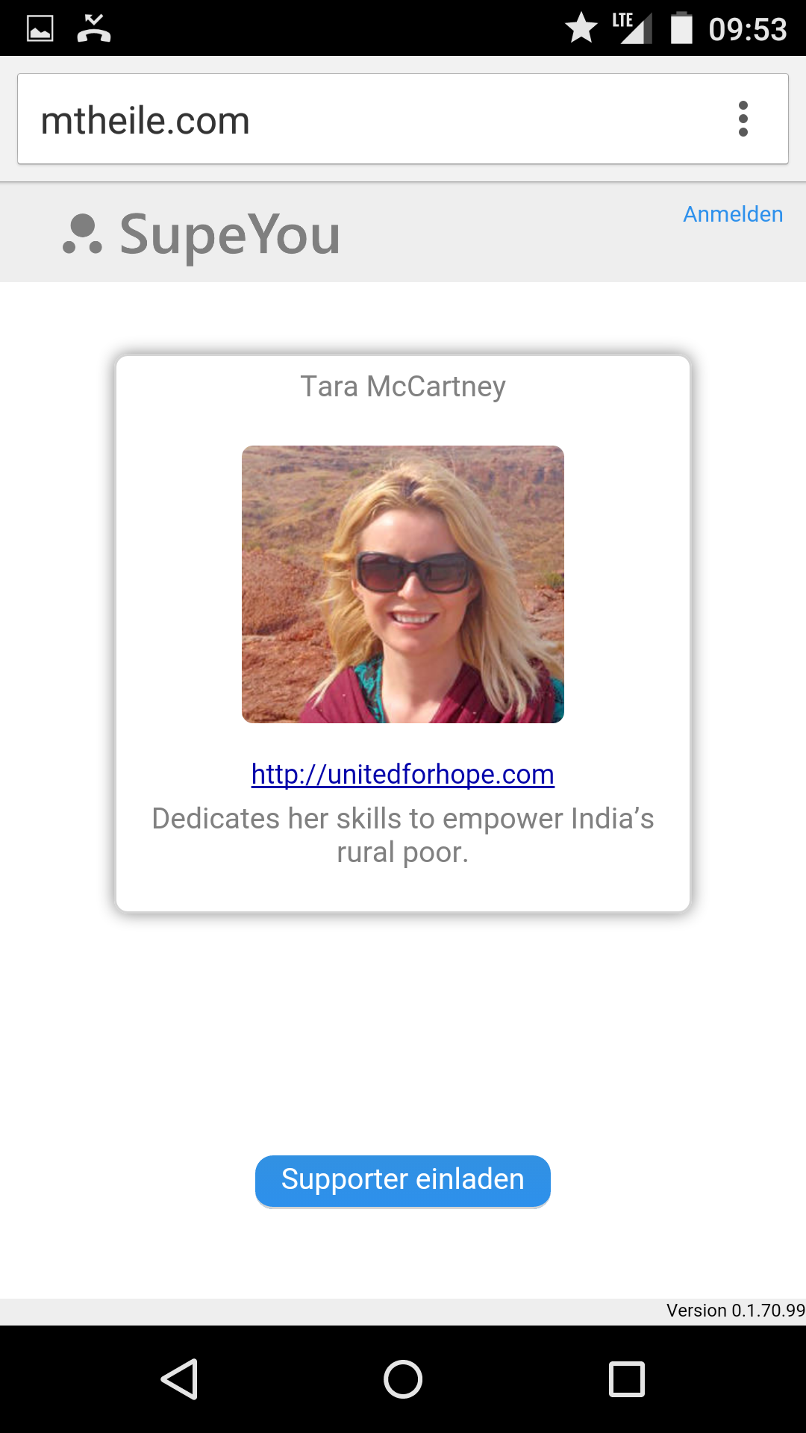


Hm, Tara, well I would like to help her, but how does it work?
supeyou.com
0 €
Generated by you.
0 €
Dontated by you.
You
Markus
Invite friends
Scroll Down
How it works

Slide 5
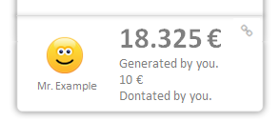
Oh, that‘ s interesting. I can invite friends and see how much we spend all together. Let‘s see…
supeyou.com
How it works
With a few invitations you can generate an enormous amount of money. And the best thing is, that you can visually see how your invitation spreads. This might look like this:
0€
15€
Adam
Eva
Markus
5€
0€
10€
5€
0€
5€
0€
10€
0€
5€
100€
5€
10€
20€
+
+
+
+
+
+

Slide 6
… I‘ll invite someone. I want to see if they donate.
supeyou.com
0 €
Generated by you.
0 €
Dontated by you.
You
Markus
Touch
Invite friends
How it works

Slide 7


I talked recently with Adam and Eva about Taras project. I‘m sure they are interested.
X
Invite friends to donate
supeyou.com
Send this link to one or more friends.
You will see if someone clicked on it.
Don‘t forget to send a convincing text along ;-)
http://supeyou.com/invit=f39z2
Copy this link to Email, WhatsApp, Facebook...
12.08.2013 14:33:09
Change the link name to remember whom you sent it
(e.g. Link for Adam):
Markus

Slide 8
Oh, great, Adam already followed my invitation.
Tomorrow I will have a look if Eva also clicked the invitation link.
supeyou.com
0 €
Generated by you.
0 €
Dontated by you.
You
Invite friends
Markus
0€
Adam

Slide 9
Next day…

Slide 10
What happened? 180€?!? Thats great! How come?
supeyou.com
180 €
Generated by you.
0 €
Dontated by you.
You
Markus
Invite friends
Scroll Down
155€
15€
+
Adam
Eva

Slide 11
Ah, thats why , Adam also invited some supporter and they donated.
Amazing how this adds up!
supeyou.com
180 €
Generated by you.
0 €
Dontated by you.
You
Invite friends
Markus
150€
15€
Adam
Eva
5€
120€
25€
+

Slide 12
Uh, I didn‘t contribute any money. Let me also donate. Lets say 10 €.
supeyou.com
180 €
Generated by you.
0 €
Dontated by you.
You
Touch
Invite friends
Markus
150€
15€
Adam
Eva
5€
120€
25€
+

Slide 13
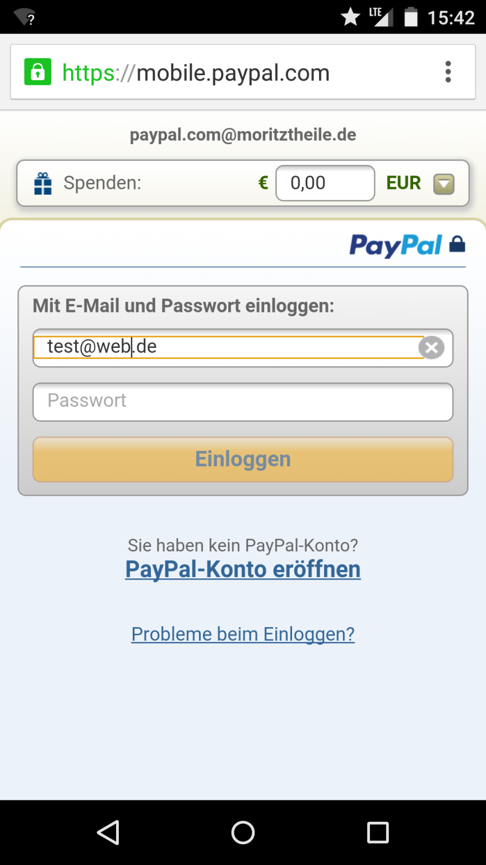
OK, thats easy with Paypal.
supeyou.com
Tara@unitedforhope.org
10,00
Markus

Slide 14
What‘s that?
supeyou.com
Touch
190 €
Generated by you.
10 €
Dontated by you.
You
Markus
Invite friends
155€
15€
Adam
Eva

Slide 15
Ah, thats nice. I can show what I have done for Tara on my business website.
X
Show what you have generated
supeyou.com
Use the code on bottom to embed this SupeYou result in your website.
190 €
Generated by you.
10 €
Dontated by you.
You
Embed code in site
<webcomponent url=„xyz“/>

Slide 16
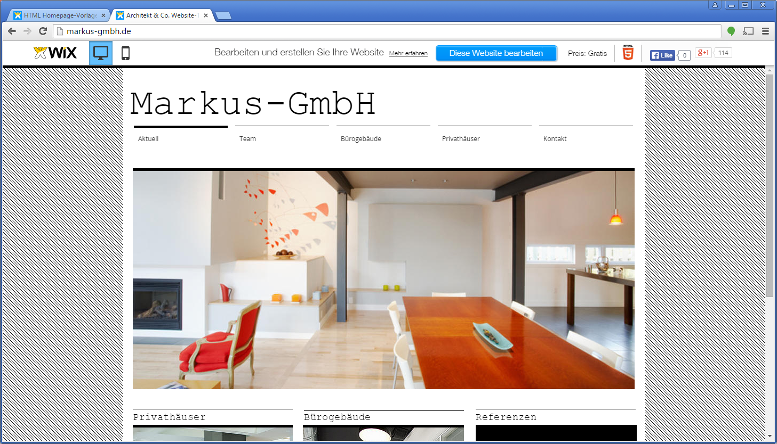
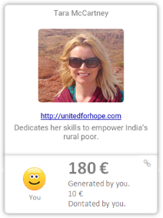
Our CSR-Contribution
Our CSR-Contribution
The sum of generated money is constantly updated.
If someone clicks, the one will be added to Markus invitated supporter.

Slide 17
Scenario „Entry via Landing Page“
This scenario assumes that the user found SupeYou e.g. by using a search engine.
(The visitor is not invited by a friend to support a hero.)

Slide 18
supeyou.com
Scroll Down

Slide 19
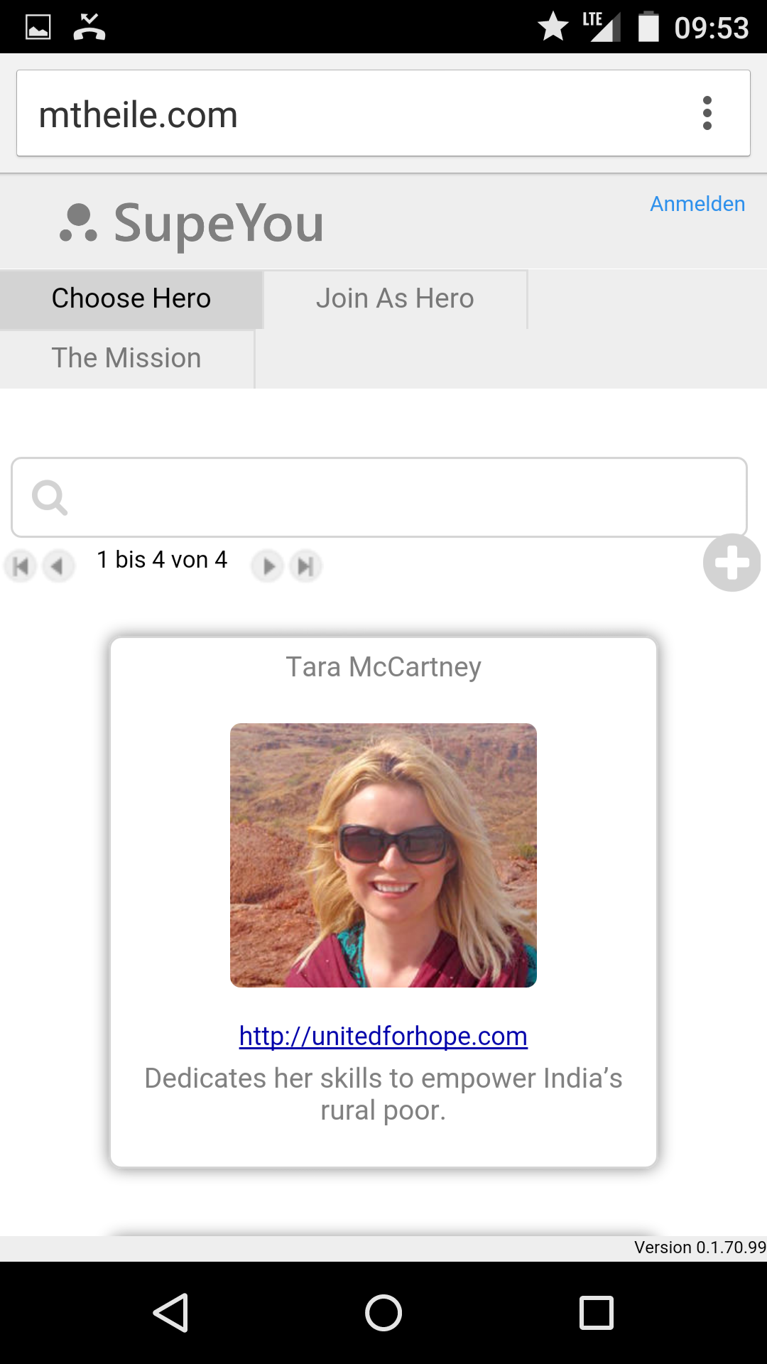
supeyou.com
Touch
From here the screens are the same as described in Scenario „Entry via Invitation“.

