Slide 1
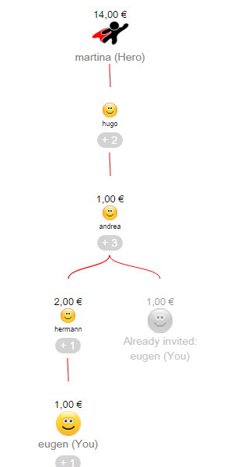
invited
invited
invited by
invited
invited by
invited by
invited by

