Slide 1
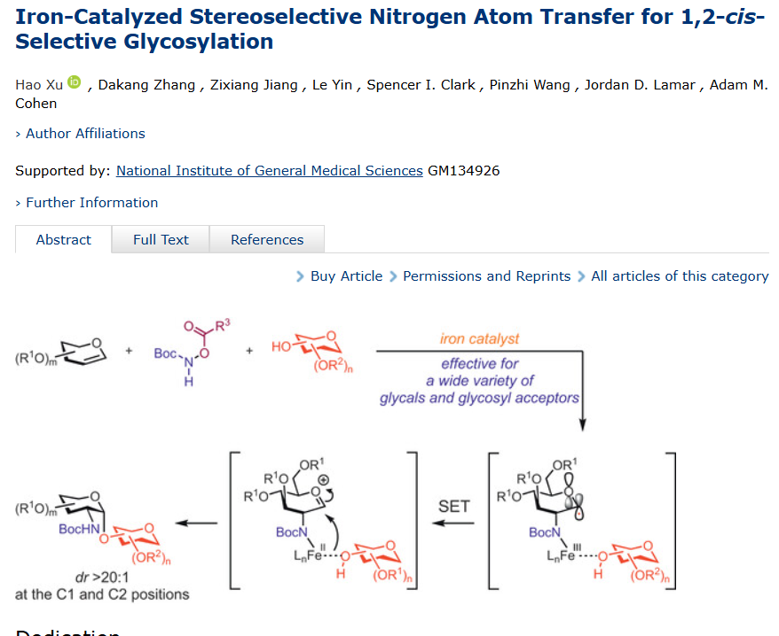
Iron-NAT

Slide 2
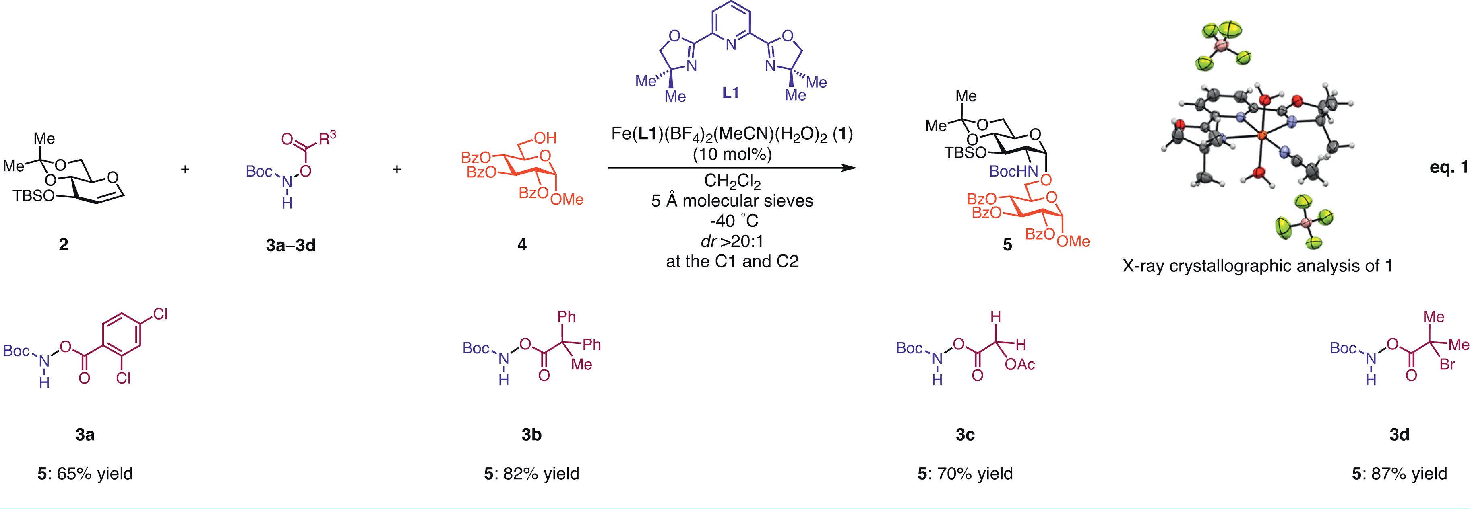
Iron-Catalyzed Reaction
Iron-NAT

Slide 3
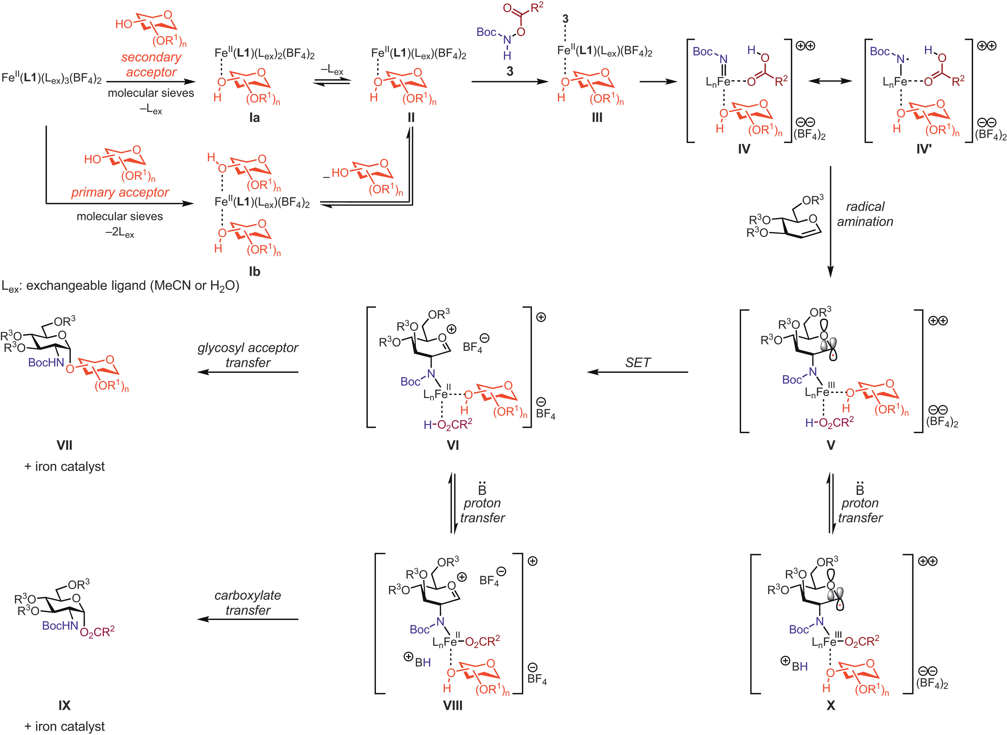
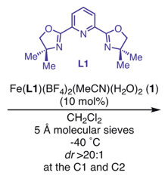
Proposed Mechanism
Step I: Formation of Fe-N complex
Step II: Addition on glycosyl
The highest barrier energy should below 20kcal/mol
Iron-NAT

Slide 4
Step I: Formation of Fe-N complex
What’s the structure of Int III?
How does the N–O bond cleavage and Fe–N bond formation occur during the transformation from Int III to Int IV?
Iron-NAT

Slide 5
Step I: Stable Configuration of Int1
opt/freq at ωB97X-D/6-31G* level, gas phase
The most possible 3 structrues within 20 kcal/mol restriction
Iron-NAT

Slide 6
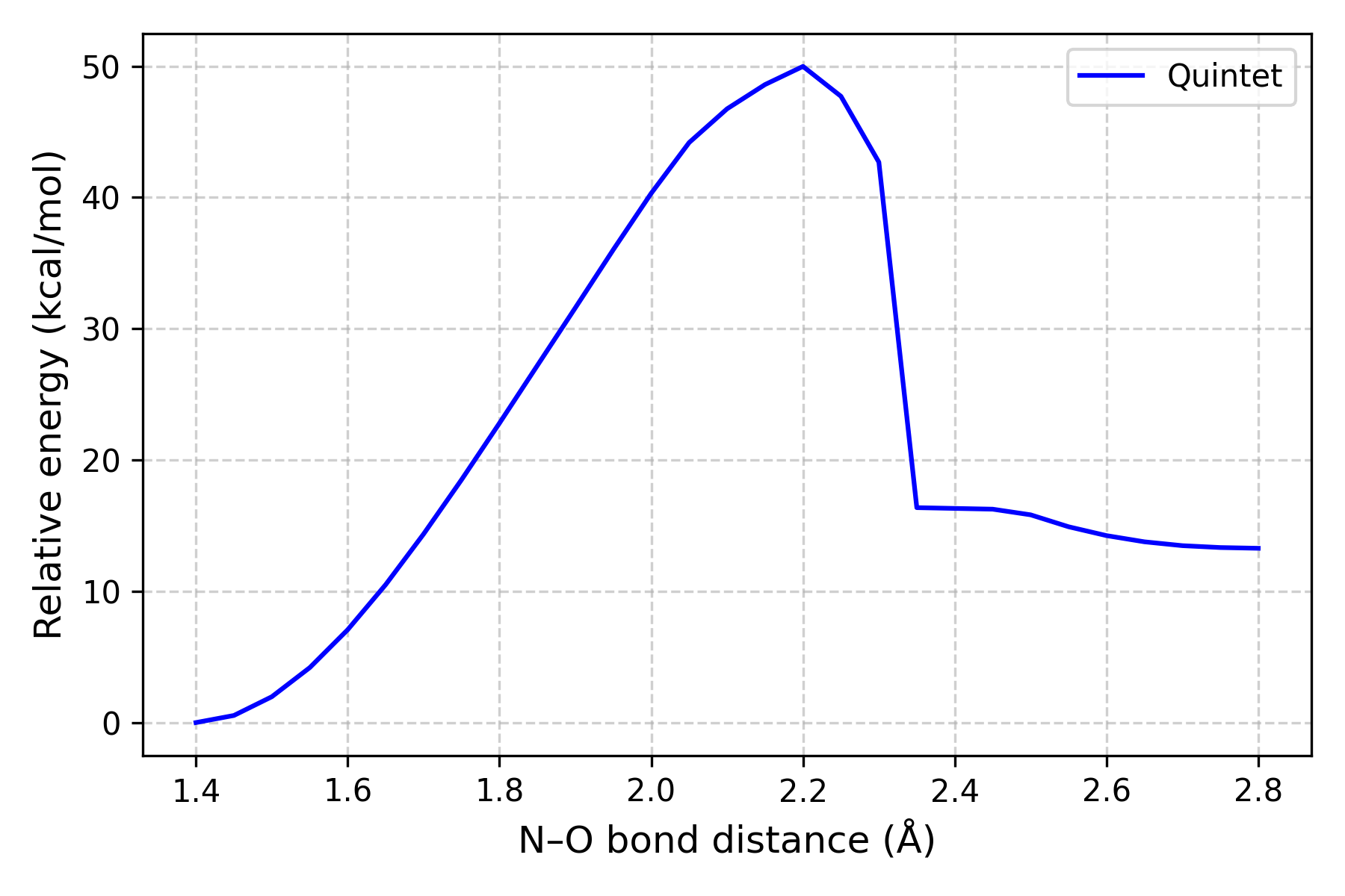
Step I: Scan of N-O Bond
opt/freq at ωB97X-D/6-31G* level, gas phase
~50kcal/mol
Total Barrier: ~50kcal/mol
Iron-NAT

Slide 7
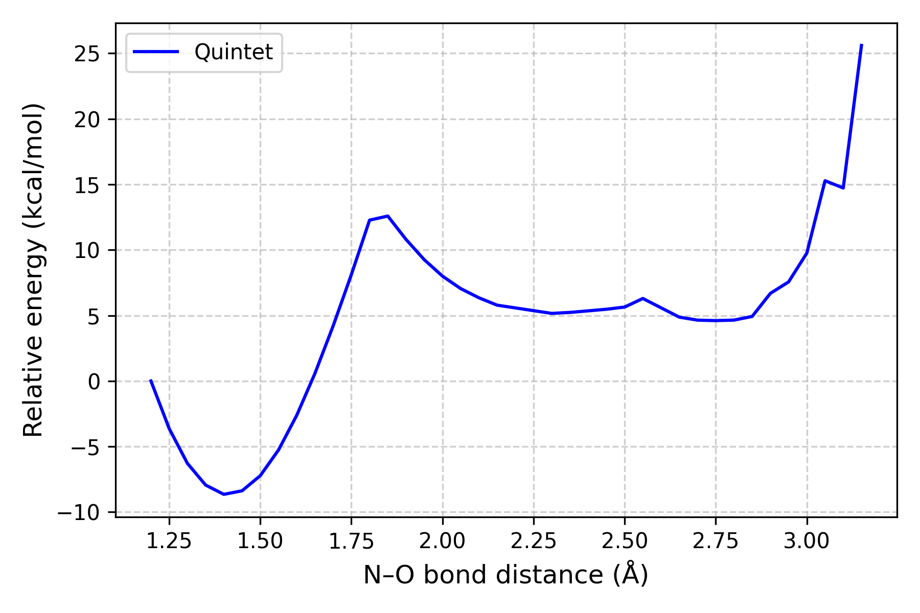
Step I: Scan of N-O Bond
opt/freq at ωB97X-D/6-31G* level, gas phase
~20kcal/mol
Total Barrier: ~26kcal/mol
Iron-NAT

Slide 8
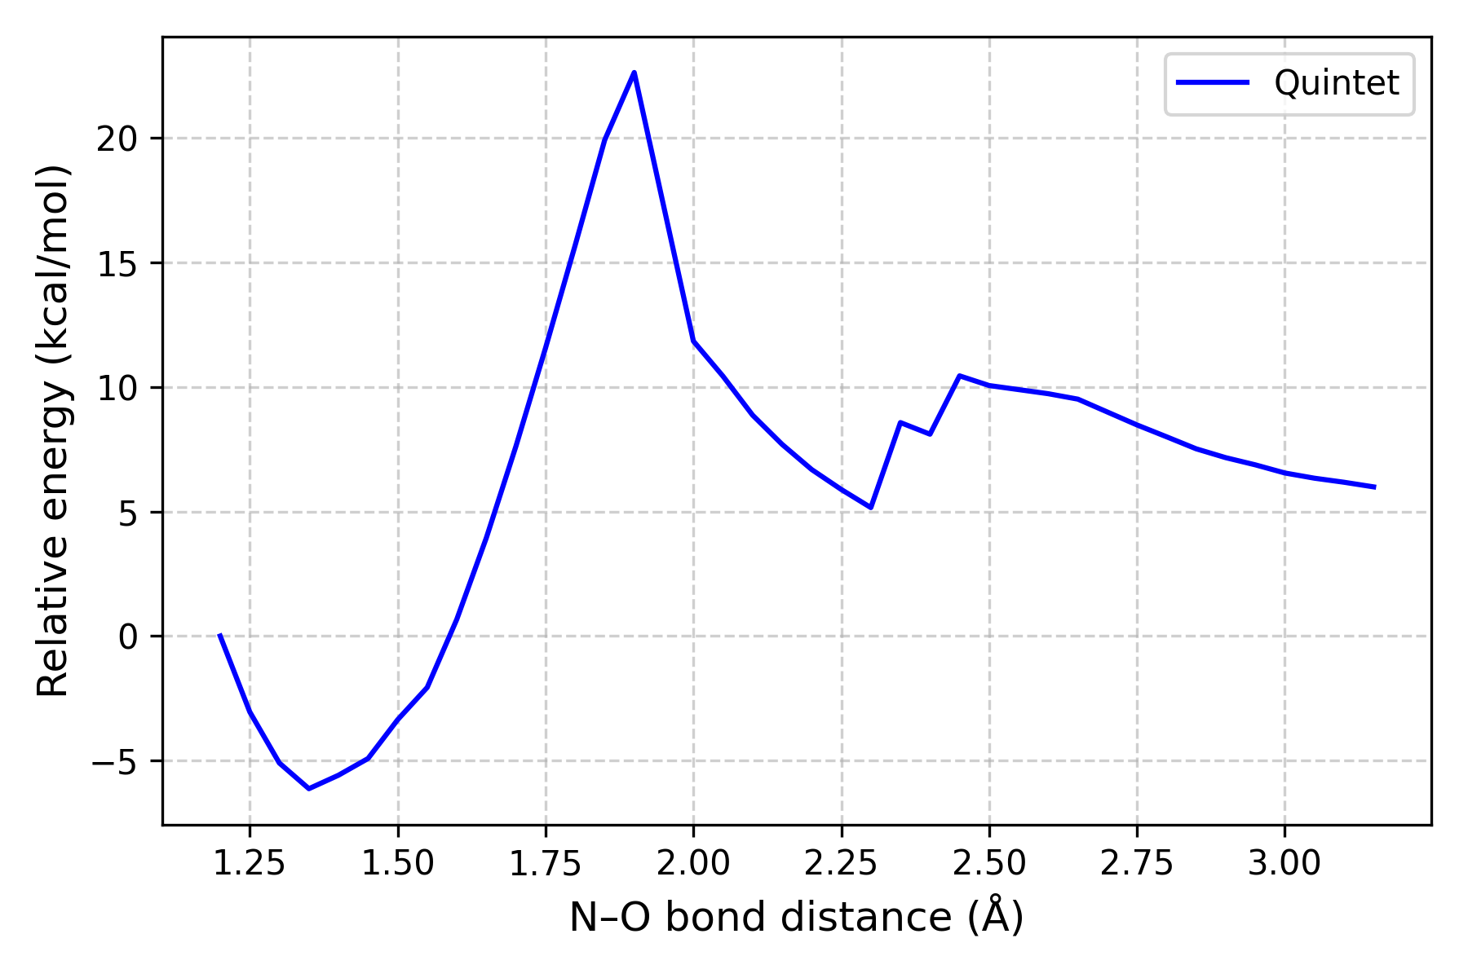
Step I: Problems
opt/freq at ωB97X-D/6-31G* level, gas phase
~30kcal/mol
Total Barrier: ~30kcal/mol
Iron-NAT

Slide 9
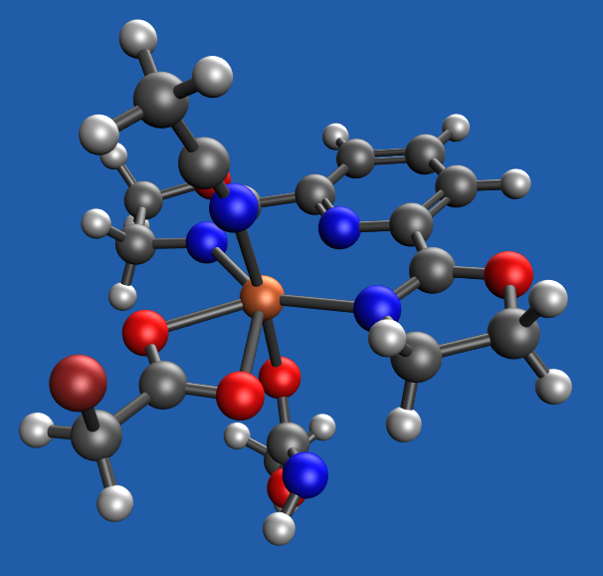
Step I: 7-Coordinate Fe Complex
opt/freq at ωB97X-D/6-31G* level, gas phase
seven-coordinate iron complex with pentagonal bipyramidal geometry
Iron-NAT

Slide 10
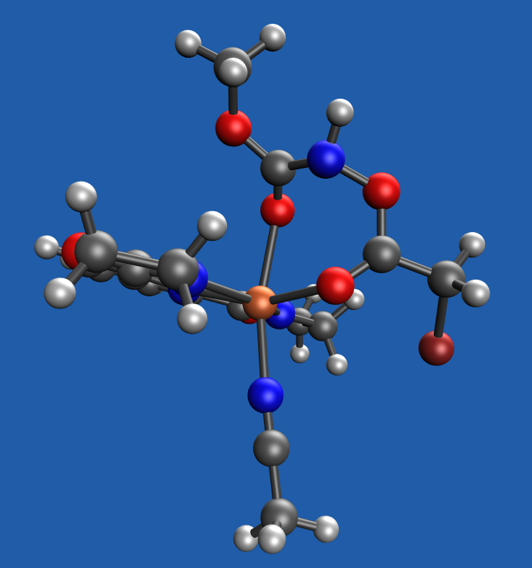
Step I: Conformation Type B of Int 1
opt/freq at ωB97X-D/6-31G* level, gas phase
Iron-NAT

Slide 11
Step I: Conformation of Int 2
opt/freq at ωB97X-D/6-31G* level, gas phase
Iron-NAT

