Slide 1
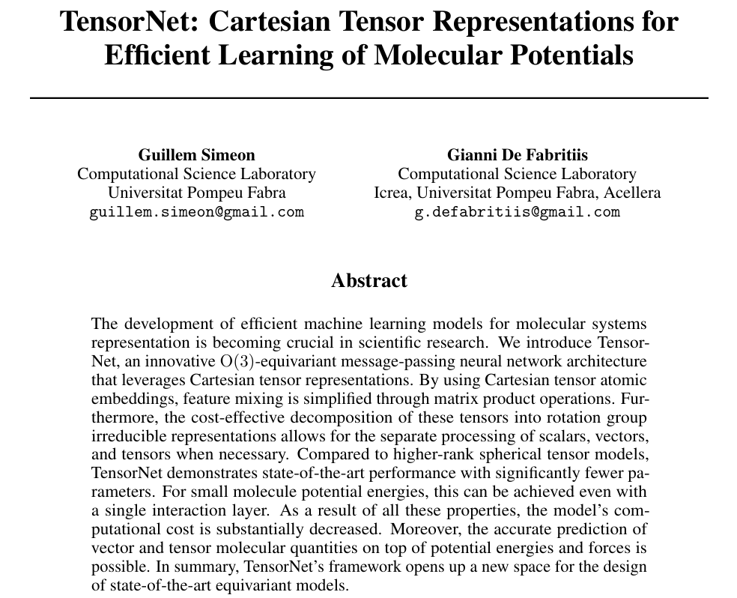
TensorNet
TensorNet

Slide 2
Background Techniques in TensorNet
1. Equivaraince and equivariant graph neural network
2. Cartesian tensors and irreducible tensor decomposition.
3. Message passing neural network.
All background techniques are mentioned in GNN Baisc.pptx
TensorNet

Slide 3

Background Techniques in TensorNet
Operations respecting O(3)-equivariance:
1. Composition from irreducible representations.
2. Invariant weights and linear combinations.
3. Matrix product.
TensorNet

Slide 4
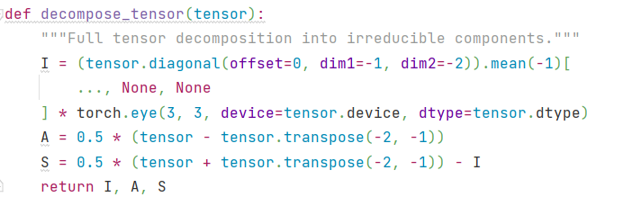
1. Composition from irreducible representations.
One can decompose tensor X into the 3 components
TensorNet

Slide 5
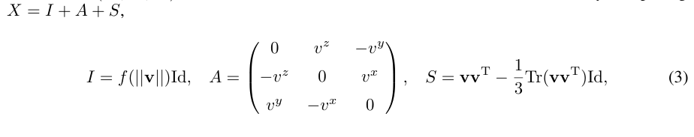
1. Composition from irreducible representations.
To ensure equivariance, all vectors v in the model are transformed into a tensor
X that is constructed to satisfy the SO(3) group operation.
TensorNet

Slide 6
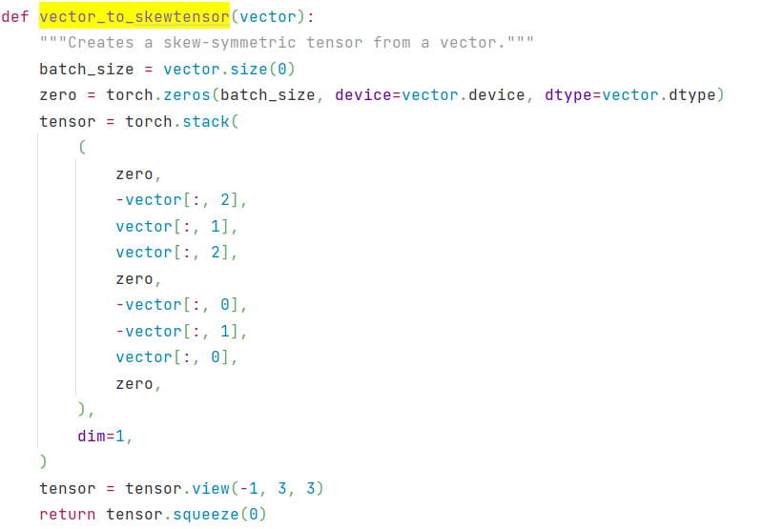
1. Composition from irreducible representations.
TensorNet

Slide 7
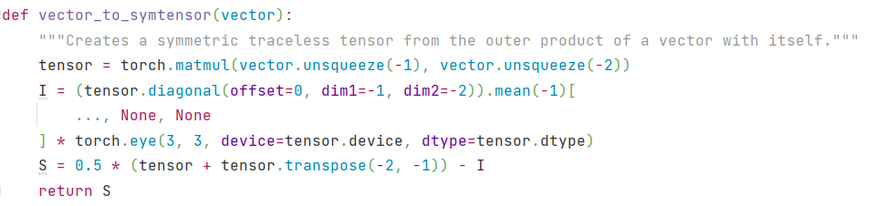

1. Composition from irreducible representations.
TensorNet

Slide 8
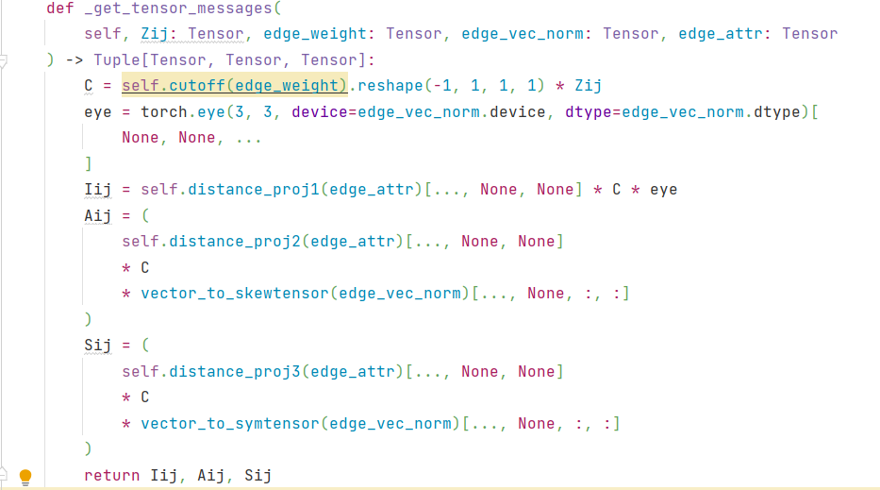
2. Invariant weights and linear combinations.
Multiple a scalar to each tensor componet won’t change the symmerty.
The weight is invariaint
TensorNet

Slide 9
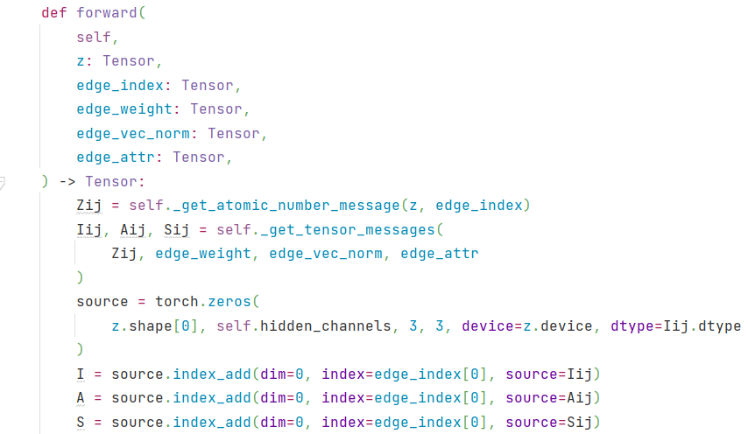
2. Invariant weights and linear combinations.
TensorNet

Slide 10
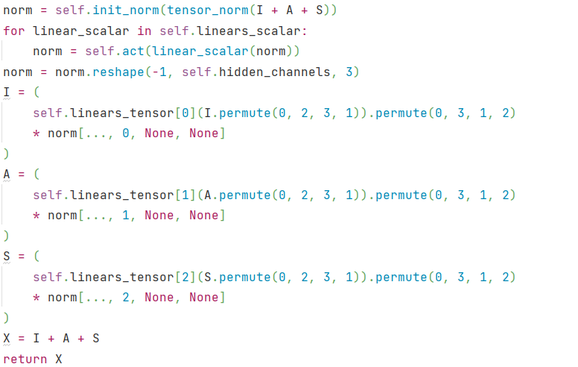
2. Invariant weights and linear combinations.
TensorNet

Slide 11
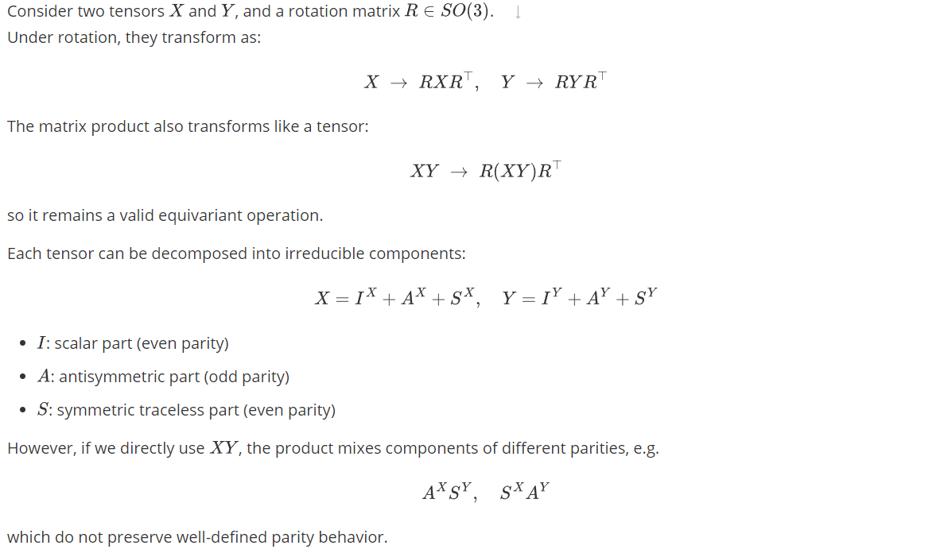
3. Matrix product.
TensorNet

Slide 12
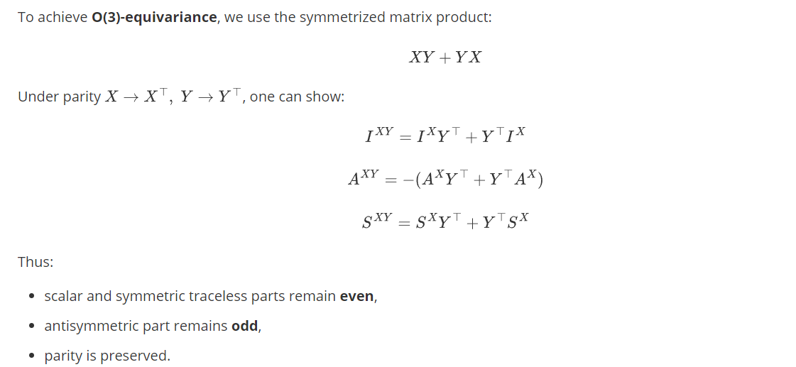
3. Matrix product.
TensorNet

Slide 13
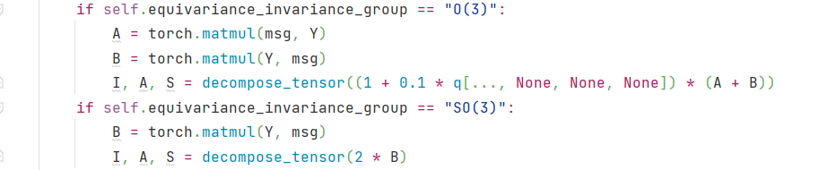
3. Matrix product.
TensorNet

Slide 14
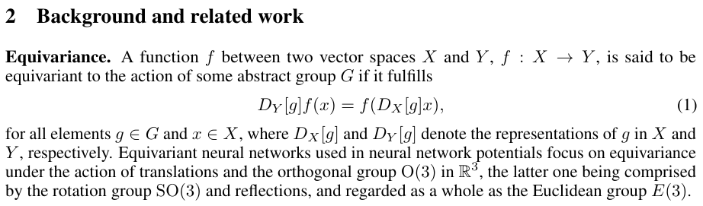
Equivariance
TensorNet is an Equivariance GNN
TensorNet

