Slide 1
Dynamic Programming
COMP90038 Algorithms and Complexity · Tutorial Week 11
Notes:
Welcome. This week is all dynamic programming: one sequence problem (coin row), one capacity problem (unbounded knapsack), one graph problem (longest path in a DAG), and Warshall's algorithm. The row of numbers on this slide is the answer table for the first question — by the end of Q74 everyone should be able to produce it.

Slide 2
Plan for today
Q74
Q77
Q76
Q78
Q75
Coin row
Unbounded knapsack
Longest path in a DAG
Warshall
Reduction (bonus)
Fill S[i] for a concrete row of coins, then backtrack
Design the recurrence when items can repeat
DP over a topological order
Transitive closure by row-OR
Coin row as a longest-path problem
≈ 12 min
≈ 15 min
≈ 15 min
≈ 6 min
if time
Notes:
Timing is a guide for a 50-minute session. Q74, Q77 and Q76 are the core: give students time to try each before revealing. Q78 (Warshall) is a quick walk-through. Q75 (reduction) is a bonus at the end — it uses the Q76 algorithm, so it only makes sense after Q76; skip it if time is short, it previews Week 12.

Slide 3
When does DP apply, and how do we build one?
Optimal substructure
Optimal answer = best combination of optimal sub-answers
1
Define the subproblem
What does one table entry mean, in words?
2
Write the recurrence
How does an entry depend on smaller ones?
Overlapping subproblems
Plain recursion re-solves the same subproblem many times
3
Base cases and fill order
Fill so every dependency is ready first
Both hold → dynamic programming
Bottom-up: fill a table in dependency order
Top-down: recursion + memoisation
4
Recover the solution
Backtrack through the table (or store choices)
Notes:
Two conditions, then a four-step recipe we'll reuse for every question today. Optimal substructure: an optimal solution is built from optimal solutions to subproblems. Overlapping subproblems: naive recursion solves the same subproblem many times (e.g. coin row recursion is exponential, like Fibonacci). Bottom-up = fill a table in an order where dependencies are already filled; top-down = recursion plus a memo table. Same recurrence, different evaluation order. Ask students at each question: what is the subproblem? That's always the hardest step.

Slide 4
Coin row: take the last coin, or don't
Q74
Pick coins from a row to maximise the total, never taking two neighbours.
c₁
c₂
…
c_{n−2}
c_{n−1}
c_{n}
S(n) = max( S(n−1), S(n−2) + c_{n} )
Take c_{n}
then c_{n−1} is off-limits: S(n−2) + c_{n}
Skip c_{n}
best of the first n−1 coins: S(n−1)
Base cases
S(0) = 0, S(1) = c₁ · Time Θ(n), space Θ(n)
Notes:
Recap before Q74. Look at the last coin c_n. Either it's in the optimal selection — then c_(n−1) can't be, and the rest is an optimal solution for the first n−2 coins — or it isn't, and we have an optimal solution for the first n−1 coins. That case split is the whole recurrence. Base cases: S(0) = 0 (no coins), S(1) = c_1. Each S(i) is computed once from two earlier entries, so Θ(n) time.

Slide 5
Q74
Q74
Your turn
Solve the coin-row instance 20, 50, 20, 5, 10, 20, 5 with the bottom-up algorithm. Which coins are picked?
20
50
20
5
10
20
5
1
2
3
4
5
6
7
i | 0 | 1 | 2 | 3 | 4 | 5 | 6 | 7
C[i] | — | 20 | 50 | 20 | 5 | 10 | 20 | 5
S[i] | 0
S[i] = max( S[i−1], S[i−2] + C[i] ), S[0] = 0, S[1] = C[1]
Notes:
Give students 3–4 minutes. Encourage them to write the two candidates (skip / take) explicitly for each i rather than doing it in their heads — that's what makes backtracking easy later. Common slip: using S(i−1) + c_i (that would allow adjacent coins).

Slide 6
Q74 · Filling the table
Q74
i | C[i] | skip: S[i−1] | take: S[i−2] + C[i] | S[i]
0 | — | — | — | 0
1 | 20 | — | 0 + 20 = 20 | 20
2 | 50 | 20 | 0 + 50 = 50 | 50
3 | 20 | 50 | 20 + 20 = 40 | 50
4 | 5 | 50 | 50 + 5 = 55 | 55
5 | 10 | 55 | 50 + 10 = 60 | 60
6 | 20 | 60 | 55 + 20 = 75 | 75
7 | 5 | 75 | 60 + 5 = 65 | 75
75
maximum total = S[7]
Sanity checks
S never decreases
Each row looks back only two entries
Notes:
Walk row by row, asking the class for each pair of candidates. Highlighted cell = the winner. Row 3: taking the second 20 gives 20 + 20 = 40 < 50, so we skip it. Row 7: taking the last 5 gives 60 + 5 = 65 < 75. Answer: S[7] = 75. Note S is non-decreasing — a useful sanity check.

Slide 7
Q74 · Which coins? Backtrack from the end
Q74
20
50
20
5
10
20
5
coin 1
coin 2
coin 3
coin 4
coin 5
coin 6
coin 7
S = 20
S = 50
S = 50
S = 55
S = 60
S = 75
S = 75
i = 7
S[7] = S[6] = 75
skip coin 7
Backtracking rule
S[i] = S[i−1] → coin i not used, go to i−1
otherwise → take coin i, go to i−2
Coins 2, 4, 6: 50 + 5 + 20 = 75
i = 6
S[6] = 75 ≠ S[5] = 60
take coin 6 → jump to 4
i = 4
S[4] = 55 ≠ S[3] = 50
take coin 4 → jump to 2
i = 2
S[2] = 50 ≠ S[1] = 20
take coin 2 → jump to 0
Notes:
Backtracking rule: at position i, if S[i] = S[i−1] then coin i wasn't needed — move to i−1. Otherwise coin i was taken — record it and jump to i−2. Trace: S[7] = S[6] → skip 7. S[6] = 75 ≠ 60 → take coin 6, go to 4. S[4] = 55 ≠ 50 → take coin 4, go to 2. S[2] = 50 ≠ 20 → take coin 2, go to 0. Coins 2, 4, 6: 50 + 5 + 20 = 75. Alternative: store a 'took coin i' flag while filling the table.

Slide 8
0/1 knapsack vs. unlimited copies
Q77
0/1 knapsack (lecture)
Each item used at most once
Unlimited copies (Q77)
Each item can be picked again and again
K(i, w): best value from the first i items, capacity w
K(i, w) = max( K(i−1, w), K(i−1, w − w_{i}) + v_{i} ) if w_{i} ≤ w
K(i, w) = K(i−1, w) otherwise
Table: (n+1) × (W+1) → Θ(nW)
After picking I_{i}, the same items are still available.
Only the remaining capacity changed.
So the subproblem needs one parameter:
V(w) = best value with capacity w
2-D table K(i, w) → 1-D table V(w): one entry per capacity, each tries all n items
Notes:
Recap of the lecture's 0/1 knapsack: K(i, w) = best value using only the first i items with capacity w. Two parameters because, once we use item i, it's gone. (Heads-up if anyone saw last year's slides: the recurrence should use the same w throughout — K(i−1, w) and K(i−1, w − w_i) + v_i.) Q77: with unlimited copies, taking item i doesn't change what's available — only the remaining capacity changes. So the subproblem collapses to one parameter. That's the hint in the question.

Slide 9
Q77 · Recurrence and algorithm
Q77
V(w) = max( v_{i} + V(w − w_{i}) | 1 ≤ i ≤ n, w_{i} ≤ w ), V(0) = 0
V[0] ← 0
for w ← 1 to W do
V[w] ← 0
for i ← 1 to n do
if w_i ≤ w and v_i + V[w − w_i] > V[w] then
V[w] ← v_i + V[w − w_i]
choice[w] ← i // remember it
return V[W]
Time Θ(nW)
Space Θ(W)
Think
Why is W in the running time a catch? (pseudo-polynomial)
Notes:
Derivation: with capacity w, the 'first' item we put in can be any I_i with w_i ≤ w. If it's I_i, the rest of the bag is an optimal bag for capacity w − w_i. Try every item, keep the best. Including 0 in the max covers the case where nothing fits. Running time Θ(nW): W entries, each tries n items. This is pseudo-polynomial — polynomial in the value W, but exponential in the number of bits needed to write W. Worth a one-sentence mention; it comes back in Week 12 (NP-completeness).

Slide 10
Q77
Q77
Your turn
Capacity W = 10. Fill V[0..10] left to right and find the best bag.
item | weight | value
I₁ | 4 | 11
I₂ | 5 | 12
I₃ | 3 | 7
For each w, try every item that fits:
11 + V[w − 4], 12 + V[w − 5], 7 + V[w − 3]
V[w] is the largest of these (or 0 if nothing fits).
w | 0 | 1 | 2 | 3 | 4 | 5 | 6 | 7 | 8 | 9 | 10
V[w] | 0
Notes:
Give 4–5 minutes. Suggest students write, for each w, the candidate from each item that fits (11 + V[w−4], 12 + V[w−5], 7 + V[w−3]). Before they start, ask: what would greedy by value/weight ratio do? I1 has the best ratio (2.75), so greedy takes I1 twice (weight 8, value 22) and can't use the last 2 units. Keep that number in mind — we'll beat it.

Slide 11
Q77 · Filling V[w]
Q77
w | 0 | 1 | 2 | 3 | 4 | 5 | 6 | 7 | 8 | 9 | 10
I₁: 11 + V[w−4] |  |  |  |  | 11 | 11 | 11 | 18 | 22 | 23 | 25
I₂: 12 + V[w−5] |  |  |  |  |  | 12 | 12 | 12 | 19 | 23 | 24
I₃: 7 + V[w−3] |  |  |  | 7 | 7 | 7 | 14 | 18 | 19 | 21 | 25
V[w] | 0 | 0 | 0 | 7 | 11 | 12 | 14 | 18 | 22 | 23 | 25
w = 6
max(11 + V[2], 12 + V[1], 7 + V[3]) = max(11, 12, 14) = 14
w = 10
max(11 + V[6], 12 + V[5], 7 + V[7]) = max(25, 24, 25) = 25
Notes:
Each column is one capacity; each row is the candidate from one item (blank = item doesn't fit). Highlighted = the maximum, which becomes V[w]. Walk a few columns slowly: w = 3 → only I3 fits: 7. w = 6 → I1: 11+V[2]=11, I2: 12+V[1]=12, I3: 7+V[3]=14 → 14 (two copies of I3). w = 10 → I1: 11+V[6]=25, I2: 12+V[5]=24, I3: 7+V[7]=25 → 25. Ties are fine — either choice gives an optimal bag.

Slide 12
Q77 · Recovering the bag
Q77
V[10]
25
V[6]
14
V[3]
7
V[0]
0
Optimal bag
I₁, I₃, I₃
value 25, weight 10
I₁
I₃
I₃
−4
−3
−3
Recovering the solution
Record choice[w] while filling. Then from w = W, repeatedly subtract the chosen item's weight until no item was chosen.
Notes:
Follow the choices back from V[10]: each step subtracts the chosen item's weight. V[10] came from I1; V[6] came from I3; V[3] came from I3. Bag {I₁, I₃, I₃}: weight 4 + 3 + 3 = 10, value 11 + 7 + 7 = 25. Compare with greedy by value/weight ratio: I1 twice = 22. Greedy fails because it can't see that the leftover capacity is wasted. That's exactly why we need DP here.

Slide 13
Q76 · Longest path in a weighted DAG
Q76
6
b
d
Given
Weights all positive
Not necessarily connected
Longest path here: 15
3
4
9
a
4
2
f
g
h
1
1
c
e
3
Before the algorithm
Which path has length 15? · Why would cycles break everything? · Why not negate weights and run Dijkstra?
Notes:
Read the question together. Positive weights, not necessarily connected (note the separate g → h component). The claimed answer is 15. Discussion prompts: (1) In a general graph, longest simple path is NP-hard — what does acyclicity buy us? (A topological order, so subproblems have a clear dependency order.) (2) Why can't we negate the weights and run Dijkstra? (Dijkstra needs non-negative weights.) Ask students to find the length-15 path by eye before we build the algorithm.

Slide 14
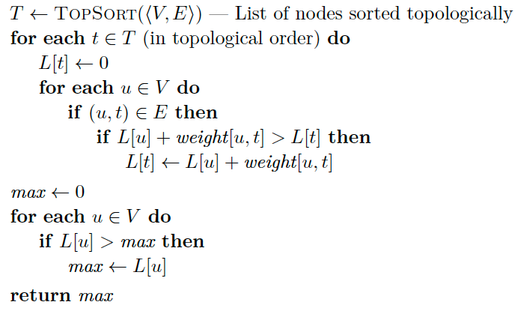
Q76 · Subproblem: longest path ending at t
Q76
L[t] = max( {0} ∪ { L[u] + weight(u, t) | (u, t) ∈ E } )
Why topological order?
Every u with (u, t) ∈ E is finished before t.
Why max over all t?
The longest path can end at any node.
Cost
Θ(|V| + |E|) with incoming-edge lists.
Notes:
Subproblem: L[t] = length of the longest path that ends at node t. Any path ending at t is either just t itself (length 0) or a longest path to some predecessor u followed by the edge (u, t). Processing nodes in topological order guarantees every predecessor u is final before t is computed — the DAG version of 'fill in dependency order'. The sample answer's pseudocode checks every u ∈ V for each t, which is Θ(|V|²). With predecessor (incoming-edge) lists it's Θ(|V| + |E|), and the topological sort is also Θ(|V| + |E|). The answer is the max over all L[t], not L of the last node — the longest path can end anywhere (and the graph needn't be connected).

Slide 15
Q76 · Trace in topological order
Q76
t | incoming candidates | L[t]
g | none (source) | 0
h | g: 0 + 9 = 9 | 9
a | none (source) | 0
c | a: 0 + 1 = 1 | 1
b | a: 0 + 3 = 3 c: 1 + 4 = 5 | 5
d | b: 5 + 6 = 11 | 11
e | d: 11 + 2 = 13 c: 1 + 3 = 4 | 13
f | d: 11 + 4 = 15 e: 13 + 1 = 14 | 15
b
6
d
3
4
a
f
g
9
h
4
2
1
c
e
1
3
Longest path = 15
a → c → b → d → f
Store pred[t] to recover the path
Notes:
DFS-based topological sort gives g, h, a, c, b, d, e, f (any topological order works). Go row by row: for each node, list its incoming edges and take the best. b: from a gives 3, from c gives 1 + 4 = 5 → 5. e: from d 11 + 2 = 13, from c 1 + 3 = 4 → 13. f: from d 11 + 4 = 15, from e 13 + 1 = 14 → 15. Max over all nodes is L[f] = 15. Following pred pointers back gives the path a → c → b → d → f.

Slide 16
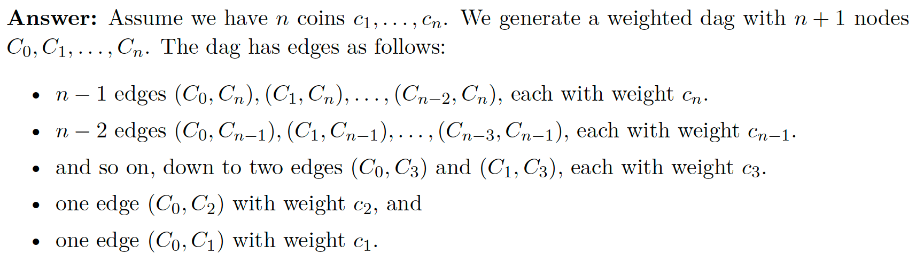
Q75 · Coin row as a longest path
Q75
No (C1, C2)
Why it works
Paths from C₀ ↔ legal selections, and path weight = sum of the coins picked.
Solve
Run the Q76 algorithm (the nodes are already in topological order). Longest path = S(n).
Notes:
A reduction turns any instance of problem A into an instance of problem B so that solving B solves A. Here A = coin row, B = longest path in a weighted DAG (Q76). Construction: nodes C_0..C_n, where C_j means 'the last coin we took was coin j' and C_0 means 'nothing taken yet'. An edge C_i → C_j (i < j) means 'next coin we take is j', with weight c_j. Legal moves: from C_0 we may take any coin; from C_i (i ≥ 1) we may take any coin j ≥ i + 2 (skip at least the neighbour). Every path from C_0 is a legal selection and its weight is the total value, and vice versa — so the longest path value equals the coin-row optimum. Note: the question mentions unweighted length, but the hint (and the construction) needs edge weights. The graph has Θ(n²) edges, so the reduction itself is polynomial.

Slide 17
Q75 · Example with the first four coins
Q75
C₁
20
C₃
Longest path
C₀ → C₂ → C₄ = 50 + 5 = 55
= S[4] in the Q74 table ✓
20
20
C₀
5
50
5
C₂
C₄
Reading the picture
Every path out of C₀ is a legal pick
No edge C₁ → C₂ or C₂ → C₃: neighbours
Edge weight = value of the coin you land on
5
coins c₁..c₄ = 20, 50, 20, 5
Notes:
Use the first four coins from Q74: 20, 50, 20, 5. Edges into C_4 come from C_0, C_1, C_2 (weight 5); into C_3 from C_0, C_1 (weight 20); into C_2 from C_0 (50); into C_1 from C_0 (20). Longest path: C_0 → C_2 → C_4 = 50 + 5 = 55, which matches S[4] = 55 from our Q74 table. Close by linking forward: next week we'll use reductions the other way round — to show problems are hard.

