Slide 1
Gerbs Curve Visualizer
Project presentation by Daniel Aaron Salwerowicz

Slide 2
Project Description
Implement
01
3rd degree B-Spline curve.
Implement
02
Blending of curves using B-Function.
Implement
03
Model curve.
Implement
04
GERBS Curve.
Use
05
Affine transformations to animate the curve.
Implement
06
GERBS Surface.

Slide 3
B-Spline
A curve made up of curves "welded together" at a point.
Clamped B-Spline.
Made using control points and least square.
Unlike Bezier can be defined over arbitrary interval.

Slide 4
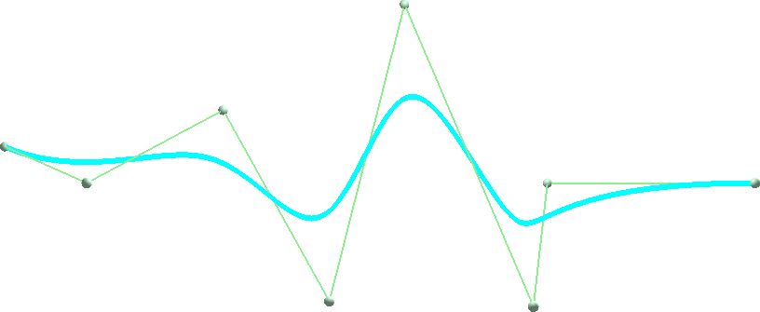
Result

Slide 5
Blending
Blend two separate curves into one.
Pick arbitrary point in curve for blending.
Apply B-function for blending, polynomial function of 1st order.
C1 smooth curve.

Slide 6
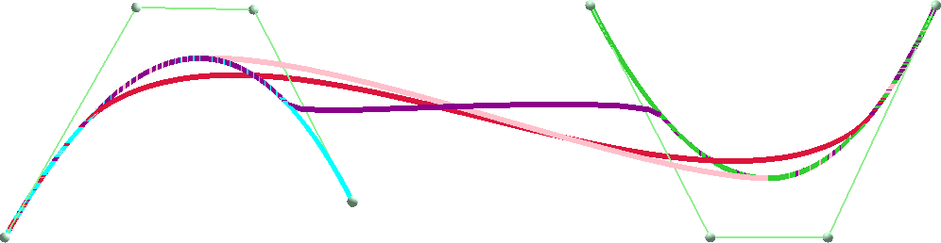
Result

Slide 7
GERBS Curve
Uses local curves and blending instead of control points.
Much more control, at bigger calculation cost.
Knot vector must be adjusted depending on curve.
Modeled after heart, animated using affine transformations.

Slide 8



Result

Slide 9
GERBS Surface
Similar to GERBS curves, uses local surfaces instead of curves.
Needs two knot vectors and matrix of local surfaces.
Matrix of surfaces needs to be made iteratively.
Good result but not perfect.

Slide 10
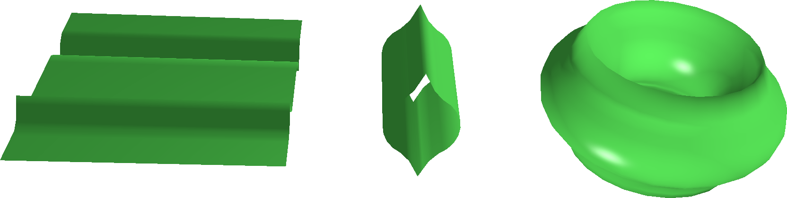
Result

Slide 11
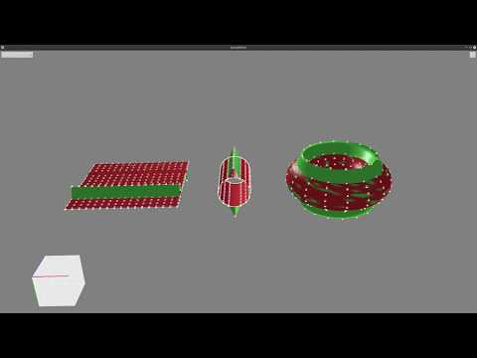
Thank you for your attention!
Questions?

