Slide 1

Project Progress Presentation
Status report for Project 1 in STE6246-2 Knowledge Based Systems

Slide 2
Problem Description (Part 1)
Two self-driving cars meet at a narrow bridge.
If they drive simultaneously they will crash.
Need to find a social convention that will benefit them.
Each one must pass the bridge.
They don't know what the other did.
They pass the bridge very often.

Slide 3
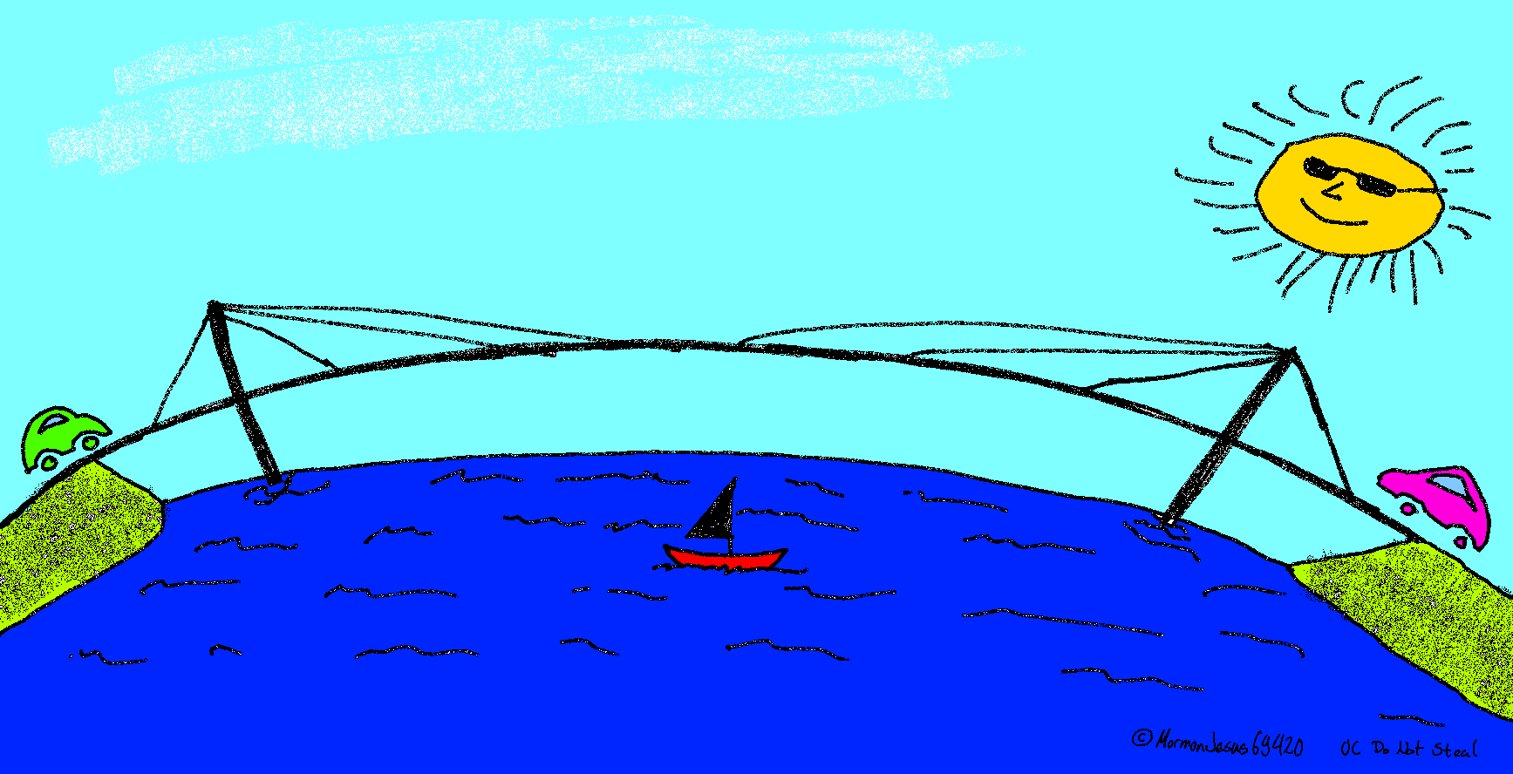
Problem visualization (Part 1)

Slide 4
My Interpretation Of Rules
Each player is on opposite side of bridge.
Needs to decide what to do blindly.
Each decides at the same time.
Goal is that both cross the bridge.
Game ends when both have passed or crashed.
After passing the bridge player is out of the game.
Players play games continually.

Slide 5
Rewards And Punishment
If they crash, both get punished by 200 points.
01
If one waits he gets punished by 10 points.
02
If one crosses the bridge, he gets rewarded by 100 points.
03

Slide 6
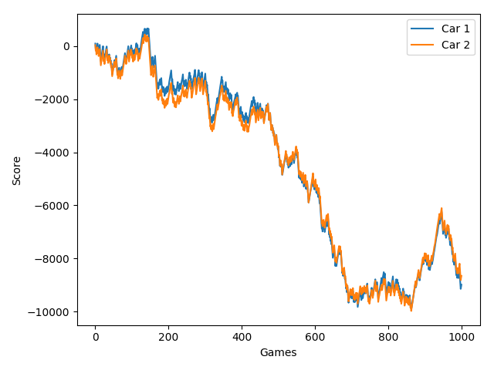
Zero intelligence agents
Behave randomly and learn nothing.
Overall decreasing score.
Sometimes gains score.

Slide 7
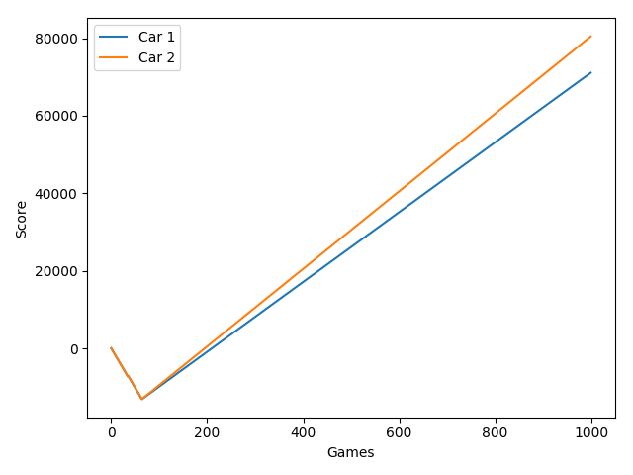
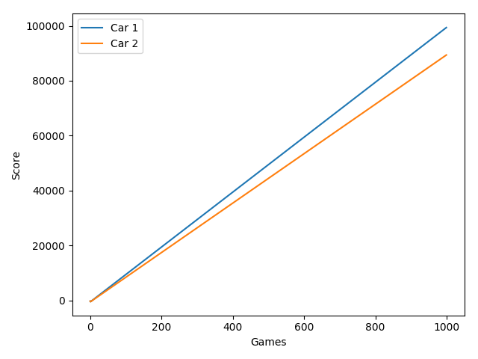
Learning agents
Use Q-Learning algorithm.
Overall increasing score.
Always converges on a beneficial policy.
Not a balanced or fair solution.
Sometimes takes time to cooperate.

Slide 8
Conclusion
Both players come to a social convention where the "alpha" player always goes first. While the "beta" waits and then goes over the bridge.

