Slide 1

nudgely ↗
A little nudge. A lasting connection.
Team Bongo Gang · AI-GNITION 2026 Finals
Thuta · Dythan · Jack · Shareef · Jayden
Notes:
One breath on this slide, then move to slide 2.
PROBLEM (0:00-0:20, Jack, 50 words max) starts on the next slide.

Slide 2

Mei Ling messages everyone the same way
KAMPUNG FRESH
KF
10% off everything this Sunday!
Same message for all
Sunday blast, to every customer
H
See you Saturday!
Discount given away
Hafiz, 61 · comes every Saturday anyway
A
can tell me when oat milk is back?
Lost to the supermarket
Mei Ling, 52
Aisha, 34 · Seen 3 weeks ago, no reply
Runs Kampung Fresh in Tampines
Notes:
PROBLEM (0:00-0:20), Jack, 50 words max:
"This is Mei Ling. She runs Kampung Fresh in Tampines. Every Sunday she sends the same '10% off' to all her customers. Hafiz comes every Saturday anyway, so that's margin given away. Aisha asked about oat milk three weeks ago. Nobody remembered. She shops at the supermarket now."

Slide 3

Blasting barely works
+0.7
points
We measure one thing
10.3% came back with no SMS, 11.0% with one
Extra return visits per message, against customers who got nothing
687,000 grocery shoppers, randomised test (Lenta)
Notes:
RESULT (0:20-0:40), Jack, 50 words max:
"Blasting barely works: in a randomised test on 687,000 grocery shoppers, an SMS lifted visits from 10.3% to 11.0%. Mei Ling needs the right message to the right person. We measure one thing: extra return visits per message, against customers who got nothing."
HANDOVER, said while Shareef walks to the laptop (no silence): "Shareef is Mei Ling for the next four minutes."

Slide 4

Live: Kampung Fresh
LIVE
Mei Ling's dashboard · Aisha's WhatsApp
Notes:
LIVE DEMO (0:40-4:40), Shareef, 4:00. Show this for 2 seconds, then the dashboard + Aisha's WhatsApp.
Beats (Pitch_Plan.md section 3): Aisha in Customers (Persuadable, oat milk + party tags) -> Hafiz is a Sure Thing -> Campaign skips Hafiz, holds back a comparison group -> edit Aisha's draft, tick, Send on WhatsApp -> it arrives -> Aisha asks about oat milk, AI replies with new tags -> refund request -> Needs a person -> STOP -> Opted out badge -> back to slide 8.
If anything fails, decide in 5 seconds (section 4). Never present the recording as live.
Close: "Everything you just saw happened live. Jack?"

Slide 5







Pick who, say what, prove it worked
Pick who
Say what
Prove it
Chats + sales
Uplift model
AI writes
Owner approves
WhatsApp
Replies tagged
No-message group
the shop's own data
who a message changes
from their own words
nothing sends alone
official API
each with its evidence
shows the real lift
Runs on ten numbers any shop's receipts have: phone, date, amount
Notes:
HOW IT WORKS (4:40-5:40), Jack, 140 words max across slides 5 and 6. Slide 5:
"Three parts. First, an uplift model. It doesn't ask who might leave; it asks who a message actually changes. It runs on ten things any shop's receipts have. Second, an AI reads each conversation and keeps the details with the customer's exact words as evidence, then drafts the nudge from them. Third, every campaign keeps a no-message group, so the shop sees its own lift."

Slide 6






Data, safety, human control
Owner approves every send
Phone numbers never stored
Names hidden from the AI
Unsure? A person takes over
STOP works everywhere
Daily cap on AI spend
Notes:
Slide 6, said as a list (~25 s):
"Nothing is sent without a person approving it. Phone numbers are never stored, only scrambled. Names are removed before text reaches the AI. Every reply is checked; if it can't verify a price or stock, or someone asks for a refund, a person takes over. STOP works on every channel. And a daily cap stops runaway AI costs."

Slide 7
Only Nudgely picks by uplift and proves the lift
How it picks who to message →
How it proves it worked ↓
Rules and tags
Predicted risk
Uplift
Extra visits vs a no-message group
Optimove (big brands)
Nudgely, for a 300‑customer shop
Opens and clicks
SleekFlow · WATI · respond.io · MantaGO · Eber · StoreHub
Klaviyo (online stores)
No proof
WhatsApp Business app
WhatsApp tools send well. Enterprise suites measure lift. Nudgely does both for a corner shop.
Notes:
DIFFERENCE (5:40-6:20), Jack, 95 words max:
"WhatsApp tools like SleekFlow and WATI are great at sending, but you choose who gets what by hand, and you see opens, not extra visits. Enterprise suites like Optimove measure lift, but they're built for big brands with marketing teams. Nudgely is the only one that, for a corner shop, picks who a message changes, writes it from their own words, and proves it worked."
If asked: "we found no Singapore player using uplift" (not "there are none"). Sources: docs/Competitors.md.

Slide 8
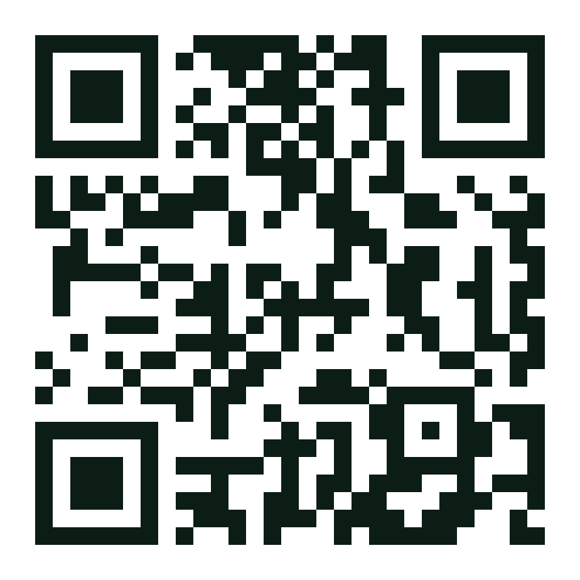
Proven overseas. Next: one Singapore shop
57%
Our limitation
The evidence is overseas
A four-week pilot needs
of the extra visits came from our top 30%, against 30% at random
One Singapore shop
Its own WhatsApp number
Four weeks of sales
A no-message group
About 1.9x random. Ranged 38–85% across 7 test splits on public grocery data (Lenta).
Talk to Kampung Fresh
nudgely-navy.vercel.app/try
Notes:
NEXT STEP (6:20-7:00), Jack, 95 words max. QR stays up into Q&A:
"Our honest limitation: the evidence is overseas. On a public grocery dataset our top 30% captured 57% of the extra visits, about 1.9 times random, though it ranged from 38 to 85% across tests. A Singapore shop still has to prove it. So the next step is a four-week pilot: one shop, its WhatsApp number, a sales export, and a no-message group. Scan the code and talk to Kampung Fresh yourselves. Thank you."
STOP AT 7:00 even mid-sentence. Dythan shows 1:00 at 6:00 and STOP at 6:50.

