Slide 1
Milestone2
Group 3
Varit Rungbanapan 6288039
Waipop Permpornskul 6288104
Rungrawee Akkarapattanakoon 6288115

Slide 2
DataFrame for Training

Slide 3
Disclaimer
Since data contain many null values, we were not sure how we should deal with it. We decided to fill null values with the ffill method and KNN/mean.

Slide 4
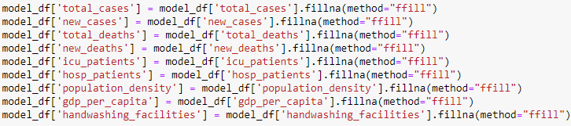
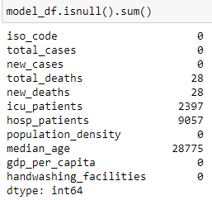
Fill null value with ffill method

Slide 5
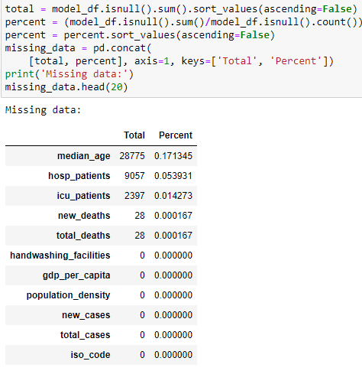
Details of Missing Data

Slide 6
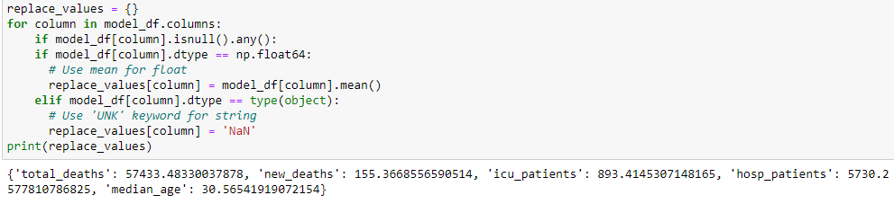
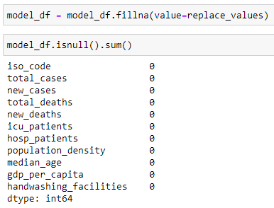
Fill null value with mean

Slide 7

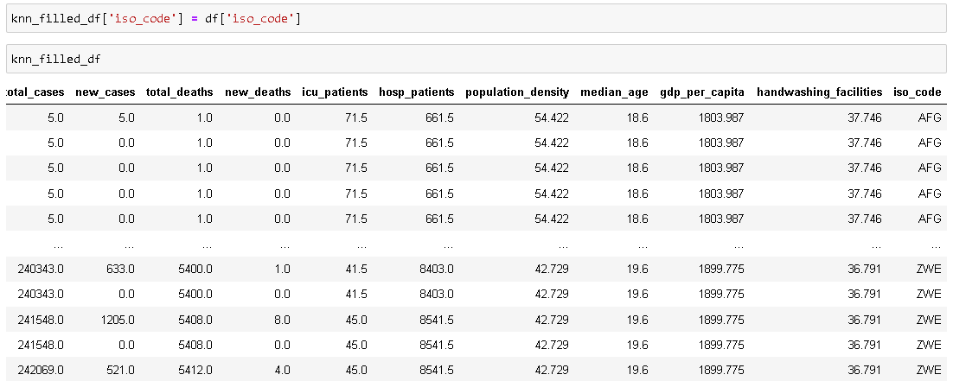
Fill null value using KNN

Slide 8
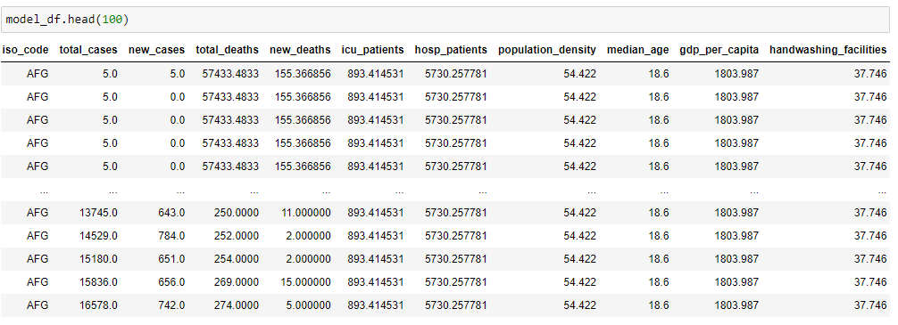
First 100 data of model_df

Slide 9
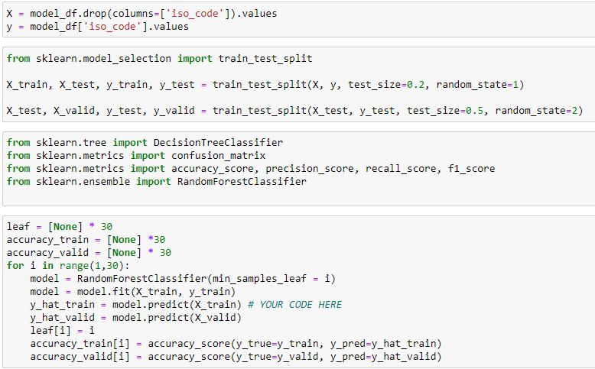
Start The simple Model Creating

Slide 10
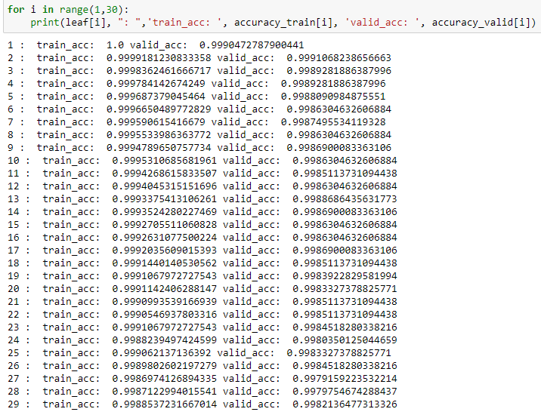
Using the Random Forest method for model creating and Print the Accuracy in different Min_Sample_leaf node used.

Slide 11
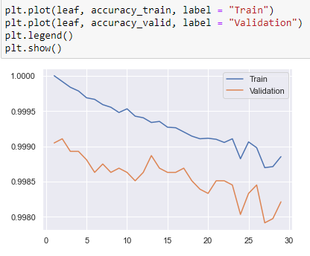
The Graph between Training and Validation Set In different Min_Sample_Leaf Node

Slide 12
Selected the most appropriated Min_sample_leaf node for the model

Slide 13
There are many factors that we can adjust for the better model, and we have plan to do it in the future…

Slide 14
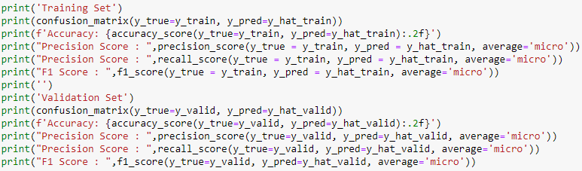
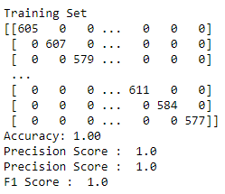
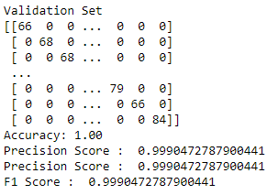
Score of Training and Validation Set

Slide 15
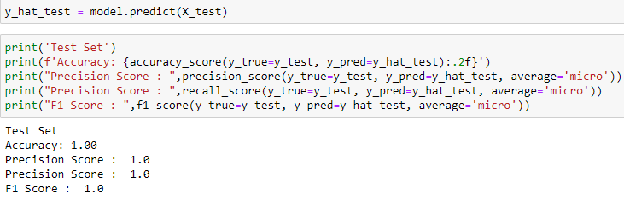
Score of Test Set

Slide 16
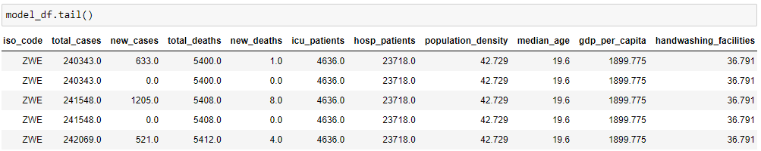
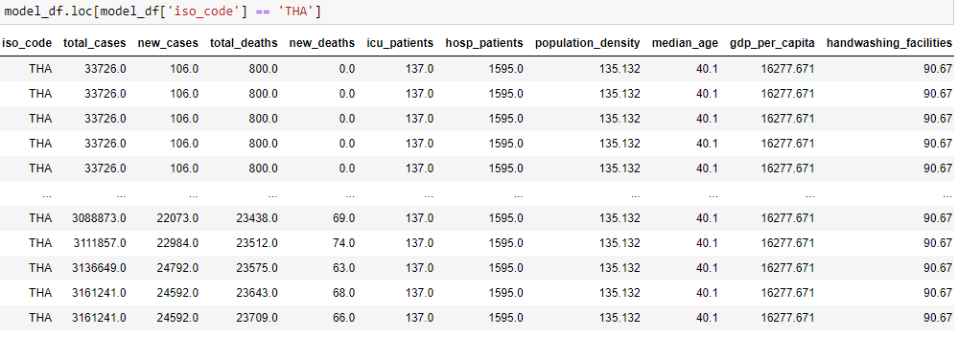

Examples of Model

Slide 17
What are we going to in the next tasks?
Completely dealing with the null value with appropriated method
Create the useful model (Instead of simple prediction like iso_code)
Try to create other kinds of model.

