Slide 1
Introduction To Image Processing term project
Smoothing-Sharpening Self Guided Filter Application on Seam Carving
EECS26 111060024 蔡孟伶

Slide 2
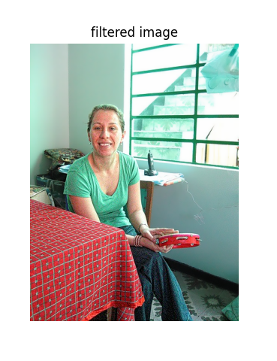
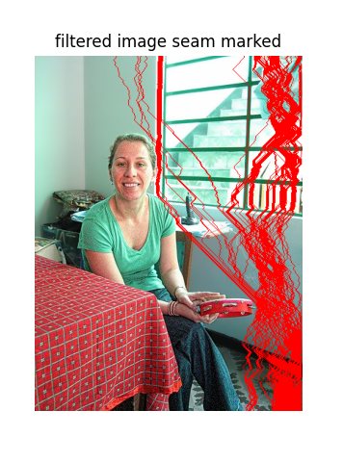
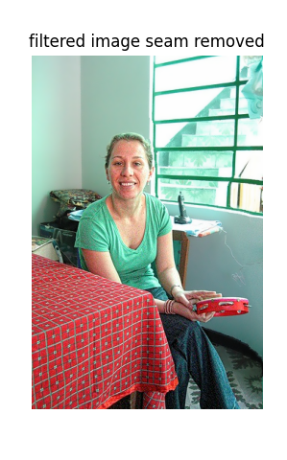
Introduction To Seam Carving

Slide 3
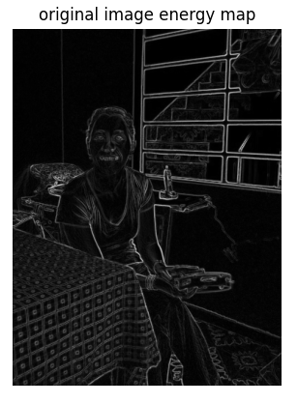
Introduction to Seam Carving
Define the energy map of the image
Use dynamic programming to find the seam that has the least cumulated lost of energy on this seam
Remove or insert N seams to accomplish image resizing, but in a content-aware way.
Other extensions include object removal, content amplification

Slide 4
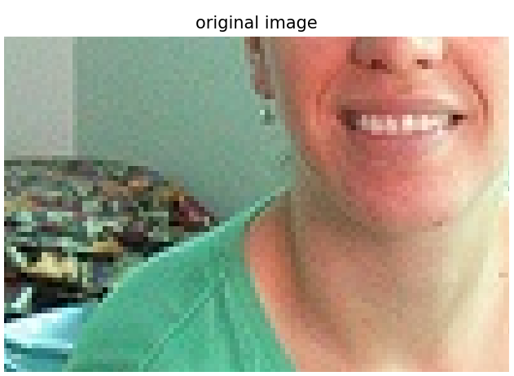
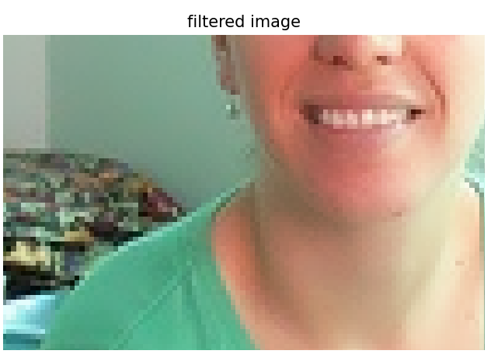
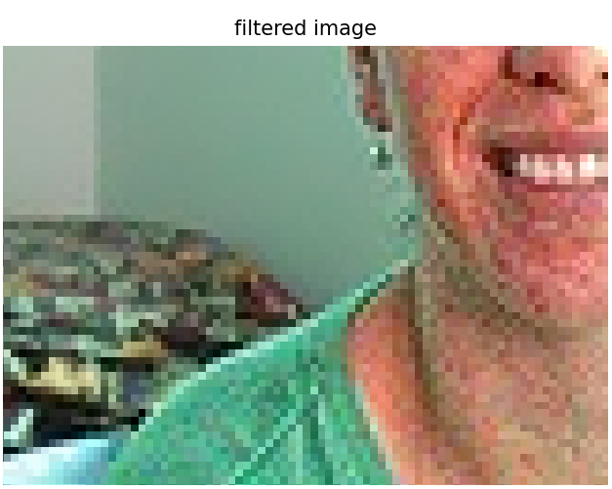
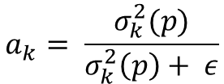

Introduction to Self-guided Filter
G. Deng, F. Galetto, M. Al–nasrawi and W. Waheed, "A Guided Edge-Aware Smoothing-Sharpening Filter Based on Patch Interpolation Model and Generalized Gamma Distribution," in IEEE
Original self-guided filter:
Edge preserving smoothing filter
Proposed smoothing-sharpening filter:
Edge preserving smoothing-sharpening filter, controlled by parameter
Original self-guided filter
Proposed self-guided filter
$$J\left(x\right)= a_{k}I\left(x\right)+(1 − a_{k})μ_{k}$$
$$a_{k}= \frac{σ_{k}^{2}(p)}{σ_{k}^{2}\left(p\right)+ ε}$$

Slide 5
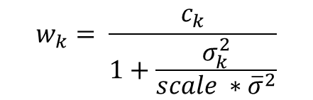
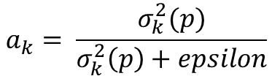
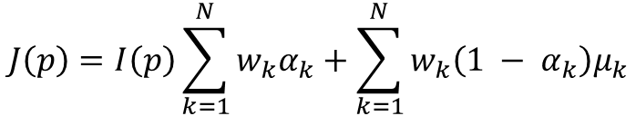

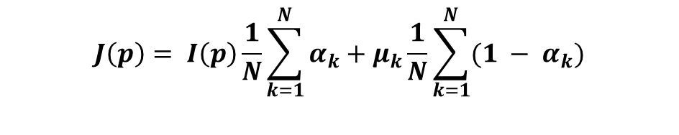

Edge-Preserving Smoothing-Sharpening Self-Guided Filter
For every filter, there are four parameters to decide: patch radius, kappa, epsilon, and scale
$$J\left(p\right)=I\left(p\right)\sum_{k=1}^{N}{w_{k}α_{k}+\sum_{k=1}^{N}{w_{k}\left({1 − α}_{k}\right)μ_{k}}}$$
$$w_{k}= \frac{c_{k}}{1+\frac{σ_{k}^{2}}{scale ∗{\overline{σ}}^{2}}}$$
$$w_{k}=\frac{1}{N}$$
$$J\left(p\right)= I\left(p\right)\frac{1}{N}\sum_{k=1}^{N}{α_{k}}+μ_{k}\frac{1}{N}\sum_{k=1}^{N}{{(1 − α}_{k})}$$
$$α_{k}= \frac{1}{2}(a_{k}+ \sqrt{a_{k}^{2}+4κ\left(1 − a_{k}\right)} )$$
$$a_{k}= \frac{σ_{k}^{2}(p)}{σ_{k}^{2}\left(p\right)+epsilon}$$
Choose big epsilon
$$κ=\left(κ_{max} −κ_{min}\right)e^{−0.69 ∗e^{−c(t − t_{0})}}+κ_{min} κ_{max,} κ_{min, }c, and t_{0} are user defined$$

Slide 6
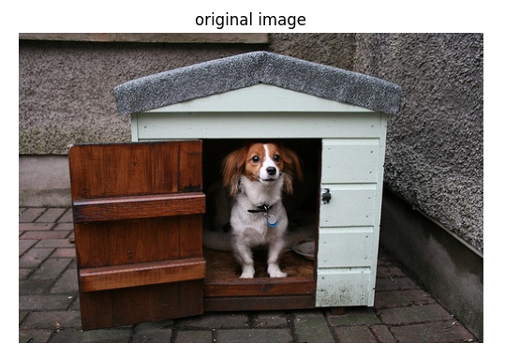
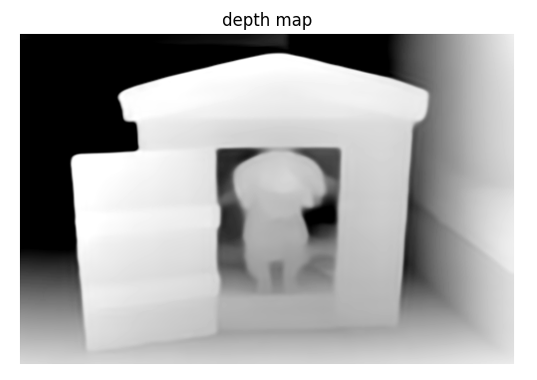
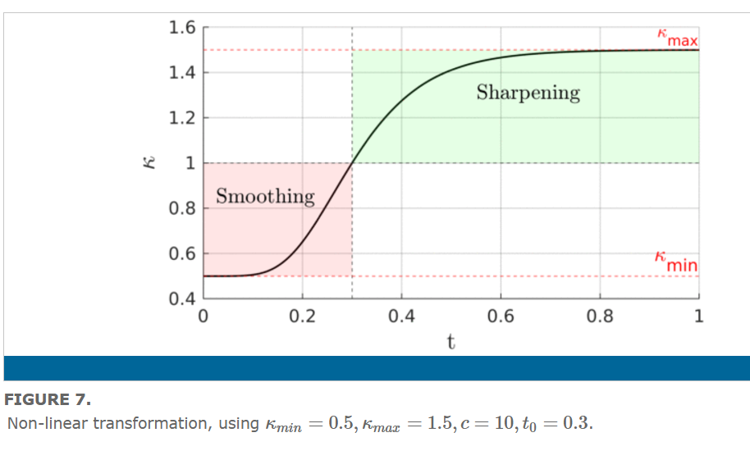
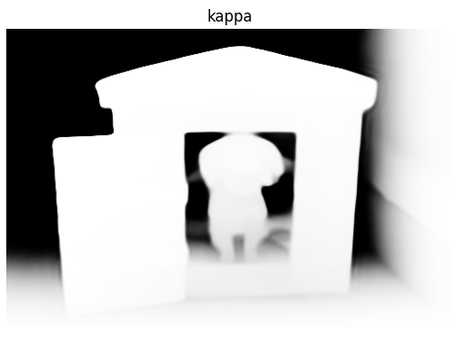
Method And Implementation
$$κ=\left(κ_{max} −κ_{min}\right)e^{−0.69 ∗e^{−c(t − t_{0})}}+κ_{min}$$
$$κ_{max,} κ_{min, }c, and t_{0} are user defined$$

Slide 7
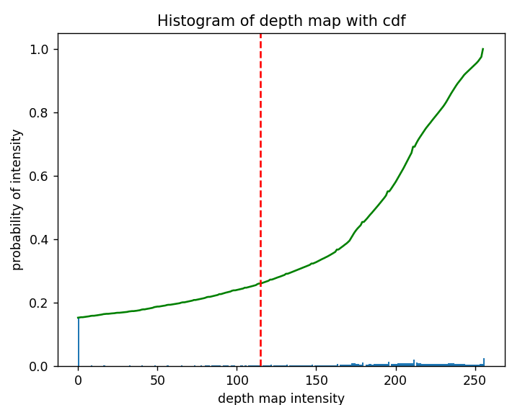
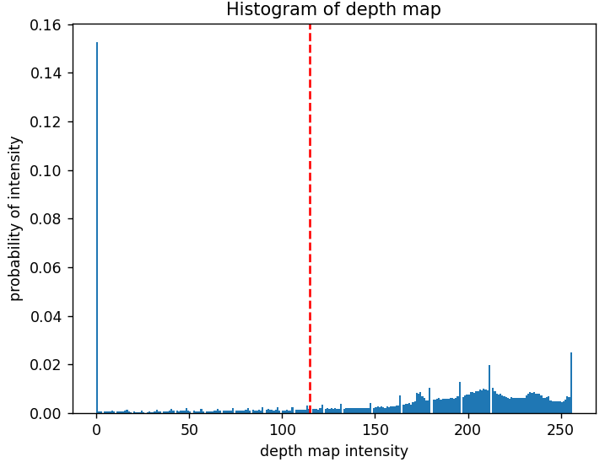
Choose of t0
At first, t0 is a parameter that the user defined, now it is taken as a thresholding problem.
Use Otsu’s method (maximizing the between-class variance) on the histogram of depth map.
Choose Kappa max > 1, Kappa min = 0, c = growth rate

Slide 8
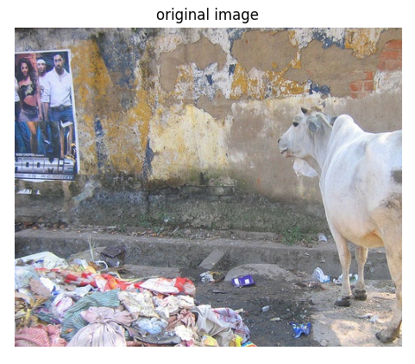

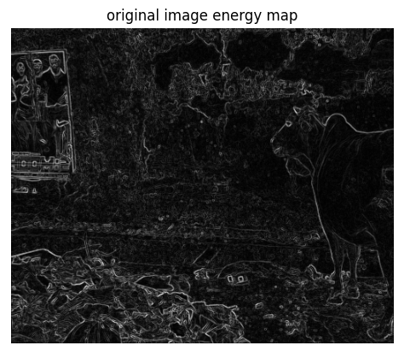
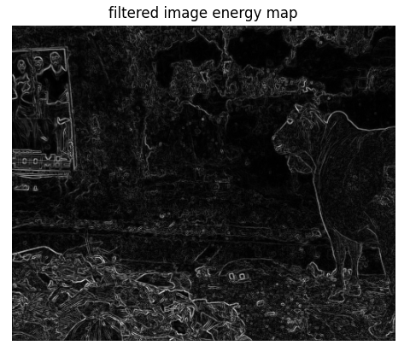
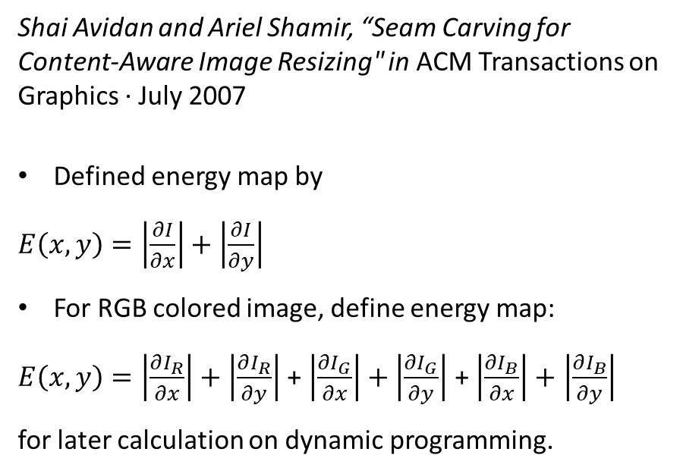
Filtered image and energy map
Shai Avidan and Ariel Shamir, “Seam Carving for Content-Aware Image Resizing" in ACM Transactions on Graphics · July 2007
Defined energy map by
$E\left(x, y\right)=\left|\frac{∂I}{∂x}\right|+$ $\left|\frac{∂I}{∂y}\right|$
For RGB colored image, define energy map:
$E\left(x, y\right)=\left|\frac{∂I_{R}}{∂x}\right|+$ $\left|\frac{∂I_{R}}{∂y}\right|$ + $\left|\frac{∂I_{G}}{∂x}\right|+$ $\left|\frac{∂I_{G}}{∂y}\right|$ + $\left|\frac{∂I_{B}}{∂x}\right|+$ $\left|\frac{∂I_{B}}{∂y}\right|$
for later calculation on dynamic programming.

Slide 9
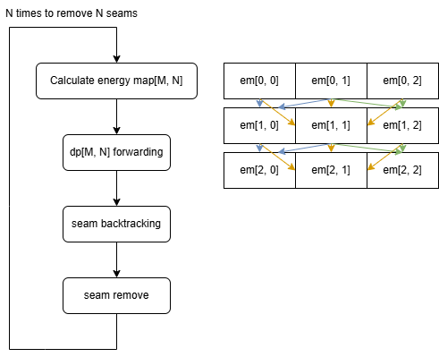
Seam carving implementation
After applying the filter to the image, it is now sharpened at the near contents and smoothed at the far background.
The energy map is supposed to have smaller value on background and bigger value at contents. Therefore, the seam track of filtered image will be different from the seam track of the original image.
To make the seam path clear, it is marked as red. When there are more than one seam to be removed, they are recorded and marked once at the end.

Slide 10
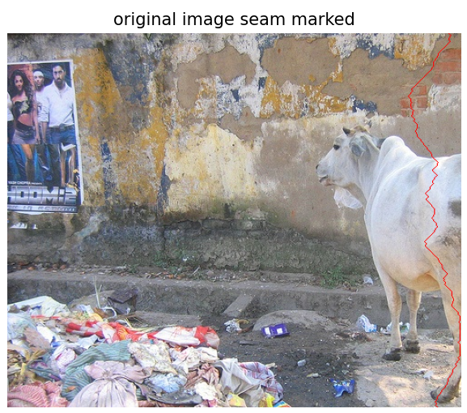
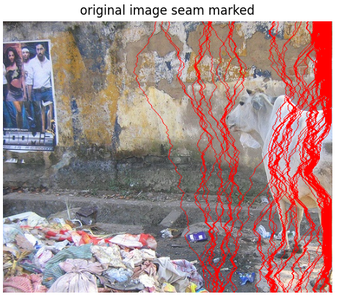
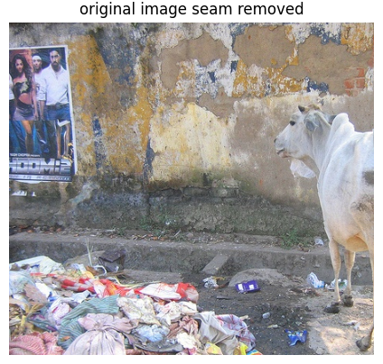
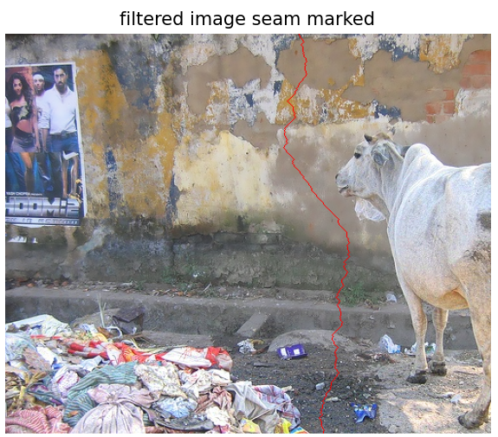
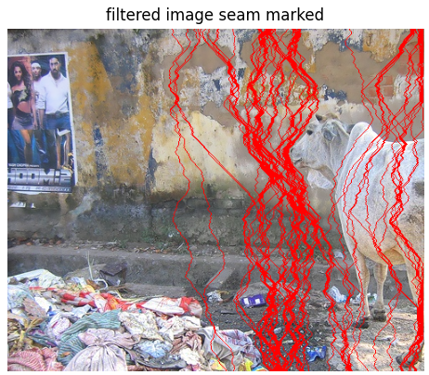
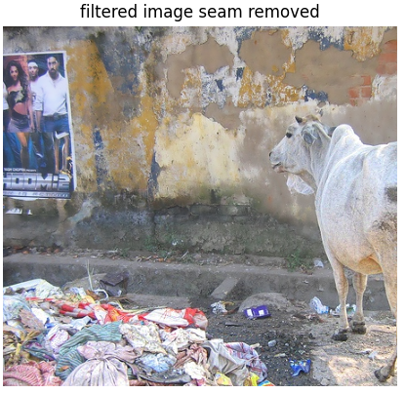
Result

Slide 11
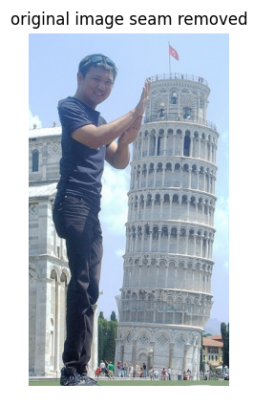
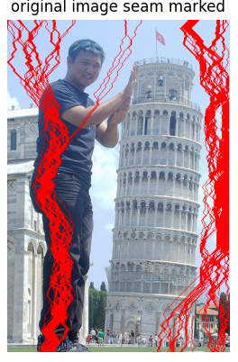
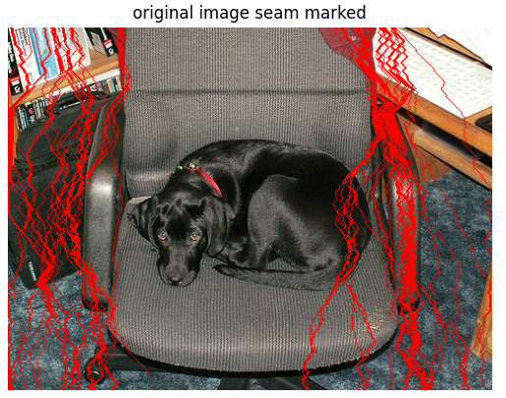
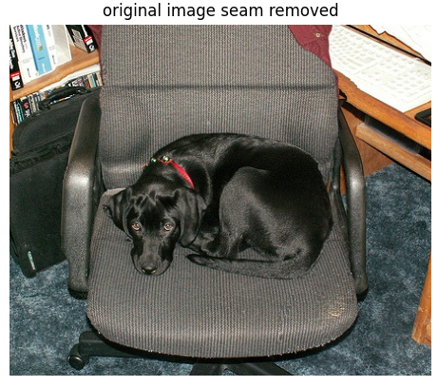
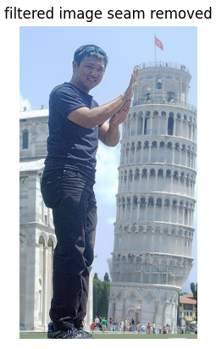
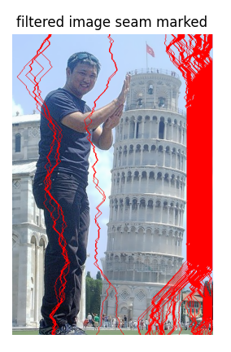
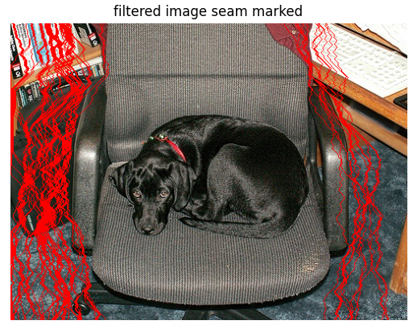
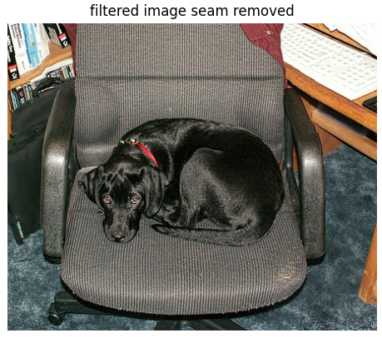
Result

Slide 12
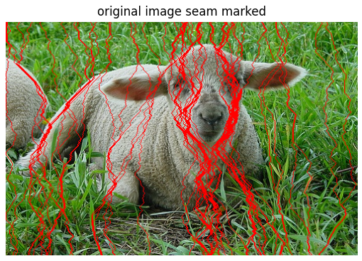
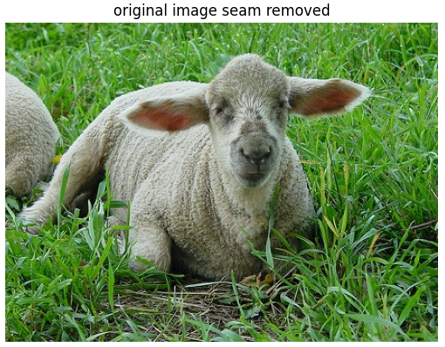
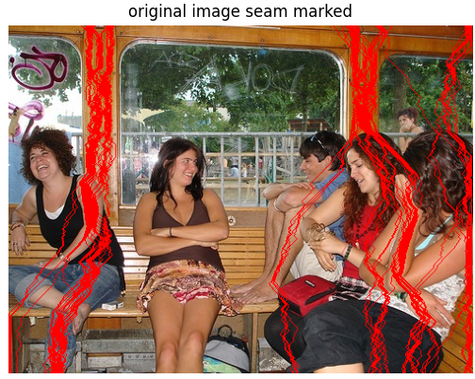
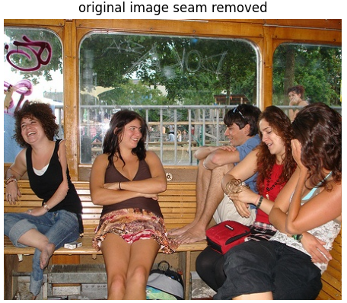
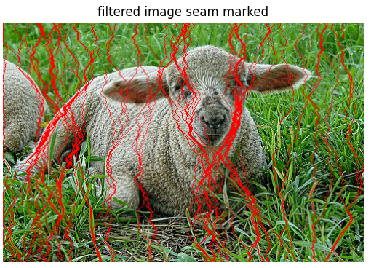
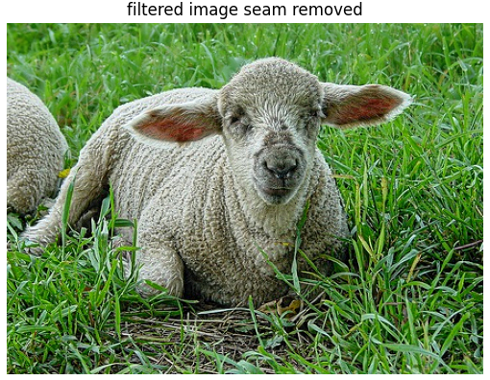
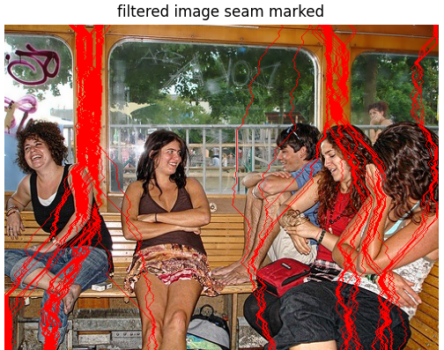
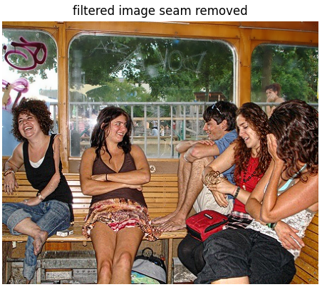
Result

Slide 13
Discussion
Generalization: This filter works well with some structure of input, however, there are still time that it doesn’t work well or maybe in some case, even worse.
Parameter setting: Though I’ve chosen a way to decide the parameter, it’s hard to tell whether this is the optimal choice. Other parameters also need finetuning compared with original self-guided filter. The transformation between depth map and kappa are also questioned.
To apply this filter, extra information of depth map is needed, but sometimes you only have the image.
The image after applying the filter is not only just a preprocessed step, but could form depth of field effect and could extend to many applications.

