Slide 1
JS, File Access & Regexp Jun Liu Dec 12th,2014

Slide 2
Outline
Preparing work
– Some basic knowledge of DHTML
A simple GUI in IE
Using Scripting.FileSystemObject to access local file.
RegExp in Javascript
Match & Replace
Group

Slide 3
DHTM Basic
First HTML page.
<HTML>
<HEAD>
<SCRIPT LANGUAGE=JavaScript'>
//Write script here.
</SCRIPT>
</HEAD>
<BODY>
<!—Add element here.-->
</BODY>
</HTML>

Slide 4



DHTM Basic
Some most popular controls in HTML.
TextBox:
<input type=“text” name="subject" value=“xxx" size=“50”/>
<TextArea rows="30" cols="80" id = "myTextArea1"></TextArea>
ComboBox:
<select name="mySelect" size="28“ width="60"></select>
Button:
<INPUT TYPE="BUTTON" ONCLICK="showfiles()" value="show files" />

Slide 5

DHTM Basic
A simple way to format layout: <Table>
<Table>
<TR>
<TD>
<INPUT TYPE=TEXT NAME="result" VALUE="Row1 Col1" SIZE=50>
</TD>
<TD>
<INPUT TYPE=TEXT NAME="result" VALUE="Row1 Col2" SIZE=50>
</TD>
</TR>
<TR>
<TD>
<INPUT TYPE=TEXT NAME="result" VALUE="Row2 Col1" SIZE=50>
</TD>
<TD>
<INPUT TYPE=TEXT NAME="result" VALUE="Row2 Col2" SIZE=50>
</TD>
</TR>
</Table>

Slide 6
DHTM Basic
Write a function in script area.
Bind the function on a control.
<HTML>
<HEAD>
<SCRIPT LANGUAGE=JavaScript'>
function FirstFunc(msg)
{
alert(msg);
}
</SCRIPT>
</HEAD>
<BODY OnLoad=“FirstFunc (‘Body OnLoad !’);”>
<INPUT TYPE=“Button” OnClick=“FirstFunc(‘BTN clicked!’)”>
</BODY>
</HTML>

Slide 7
DHTM Basic
Get and set the value of the textbox.
<HTML>
<HEAD>
<SCRIPT LANGUAGE=JavaScript'>
function showValue(inputObj)
{
alert(inputObj.value);
inputObj.value = “aabbcc”;
}
</SCRIPT>
</HEAD>
<BODY>
<INPUT TYPE=“Button” OnClick=“ShowValue(myTextArea2)”>
<TextArea rows="30" cols="80" id = "myTextArea2" >abc</TextArea>
</BODY>
</HTML>

Slide 8
A simple GUI
<HTML>
<HEAD>
<SCRIPT LANGUAGE='javaSCRIPT'>
</SCRIPT>
</HEAD>
<BODY valign="Top" onLoad = ";">
<INPUT id="folder" TYPE="TEXT" Size="60" VALUE="C:\Work\TrainingSep\JavaScript\" />
<INPUT TYPE="BUTTON" ONCLICK="showfiles()" value="show files" />
<BR/>
<Table>
<TR>
<TD>
<select name="mySelect" size=“20" OnChange="showTextFile(getFileName(this), myTextArea1)" width="60">
<Option>a combobox</Option>
</select>
</TD>
<TD>
<TextArea rows="30" cols="80" id = "myTextArea1"></TextArea>
</TD>
<TD>
<INPUT TYPE="BUTTON" ONCLICK="regReplace(getFileName(mySelect));" value="Reg Replace" valign="Center"/>
</TD>
<TD>
<TextArea rows="30" cols="80" id = "myTextArea2" ></TextArea>
</TD>
<TD>
&nbsp;
</TD>
</TR>
</Table>
<BR/>
</BODY>
</HTML>

Slide 9
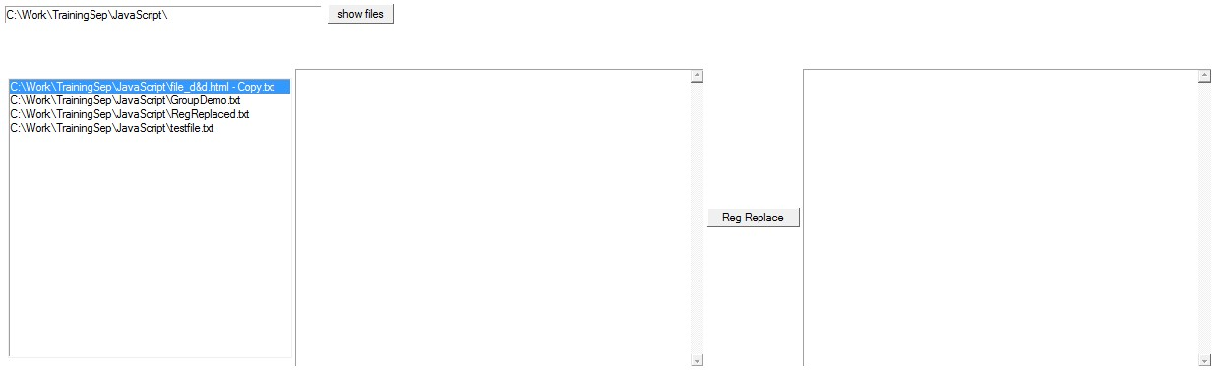
A simple GUI
First GUI .

Slide 10
File access in IE
Scripting.FileSystemObject – Read File
.
1. Create FSO object
2.Open file.
3. Read line.
4. Close file
function readFile(filename){
var fso = new ActiveXObject("Scripting.FileSystemObject");
// open file
var f = fso.OpenTextFile(filename,1);
var s = "";
//Read file content by line.
while (!f.AtEndOfStream)
{
var newLine = f.ReadLine();
s += newLine+"\n";
}
f.Close();
return s;
}

Slide 11
File access in IE
Scripting.FileSystemObject – Write File
1. Create FSO object.
2. Open file.
3.Write line.
4.Close file.
function writeFile(filename,filecontent){
var fso, f, s ;
fso = new ActiveXObject("Scripting.FileSystemObject");
//2nd parm: 1 Read , 2 Write , 8 Append
//3rd param: true createfile
f = fso.OpenTextFile(filename,8,true);
f.WriteLine(filecontent);
f.Close();
}

Slide 12
RegExp in Javascript
Create RegExp object
var regExpObj = new RegExp(“Fill REG expression here”, “Fill match mode here(igm)”);
Sample: var r= /^(\d{4})-(\d{1,2})-(\d{1,2})$/
Or
var regExpObj = /Fill REG expression here/write match mode here(igm)
Sample : var r= /^(\d{4})-(\d{1,2})-(\d{1,2})$/
Match mode
i : ignore case
g : global match
m : multi line match

Slide 13
RegExp in Javascript
Use RegExp to test match.
//Option 1
function demoMatchClick() {
var somestring = “xxxxxx”;
var re = new RegExp(“\bt[a-z]+\b”);
if (somestring.match(re))
{
alert("Successful match");
}
else {
alert("No match");
}
}
------------------------------------------------
//Option 2
var rege = /^([A-Za-z0-9_\-\.])+\@([A-Za-z0-9_\-\.])+\.([A-Za-z]{2,4})$/; if(rege.test($('#uemail').val())){ //do something }

Slide 14
RegExp in Javascript
Use RegExp to replace .
function demoReplaceClick() {
var regObj = new RegExp(” \bt[a-z]+\b” "g");
var strReplaceTo = “bbbbbb”;
var someString = “xxxxxxxx”
document.demoMatch.result.value =
someString.replace(regObj, strReplaceTo);
}

Slide 15
RegExp in Javascript
Grouping in javascript’s RegExp .
(reg expression) to create group
Use RegExp.$1, $2,$3…..$99 to capture group.
<HTML>
<HEAD>
<SCRIPT LANGUAGE='javascript'>
function matchDemo1(){
var r= /^(\d{4})-(\d{1,2})-(\d{1,2})$/;
//alert(myInput2.value);
r = new RegExp(myInput2.value, "ig")
r.exec(myInput1.value);
s1=RegExp.$1;
s2=RegExp.$2;
s3=RegExp.$3;
myText1.value = "\nRegExp.$1 = " + s1 +"\nRegExp.$2 = "+s2+"\nRegExp.$3 = "+s3
}
</SCRIPT>
</HEAD>
<BODY valign="Top" onLoad="myText1.value = ''">
<INPUT TYPE="BUTTON" ONCLICK="matchDemo1()" value="matchDemo1" />
Input String:<INPUT TYPE="Text" id="myInput1" value="1985-10-15"/>
RegExp:<INPUT TYPE="Text" size="50"id="myInput2" value="^(\d{4})-(\d{1,2})-(\d{1,2})$"/>
<br>
<TextArea id="myText1" rows="10" cols="80"></Text>
</BODY>
</HTML>

Slide 16
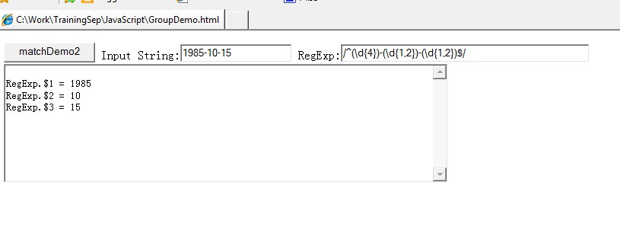
RegExp in Javascript
Grouping in javascript’s RegExp .
(reg expression) to create group
Use RegExp.$1, $2,$3…..$99 to capture group.

Slide 17
Lab
LAB

Slide 18
Q&A
Any Questions？

