Slide 1
Modelling the impact of lockdowns on changes in depression and anxiety
Modifiable variables: Number of social connections -> during lockdowns everybody became socially isolated
Output variables: changes in depression and anxiety in BC

Slide 2
Objective of Project – Note it’s changing with available Data Sources -
Create a model of BC’s mental health that can predict impact of significant societal events (like shifts in labor market etc..)
Use past experience to calibrate the model – i.e. impact of lockdowns
Add complexity into model once calibrated on simpler inputs – changes in employment, risks of populist uprisings etc
Key independent variables: changes in social network size, changes in employment status
Key dependent variables: changes in PHQ-9 (Depression/Despair) and GAD-7 (Anxiety / Fear)

Slide 3
Measuring Changes in Mental Health from Lockdowns – i.e. increase in social isolation
Baseline (Time Zero) – No lockdown
Follow-up – Lockdown
Changes in depression (PHQ-9 and Anxiety)
Based on changes in social isolation and loneliness

Slide 4
Variable Description
PHQ-9 Depression Questionnaire | GAD-7 (Anxiety questionnaire) | Loneliness Score (UCLA-8) | Social Network Size
Scores between 0 and 27. >10 = depressed | 0 to 21 >= 10 cut point for GAD-7 | 8-32 -> higher = more loneliness | Can’t find well validated measures for social network size

Slide 5
Variables in the BC dataset – At Baseline
Age Category | Age dummy variable | Sex / Gender | Baseline loneliness score (Score 8-32) | Baseline PHQ-9 Score | Baseline GAD-7 | Baseline social network size
From census | For regression / machine learning | 0 for females and 1 for males | Generate age and sex distributions from Fig 3 from here Logarithmic score… | Generate from correlation with loneliness (r=0.61) | Generate from correlation with loneliness (r=0.50) | Average values from Fig 2 – support clique and sympathy group from this paper

Slide 6
Lockdown BC Dataset – Follow-up Dataset
Age Category | Age dummy variable | Sex / Gender | Follow-up social network size | Follow-up loneliness score | Follow-up PHQ-9_1 Score (Depression) | Follow-up PHQ9_2 | Follow-up GAD-7 Score
Same as baseline | Same as baseline | Same as baseline | Lockdown value of 2.4 based on census data average household size | Females (r=0.45) to social network size Males (r=0.35) to social network size | Generate from correlation with loneliness (r=0.61) | Generate from regression coefficients* Slide 7 | Generate from correlation with follow-up loneliness (r=0.50)

Slide 7
Variables for differences in the BC dataset – At Follow-up
Differences in Loneliness Score | Differences PHQ-9 (Depression) | Differences GAD-7 (Anxiety)
Follow-up – Baseline | Follow-up – baseline | Follow-up – baseline

Slide 8
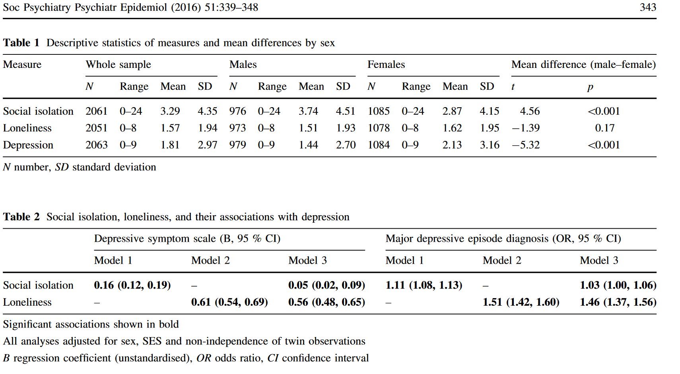
Regression coefficients between PHQ9, loneliness and depression…. Will need to normalize the variables…see Table 1 ranges…

Slide 9
Validation of Model
Stats Canada actually measured changes in mental health in the Canadian Population across COVID – can use this as a validation
Loneliness is a key variable -> loneliness was measured across pandemic…
US population – Depression Scores measured before and during pandemic

