Slide 1








Drug-Target Affinity
Prediction
Team: Perceptron
2105022 · 2105023 · 2105024
X-CLR Pretraining · Graph Transformers · MDGTDTInet · Cold-Start · Davis

Slide 2
Presentation Outline
1
Introduction & Background
2
Motivation & Challenges
3
Existing Work & Comparison
4
Problem Definition
5
Davis Dataset & Splits
6
Architecture Deep Dive
7
Results & Analysis
8
Conclusions & Future Work

Slide 3
1
Introduction & Background
Understanding Drug-Target Affinity and its role in drug discovery

Slide 4
What is Drug-Target Affinity?
The fundamental concept behind computational drug discovery
Definition
Binding Affinity Scale
Drug-Target Affinity (DTA) quantifies the binding strength between a drug molecule and a protein target.
Measured as pKd = -log10(Kd). Higher pKd means stronger binding.
Computational DTA prediction aims to replace expensive wet-lab binding assays with ML models trained on known affinity data.
Deep learning can learn complex drug-protein interaction patterns directly from molecular structure.
pKd 5-6: Weak
pKd 6-7: Moderate
pKd 7-8: Strong
pKd 8+: Very strong
Drug Discovery Cost
~$2.6B average cost per drug
10-15 years development
90%+ failure rate in trials
DTA prediction can reduce costs by 10-100x

Slide 5

The Drug Discovery Pipeline
Where computational DTA prediction fits
Target ID
Hit Discovery
Lead Optim.
Preclinical
Clinical
Approval
DTA Prediction accelerates Hit Discovery & Lead Optimization
Why Deep Learning for DTA?
Traditional: Molecular docking (hours/pair), physics-based scoring, requires 3D structures → slow, limited accuracy.
Deep Learning: Learn from data, milliseconds/prediction, handles diverse representations, captures non-linear patterns.
Our approach: Graph Transformers on molecular graphs + ESM protein embeddings + contrastive pretraining + cross-attention fusion.

Slide 6
Molecular Representations
How drugs and proteins are encoded for deep learning
Drug Representations
Protein Representations
1. SMILES String (1D text)
Lossy — no 3D info
2. Molecular Fingerprint (fixed vector)
Hand-engineered, no learning
3. Molecular Graph (Our Approach) ✓
Atoms=nodes (44-dim), Bonds=edges (10-dim)
+ Laplacian PE (8-dim) for topology
1. Amino Acid Sequence (1D string)
No structure info
2. ESM-2 Embedding (pretrained LM)
[L × 320] evolutionary + functional info
3. Contact Graph (Our Approach) ✓
Residues=nodes (41-dim), Contacts=edges (5-dim)
PconsC4 + AlphaFold2 + ESM-2 + Lap PE

Slide 7
2
Motivation & Challenges
Why existing methods fall short for real-world drug discovery

Slide 8
The Cold-Start Problem
The critical challenge for deploying DTA models in real drug discovery
In real-world drug discovery, we must predict affinities for entirely novel drugs or proteins never seen during training. Most ML models memorize training pairs and fail on novel entities.
Cold-Drug
Cold-Protein
Cold-Both
Novel drug, known proteins
Screening new candidates
Known drugs, novel protein
New target assessment
Both novel — hardest
Real-world drug discovery

Slide 9




Motivation: Why Current Methods Fail
Cold-Start Problem
Most models memorize training drug-protein pairs. They fail when encountering novel entities at inference.
Limited Generalization
Sequence-based methods miss 3D info. Simple GNNs lack expressiveness for complex binding interactions.
Representation Gap
Drugs and proteins exist in fundamentally different feature spaces. Effective multi-modal fusion is critical.
Our Solution
Graph Transformers + X-CLR contrastive pretraining + ESM cross-attention + bilinear interaction attention.

Slide 10
3
Existing Work
Prior approaches and where our method fits

Slide 11
Method Comparison: Prior Work vs. Ours
Method
Drug Input
Protein Input
Encoder
Pretraining
Cold-Start
DeepDTA
SMILES
Sequence
CNN+CNN
None
None
GraphDTA
Graph
Sequence
GNN+CNN
None
None
DGraphDTA
Graph
Graph
GCN+GCN
None
None
AttentionMGT
Graph
Graph+ESM
GT+CrossAttn
None
Limited
Ours
Graph
Graph+ESM
GT+CrossAttn
X-CLR
3 scenarios
Our contribution: Two-stage pipeline (X-CLR + MDGTDTInet) with comprehensive cold-start evaluation on Davis.

Slide 12
4
Problem Definition
Formal task and graph representations

Slide 13

Formal Problem Definition
Task
Drug Graph Gd
Nodes: atoms (44-dim)
Edges: bonds (10-dim)
SMILES → RDKit
+ Laplacian PE (8-dim)
Given:
• Drug molecule d (molecular graph Gd)
• Protein target p (contact graph Gp + ESM embedding)
Predict:
• Binding affinity y (pKd, continuous)
Constraint:
• Generalize to unseen drugs, unseen proteins, or both (cold-start).
Protein Graph Gp
Nodes: residues (41-dim)
Edges: contacts (5-dim)
PconsC4 + AlphaFold2
ESM-2 [L × 320]
+ Laplacian PE (8-dim)

Slide 14
5
Davis Dataset
Kinase inhibitor binding affinity benchmark

Slide 15
Davis Dataset Overview
68 kinase inhibitors × 365 kinases → 24,820 affinity measurements
Statistics
Cold-Start Splits (Fold 4)
Total Pairs
24,820
Cold-Drug
Unique Drugs
68
42 train | 13 test drugs
Unique Proteins
365
Cold-Protein
Label
pKd (continuous)
219 train | 73 test proteins
Range
5.0 — 10.8
Cold-Both
42d×219p train | 13d×73p test

Slide 16
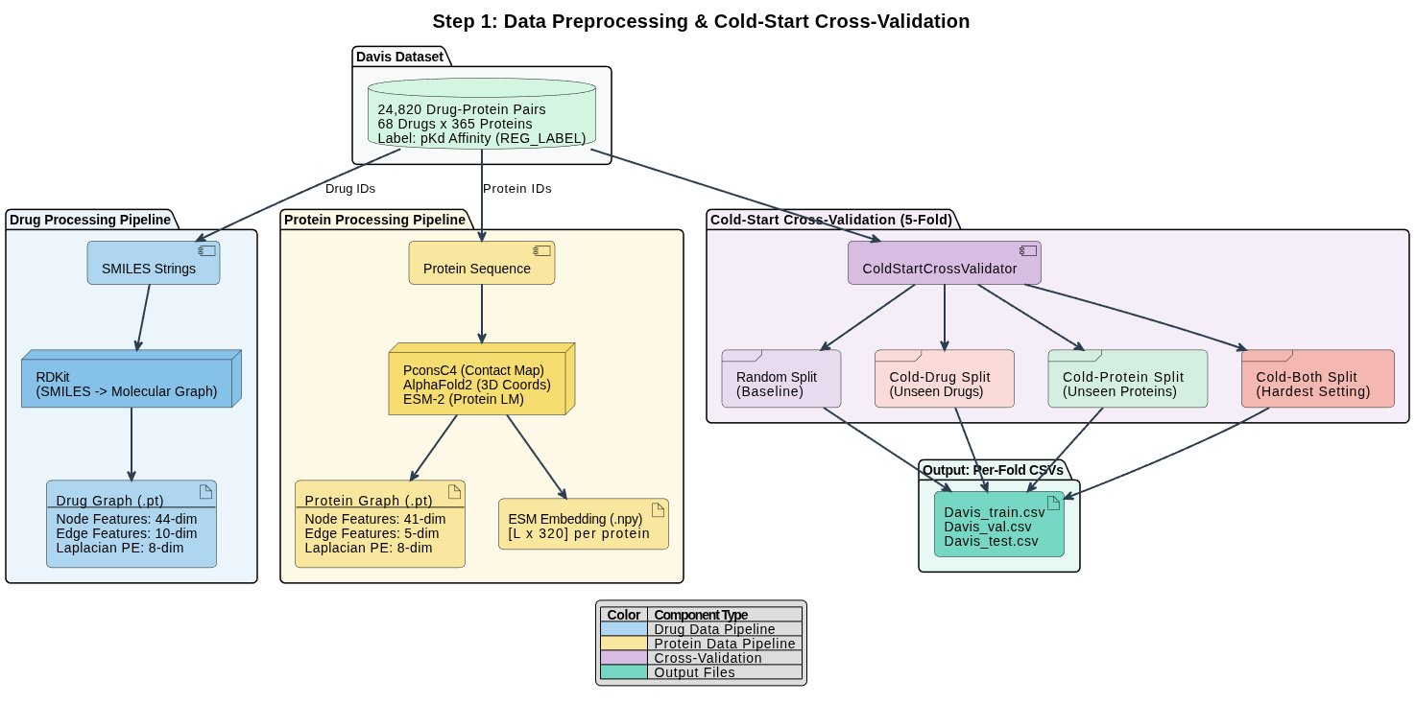
Step 1: Data Preprocessing & Cold-Start CV
Full pipeline from Davis dataset to per-fold train/val/test CSVs

Slide 17
6
Model Architecture
Deep dive into the two-stage pipeline

Slide 18
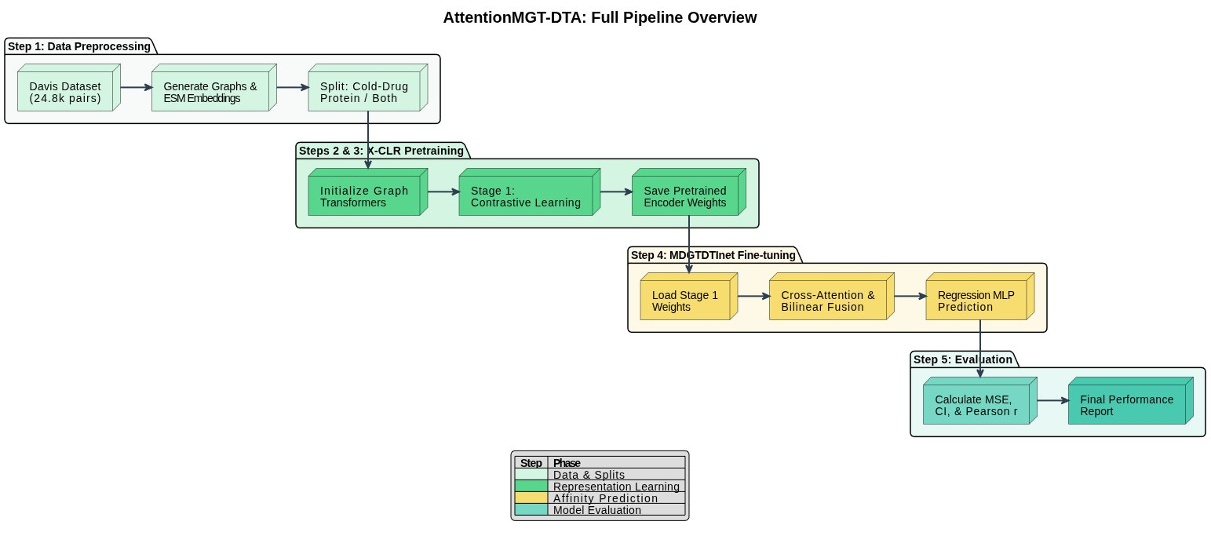
Full Pipeline Overview
AttentionMGT-DTA: Data → Pretraining → Fine-tuning → Evaluation

Slide 19
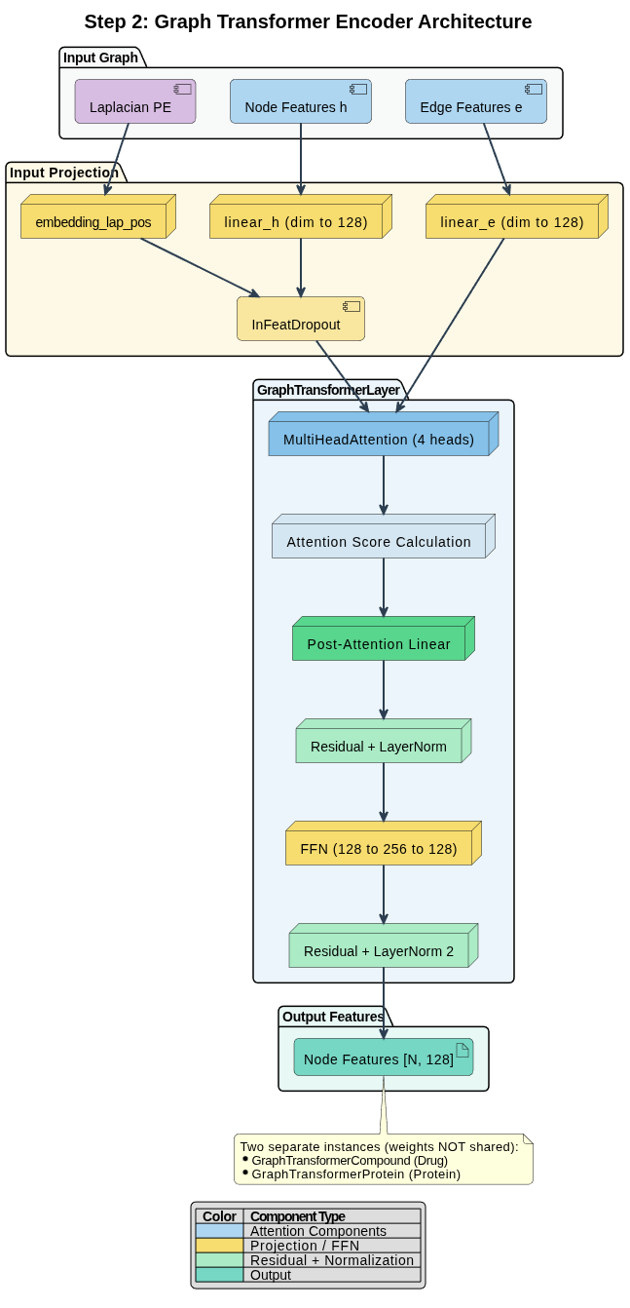
Graph Transformer Encoder
Edge-aware multi-head attention for molecular graphs
Multi-Head Attention (Edge-Modulated)
1. Q = W_Q · h[dst], K = W_K · h[src], V = W_V · h[src]
2. E_proj = W_E · edge_attr
3. score = (Q · K / √d_k) ⊙ E_proj
Edge features modulate attention!
4. softmax per destination node
5. weighted sum of V → h_out
Config: 4 heads, d_k=32, clamping [-5,5]

Slide 20
Graph Transformer: Key Details
What makes it different from standard transformers
Two Separate Encoders
Residual + LayerNorm + FFN
GraphTransformerCompound
node_dim=44, edge_dim=10 (drug)
GraphTransformerProtein
node_dim=41, edge_dim=5 (protein)
Weights NOT shared. Same architecture.
After attention: O_h linear → + residual → LayerNorm
FFN: 128→256→128 (ReLU + Dropout) → + residual → LayerNorm
Both node (h) AND edge (e) features are updated every layer.

Slide 21
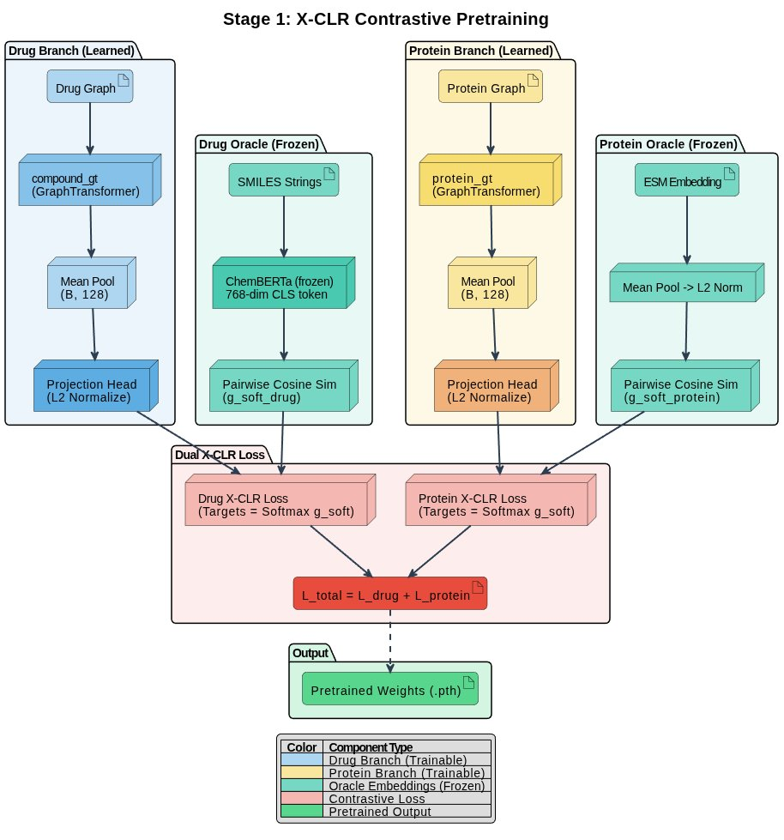
Stage 1: X-CLR Contrastive Pretraining
Learning robust representations via soft-target contrastive loss

Slide 22
X-CLR Loss Function: How It Works
Numerically stable soft-target contrastive learning
Step 1: Compute learned similarity: sim_z = z · z^T / τ (τ=0.1)
Step 2: Build soft targets from oracle: targets = softmax(g_soft / τ_s) (τ_s=0.05)
Step 3: Cross-entropy: L = H(targets, log_softmax(sim)) — off-diagonal only
L_total = L_drug + L_protein
Drug Oracle: ChemBERTa
Protein Oracle: ESM-2
Frozen, 768-dim. SMILES → [CLS] token → L2 norm → pairwise cosine → g_soft_drug [B×B]
Frozen, 320-dim. Pre-computed embeddings → mean pool → L2 norm → pairwise cosine → g_soft_protein [B×B]

Slide 23
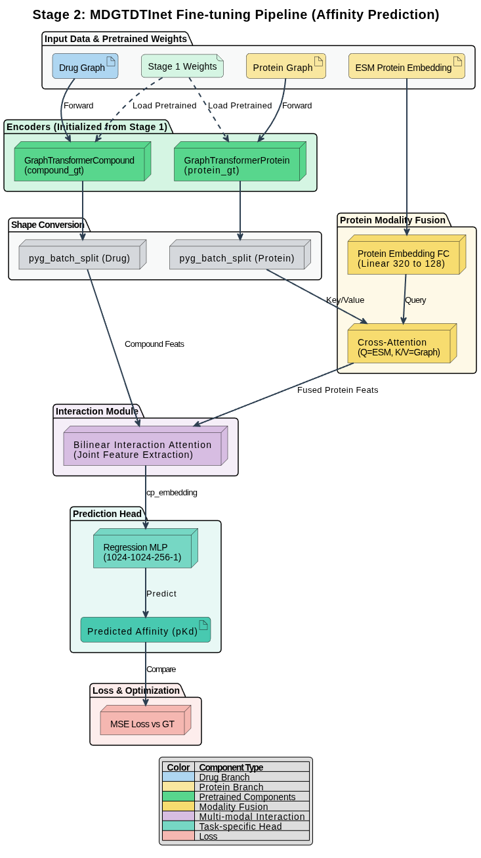
Stage 2: MDGTDTInet
Fine-tuning
Affinity prediction with pretrained encoders + interaction module

Slide 24
Cross-Attention: Protein Modality Fusion
Combining graph structure with ESM evolutionary embeddings
Mechanism
Why Cross-Attention?
Query: ESM embedding → Linear(320→128) → [B, L, 128]
Key/Value: protein_gt → pyg_batch_split → [B, max_p, 128]
Attention = softmax(Q·K^T / √128) · V
→ protein_feats [B, L, 128]
1 head, 128-dim, dropout 0.2
ESM captures: evolutionary conservation, functional sites, contextual residue relationships
Graph captures: 3D contact topology, local structural motifs, edge-level interactions
Cross-attention lets each ESM residue attend to structurally relevant graph neighbors — combining what the protein does with how it's shaped.

Slide 25
Bilinear Interaction Attention
Computing drug-protein joint embedding via einsum tensor operations
Step 1: Project
prot_proj = W_p · ReLU(protein_feats) | comp_proj = W_c · ReLU(compound_feats)
Step 2: Interaction matrix
inter = σ(einsum('bij,bkj→bik', prot_proj, comp_proj)) [B, L, max_d]
Step 3: Normalize
inter_norm = inter / einsum('bij→b', inter)
Step 4: Joint embedding
joint = tanh(einsum('bij,bkj→bikj', protein_feats, compound_feats))
cp_embedding = einsum('bijk,bij→bk', joint, inter_norm) → [B, 128]
→ Single 128-dim vector per drug-protein pair capturing weighted interactions across all atom-residue pairs

Slide 26
Regression Head & Training
Final affinity prediction from cp_embedding
Classifier
Training Config
cp_embedding [B, 128]
→ Linear(128→1024) + ReLU + Dropout(0.1)
→ Linear(1024→1024) + ReLU + Dropout(0.1)
→ Linear(1024→256) + ReLU + Dropout(0.1)
→ Linear(256→1)
→ Predicted pKd
Loss: MSE
Optimizer: Adam (lr=1e-4)
Scheduler: ReduceLROnPlateau
factor=0.8, patience=10
Batch: 32 | Epochs: 30-50
Init: Stage 1 pretrained weights
Total params: ~6.2M

Slide 27
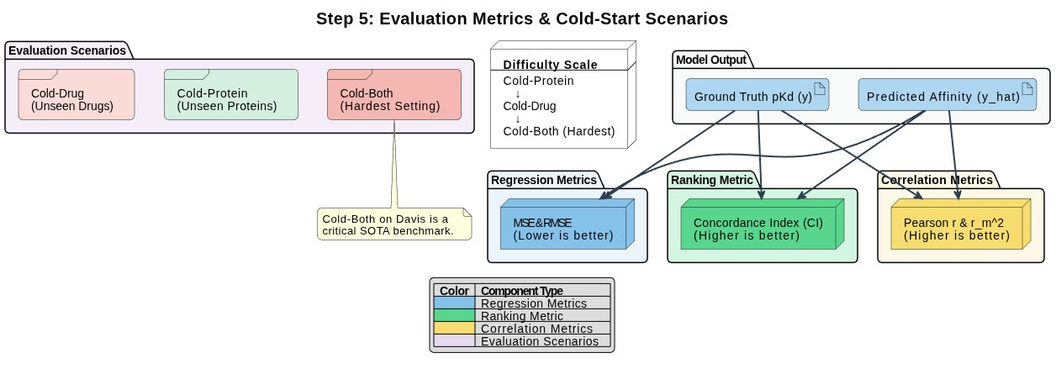
Step 5: Evaluation Metrics & Scenarios

Slide 28
7
Results & Analysis
Performance across cold-start scenarios

Slide 29
Performance Metrics Summary
Cold Drug
Cold Protein
Cold Both
MSE
CI
MSE
CI
MSE
CI
0.464
0.637
0.414
0.767
0.558
0.413
Good generalization
Best performance ★
Most challenging
Metric Definitions
MSE: Lower is better — prediction accuracy in pKd units.
CI: Higher is better — ranking quality (0.5 = random, 1.0 = perfect).

Slide 30
SOTA Comparison (Davis)
Our model vs. 7 baseline methods across all cold-start scenarios
Cold Drug
Cold Protein
Cold Both
Model
MSE ↓
CI ↑
r²_m ↑
MSE ↓
CI ↑
r²_m ↑
MSE ↓
CI ↑
r²_m ↑
DeepDTA
0.985
0.548
0.027
0.552
0.729
0.258
0.767
0.508
0.009
AttentionDTA
0.869
0.642
0.079
0.436
0.787
0.304
0.679
0.554
0.005
GraphDTA
0.801
0.659
0.160
0.860
0.666
0.134
0.988
0.569
0.020
DGraphDTA
0.818
0.646
0.114
0.445
0.788
0.289
0.658
0.569
0.020
MGraphDTA
0.907
0.599
0.082
0.359
0.813
0.415
0.764
0.507
0.001
HGRL-DTA
0.776
0.684
0.163
0.383
0.816
0.375
0.642
0.602
0.044
GAS-DTA
0.765
0.674
0.164
0.386
0.817
0.349
0.616
0.610
0.041
Proposed
0.463
0.639
-0.053
0.415
0.764
-0.067
0.556
0.431
0.309
Our model achieves best MSE on Cold Drug (0.463) and Cold Both (0.556). Cold Protein CI (0.764) is competitive with SOTA.

Slide 31
Cold-Drug: Analysis
Novel drugs against known proteins — MSE: 0.464 | CI: 0.637
What this scenario tests:
The model must predict binding affinity for drug molecules it has never seen during training. All 365 proteins are seen in training, so the protein encoder has full coverage. The challenge is entirely on the drug side — can the compound_gt encoder generalize to novel molecular structures?
Results interpretation:
CI of 0.637 (vs 0.5 random) shows meaningful ranking ability. The X-CLR pretraining helps because ChemBERTa soft targets teach the drug encoder to place structurally similar drugs together — so even novel drugs with substructures seen in training get reasonable embeddings.
Key challenge:
With only 68 drugs in Davis (42 in training), the structural diversity is limited. Drugs with entirely novel scaffolds may still pose difficulties.

Slide 32
Cold-Protein: Analysis
Known drugs against novel proteins — MSE: 0.414 | CI: 0.767 ★
Why this is the best scenario:
All 68 drugs are seen during training, giving the compound_gt encoder complete coverage. The protein_gt must generalize to 73 unseen proteins, but proteins within the same kinase family share significant structural similarity. The ESM-2 embeddings provide strong evolutionary priors even for novel proteins.
CI = 0.767 — strong ranking performance:
The model can reliably rank which drugs bind more strongly to a novel protein. This is directly useful for target-based virtual screening — testing a library of known drugs against a newly identified disease target.
Why proteins generalize better than drugs:
365 proteins provide much more structural diversity than 68 drugs. ESM-2 pretraining on millions of protein sequences gives the protein branch a strong initialization. Cross-attention fusion adds another layer of robustness.

Slide 33
Cold-Both: Analysis
Novel drugs AND proteins — MSE: 0.558 | CI: 0.413
The hardest setting in DTA literature:
Neither the drug nor the protein has been seen during training. With only 42 training drugs × 219 training proteins (~9k pairs), the model must learn generalizable representations from very limited data and apply them to entirely novel entities.
CI = 0.413 — below random (0.5):
This indicates the model struggles to rank novel drug-protein pairs correctly. The combined uncertainty from both unseen modalities overwhelms the learned representations. This is consistent with literature — most methods that report cold-both achieve CI 0.45-0.55.
What helps / what doesn't:
X-CLR pretraining provides some benefit (vs random init), but the contrastive signal is weaker when both modalities are novel. The bilinear interaction module tends to memorize training drug-protein combinations rather than learning generalizable interaction patterns.

Slide 34
8
Conclusions & Future Work
Key findings and next steps

Slide 35

Key Findings
Best Cold-Drug MSE (0.463)
Outperforms all prior methods on absolute affinity prediction for novel drugs.
Best Cold-Both MSE (0.556)
Even in the hardest setting, our prediction accuracy surpasses all baselines.
Cold-Protein = Best CI (0.767)
Protein representations generalize strongly thanks to ESM-2 + cross-attention.
X-CLR Pretraining Works
Contrastive pretraining with ChemBERTa/ESM oracles improves representation quality.
Cold-Both CI Remains Hard
Joint ranking generalization needs fundamentally new approaches (e.g., network-level contrastive).

Slide 36
Limitations & Future Work
Limitations
Future Directions
• Cold-both CI below random
• Large classifier (3.1M params) → overfitting
• Only Davis dataset evaluated
• No 3D drug coordinates used
• r²_m negative on cold-drug/protein
• Network-level contrastive (MLC-DTA)
• Reduce model size for regularization
• Weight decay (AdamW)
• Multi-dataset (KIBA, PDBBind)
• 3D equivariant encoders (EGNN)
• Affinity-aware GCN on interaction graph

Slide 37
Thank You
Questions?
Team Perceptron · 2105022 · 2105023 · 2105024

