Slide 1

School of Computer Science and Engineering
Internship Review - Presentation
BCSE399J (Summer Industrial Internship)/
CBS1902/CSE1902/ CSI3903 (Industrial Internship)
FALL SEMESTER 2025-26
Type of Intern: Industry offline
Title of Intern: Backend Intern
Internship completed at :
H-10B, Sector-98, Noida-201304
https://paytm.com/
+91-120- 4770770
Duration : 44 Days : From 26th May to 8th July, 2025
Date of Presentation: 30th October, 2025
by
UTKARSH GUPTA
22BCT0102

Slide 2
Contents (Industry/TBI/VAC)
Outline slide
Introduction
Aim, objective(s) and motivation.
About the industry/TBI / VAC
Certificate (Period of study)
Skills acquired during industrial internship / VAC period
New technologies/Frameworks/real-time problems/Analysis based knowledge acquired during industrial internship
Conclusion (Brief Summary)

Slide 3
Introduction
Introduction
During my internship, I worked on developing a Model Context Protocol (MCP) Server designed to manage and fetch databases of merchant subscriptions efficiently. The project involved creating a modular system integrating multi-query results, dynamic query generation, and graph-based data relationships, along with a remote client SDK and AI integration with Claude. My key responsibilities included contributing to backend development, database design, query optimization, and testing real-time client interactions.

Slide 4
Aim, Objective(s) and Motivation
Aim, Objective(s) and Motivation
Aim: To develop a scalable MCP server capable of efficiently managing merchant subscription data.
Objectives:
  Implement multi-query execution and dynamic query generation.
  Integrate graph-based data relationships for real-time dependency mapping.
  Design remote client SDK and integrate Claude AI for intelligent query handling.
Motivation: To automate and streamline Paytm's merchant data processing with advanced backend and AI-driven insights.

Slide 5
About Paytm
About Paytm
Paytm is India’s leading digital payment and financial services platform headquartered in Noida. It provides a wide range of services such as mobile recharges, bill payments, merchant transactions, and online financial solutions. The company operates in a dynamic fintech ecosystem, offering a great environment for learning backend and data-driven systems.

Slide 6
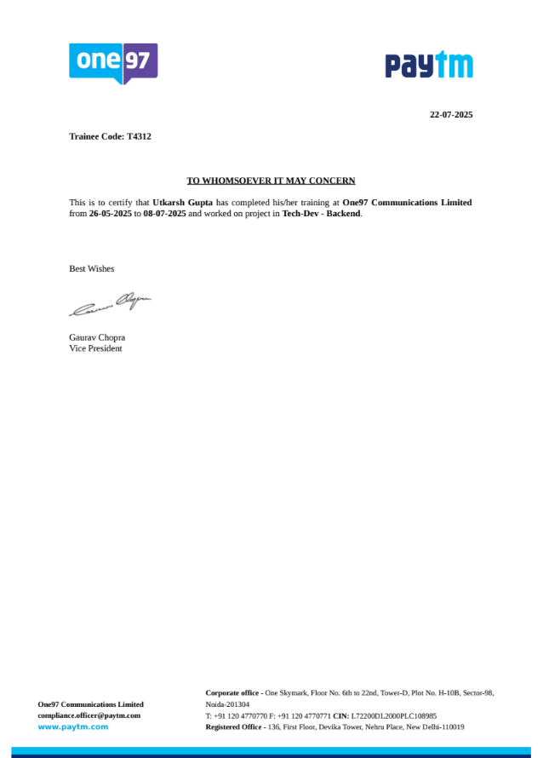
Certificate
Certificate

Slide 7
Skills Acquired During Industrial Internship Period
Skills Acquired During Industrial Internship Period
Technical Skills:
  Backend development and database management
  Query optimization and data structuring
  AI and API integration for automated query generation
Soft Skills:
  Team collaboration, communication, and documentation
  Problem-solving and analytical thinking
Domain Knowledge:
  Merchant subscription systems and intelligent server design

Slide 8
New Technologies/Frameworks/Real-Time Problems/Analysis
Technologies and Tools Used:
New Technologies/Frameworks/Real-Time Problems/Analysis
Technologies and Tools Used:
Programming Languages: Python, JavaScript
Frameworks: Node.js, FastAPI
Databases: PostgreSQL, Neo4j (for graph implementation)
Tools: MCP, Git, API Testing Platforms, Claude AI Integration
Concepts: Dynamic Query Generation, Caching, Graph Traversal

Slide 9
Real-Time Problems and Solutions:
Challenge 1: Multi-query execution led to performance bottlenecks on large datasets.
  Solution: Used caching, query batching, and database indexing to optimize performance.
Challenge 2: Translating Claude AI natural language queries into structured queries.
  Solution: Implemented iterative prompt tuning and query mapping to ensure accuracy and relevance.

Slide 10
Conclusion
Conclusion
This internship at Paytm provided a comprehensive exposure to real-world backend system development and AI integration. It enhanced both my technical and interpersonal skills while allowing me to contribute to an impactful project. The project improved my understanding of distributed systems, performance tuning, and AI-driven backend automation.

