Slide 1
Leading a Robotics Team in University - System Engineering Approach -
By Morokot SAKAL
December 2021

Slide 2






Contents
Goal & Strategy
Finance
Team Organization
Yearly Activities
Trainings
Meetings

Slide 3

1. Goal & Strategy
Where do you want to go?
How do you get there?
Every team has different goal:
Some team might want to focus on winning the competition.
Some other team might want to try new technology.
Discuss and define a clear goal at the beginning.
At the kick-off meeting, making sure that everyone is aware of what is the team goal & strategy.

Slide 4

1.1. Constraints
Where are you currently at?
Every team always have constraints such as:
Funding: not enough fund to build the robot.
Human resource: new team with no experience or members only come from one department/major (lack of diversity).
Leadership: no one in the team know how to lead.
Time & commitment: members are busy with school works.
Technology: limit knowledge of how to build a robot.
Facility: no machine, or tools to manufacture robot’s parts.
Identifying your constraints help set a realistic goal for your team and your team is likely able to achieve it.

Slide 5
1.2. Success Level Criteria
Once you answers the three questions, now it is time to set the success level criteria.
If it is the first year for the team joining the competition, setting the goal as to “win the national competition” is ridiculous and unrealistic.
Success levels is also a good reference for comparing your team achievement during the reflection meeting at the end of the competition.
Success Level | Description
Minimum | The minimum things to achieve in case the project does not goes according to the plan
Full | The things to achieve for the project to be called success
Extra | The extra things that can be achieved after the team reach full success

Slide 6
1.3. Success Level Example
This is an example of a robotics team consists of all new members, having no previous experience with robotics competition. In addition, no one in the team has experience with leadership and team management.
To make their project realistic, having a clear and achievable goal, they set the success level criteria as following:
Success Level | Criteria
Minimum | Have a full functionality robot to join competition
Full | Win the group stage and be able to advance to the tournament
Extra | Win one match at tournament

Slide 7
2. Finance
Running a robot team is not free. This is the estimated cost for running a robotics team to join Robocon Cambodia.
Note: For new team without existing facilities, the initial cost of more than $5,000 is need for facilities setup
TOTAL: $7,900
Items | Amount (USD)
Robot Hardware | $ 4,000
Game Field Construction | $ 1,500
Facilities Maintenance | $ 2,000
Pizza Party ;) | $ 400

Slide 8



2.1. Fund-raising
GET SUPPORT FROM SCHOOL OR ALUMNI
FIND SPONSOR FROM COMPANY
CROWD-FUNDING

Slide 9

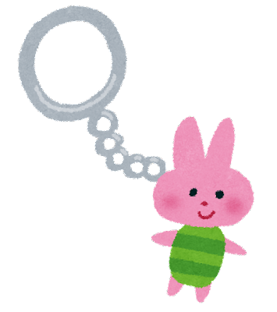
2.2. More about Fundraising (Crowd-funding)
Every year, many teams have encountered the funding issue.
However, don’t let it stop you from being creative. Use your team creativity to raise the fund.
What we can do:
Create team t-shirt, key-chain, etc… and sell them to our robotics team fan
Get support/donations from your classmates or seniors
Robotics
SE

Slide 10
3. Team Structure
Senior Members
Year 3rd, 4th students
(more than two year of experience)
Tasks
Conduct research & development of new key technology to be used in the next year
Advising core members, teaching the supporting members
Core Members
Year 2nd or 3rd students
(at least one year of experience)
Tasks
Join national robocon competition as the team representative
Lead the supporting members to build the robot
Supporting Members
Year one students
(newly join)
Tasks
Help the core members with manufacturing
Experience the whole year activities of the robotics team

Slide 11
3.1. Responsibilities
Team Coordinator (Faculty Member)
Finance
Marketing
Recruitment & Training
R & D
Management & Operation
Design and Manufacturing
Electronics and Control
Rulebooks and Strategy
3D Models and Simulation
MCU Subsystem and Control Firmware
System Design, Integration, and Test
Manufacturing Parts and Assemblies
Power, Sensors, and Actuators
Documentation and Resource Tracking
Game Field Construction
PCB Design, Layout, and Assembly

Slide 12
4. Yearly Activities (1 of 2)
No. | Actions | Jul | Aug | Sep | Oct | Nov | Dec | Jan
M#1 | New member recruitment
D#1 | Intensive training for new members
E#1 | New rulebook release
M#2 | Team formation & kick-off meeting
D#2 | Rulebook reading & define game strategy
D#3 | Concept design (ideas brainstorming)
D#4 | Grame field construction
M#3 | Preminary design review
Note: M is Milestone, E is event, D is development

Slide 13
4. Yearly Activities (2 of 2)
No. | Actions | Dec | Jan | Feb | Mar | Apr | May | Jun | …
D#5 | First prototype development
D#6 | Prototype field testing
M#4 | Prototype design review
D#6 | Revised design development
M#5 | Revised (final) design review
D#7 | Field testing & pilot training
E#2 | Competition (National round)
D#8 | Preparing for international competition
E#3 | Competition (International round)
M#6 | Reflection & kaizen meeting
Note: M is Milestone, E is event, D is development

Slide 14




5. Trainings
Project management & team communication
Mechanical design
Power & electronics design
Software development

Slide 15
6. Meetings
Regular meetings is held for discussing to keep track of team progress (what has been done and what to do next, issue reporting, etc...)
Regular meetings | Occurrence
Mechanical design progress update | Once every week
Electronics design progress update | Once every week
Rulebook reconfirmation & strategic meeting | Once every 2 months

Slide 16
6. Meetings
Seniors and teachers are invited to join for providing constructive feedbacks to the design and what to improve.
Review meetings | Date
Preliminary design review | End of December
Prototype design review | Start of March
Final design review | Start of May
One year reflection & kaizen | End of Competition

Slide 17

How to Keep Your Team Motivated
Work hard? Play harder. That’s engineering principle.
Every now and then stop working for a day. Get together for a dinner out or organize a pizza party.
Create incentives
Give awards/rewards for recognizing the team members that work hard Example: best mechanical engineer award, best support engineer, etc…
Make the project as part of a course, give course credit to students that devote their time in the competition.

Slide 18
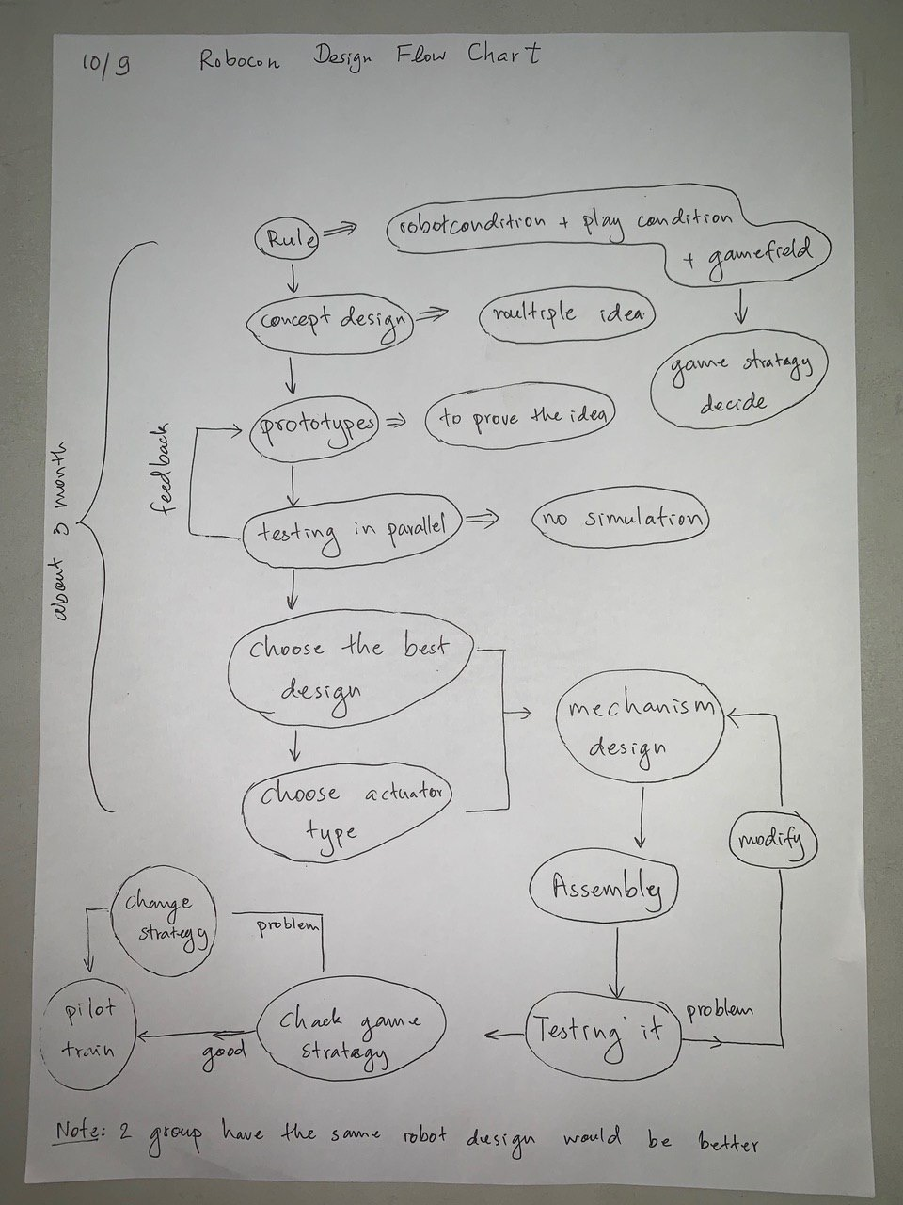
(Bonus) Design Flow
This is the design flow which based on the experience of previous team members.
Credit to Iphing Lim and Penghuy Srean.

Slide 19
Acknowledgement
Author would like to thank to Chanraksmey Lay for grammatical check and proof-reading, Sok An Siek for his feedback about the finance section, also to Iphing Lim and Penghuy Srean for the documentation of the design flow section.

Slide 20
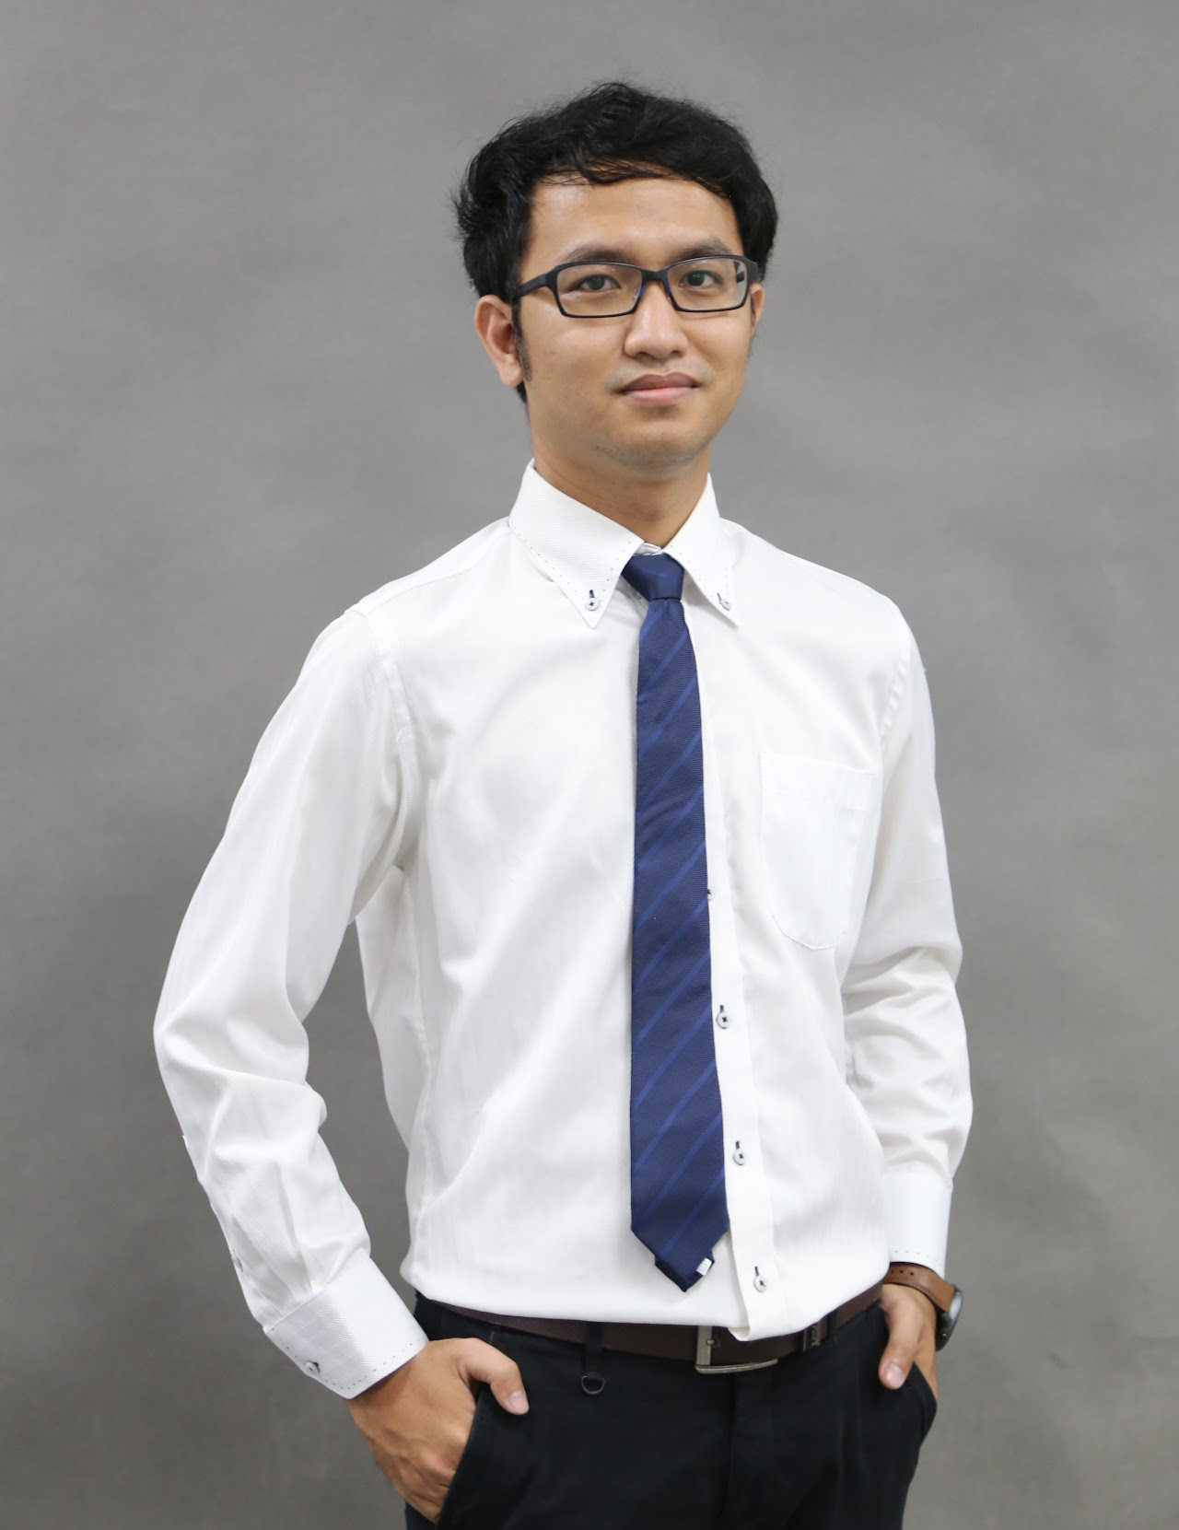
About Author
Morokot Sakal is a lecturer in the Information Technology Faculty of the American University of Phnom Penh (AUPP) and Teacher of Robotics Class at the AUPP Highschool Foxcroft Academy (AUPPHS-FA).
In 2012, he was granted a Japanese government scholarship (MEXT) to pursue his study in Japan. He completed his Bachelor’s degree (2018) in Mechanical Engineering and Master’s degree (2020) in Aerospace Engineering from Tohoku University, Japan.
Website: https://sites.google.com/view/smorokot/home

Slide 21
Thank you for your attention.

