Slide 1

Pricing Analysis
A 3-Year Analysis of Gross Margin and Pricing Intervention

Slide 2
Email from Management
We have observed a significant decrease in our profit margin across the portfolio, which we attribute primarily to rising Cost of Goods Sold (COGS), tariffs and other factors. Please review our portfolio across the 2023-2025 Order data to make a recommendation on our pricing strategy.
Task:
Identify all products with a Gross Margin % (GMP) below 30% in Q3 2025.
Create a dashboard showing Year-over-Year GMP, Revenue by Category, Product and Region.
Provide clear, data-backed recommendations on which items require a price increase or discontinuation.
Please start on this ASAP.
Best,
Director of Operations, The Daily Grind

Slide 3
METHODOLOGY
Downloaded the raw data: yearly order files for 2023, 2024 and 2025, plus customer and product tables.
Imported the CSV files into a PostgreSQL database using pgAdmin 4.
Connected to the database, cleaned and combined the data with SQL in VS Code.
Connected Power BI to the database and loaded the cleaned SQL query to build the dashboard.

Slide 4
Results

Slide 5
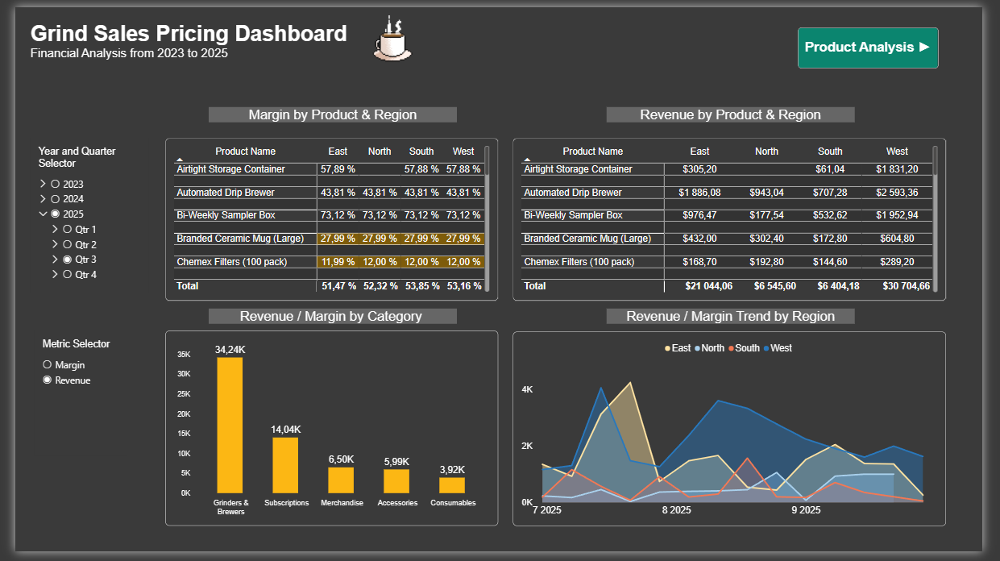
Revenue & Margin Dashboard

Slide 6
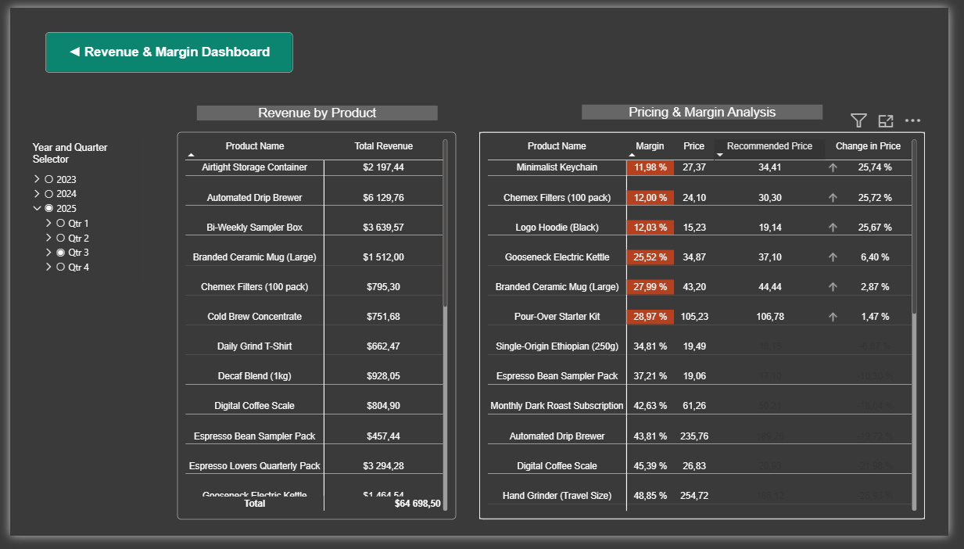
Product Analysis Dashboard

Slide 7
Findings
Six products fell below the 30% Q3 2025 margin threshold and require a price increase or discontinuation.
Product | Q3 2025 Margin
Minimalist Keychain | 11.98%
Chemex Filters (100 pack) | 12.00%
Logo Hoodie (Black) | 12.03%
Gooseneck Electric Kettle | 25.52%
Branded Ceramic Mug (Large) | 27.99%
Pour-Over Starter Kit | 28.97%

Slide 8
Recommendations
Increase price to reach the 30% margin target on each product.
Product | Current Price | Recommended Price | Change
Minimalist Keychain | $27.37 | $34.41 | +25.74%
Chemex Filters (100 pack) | $24.10 | $30.30 | +25.72%
Logo Hoodie (Black) | $15.23 | $19.14 | +25.67%
Gooseneck Electric Kettle | $34.87 | $37.10 | +6.40%
Branded Ceramic Mug (Large) | $43.20 | $44.44 | +2.87%
Pour-Over Starter Kit | $105.23 | $106.78 | +1.47%
Discontinuation is the alternative for these products

Slide 9
Thank you for your attention

