Slide 1
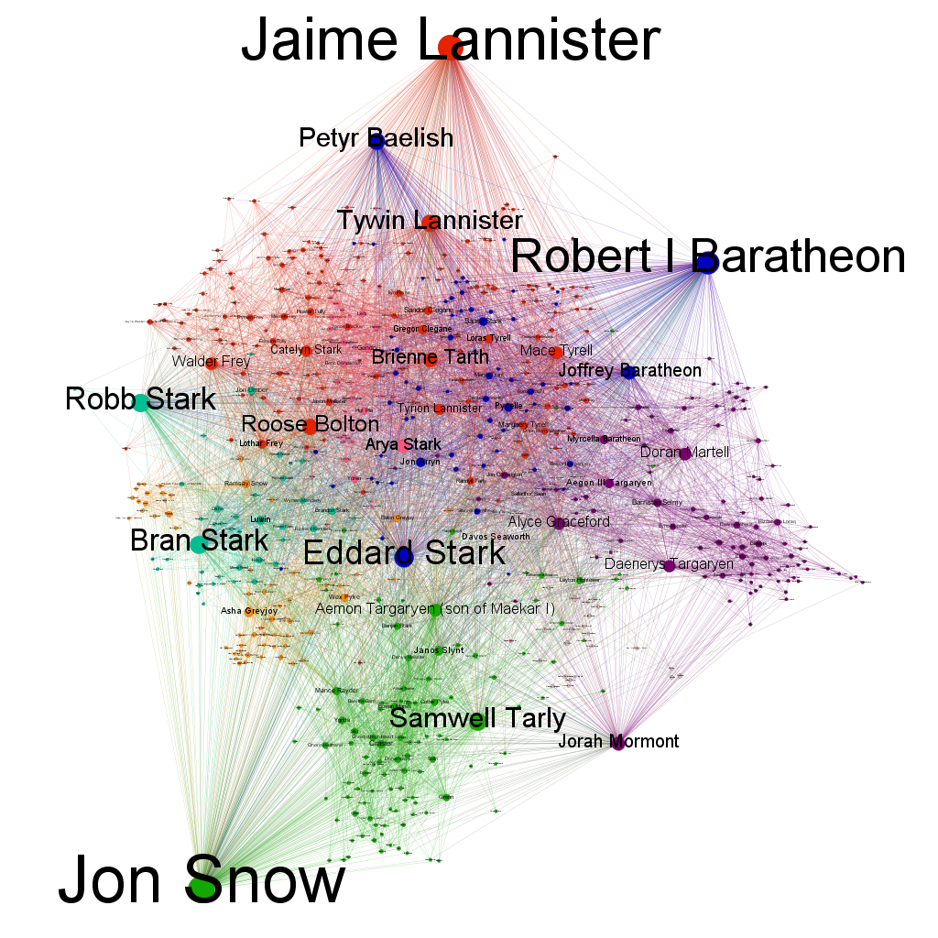
The 7 kingdoms’s story bearers
This represents all the characters book having more than 5 interactions with at least 2 characters.
The bigger a node/name is, the more connections the character has in the books.
The colors are based on the modularity class. It means that the nodes of the same color interact mainly between them
If a node has many different edge colors, it means that he is a “bridge” between communities, such as Jon Snow or Jaime Lannister.
This graph represents, in fine, the characters that connect all the different stories of Westeros together. They may not be the most important ones, such as Jorah but they are key connectors in the books. That’s why, for example, Daenerys Targaryen is not as “important” as Tywin or Jorah.

